Slide 1

Team Name : SatyaSetu
Team Leader Name : Rupali Rana
Problem Statement : Digital Text is full of traps. SatyaSetu shows the truth.

Slide 2

SatyaSetu – AI-Powered Digital Reasoning Assistant for Bharat
SatyaSetu is a GenAI-powered digital reasoning assistant designed to strengthen community-level digital literacy across Bharat.
The platform analyzes unstructured digital text — including articles, opinion pieces, and online posts — to detect logical fallacies and manipulation signals such as emotional exaggeration, fear-based persuasion, false dilemmas, and biased framing.
Using transformer-based large language models, SatyaSetu generates contextual explanations, confidence scores, and balanced rewrite suggestions. Instead of labeling content as “true” or “false,” it promotes critical thinking by making reasoning patterns transparent and understandable.
SatyaSetu empowers communities to make informed decisions in an increasingly complex digital information ecosystem.

Slide 3
1. Not a Fact-Checker
-Most existing tools focus on verifying factual claims.
-SatyaSetu analyzes reasoning quality and persuasive techniques
2. Context-Aware GenAI
-Unlike rule-based keyword systems, SatyaSetu uses transformer-based semantic reasoning to detect nuanced fallacies and rhetorical manipulation across varied phrasing.
3. Explanation-First Design
Instead of giving binary labels, the system:
-Explains detected reasoning patterns
-Provides probabilistic confidence scores
-Suggests balanced rewrites
4. Community-Centric & Responsible
-Avoids definitive labeling
-Encourages informed judgment
-Designed for digital literacy, not censorship

Slide 4
Unique Selling Proposition
1.Reasoning-Level Analysis, Not Just Fact-Checking
Most existing tools focus on verifying factual accuracy.SatyaSetu goes deeper — it analyzes how information is presented, identifying flawed reasoning structures and persuasive manipulation patterns that traditional fact-checkers miss.
2.Context-Aware Generative AI (Not Rule-Based Detection)
Unlike keyword-based systems, SatyaSetu uses transformer-based large language models to understand semantic context, tone, and argument structure.This enables detection of nuanced fallacies and rhetorical manipulation across varied phrasing and writing styles
3.Explanation-First, Education-Centric Design
Instead of producing binary labels (“true” or “false”), SatyaSetu:
Explains why a reasoning pattern is detected
Provides confidence scores
Suggests balanced rewritesPromotes critical thinking rather than censorship
This makes it a digital literacy tool, not just a moderation system
4.Community-Centric & Bharat-Aligned
Designed with public impact in mind, SatyaSetu aims to:Strengthen informed civic discourseSupport digital literacy initiativesEnable scalable deployment across diverse digital communitiesProvide a roadmap for multilingual expansion across Indian languages
5.Responsible & Transparent AI Design
Uses probabilistic outputs instead of definitive judgments
Avoids labeling content as “fake”Includes clear disclaimers
Encourages human judgment
This ensures ethical, transparent AI usage..

Slide 5
Features:
1.Digital Text Analysis
Supports analysis of:
Articles
Statements
Opinion pieces
Social media posts
2. Logical Fallacy Detection
Identifies patterns such as:
Ad hominem
Slippery slope
False dilemma
Hasty generalization
3.Digital Text Analysis
Supports analysis of:
Articles
Statements
Opinion pieces
Social media posts
4. Logical Fallacy Detection
Identifies patterns such as:
Ad hominem
Slippery slope
False dilemma
Hasty generalization
5.Manipulation Signal Detection
Detects:
Emotional exaggeration
Fear appeals
Bias framing
Overgeneralization
6.Contextual Explanation Generation
Generates easy-to-understand explanations of why a pattern is detected.
7.Confidence Scoring
Provides probabilistic confidence scores for transparency.
8.Balanced Rewrite Suggestions
Suggests improved phrasing and explains why the rewrite improves clarity.

Slide 6
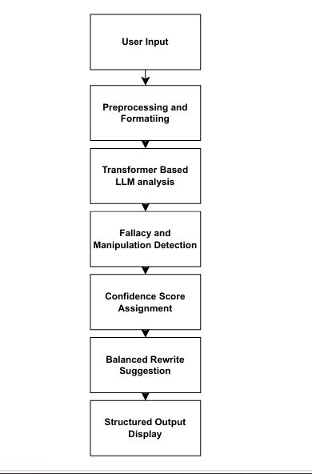
Process Flow Diagram
Use Case
1. User pastes article or statement.
2. System analyzes semantic structure.
3. System highlights detected reasoning patterns.
4. User receives explanation + confidence score.
5. User views balanced rewrite for improved clarity.

Slide 7
Architecture diagram of the proposed solution:
User Interface
API Gateway
The system is cloud native and scalable for concurrent users
AI Analysis
Response Formatting
Output

Slide 8
Technologies Used:
Frontend:
Streamlit (fast for demos)
Simple CSS / layout for clarity
Backend:
Python
Flask / FastAPI
JSON API communication
AI / NLP Layer:
Open-source transformer model (GPT-J / GPT-Neo / LLaMA)
Simple prompt templates for fallacy detection
Confidence scoring implemented with heuristics or probabilities
Data / Storage:
Local JSON / CSV for test articles (hackathon prototype)

Slide 9
Vision
SatyaSetu aims to become a foundational AI-powered reasoning assistant that strengthens informed discourse, promotes digital literacy, and empowers communities across Bharat to navigate digital information responsibly.

Slide 10


