Slide 1

Software implementation explanation
by Rupali P

Slide 2
1st Implementation
Problem statement – To do the layout optimization for dining table in the Kitchen space.
Solution –
Rich dataset creation – By web scrapping (Amazon, IKEA)
Rules and Regulation - .JSON file → {Furniture must not be placed near the door…,…..,…….,etc}
Universal dataset for Kitchen
Anthropometry data – To consider for the perfect placement of the furniture.
Model building – CNN/ Reinforcement learning/ Rule based – Learning algorithms.
Output – Best 5 layout optimization pictures (saved in a folder) → Assistance for the interior designer.

Slide 3
Features
Dimensions – Height(H), Width(W), Depth(D)
Color – For color theory (in future)
Shape – For adjustments
Name – Product name / product code(for future )
Product link - Quick accessibility
Image link – For the visuals
Weight
Material used

Slide 4
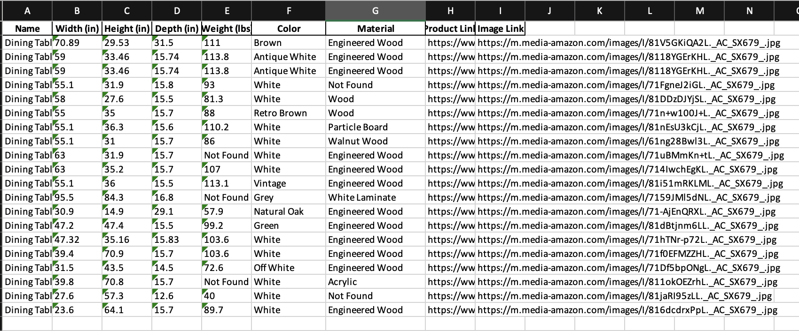
Dataset

Slide 5
Time Frame
Dataset preparation – 24 hours
Building rules – 8 hours
Model selection and building – 48 hours
Training and Testing – 12 hours
Output testing – 1 day

Slide 6
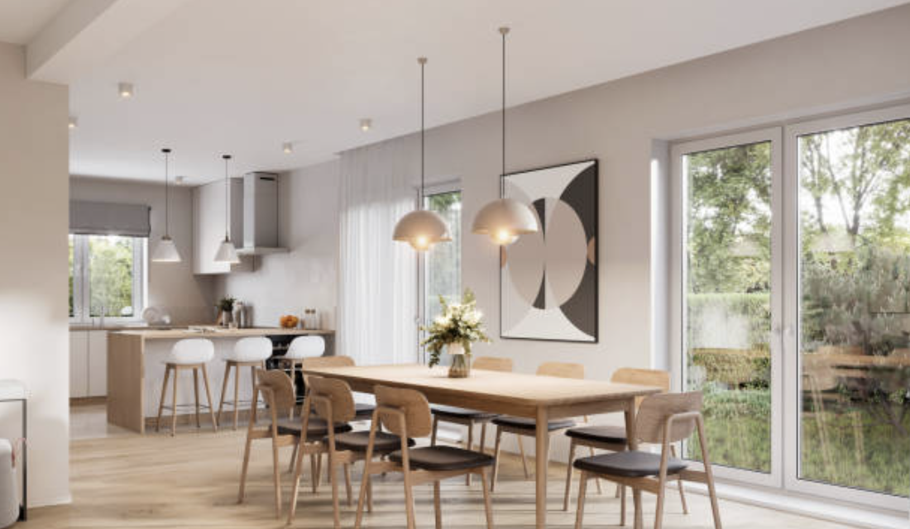
Output generalization
Output – Will get the best 5 layout optimized images of the arrangements of the Dining table on a common template of the kitchen.
This will be based on the maximum voting (The one which follows maximum rules will be the best among everything – This is the logic behind it ).

