Slide 1
Rupali S 2021503042 CT Dept. MIT, Anna University
TNSDC-Gen AI-Project
3/21/2024 Annual Review

Slide 2
PROJECT TITLE
ArtWiz: Art Generation Made Simple
3/21/2024 Annual Review

Slide 3


AGENDA
To break down technical barriers and empower users with limited artistic experience to generate art.
To produce visually appealing and high-resolution art pieces that meet user expectations.
To empower users to overcome creative blocks, sparking inspiration and facilitating the realization of artistic visions.
3/21/2024 Annual Review

Slide 4

PROBLEM STATEMENT
ArtWiz addresses the challenge of facilitating the creation of art. Traditional art-making processes often require extensive skill, time, and resources, limiting access to those with specialized training or means. Additionally, artists may face creative blocks or lack inspiration. There's a need for a solution that empowers individuals, regardless of artistic background, to unleash their creativity and produce compelling artworks effortlessly.
3/21/2024 Annual Review

Slide 5

PROJECT OVERVIEW
ArtWiz is designed to inspire and assist users in creating stunning artworks. Leveraging cutting-edge Generative Adversarial Networks (GANs) and deep learning techniques, ArtWiz transforms simple artwork into diverse art pieces.
3/21/2024 Annual Review

Slide 6

WHO ARE THE END USERS?
Aspiring artists seeking inspiration and guidance in their creative journey.
Professionals looking to streamline their workflow and explore new artistic avenues.
Educators interested in integrating AI-driven art tools into their curriculum.
Businesses aiming to enhance visual content creation for marketing or branding purposes.
3/21/2024 Annual Review

Slide 7

YOUR SOLUTION AND ITS VALUE PROPOSITION
Utilizing GAN architecture, we can
Tailor the art generation process to individual preferences.
Offer a wide range of artistic styles, techniques, and genres to explore.
Help students, educators, and enthusiasts by providing insights into artistic techniques.
3/21/2024 Annual Review

Slide 8

THE WOW IN YOUR SOLUTION
ArtWiz pioneers the concept of evolutionary art, where artworks evolve and mutate over time through generative algorithms.
It enables us to generate unexpected variations that spark new creative ideas and overcome artistic block.
3/21/2024 Annual Review
8

Slide 9
MODELLING
We can make use of the opendatasets library to download the dataset from Kaggle. ('https://www.kaggle.com/ikarus777/best-artworks-of-all-time’).
The discriminator network uses a convolutional neural network (CNN) which outputs a single number output for every image and a stride of 2 to progressively reduce the size of the output feature map.
3/21/2024 Annual Review
9

Slide 10
MODELLING- CONTD.
The generator will convert a latent tensor of shape (128, 1, 1) into an image tensor of shape 3 x 28 x 28 using the ConvTranspose2d layer from PyTorch.
Adam Optimizer and ReLU activation function are used to enhance the performance.

Slide 11
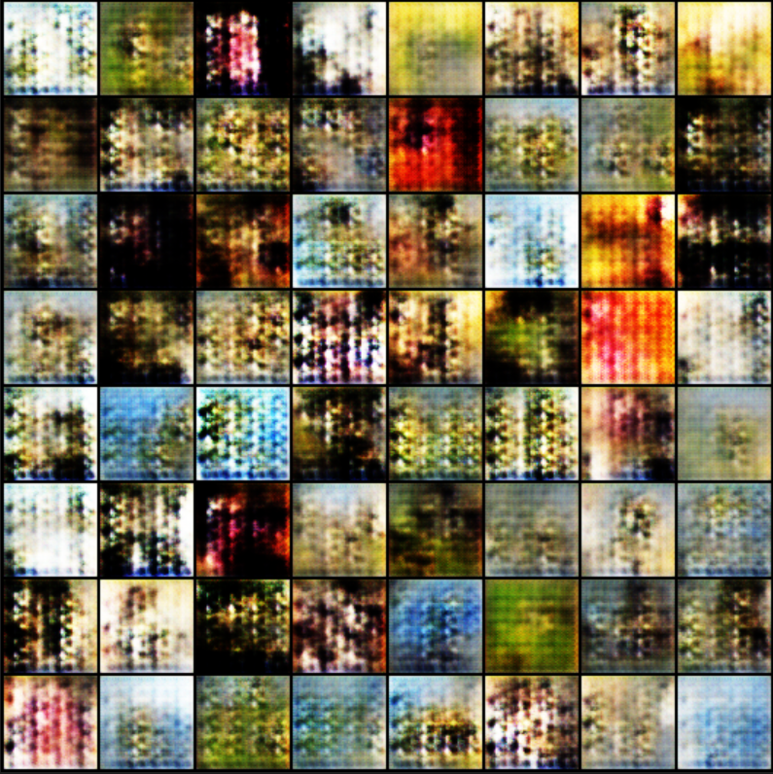
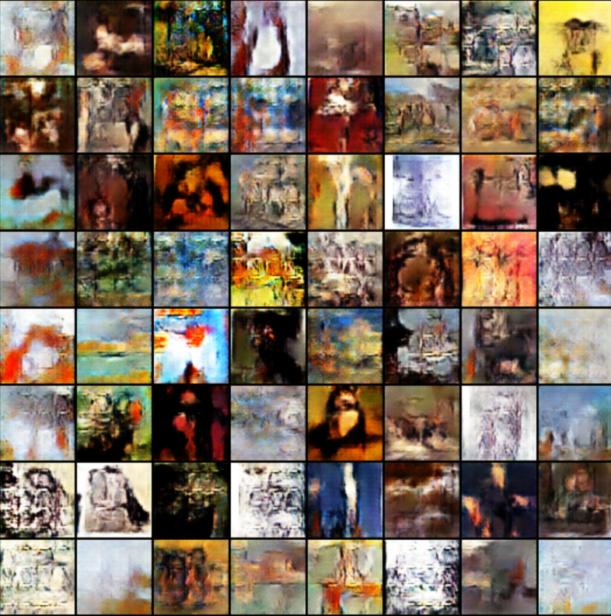
RESULTS
The model was executed for 100 epochs using learning rate = 0.0001.
Epoch 24:
Epoch 100:
Demo Link
3/21/2024 Annual Review
11

Slide 12
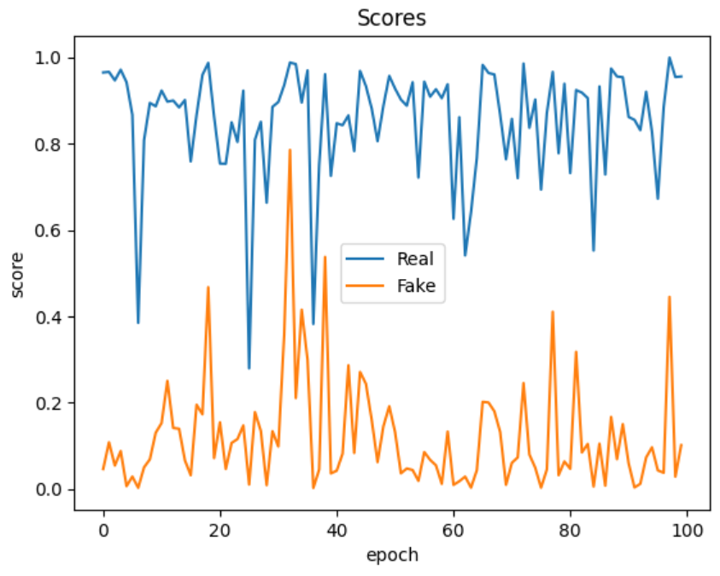
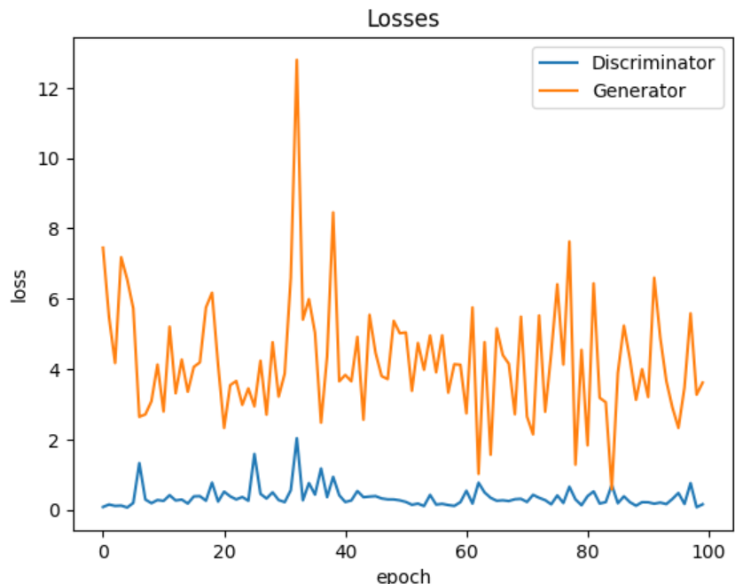
GRAPHS
Experimenting with different values for learning rate and number of epochs can generate high quality images and accurate prediction values.

