Slide 1

Project Presentation on
Human Activity Recognition using HMM based Intermediate Matching Kernel by representing videos as sets of feature vectors
Presented By
Rupali Bhatnagar
14CSE2013
Under the guidance of
Dr. Veena T.
Assistant Professor
Department of Computer Science And Engineering
National Institute of Technology Goa
8 July 2016

Slide 2
Outline
Human Activity Recognition
Types of patterns in a video
Challenges to the task of classification of videos
Problem Statement
Related Work
SVM based methods
GMM based methods
HMM based methods
Proposed Solution
Feature Extraction Module
Classification using HIMK based SVM
Results
Conclusions and Future Directions
References

Slide 3
Human Activity Recognition
Automatic detection of human activity events from videos by :-
Detecting when the activity takes place
Determining what activity has taken place
APPLICATIONS:-
Surveillance Systems
Patient Monitoring Systems
Crowd Behaviour Prediction Systems
Sports play analysis
Content based video search

Slide 4
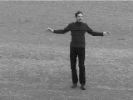
Classification of videos
Video is composed of a sequence of frames.
The number of frames depends on the duration of the video.
The images are temporally related to one another.
The images themselves have a local spatial correlations.
Time t= 0 1 2 3 4 t T-2 T-1 T
Figure : A video is composed of a sequence of frames

Slide 5
Classification of videos : Types of patterns
A video has 2 categories of patterns:-
SPATIAL PATTERNS
TEMPORAL PATTERNS

Slide 6
Classification of videos : Types of patterns
A video has 2 categories of patterns:-
SPATIAL PATTERNS
Local features of frames of videos.
Appearance based features – Corners, Edges, Colors, etc
Helps in detecting:-
Edges
Backgrounds
Textures
Objects
TEMPORAL PATTERNS
Figure : Spatial patterns in an image

Slide 7
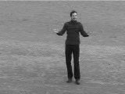
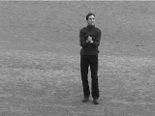
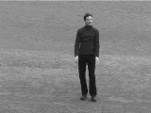
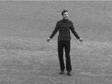
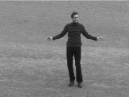
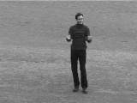
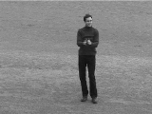
Classification of videos : Types of patterns
A video has 2 categories of patterns:-
SPATIAL PATTERNS
TEMPORAL PATTERNS
Capture the sequence of frames.
Motion information embedded in the video can be taken out.
Figure : Motion information embedded in a video (Action = handclapping)

Slide 8
Classification of videos : Challenges
Varying length representations[1]
High dimensionality
Intra-class variability
Inter-class similarity

Slide 9
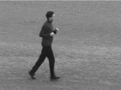
Classification of videos : Challenges
T1 frames =
F1 | F2 | …… | Ft1 | ……. | ……… | FT1
Varying length representations[1]
High dimensionality
Intra-class variability
Inter-class similarity
Video 1
Time t= 0 1 2 3 4 t1 T1 -2 T1 -1 T1
Video 2
Time t= 0 1 2 3 4 t2 T2 -2 T2-1 T2
T2 frames =
F1 | F2 | …… | Ft2 | ……. | …….. | ……. | ……… | FT2
Figure : Varying length representations for videos of different sizes

Slide 10
Classification of videos : Challenges
Varying length representations
High dimensionality
Intra-class variability
Inter-class similarity
Time t= 0 1 2 3 4 t T-2 T-1 T
D-dimensional
D-dimensional
D-dimensional
D-dim | D-dim |  |  | D-dim |  |  | D-dim
F1 | F2 | … | … | Ft | … | …. | FT
Figure : High dimensionality of video data

Slide 11
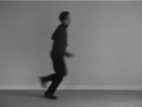
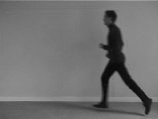
Classification of videos : Challenges
Varying length representations
High dimensionality
Intra-class variability
Inter-class similarity
Figure : Variations in the running class

Slide 12
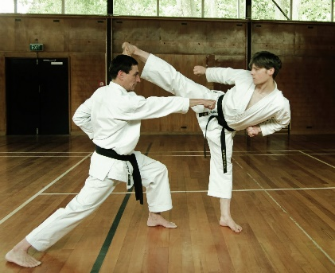
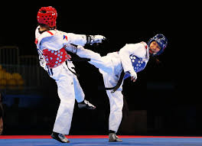
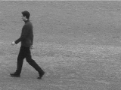
Classification of videos : Challenges
Varying length representations
High dimensionality
Intra-class variability
Inter-class similarity
(a)
(b)
Figure : (a) Similarity between Karate and Taekwondo classes
(b) Similarity between running and walking classes

Slide 13
Problem Statement
For the task of human activity recognition, we need to come up with a methodology that does the following:-
The model should capture the appearance based information in the video.
It should also capture the temporal information of a video.
The model captures the sequential information in video accurately.
The model should have a definitive reason to classify a given video by using the information we capture above.

Slide 14
Related Work
SVM based methods
GMM based methods
HMM based methods

Slide 15
Related Work
SVM based methods
Method 1 : By Yegnanarayana et al.[2]
Uses 3 kinds of features : Color Features, Shape features & Motion features
Uses 1-vs-rest approach for SVM classification
GMM based methods
HMM based methods

Slide 16
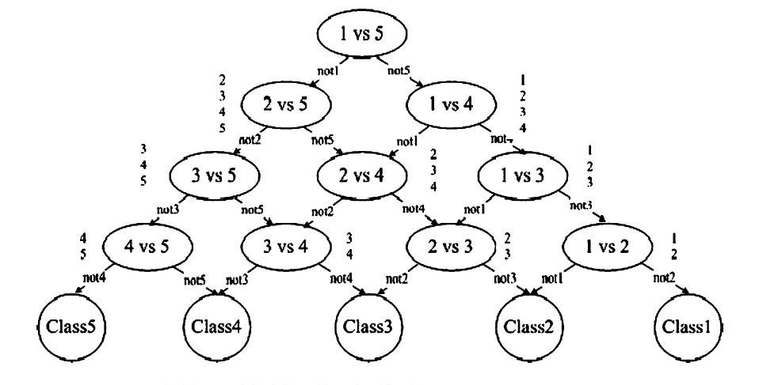
Related Work
SVM based methods
Method 2 : Directed Acyclic Graph based SVM (DAGSVM) by Jiang et al.[3]
Uses features based on video editing, color, texture and motion.
Uses 1-vs-1 SVM classifiers arranged as a directed acyclic graph.
GMM based methods
HMM based methods
Figure : DAGSVM Approach

Slide 17
Related Work
SVM based methods
Method 3 : Hierarchical SVM by Yuan et al.[4]
Uses Spatial features – face-frame ratio, brightness & entropy.
Uses Temporal features - average shot length, cut percentage, average color diﬀerence & camera motion.
Creates 2 trees:
Local optimal SVM binary tree
Global optimal SVM binary tree
GMM based methods
HMM based methods

Slide 18
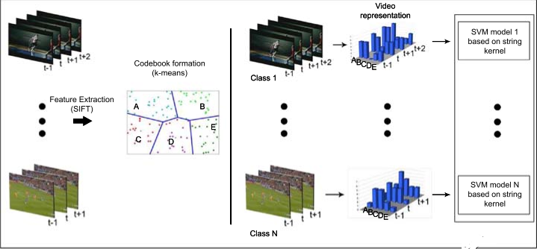

Related Work
SVM based methods
Method 4 : String Kernel by Ballan et al.[5]
Events are modeled as a sequence composed of histograms of visual features, computed using Bag of Words(BoW) approach.
The sequences are treated as strings (phrases) where each histogram is considered as a character.
String kernel is based on Needleman-Wunsch edit distance which is computed as following:-
$K\left(x,x^{′}\right)= e^{−d(x,x′)}$
GMM based methods
HMM based methods
Figure: String Kernel Approach by Ballan et al.

Slide 19
Related Work
SVM based methods
GMM based methods
Method 1: Approach by Xu et al.[6]
They combine 3 video features and 1 audio feature to create a super vector and then apply Principal Component Analysis(PCA) to reduce the dimensionality.
They model the features for various classes using GMM and train the parameters of GMM using Expectation-Maximization Algorithm(EM).
HMM based methods

Slide 20
Related Work
SVM based methods
GMM based methods
HMM based methods
Method: ACTIVE(Activity Concept Transition in Video Events) by Nevatia et al.[7]
Video event is defined as a sequence of activity concepts .
A new concept is generated with certain probabilities based on the previous concept.
An observation is a low level feature vector from a sub-clip and generated based on the concepts.
The feature vector is obtained by using Fisher Kernel over the HMM.

Slide 21
Proposed Solution
Video Dataset
HoG Feature Extraction
Video Representation using Bag of Words of models
HIMK Kernel Gram Matrix
SVM Classifier
Class Labels
Feature Extraction Module
Classification Module
Figure : Model of the proposed solution

Slide 22
Proposed Model: Feature Extraction
Histogram of Oriented Gradients[8] is scale-invariant & rotation-invariant within a cell. Normalization makes it illuminance-invariant.
Useful for object detection.
 |  |  |  | Block B
C11 | C12 | C13 | C14 | C15
. |  |  |  | .
. |  |  |  | .
. |  | Cell |  | .
. |  |  |  | .
C51 | C52 | C53 | C54 | C55
Figure : Image containing blocks which contain overlapping cells

Slide 23
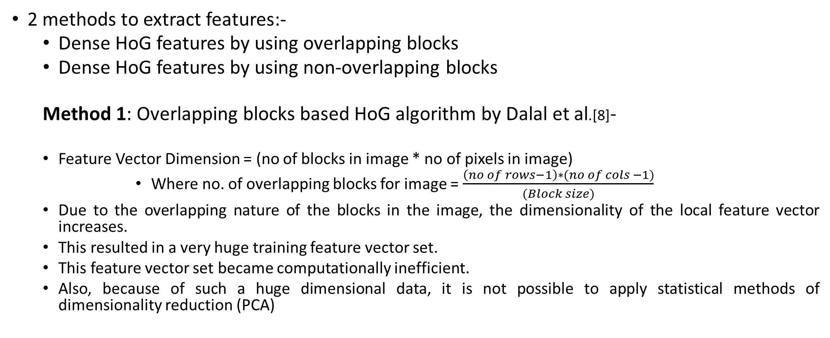
Proposed Model: Feature Extraction
2 methods to extract features:-
Dense HoG features by using overlapping blocks
Dense HoG features by using non-overlapping blocks
Method 1: Overlapping blocks based HoG algorithm by Dalal et al.[8]-
Feature Vector Dimension = (no of blocks in image * no of pixels in image)
Where no. of overlapping blocks for image = $\frac{\left(no of rows−1\right)∗(no of cols −1)}{(Block size)}$
Due to the overlapping nature of the blocks in the image, the dimensionality of the local feature vector increases.
This resulted in a very huge training feature vector set.
This feature vector set became computationally inefficient.
Also, because of such a huge dimensional data, it is not possible to apply statistical methods of dimensionality reduction (PCA)

Slide 24
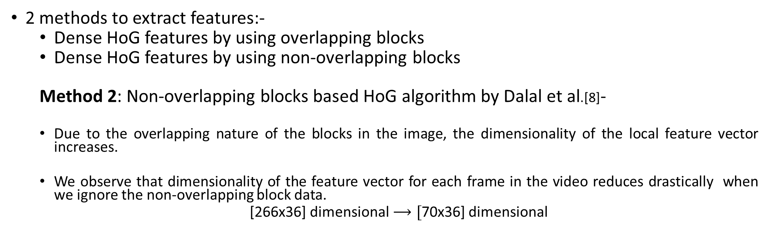
Proposed Model: Feature Extraction
2 methods to extract features:-
Dense HoG features by using overlapping blocks
Dense HoG features by using non-overlapping blocks
Method 2: Non-overlapping blocks based HoG algorithm by Dalal et al.[8]-
Due to the overlapping nature of the blocks in the image, the dimensionality of the local feature vector increases.
We observe that dimensionality of the feature vector for each frame in the video reduces drastically when we ignore the non-overlapping block data.
[266x36] dimensional$⟶[$70x36] dimensional

Slide 25
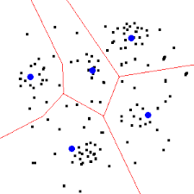
Video Representation: Bag of words model
D
B
Clustering
A
Codebook Generation
F
E
Training dataset represented as a set of HoG feature vectors taken from each frame of each training video
Codewords generated by clustering
Generated codebook
(extracted Features)
Figure: Codebook generated using codewords (Bag of words model)

Slide 26
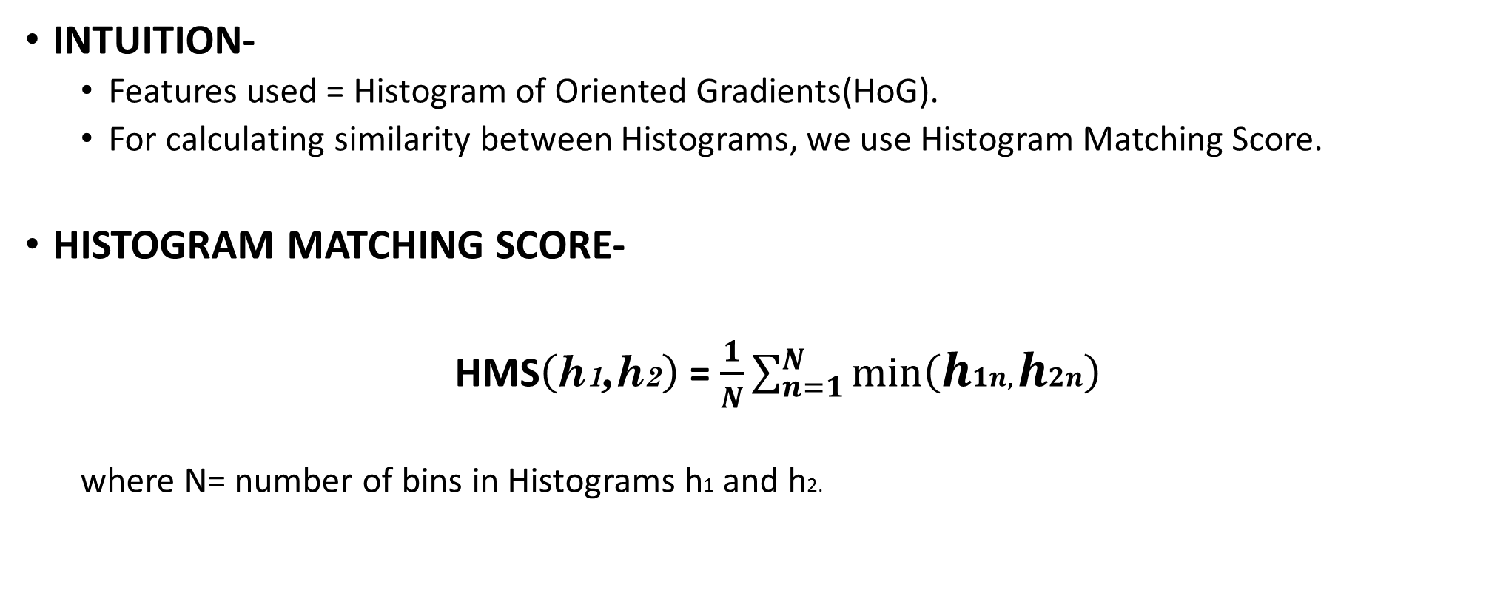
Histogram Matching Score based K-medoid clustering
INTUITION-
Features used = Histogram of Oriented Gradients(HoG).
For calculating similarity between Histograms, we use Histogram Matching Score.
HISTOGRAM MATCHING SCORE-
HMS$\left(\text{h}\text{1}\text{,}\text{h}\text{2}\right)$ = $\frac{1}{N}\sum_{n=1}^{N}{min\left(h1n,h2n\right)}$
where N= number of bins in Histograms h1 and h2.

Slide 27
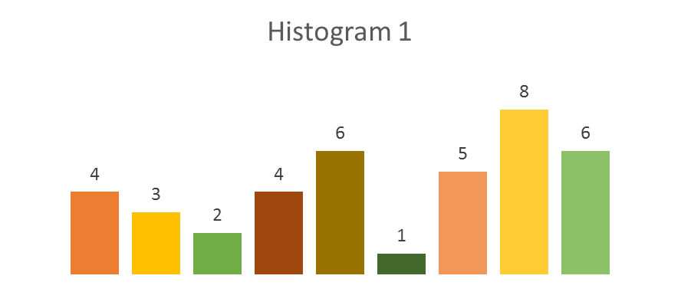
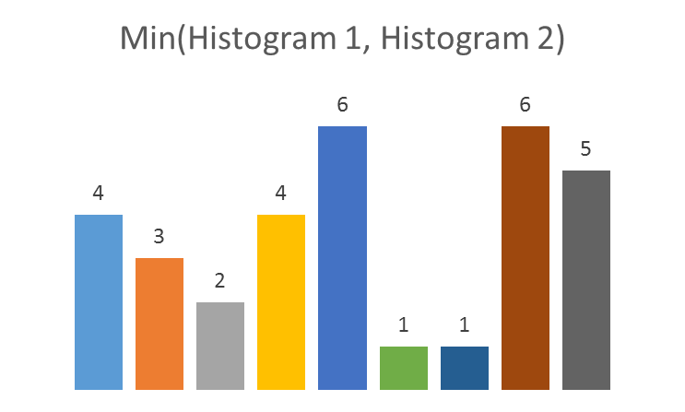
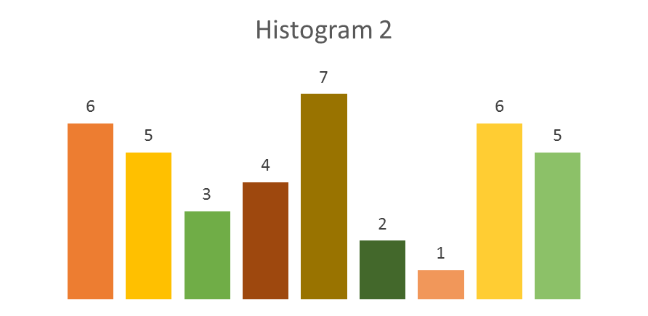

Histogram Matching Score based K-medoid clustering
HMS(H1,H2)= $\frac{4+3+2+4+6+1+1+6+5}{9}=3.44$
Figure : Calculation of Histogram Matching Score

Slide 28
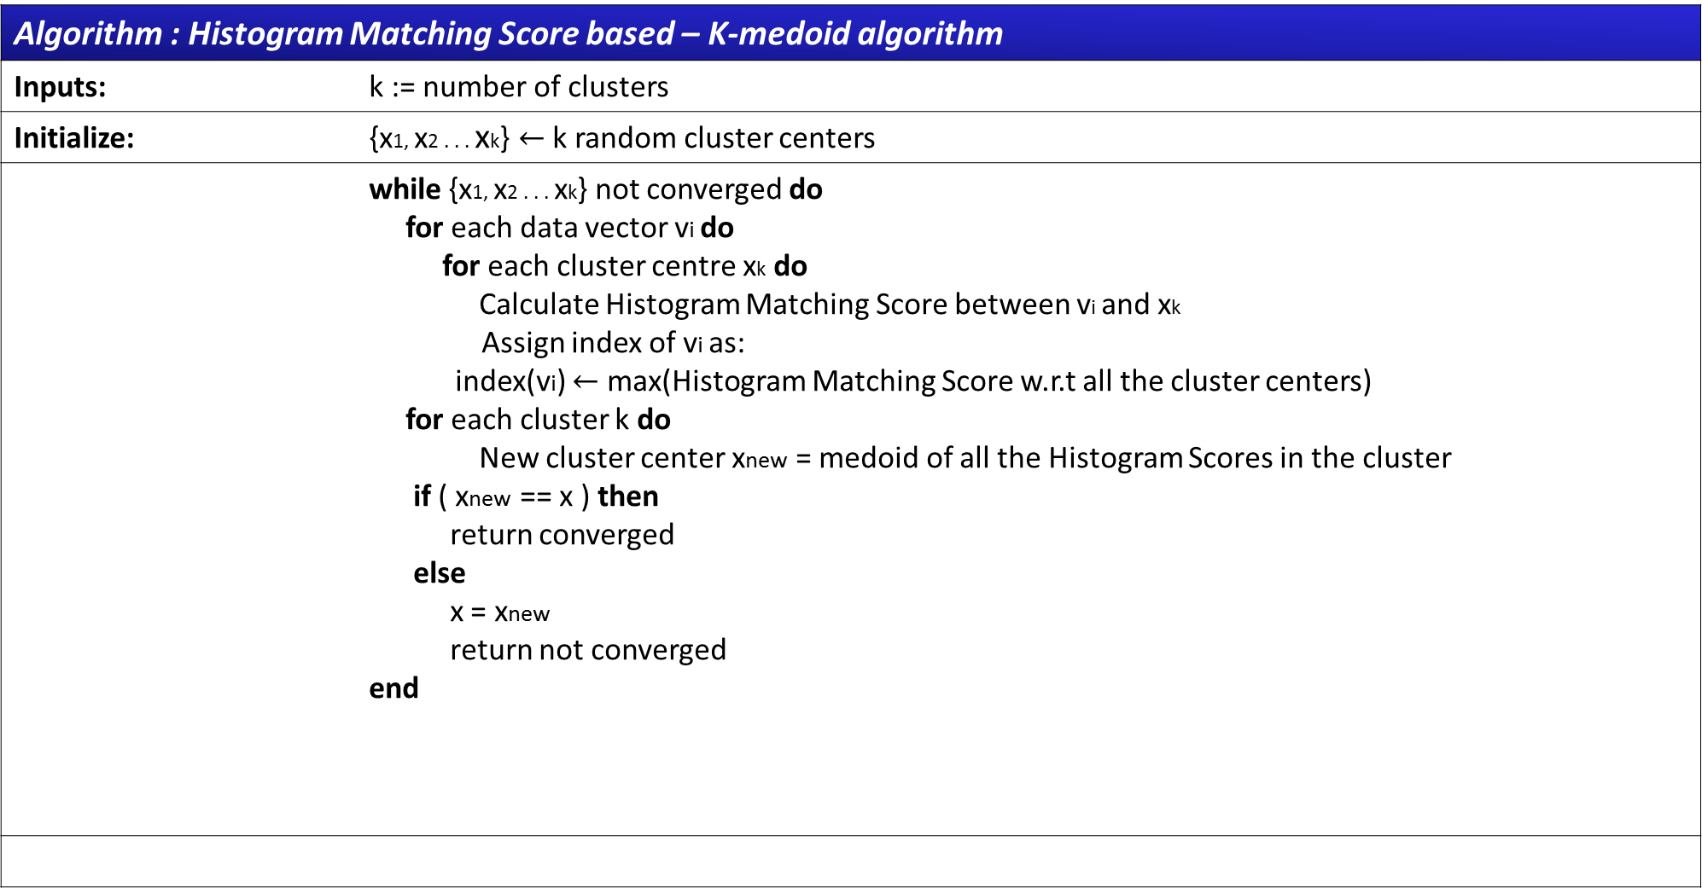
Histogram Matching Score based K-medoid clustering
Algorithm : Histogram Matching Score based – K-medoid algorithm
Inputs: | k := number of clusters
Initialize: | $\text{\{}\text{x}\text{1, }\text{x}\text{2 . . . }\text{x}\text{k}\text{\}}←$k random cluster centers
 | while {x1, x2 . . . xk} not converged do for each data vector vi do for each cluster centre xk do Calculate Histogram Matching Score between vi and xk Assign index of vi as: index(vi) $←$ max(Histogram Matching Score w.r.t all the cluster centers) for each cluster k do New cluster center xnew = medoid of all the Histogram Scores in the cluster if ( xnew == x ) then return converged else x = xnew return not converged end

Slide 29
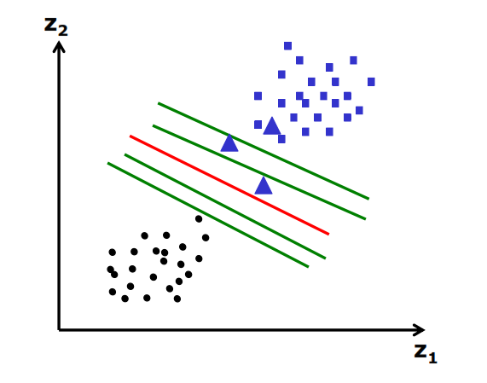
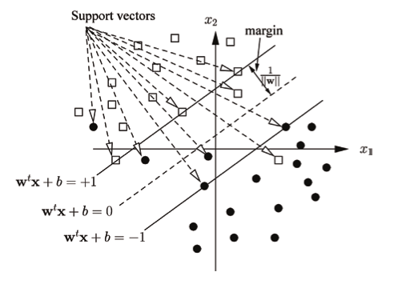
SVM Classifier
SVM is a discriminative classifier with the following properties:-
It is a binary classifier.
It constructs an optimum hyperplane to divide the data.[9]
Maximum Margin Hyperplane
Figure : Maximum Margin Hyperplane for Linearly Separable Data
Figure : Soft Margin Hyperplane for Non Linearly Separable Data & Overlapping Data[10]

Slide 30
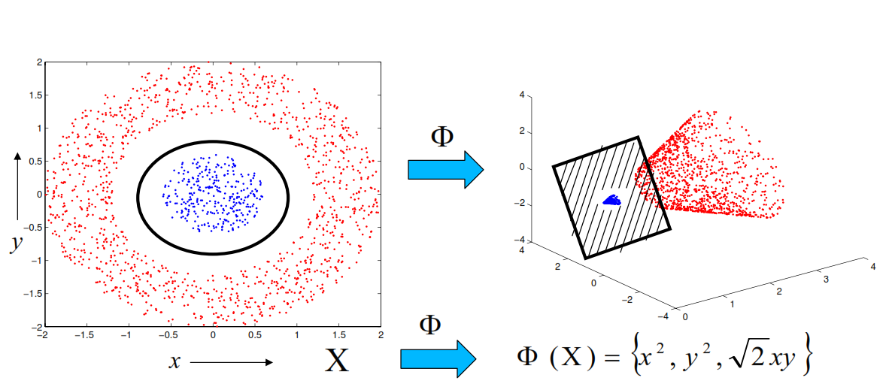
Kernel based methods for SVM
Kernel method was proposed to handle the issues for non-linearly separable data & overlapping data.
Nonlinear transformation of data to a higher dimensional feature space induced by a Mercer kernel.
Construction of optimal linear solutions in the kernel feature space.
Figure: Illustration of Kernel method for non-linearly separable data

Slide 31
Sequence Kernel/Dynamic Kernel
Videos are a sequence of frames. To capture the motion information, we model a video as a sequence of feature vectors.
ADVANTAGE- No need to convert varying length representations into a fixed length representation.
Examples of Sequence Kernels:
Fisher Kernel
Probablistic Sequence Kernel
GMM Supervector kernel
CIGMM-IMK[11]
HIMK[12]
F1 | F2 | …… | Ft1 | ……. | ……… | FT1
Feature vector of size T1 (xi)
K(xi,xj)
SEQUENCE KERNEL
F1 | F2 | …… | Ft2 | ……. | …….. | ……. | ……… | FT2
Feature vector of size T2 (xj)
Figure: Feature vector of 2 examples with different lengths

Slide 32
Intermediate Matching Kernel(IMK)
Intermediate Matching Kernel makes use of virtual feature vectors to match 2 varying length representations.
X1 | X2 | … | … | Xm
Y1 | Y2 | … | … | … | … | Yn
Mapping to virtual feature vector
Mapping to virtual feature vector
X1* | X2* | … | … | … | … | XQ*
Y1* | Y2* | … | … | … | … | YQ*
K(X1*, Y1*) | K(X2*, Y2*) | … | … | … | … | K(XQ*, YQ*)
Figure: Matching using virtual feature vectors

Slide 33
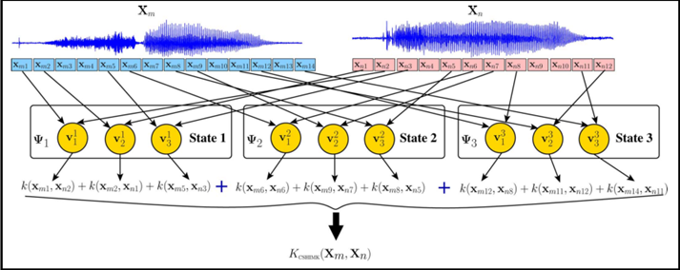
HMM-based Intermediate Matching Kernel(HIMK)
In its core, it uses an HMM that is an apt model for representing sequential information.
Intermediate Matching Kernel makes use of virtual feature vectors to match 2 varying length representations.
Proposed by Dileep et al.[12], HIMK for speech is calculated as sum of base kernels of all the components of all the GMMs that are present at each state of the HMM.
Figure: HMM based IMK calculation for speech signals [12]

Slide 34
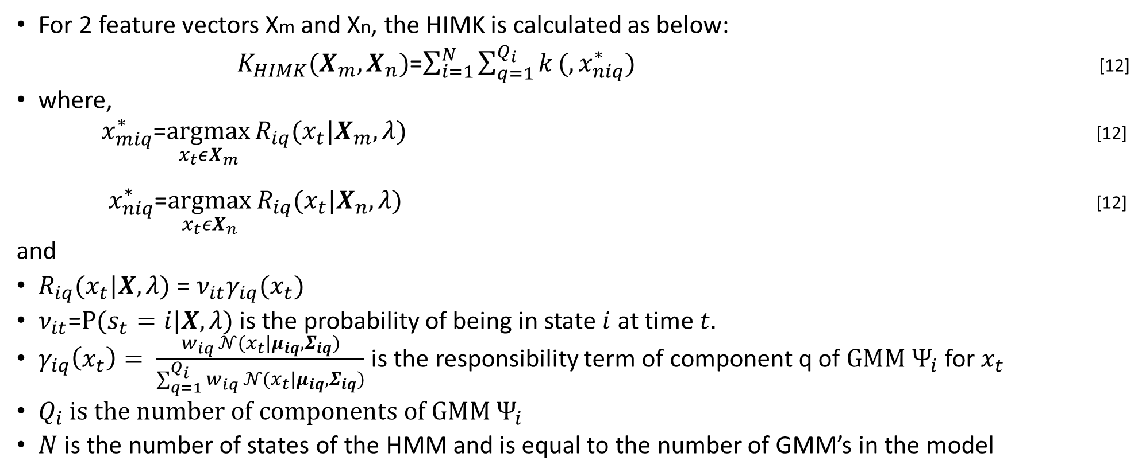
HMM-based Intermediate Matching Kernel(HIMK)
For 2 feature vectors Xm and Xn, the HIMK is calculated as below:
$K_{HIMK}(X_{m},X_{n})$=$\sum_{i=1}^{N}{\sum_{q=1}^{Q_{i}}{k}}(,x_{niq}^{∗})$ [12]
where,
${ x}_{miq}^{∗}$=$\underset{x_{t}εX_{m}}{argmax}{R_{iq}(x_{t}|X_{m},λ)}$ [12]
${ x}_{niq}^{∗}$=$\underset{x_{t}εX_{n}}{argmax}{R_{iq}(x_{t}|X_{n},λ)}$ [12]
and
$R_{iq}(x_{t}|X,λ)$ = $ν_{it}γ_{iq}(x_{t})$
$ν_{it}$=$Ρ(s_{t}=i|X,λ)$ is the probability of being in state $i$ at time $t.$
$γ_{iq}\left(x_{t}\right)= \frac{w_{iq} 𝒩(x_{t}|μ_{iq},Σ_{iq})}{\sum_{q=1}^{Q_{i}}{w_{iq} 𝒩(x_{t}|μ_{iq},Σ_{iq})}}$ is the responsibility term of component q of $GMM Ψ_{i}$ for $x_{t}$
$Q_{i}$
$N$ is the number of states of the HMM and is equal to the number of GMM’s in the model

Slide 35
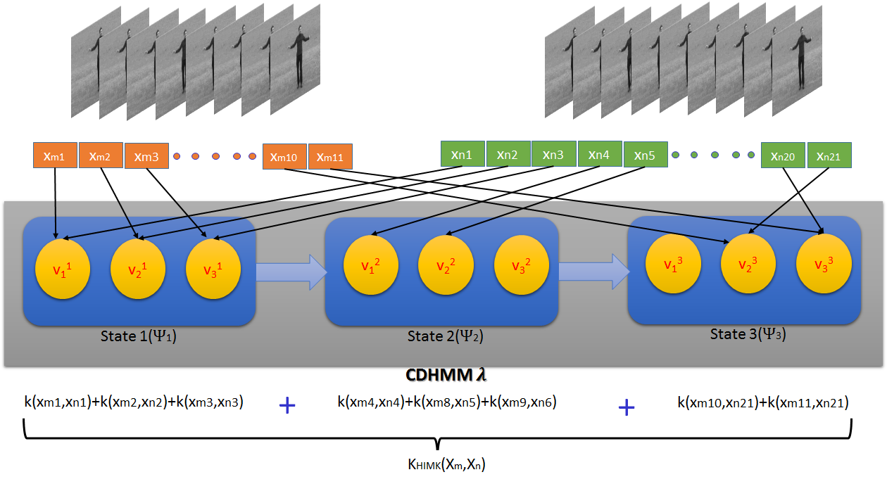
HMM-based Intermediate Matching Kernel(HIMK)
Figure: HIMK for videos

Slide 36
Results
 | Boxing | Handclapping | Handwaving | Jogging | Running | Walking
Boxing | 63.7% | 6.72% | 2.61% | 7.34% | 15.9% | 3.73%
Handclapping | 11.31% | 71.48% | 8.41% | 2.64% | 5.11% | 1.05%
Handwaving | 18.26% | 12.39% | 65.34% | 1.4% | 2.03% | 0.58%
Jogging | 8.61% | 1.26% | 1.4% | 49.54% | 22.9% | 16.29%
Running | 4.65% | 0.16% | 0.67% | 19.61% | 62.18% | 12.73%
Walking | 5.13% | 2.19% | 4.31% | 23.47% | 12.29% | 52.61%
Accuracy | 60.81%
Table: Percent wise Confusion Matrix using the proposed method for k=32

Slide 37
Results
Representation | Accuracy
String kernel with Chi Square Metric | 52.5%
String kernel with Intersection metric | 51.48%
String kernel with Kolomogrov Smirnov metric | 48.37%
Proposed method | 60.81%
Table: Comparison of accuracy of classification

Slide 38
Conclusions & Future Directions
Conclusion
We proposed to use HIMK based SVM classifier for the task of human activity recognition.
We discussed the feature extraction process to get a varying length representation for videos using the Bag of Features model using Histogram Match based K-medoids algorithm.
We then discussed about the HMM based IMK and how to use the HIMK for the task of classification for videos.
Future Work
Use of motion features for better representation.
Use of deep learning based feature representations for videos.

Slide 39
References
Roach, M., Mason, J. S., Evans, N. W., Xu, L. Q., & Stentiford, F. “Recent Trends in Video Analysis: A Taxonomy of Video Classification Problems”, in IMSA, 2002, pp. 348-353.
V. Suresh, M. C Krishna, R. Swamy and B. Yegnanarayana, "Content-based video classification using support vector machines", in International conference on neural information processing, 2004, pp. 726-731.
X. Jiang, T. Sun, and S. Wang, "An automatic video content classification scheme based on combined visual features model with modified DAGSVM,“ in Multimedia Tools and Applications, 2010 ,vol. 52, no. 1, pp. 105–120.
Yuan, X., Lai, W., Mei, T., Hua, X. S., Wu, X. Q., & Li, S., ”Automatic video genre categorization using hierarchical SVM”, in International Conference on Image Processing, 2006, pp. 2905-2908
L. Ballan, M. Bertini, A. Del Bimbo, and G. Serra, "Video event classification using string kernels, in "Multimedia Tools and Applications, 2009 vol. 48, no. 1, pp. 69–87.
Xu, L. Q., & Li, Y. “Video classification using spatial-temporal features and PCA”, in In International Conference on Multimedia and Expo ,2003, vol. 3, pp: 3-485.
Sun, Chen, and Ram Nevatia. "Active: Activity concept transitions in video event classification." In Proceedings of the IEEE International Conference on Computer Vision, 2013 ,pp. 913-920.
Dalal, Navneet, and Bill Triggs. "Histograms of oriented gradients for human detection." In IEEE Computer Society Conference on Computer Vision and Pattern Recognition,2005, vol. 1, pp. 886-893.

Slide 40
References
Vapnik, Vladimir N. "An overview of statistical learning theory“ in IEEE transactions on neural networks,1999, vol. 10,no 5, pp : 988-999.
Dileep, A. D., T. Veena, and C. Chandra Sekhar "A review of kernel methods based approaches to classification and clustering of sequential patterns, part i: sequences of continuous feature vectors.“ in Data Mining: Concepts, Methodologies, Tools, and Applications: Concepts, Methodologies, Tools, and Applications, 2012,vol. 1, pp: 1-251.
Dileep, Aroor Dinesh, and Chellu Chandra Sekhar "GMM-based intermediate matching kernel for classification of varying length patterns of long duration speech using support vector machines“ in IEEE transactions on neural networks and learning systems, 2014, vol. 25, no. 8, pp: 1421-1432.
Dileep, A. D., and C. Chandra Sekhar "HMM based intermediate matching kernel for classification of sequential patterns of speech using support vector machines. in IEEE Transactions on Audio, Speech, and Language Processing, 2013, vol. 21, no. 12, pp: 2570-2582.

Slide 41
THANK YOU

