Slide 1
Data Science Capstone Project
Local Governments Survey
Team #7
Teja Sree Mukkapati-Q389W584 Anudeepthi Chirumamilla- Y828R524 Rupali Avhad - d798z925

Slide 2
Project Overview
Project Goal The goal of this project is to create a clean, analysis-ready harmonized dataset by aligning two real survey sources related to Kansas local governments:
ARISE Kansas City Survey
CivicPulse Kansas Sample
Although both surveys study similar themes such as workforce capacity, fiscal condition, infrastructure, preparedness, and service challenges, they use different wording, scales, and coding systems. Our work focuses on bringing these surveys into a shared analytical framework so they can be studied together.

Slide 3
Why This Project Matters
It is a real-world data harmonization project using imperfect survey data.
It gives practical experience in data cleaning, recoding, documentation, and merging.
It strengthens core data science skills such as handling missing values, aligning variables, and creating reproducible workflows.
It has policy relevance because it helps study the challenges faced by Kansas local governments.
It is a strong portfolio project because it shows end-to-end work from raw data to harmonized outputs and insights.

Slide 4
Datasets Used
1. ARISE Kansas City Survey
Kansas-only city survey
Contains 309 responses and 91 variables
Includes information on infrastructure systems, governance capacity, grant challenges, fiscal stress, hazard concerns, and preparedness.
2. CivicPulse Kansas Sample
Kansas subset from a nationwide local government survey
Contains 135 rows and 74 columns
Includes workforce challenges, fiscal condition, infrastructure financing, metadata, and coded response variables.

Slide 5
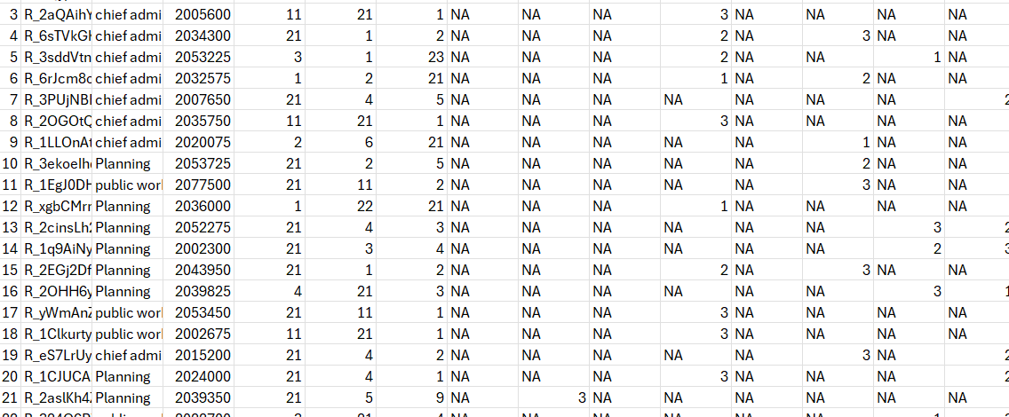
ARISE-Datasets

Slide 6
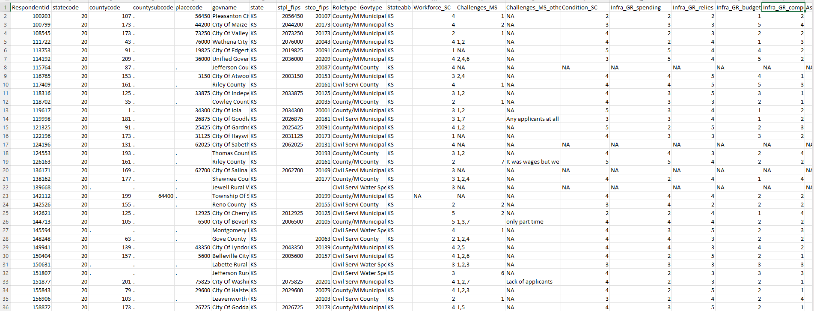
Civic -Dataset

Slide 7
Understanding the Survey Structure
How the two surveys are structured
Both surveys contain:
metadata variables
rating scale variables
coded or multi-select survey responses
ARISE
Uses variable names like Q8, Q119, Q9 series, Q10 series
Includes ranking questions, Likert-type responses, and binary program indicators.

Slide 8
Understanding the Survey Structure
CivicPulse
Uses variable names like Workforce_SC, Condition_SC, Infra_GR_spending
Includes metadata, response variables, and multi-select coded fields.

Slide 9
Role of the Codebooks
Why codebooks were essential
The codebooks were used to:
understand the meaning of each variable
decode response labels and value meanings
identify missing-value representations
interpret both surveys consistently
confirm whether variables were conceptually comparable across datasets.

Slide 10
Role of the Codebooks
Example In ARISE, numeric values can represent hazard codes, rank positions, or rating scales depending on the question, so the codebook is necessary for correct interpretation.

Slide 11
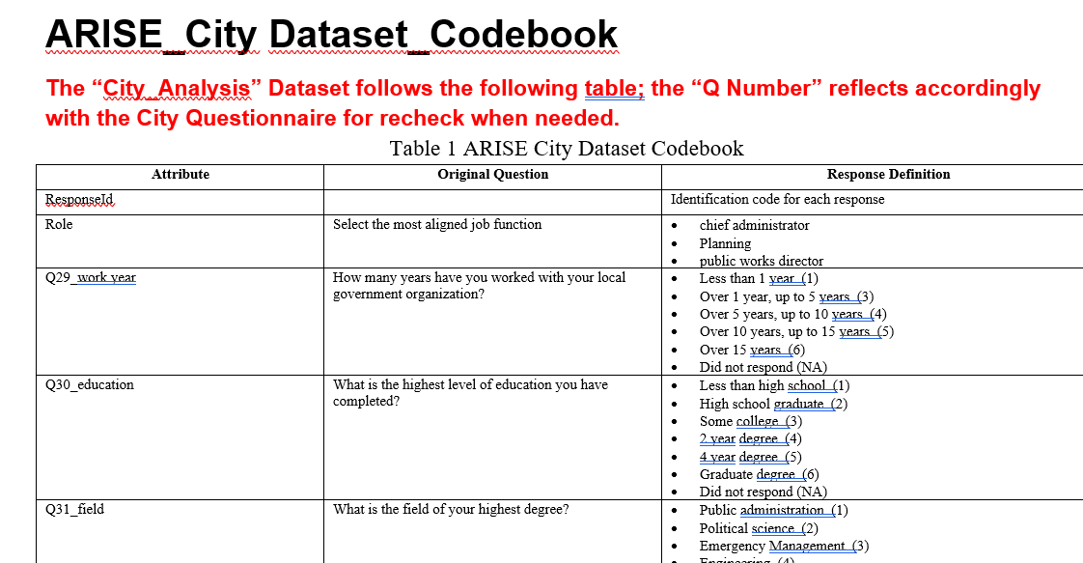
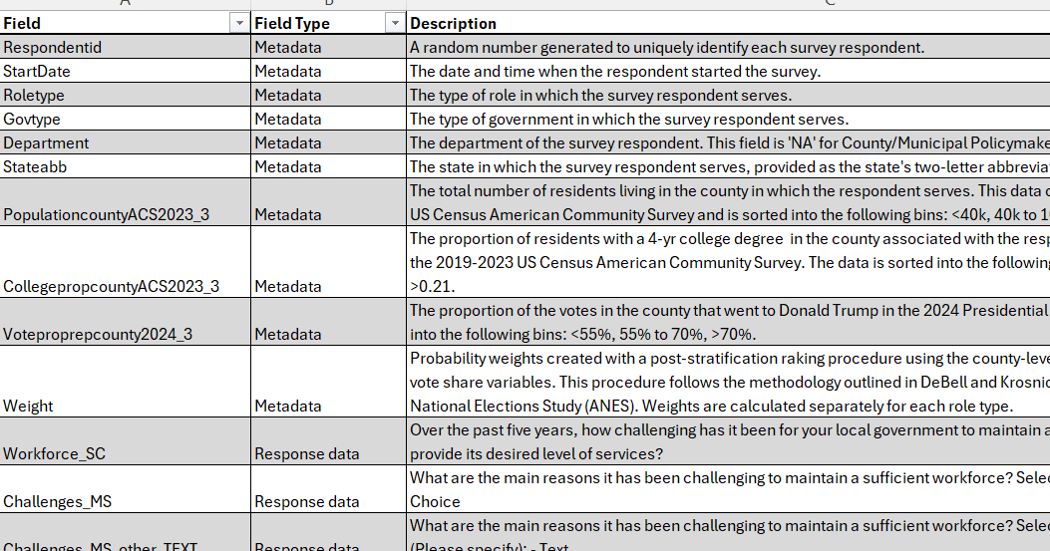
Two Code Books

Slide 12
Problem Statement
Main problem
The two surveys cover similar concepts, but they cannot be directly compared because they differ in:
variable naming style
question wording
response format
coding structure
level of detail
missing-value labels
Because of this, we needed a crosswalk table to create a common framework for harmonization and later analysis.

Slide 13
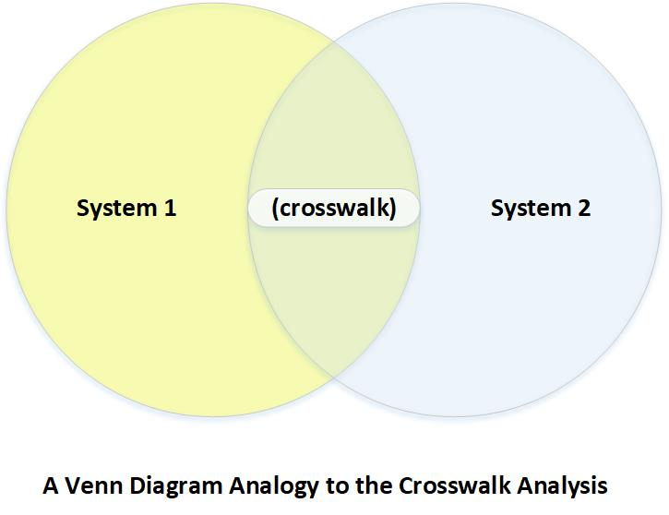
Crosswalk Table Purpose
Purpose of the Crosswalk Table
The crosswalk is the core document that aligns ARISE and CivicPulse variables. It helps define:
which variables measure the same concept
how closely they match
how they should be recoded
what the final harmonized variable should look like
how missing values should be handled
It acts as a translation map between the two survey systems.

Slide 14
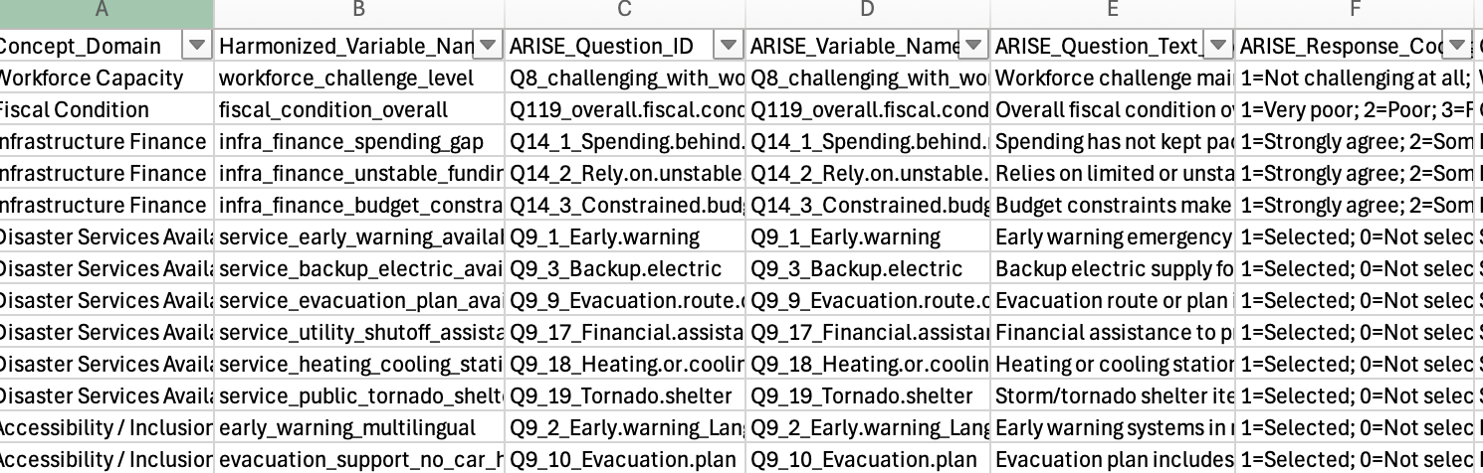
Crosswalk Table Structure
Each crosswalk row contains:
Concept_Domain
Harmonized_Variable_Name
ARISE_Question_ID
ARISE_Variable_Name
ARISE_Question_Text_Short
ARISE_Response_Coding
CivicPulse_Question_Block
CivicPulse_Variable_Name
CivicPulse_Question_Text_Short
CivicPulse_Response_Coding
Match_Type
Harmonization_Rule
Output_Scale
Missing_Value_Rule
Notes

Slide 15
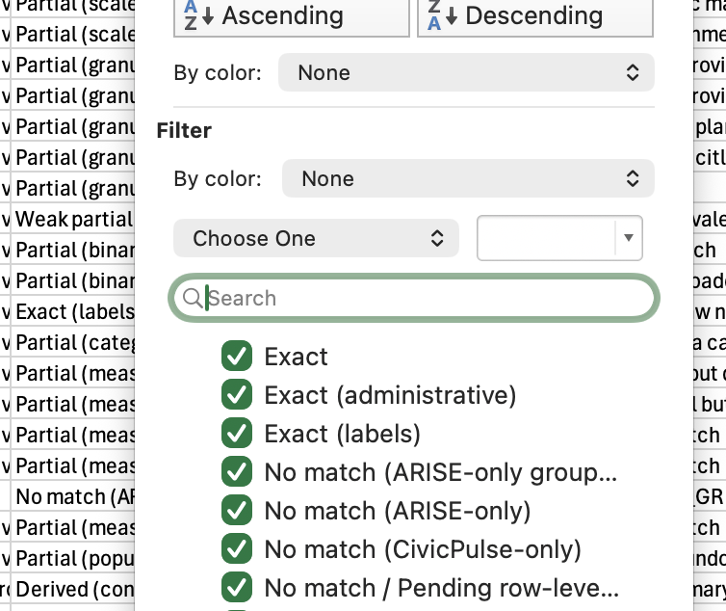
Match Types Used in Harmonization
To keep the harmonization methodologically correct, each variable pair was labeled using a match type:
Exact — same concept and very similar scale
Partial — same concept, but wording or coding differs
Weak Partial — related idea, but not directly equivalent
Derived — needs recoding or aggregation
No Match — variable exists only in one source
This prevents forcing weak matches into direct comparisons.

Slide 16
Example Harmonized Variables
Examples of harmonized concepts
1. Workforce Challenge ARISE Q8 and CivicPulse workforce challenge question were aligned to a common 1–5 scale, where higher values indicate greater challenge.
2. Fiscal Condition ARISE Q119 and CivicPulse fiscal condition rating were harmonized to a common 1–5 ordinal scale.

Slide 17
Example Harmonized Variables
3. Emergency Preparedness Capacity Preparedness items were converted into binary indicators (1 = present, 0 = not present) and combined into a composite score.
4. Protection of Vulnerable Populations Support-related items were aligned into a composite measure representing local support efforts for vulnerable groups.

Slide 18
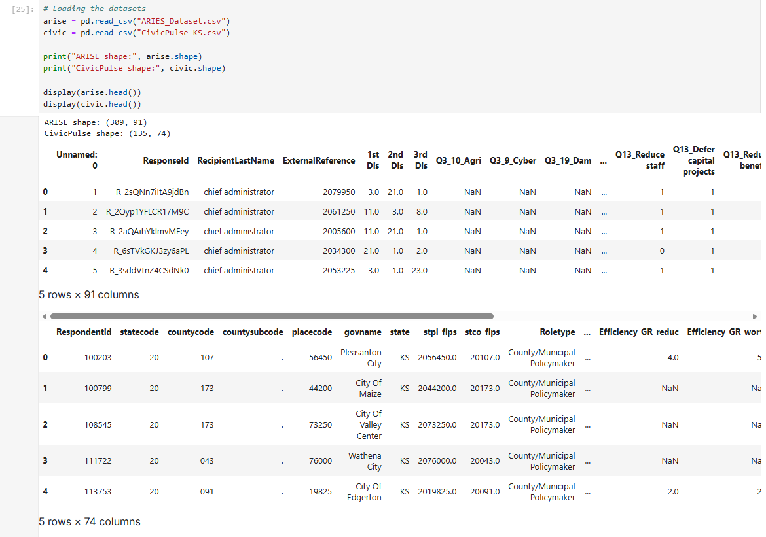
Dataset Overview
Loaded and examined both the datasets
Each row represents a respondent and each column represents a survey variable.

Slide 19
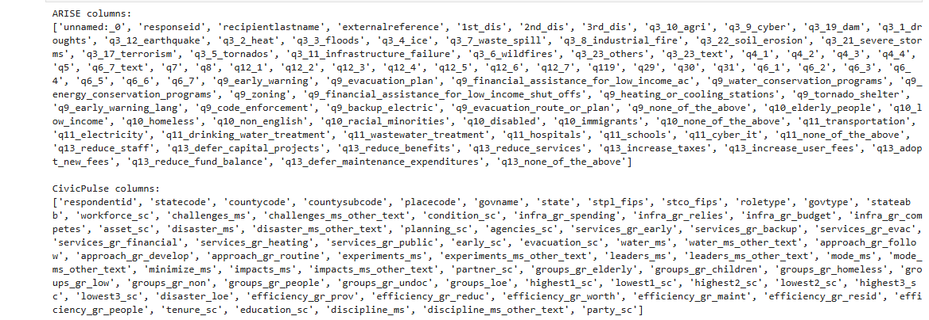
Column Name Standardization
It defines the clean_columns() function, which standardizes and cleans column names.
Converted all variable names to lowercase and replaced spaces and special characters with underscores.
Ensured consistent variable naming before performing the crosswalk mapping

Slide 20


Data Cleaning
Cleaned both the datasets
Standardized text fields

Slide 21
Data Cleaning Methodology
Data cleaning steps implemented
The cleaning pipeline standardized missing values by converting:
blank cells and whitespace to NaN
text indicators such as NA, N/A, Don’t know, and Refused to NaN
numeric missing codes such as 99, 999, and -99 to NaN
We also generated missingness checks to identify:
columns with high missing percentages
rows with high levels of non-response
This improved transparency and reproducibility before harmonization.

Slide 22
Crosswalk Variable Mapping
Created the crosswalk mapping between the ARISE and CivicPulse datasets.
The common_vars_map dictionary specifies which ARISE variables match which CivicPulse variables.
Each entry follows this structure:
Harmonized variables name -> [ARISE variable, CivicPulse variable]

Slide 23
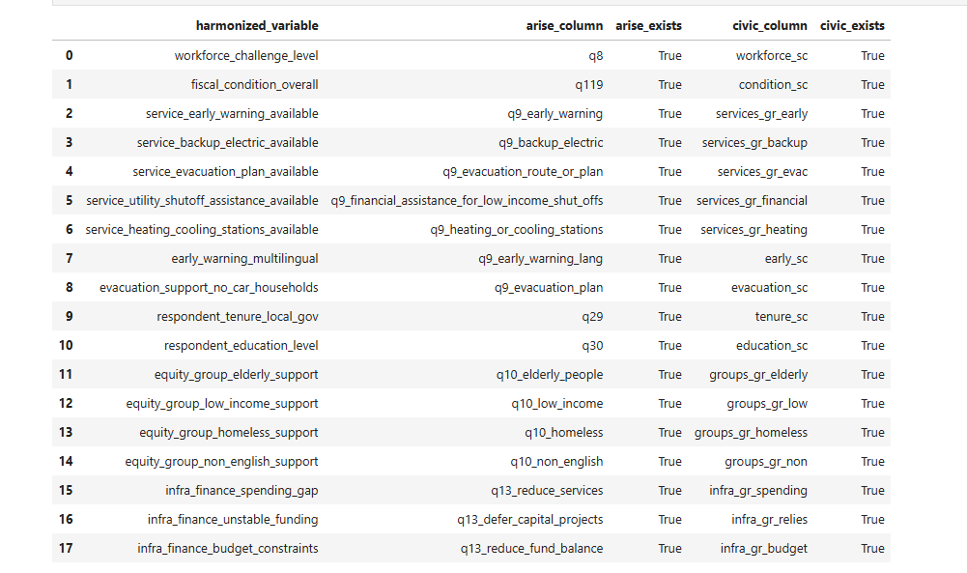
Crosswalk table

Slide 24
Adding Harmonized Variables to Datasets
Added harmonized variables to the original ARISE and CivicPulse datasets using the crosswalk mapping.
Standardized variable columns were created to represent the same ideas in both datasets.
Harmonized variables are now included in updated datasets, allowing for consistent comparison and analysis.

Slide 25
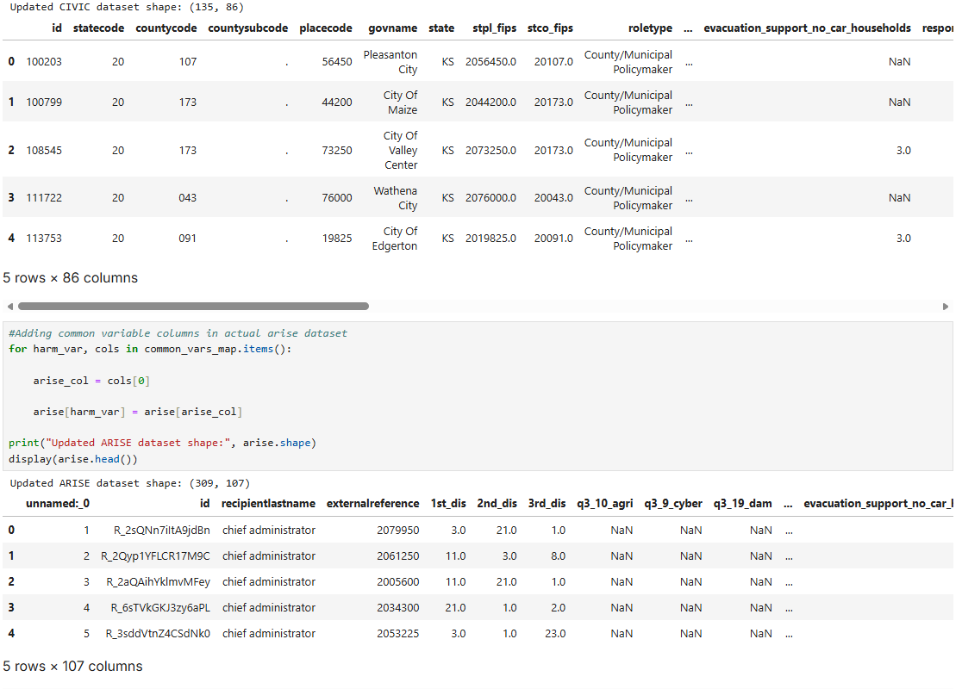

Slide 26
Current Status / What We Have Completed
Completed so far
reviewed ARISE and CivicPulse codebooks
understood survey structure and variable categories
identified overlapping concepts
created the crosswalk framework
classified matches as exact, partial, weak partial, derived, or no match
cleaned and standardized data
implemented harmonized variable creation in Python
prepared updated datasets for the next stage of analysis

Slide 27
Challenges Faced
Challenges during the project
Different naming conventions across surveys
Different response formats such as single-choice, grid, and multi-select
Different missing-value labels
Some variables only partially match
Some concepts require derived variables or aggregation
CivicPulse wording and actual stored dataset structure needed extra validation before finalizing the crosswalk

Slide 28
Next Week Goal
Next phase of the project
finalize coding notes and harmonized data dictionary
run quality checks on harmonized variables
generate summary statistics
create charts and visualizations
compare patterns across ARISE and CivicPulse

