Slide 1
Data Science Capstone Project
Local Governments Survey
Team #7 Anudeepthi Chirumamilla- Y828R524 Rupali Avhad - d798z925 Teja Sree Mukkapati-Q389W584

Slide 2
Project Progress Update
Last week (Deliverables)
Verified the variables and structure of the CivicPulse response dataset.
Used Excel to review the survey codebooks and understand the variables conceptually.
This week (Deliverables)
Reviewed both datasets to develop a crosswalk to align related variables.
Python was used to create harmonized datasets that are prepared for
additional analysis.

Slide 3
Crosswalk Process Overview
Excel Review: To identify similar variables across the datasets, Excel was used to examine the survey codebooks and obtain a conceptual understanding of the variables.
Python Implementation: The crosswalk was implemented using Python, and harmonized variables were programmatically created for additional analysis.

Slide 4
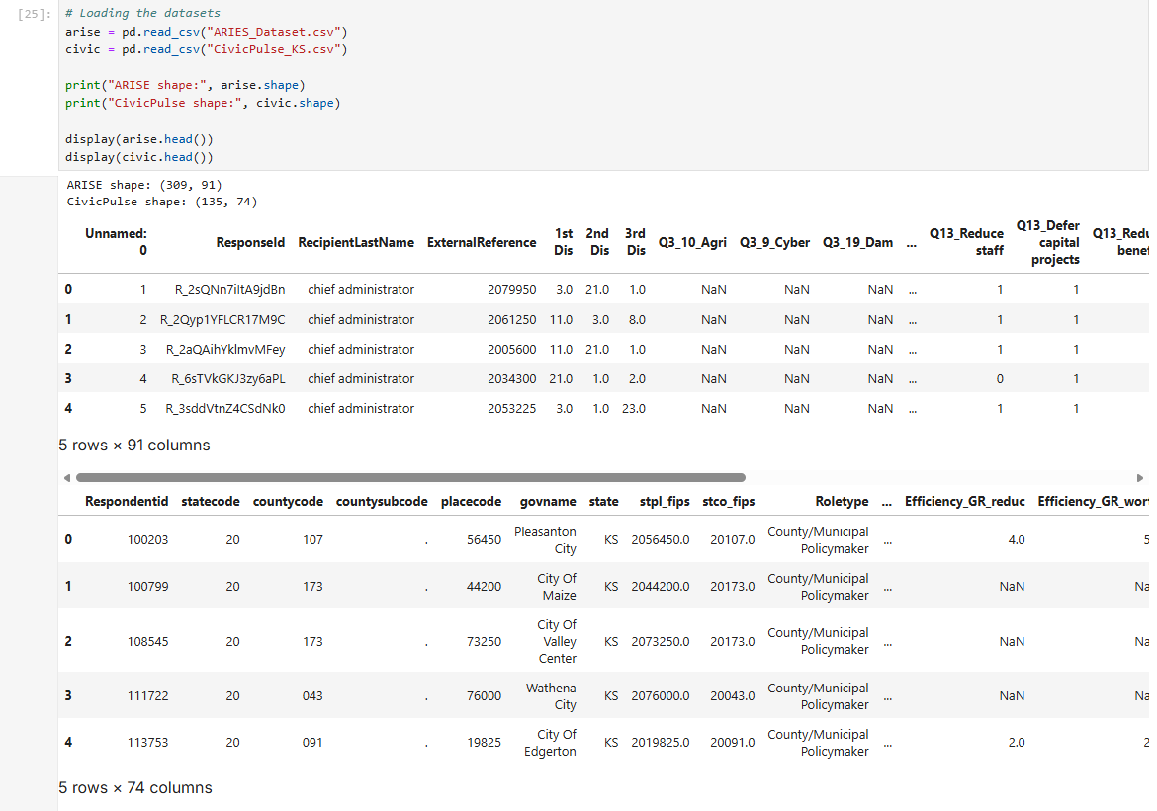
Dataset Overview
Loaded and examined both the datasets
Each row represents a respondent and each column represents a survey variable.

Slide 5
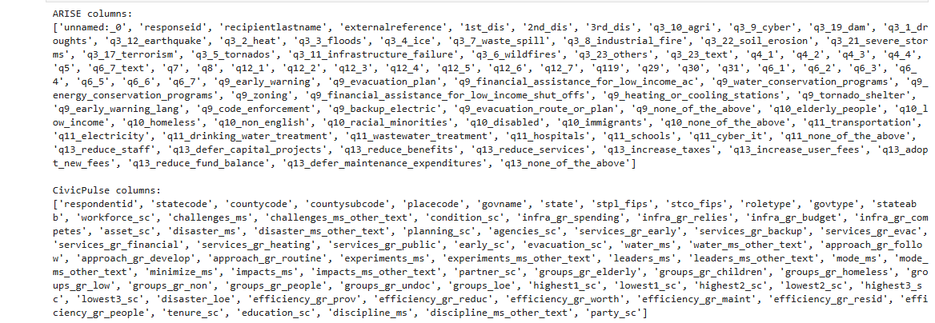
Column Name Standardization
It defines the clean_columns() function, which standardizes and cleans column names.
Converted all variable names to lowercase and replaced spaces and special characters with underscores.
Ensured consistent variable naming before performing the crosswalk mapping

Slide 6


Data Cleaning
Cleaned both the datasets
Standardized text fields

Slide 7
Crosswalk Variable Mapping
Created the crosswalk mapping between the ARISE and CivicPulse datasets.
The common_vars_map dictionary specifies which ARISE variables match which CivicPulse variables.
Each entry follows this structure:
Harmonized variables name -> [ARISE variable, CivicPulse variable]

Slide 8
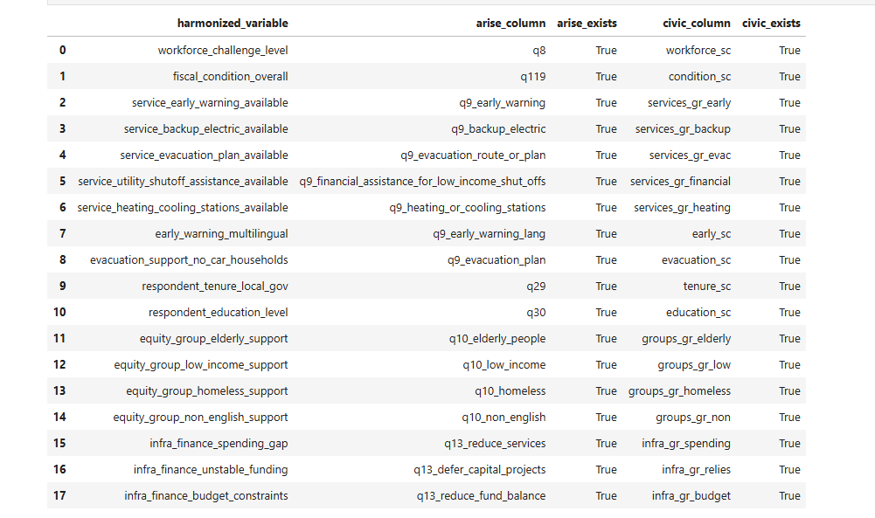
Crosswalk table

Slide 9
Adding Harmonized Variables to Datasets
Added harmonized variables to the original ARISE and CivicPulse datasets using the crosswalk mapping.
Standardized variable columns were created to represent the same ideas in both datasets.
Harmonized variables are now included in updated datasets, allowing for consistent comparison and analysis.

Slide 10
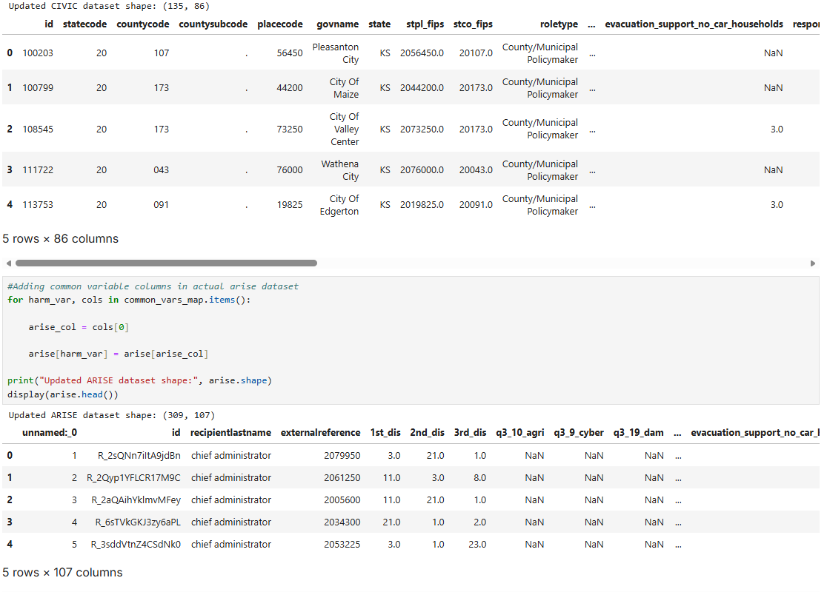

Slide 11
Next week deliverables :
In the next phase, we will analyze the harmonized variables and generate summary statistics and visualizations to compare patterns across the ARISE and CivicPulse datasets.

