Slide 1
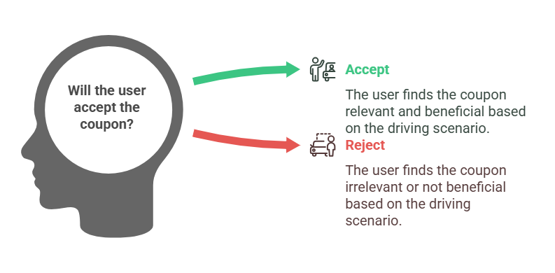
In today's competitive e-commerce landscape, understanding user behavior is crucial for enhancing customer engagement and maximizing promotional effectiveness. This project focuses on the critical question: Will users accept coupons during their journeys based on different factors?
Predicting Coupon Acceptance on E-commerce Platforms

Slide 2
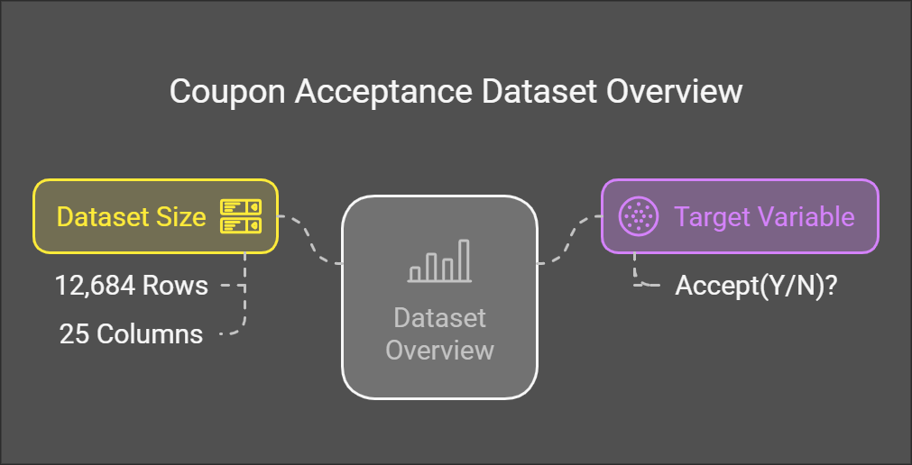

Slide 3
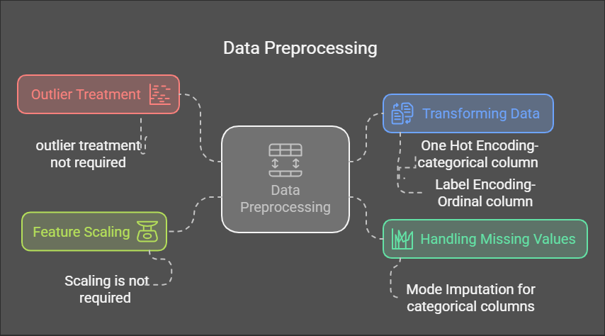

Slide 4
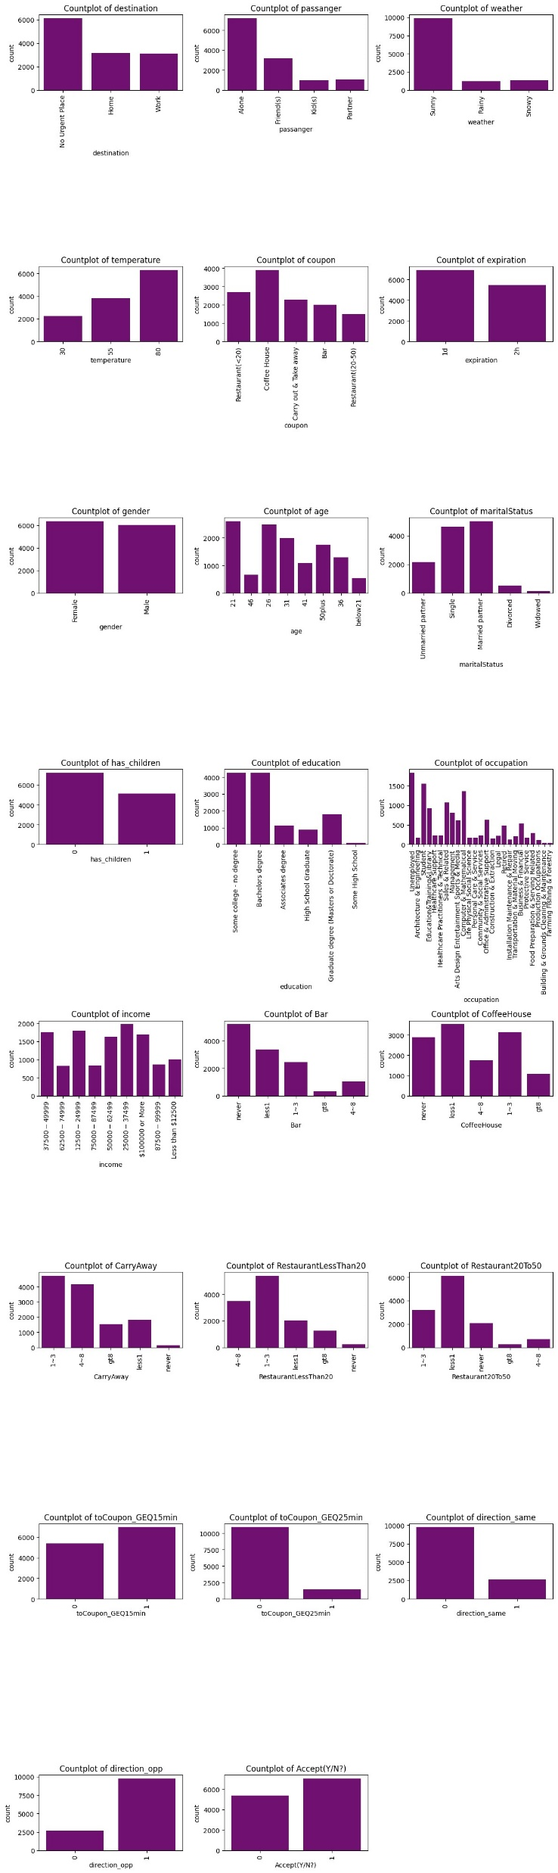
Exploratory Data Analysis
DISTRIBUTION PLOTS
Countplot helped in understanding the distribution of different categories within a dataset.

Slide 5
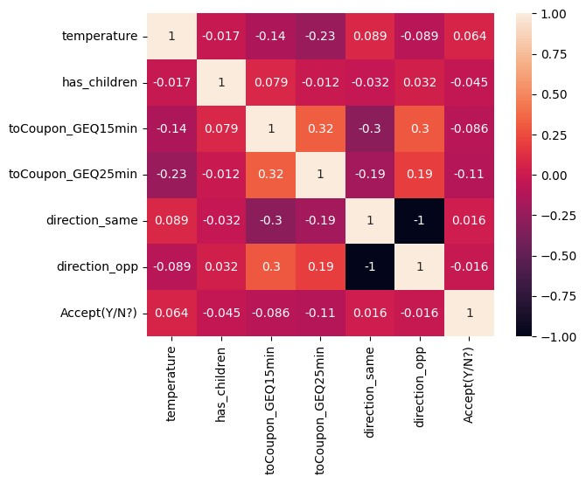
Correlation Analysis
Helps identify strongly correlated variables, guiding feature selection.
Columns direction_opp and direction_same are perfectly correlated (-1), so we can retain only one.

Slide 6
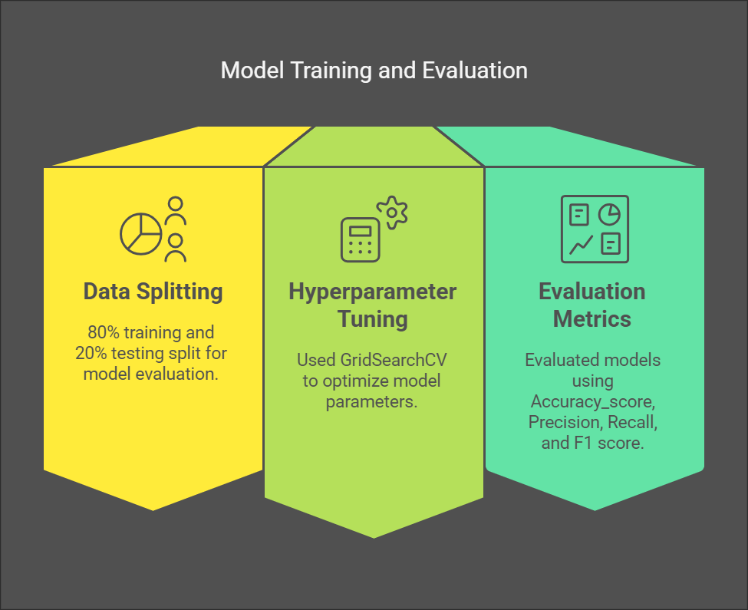

Slide 7
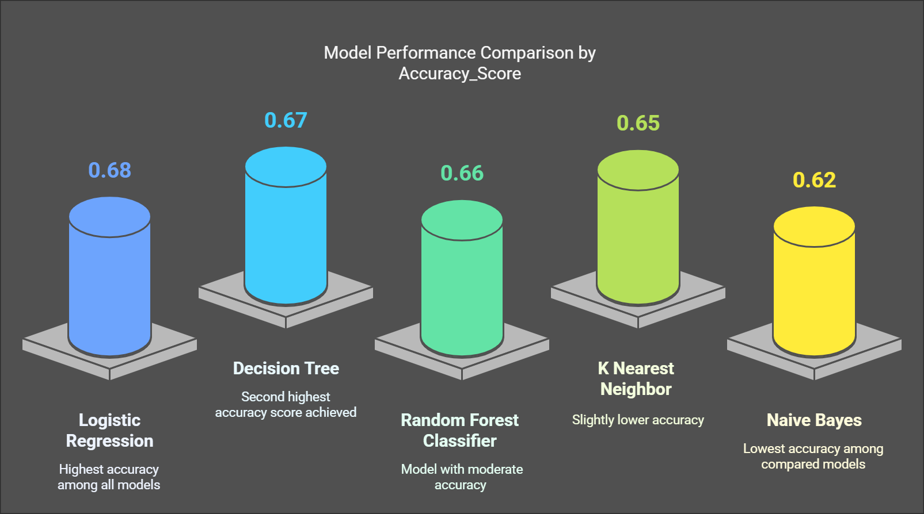

Slide 8
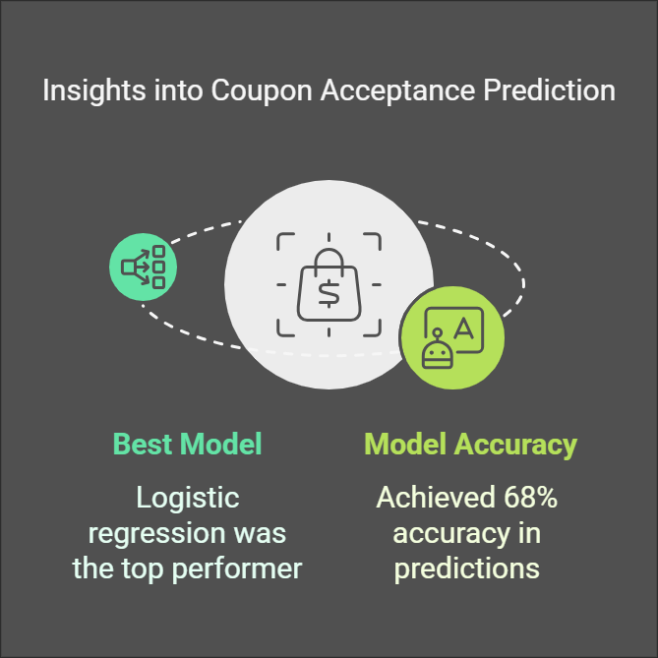

Slide 9
Thankyou

