Slide 1

DATA SCIENCE EXECUTED SUMMARY
BY
RUPAM KUMARI

Slide 2
Objective
Introduction slide
Data collection and data wrangling methodology related slides
EDA and interactive visual analytics methodology related slides
Predictive analysis methodology related slides
EDA with visualization results slides
EDA with SQL results slides
Interactive map with Folium results slides
Plotly Dash dashboard results slides
Predictive analysis (classification) results slides
Conclusion slide

Slide 3
INTRODUCTION
In this presentation, I will try to cover all the modules in a concise and graphical way.
Each and every module is well structured, that one can implement in the real world use cases.
Graphs and plots have been displayed for better visualization.

Slide 4
Data collection
Data Collection is the next step after Business Understanding.
It consists of collecting data from various sources, in different formats, structured or unstructured, according to the availability and needs of stakeholder.
One can use the available data from the organisation to move ahead onto the next step.
Data can also be collected from public, private or semi-private websites to complete this step.
More the data, More is the accuracy of a model in terms of model deployment.

Slide 5
data wrangling
Data Wrangling is one of the most important steps in any Data science project.
It consists of pre-processing the data for further implementation, in terms of handling missing values, removing duplicates and removing the irrelevant columns and rows for further exploratory analysis.
Various methodology consists of: Applying mean value or median value of the feature to handle missing values, Removing the irrelevant rows and columns from the dataset etc.

Slide 6
Exploratory data analysis (eda)
EDA is the most crucial step in Data science part, where data scientists or analysts explore the whole dataset after pre-processing to understand the relationships among variables.
It consists of feature engineering process to extract relevant features and applying various statistics approach to understand the whole dataset.
It consists of applying suitable language, tool, platform and applying model according to the provided use-case.

Slide 7
Interactive visual analytics (data visualization)
Interactive visual analytics(Data visualization) solves the problem of understanding row and column formatted data in a more approachable way, that is, in terms of various graphs and plots.
These pictorial representation shows the relationship among variables with respect to target.
This is the one of the steps where a technical person can simply represent its findings and patterns from data to non-technical person in an understandable manner.
Various tools for Interactive visual analytics include: Jupyter Notebook, Tableau, Power BI, R and much more.

Slide 8
Predictive analysis
Predictive analysis comes under Machine learning part.
It comprises of different independent variables and a dependent variable.
In this module of certification, they have covered the classification mechanism for predictive analysis where the supervised machine learning model have been used.

Slide 9
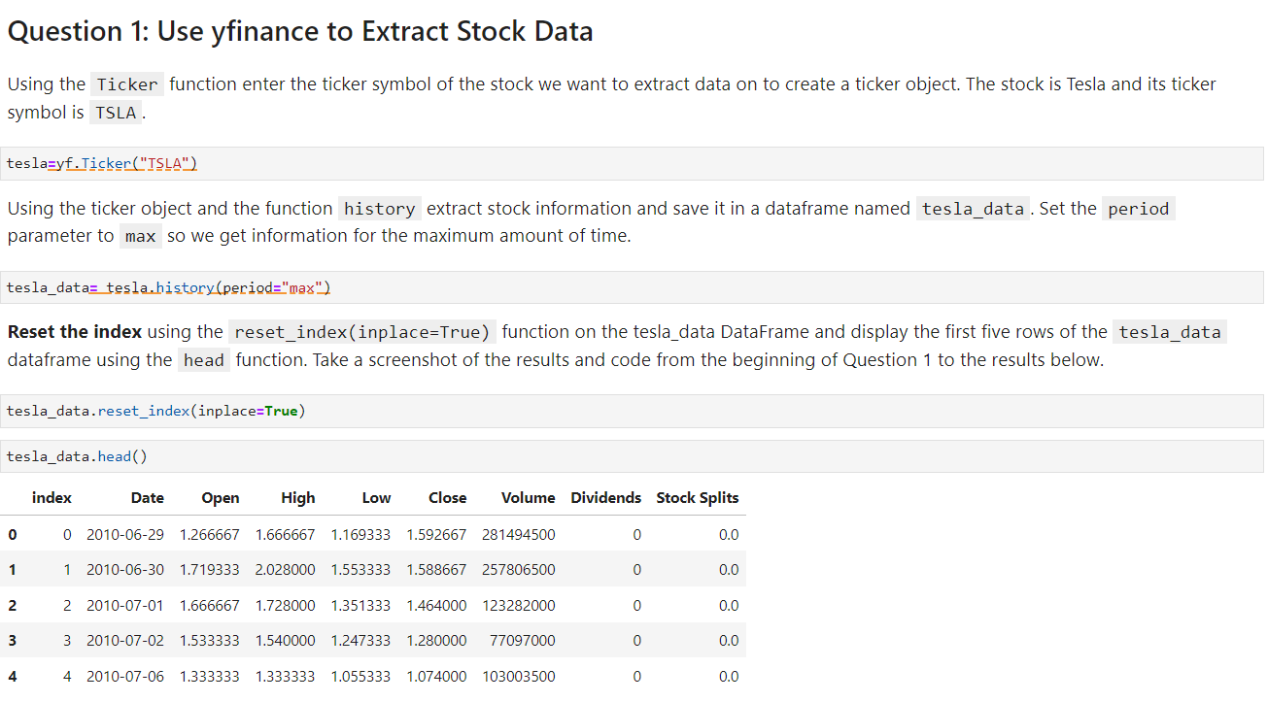
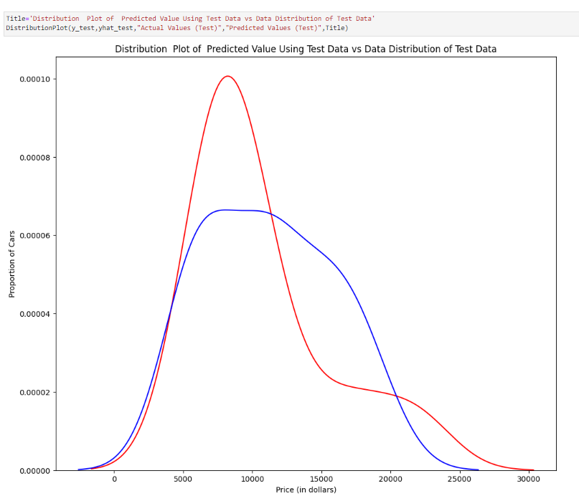
EDA with visualization

Slide 10
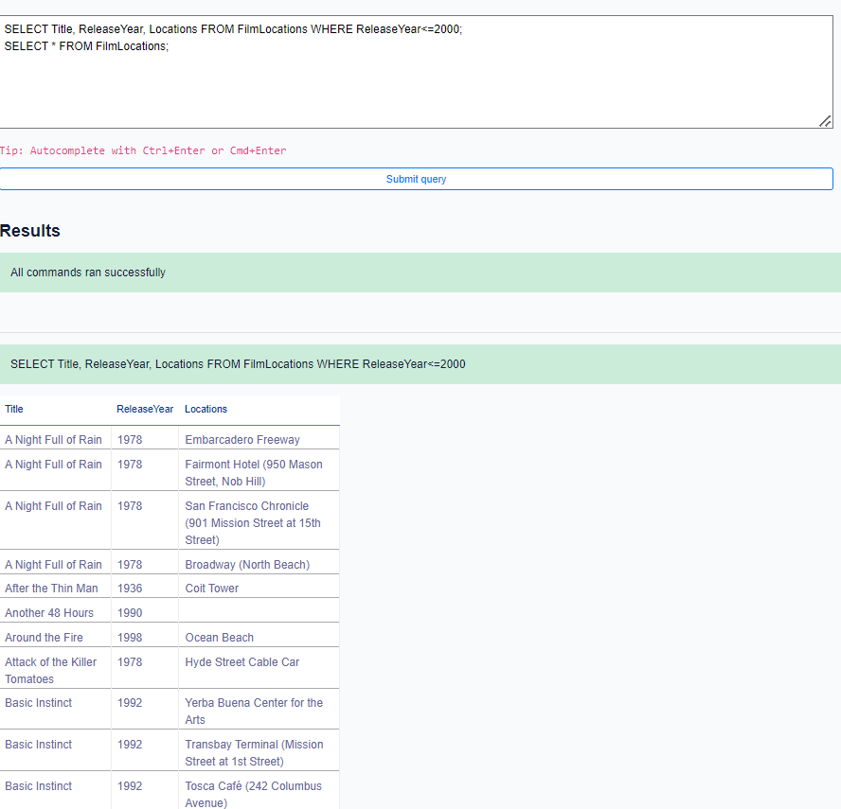
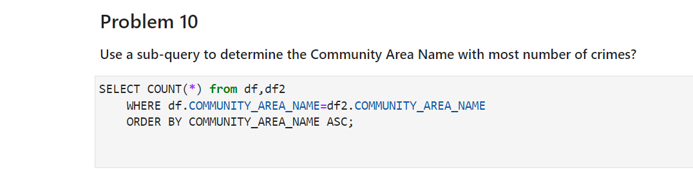
EDA with SQL

Slide 11
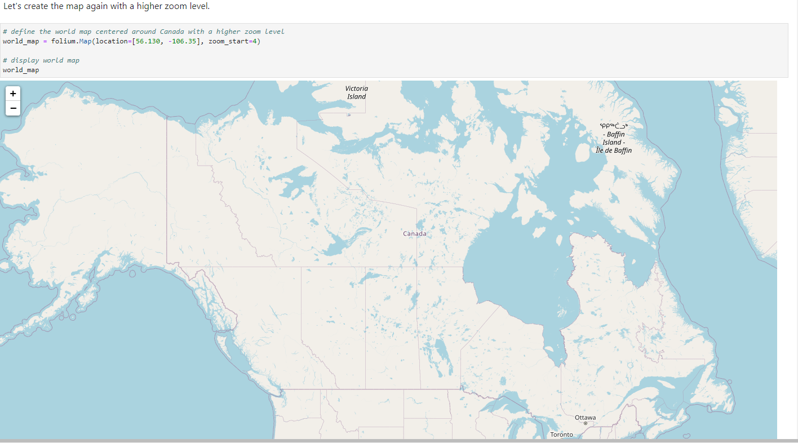
Interactive map with Folium

Slide 12
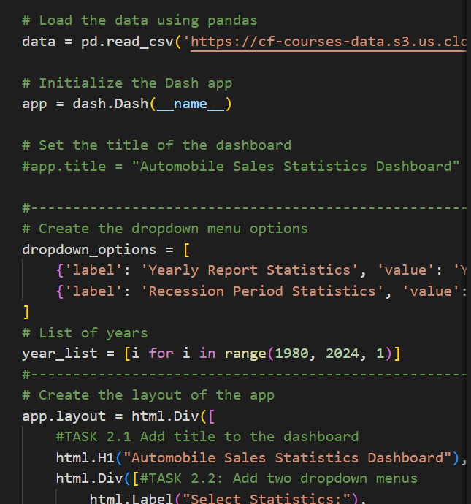
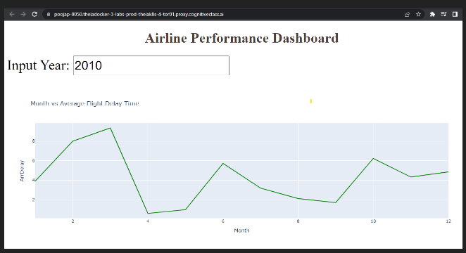
Plotly Dash dashboard

Slide 13
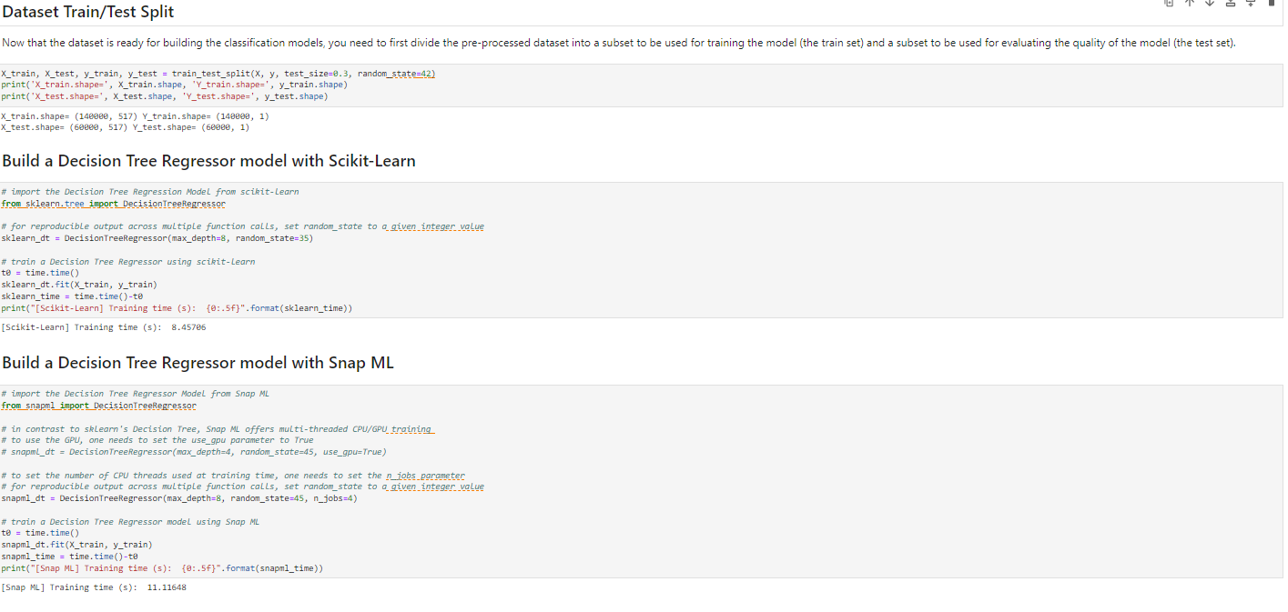
Predictive analysis (classification) results

Slide 14
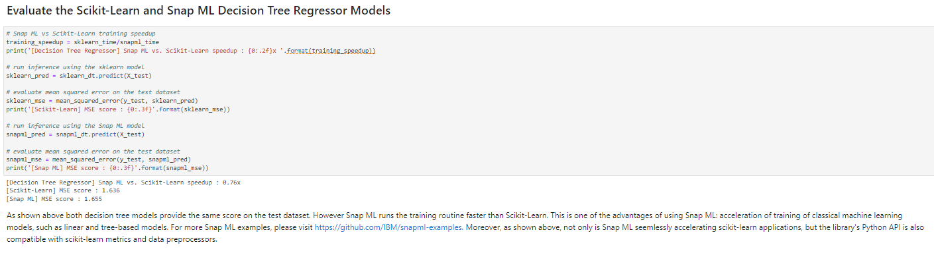
Predictive analysis (classification) results

Slide 15
CONCLUSION
In this professional certificate, one can learn several topics from AI and Data Science related to Tools, methodology, languages, Ethics and much more.
Different modules provide proper way of each and every related topic associated to modern Data science and Artificial Intelligence along with their practical implementation.
Each and Every module is well prepared with lessons, quizzes, assignments and labs.
There has been a brief part on Generative AI, which is very new in this AI industry.

