Slide 1
HOTEL BOOKING
& REVENUE ANALYSIS
Business insights and recommendations from 19,982 booking records
TOOLS | Microsoft Excel • SQL Server
Portfolio Project

Slide 2
Executive Summary
A snapshot of revenue, bookings, and booking outcomes
BOOKINGS ANALYZED
TOTAL REVENUE
CANCELLATION RATE
AVERAGE STAY
19,982
₹525.95M
14.04%
6 nights
• Revenue is relatively balanced across five hotels and four booking channels.
• Suites are the largest revenue-generating room category.
• Cancellations are a key area for further investigation.
• Recommendations focus on premium-room upselling, cancellation analysis, and channel optimization.
02

Slide 3
Objectives & Approach
From raw booking records to actionable business recommendations
BUSINESS QUESTIONS
ANALYTICAL WORKFLOW
• Which hotels and room types generate the most revenue?
• How do booking channels and customer segments perform?
• Where do cancellations create opportunities?
• Cleaned and validated booking records in Excel
• Calculated revenue and analyzed KPIs with PivotTables
• Used SQL Server for aggregation and validation
03

Slide 4
Data Preparation
Cleaning and validation before analysis
ORIGINAL DATASET
CLEAN RECORDS
DUPLICATE ROWS REMOVED
~20,000
19,982
20
• Removed duplicate records and rows with invalid negative Nights or RoomRate values.
• Standardized text fields and removed extra spaces from RoomType.
• Reviewed missing values and checked dates, booking status, discounts, and ratings.
• Retained appropriate missing values as blank rather than inventing replacements.
04

Slide 5
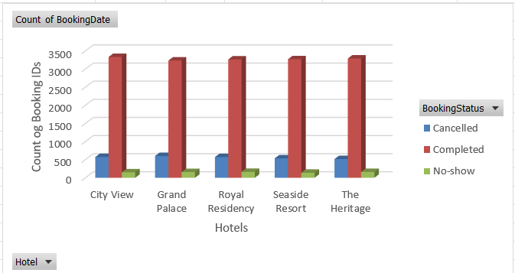
Booking Outcomes
Most bookings were completed; cancellations remain material
STATUS MIX
16,403 completed bookings
2,805 cancelled bookings
774 no-shows
Cancellation rate: 14.04%
No-show rate: 3.87%
05

Slide 6
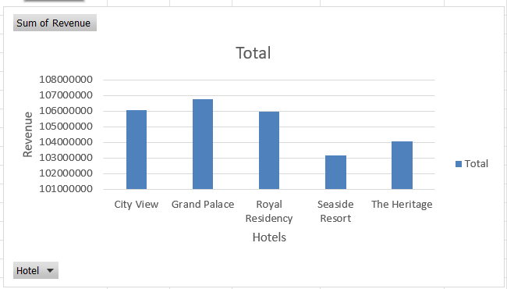
Revenue by Hotel
Revenue is distributed fairly evenly across the five properties
HIGHEST REVENUE
₹106.74M
Grand Palace
Insight
The difference between the highest- and lowest-revenue hotels is relatively small. Focus on property-level optimization rather than relying on one hotel.
06

Slide 7
Revenue by Room Type
Premium room categories are the strongest revenue contributors
Suite
₹151.84M
Deluxe
Standard
Executive
₹195.19M
₹151.84M
₹109.07M
₹69.85M
Recommendation
Promote Suites and Executive rooms through targeted upselling.
Offer room upgrades during the booking process.
Create premium packages combining rooms with additional services.
Monitor demand before applying discounts to premium rooms.
Use Standard/Deluxe bookings as opportunities for upgrade offers.
07

Slide 8
Booking Channel Performance
Channel revenue and booking volumes are relatively balanced
What this means
• Walk-in has the highest revenue at about ₹133.21M.
• Website revenue is about ₹130.18M.
• Compare profitability, acquisition cost, cancellation rate, and revenue per booking before shifting channel investment.
08

Slide 9
Customer Segment Insights
Booking and revenue contributions are similar across customer types
Potential segment strategies
• Individual: personalized and weekend offers.
• Corporate: business and long-stay packages.
• Group: group rates and event packages.
Average stay: Individual ~6 nights | Corporate ~6 nights | Group ~5 nights
09

Slide 10
Cancellation Rate by Hotel
Use property differences to guide deeper investigation
HIGHEST CANCELLATION
15.08%
Grand Palace
Next analysis
• Compare channel and customer type
• Check booking lead time and room type
• Review cancellation policy and payment method
10

Slide 11
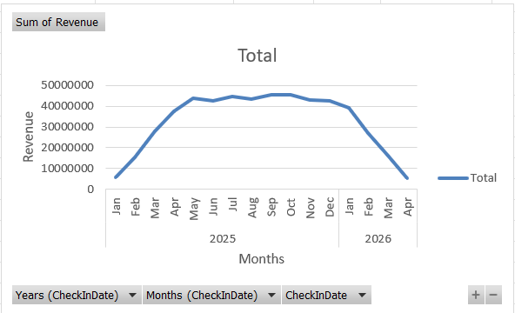
Monthly Revenue Trend
Revenue rose through 2025; 2026 data is available only through April
11

Slide 12
Priority Recommendations
Practical next steps grounded in the observed patterns
01
Grow premium-room revenue
Promote Suite and Executive upgrades; test packages and add-on services.
02
Investigate cancellations
Segment cancellation rates by channel, customer type, room type, and booking lead time.
03
Optimize channels
Compare revenue per booking, acquisition cost, cancellation rate, and profitability.
04
Personalize offers
Tailor promotions for Individual, Corporate, and Group customers.
05
Monitor demand and pricing
Use occupancy, availability, seasonality, and lead time to inform pricing decisions.
12

Slide 13
Further Analysis & Considerations
Validate recommendations with operational and financial measures
• Analyze booking lead time and cancellation behavior.
• Compare cancellation rates across channels and customer segments.
• Assess occupancy, room utilization, and RevPAR where data is available.
• Measure channel profitability after commissions and acquisition costs.
• Use complete-year and comparable-period data to assess seasonality.
13

Slide 14
KEY TAKEAWAY
Strong, balanced revenue—with clear opportunities to improve realization.
Focus on premium-room upselling, cancellation analysis, customer-specific offers, and evidence-based channel and pricing decisions.
Thank you
Hotel Booking & Revenue Analysis | Excel + SQL Server

