Slide 1
ShopEasy
E-commerce Sales & Customer Analysis
End-to-end analytics project using Python, SQL, Power BI & Excel
₹1.80B
99,995
88%
₹18.05K
Revenue
Valid orders
Delivered
AOV

Slide 2
Project Overview
ShopEasy is an e-commerce analytics project focused on sales, customers, products, order outcomes and geographic performance.
Objective: transform raw transactional data into reliable analysis and actionable business insights.
Workflow: Raw Data → Python/Pandas → SQL Server → Power BI → Insights & Recommendations.
Data covers customers, products and orders for the 2025 calendar year.
Raw Data
Python / Pandas
SQL Server
Power BI
Insights
ShopEasy | E-commerce Sales & Customer Analysis
2

Slide 3
Dataset
20,000
500
100,000
Customers
Products
Raw orders
Orders contain OrderID, CustomerID, ProductID, OrderDate, Quantity, Discount and Status.
Customer and product tables were used as reference data for validation and analysis.
After data cleaning, 99,995 valid orders remained.
ShopEasy | E-commerce Sales & Customer Analysis
3

Slide 4
Data Cleaning & Validation
Python / Pandas
Checked missing values and duplicate OrderIDs.
Validated CustomerIDs and ProductIDs against reference tables.
Identified invalid quantity values, including a negative quantity.
Converted discount percentages to numeric values and identified an invalid 150% discount.
Converted OrderDate to a proper date format and handled an invalid date.
Standardized inconsistent status values such as 'delivered' to 'Delivered'.
Removed invalid records and saved the cleaned dataset as clean_orders.csv.
100,000 → 99,995
Valid orders
ShopEasy | E-commerce Sales & Customer Analysis
4

Slide 5
SQL Analysis
Imported Customers, Products and clean_orders into SQL Server.
Analyzed order status, monthly order volume and revenue trends.
Calculated revenue, Average Order Value and average discount.
Identified top customers and products by revenue and order frequency.
Analyzed return and cancellation rates by category.
Compared revenue across cities and states.
SQL techniques
JOIN
GROUP BY
CASE WHEN
SUM / COUNT / AVG
TOP
ShopEasy | E-commerce Sales & Customer Analysis
5

Slide 6
Key Performance Metrics
₹1.80B
99,995
198K
₹18.05K
Total Revenue
Total Orders
Total Quantity
Average Order Value
7.90%
4.10%
11.50%
Return Rate
Cancellation Rate
Average Discount
ShopEasy | E-commerce Sales & Customer Analysis
6

Slide 7
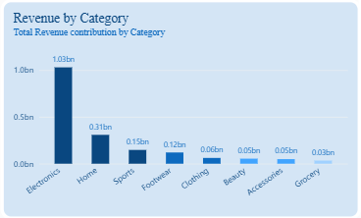
Revenue & Category Performance
Electronics generated approximately ₹1.03 billion, making it the largest revenue-generating category.
Home generated approximately ₹308.61 million, followed by Sports at ₹147.30 million.
Electronics had an Average Order Value of approximately ₹81,169, substantially higher than other categories.
All top 10 revenue-generating products belonged to the Electronics category.
ShopEasy | E-commerce Sales & Customer Analysis
7

Slide 8
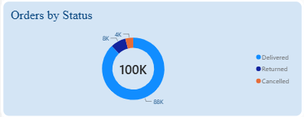
Orders, Returns & Cancellations
Overall, 12% of orders were returned or cancelled.
Beauty recorded the highest return rate at 8.19%.
Clothing recorded the highest cancellation rate at 4.24%.
Category-level differences were relatively small, so return and cancellation drivers should be investigated further.
ShopEasy | E-commerce Sales & Customer Analysis
8

Slide 9
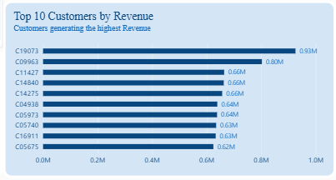
Customer Insights
Customer C19073 generated approximately ₹0.93 million from 6 orders, showing that high customer value can come from high transaction values rather than only high order frequency.
C04335 placed the highest number of orders at 18.
The top 10 customers each generated more than ₹0.62 million in revenue.
High-value customers can be targeted for retention and loyalty programs.
Frequent buyers can be analyzed to understand repeat-purchase behavior.
Customer revenue depends on both order frequency and transaction value.
ShopEasy | E-commerce Sales & Customer Analysis
9

Slide 10
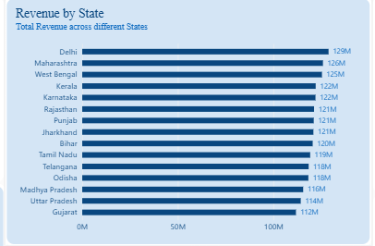
Geographic Insights
Delhi recorded the highest state-level revenue at approximately ₹128.77 million.
Lucknow recorded the highest city-level revenue at approximately ₹133.71 million.
Revenue was distributed across multiple states and cities rather than being concentrated in a single market.
Maharashtra and West Bengal were also among the top revenue-generating states.
Chennai and Ahmedabad followed Lucknow among the top cities.
Regional performance can support better marketing and inventory planning.
ShopEasy | E-commerce Sales & Customer Analysis

Slide 11
Power BI Dashboard
KPI cards: Revenue, Orders, Quantity, AOV, Return Rate, Cancellation Rate and Average Discount.
Monthly Revenue line chart.
Revenue by Category and Revenue by State.
Orders by Status.
Top 10 Customers and Top 10 Products by Revenue.
Interactive slicers for Order Date, Category and Status.
Dashboard figures were validated against the SQL analysis.
POWER BI
KPIs
Revenue Trends
Category Analysis
Customer & Product Analysis
Geographic Analysis
Interactive Slicers
ShopEasy | E-commerce Sales & Customer Analysis
10

Slide 12
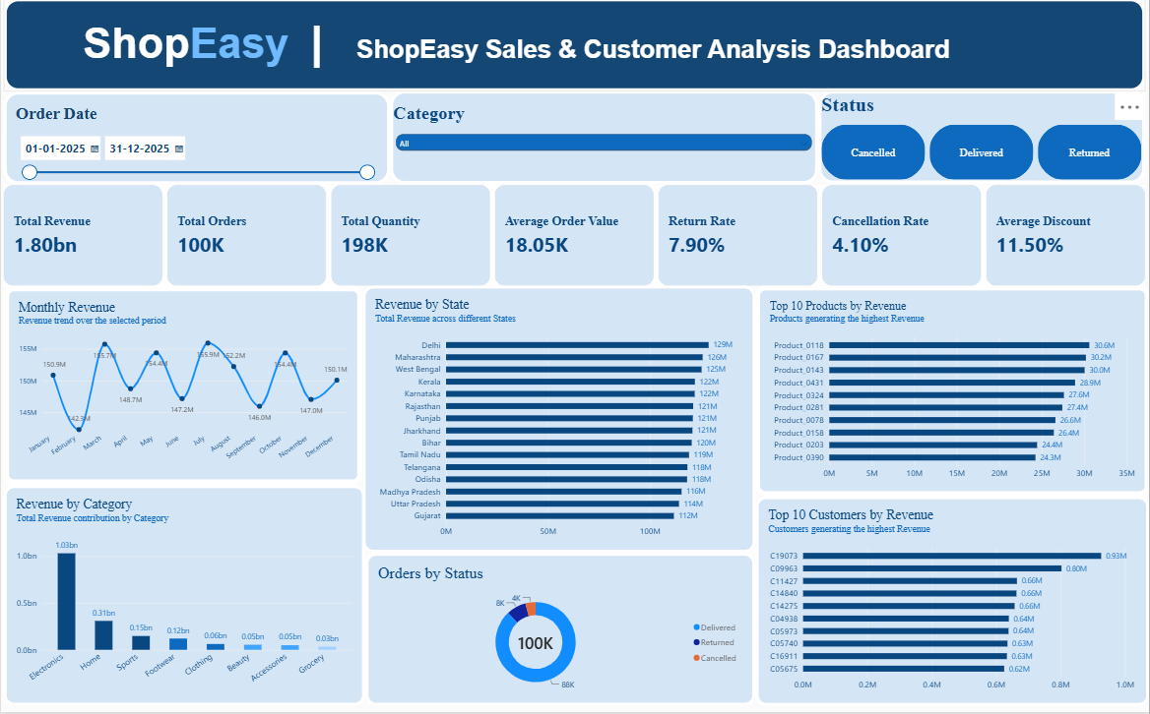

Slide 13
Business Insights
1
Electronics was the primary revenue driver, supported by its much higher AOV.
2
Monthly revenue remained relatively stable, with July highest at ₹155.91 million and February lowest at ₹142.28 million.
3
88% of orders were delivered successfully; returns and cancellations accounted for 12%.
4
High-revenue products were concentrated in Electronics, while high-order-frequency products were spread across categories.
5
Revenue was geographically diversified across several states and cities.
6
Customer revenue depended on both purchase frequency and transaction value.
ShopEasy | E-commerce Sales & Customer Analysis
11

Slide 14
Recommendations
1
Investigate Electronics performance
Analyze pricing, product mix, and customer demand within Electronics to understand the factors contributing to its high revenue and AOV.
2
Reduce product returns
Investigate the reasons behind the higher return rate in Beauty and identify potential issues related to product expectations, descriptions, quality, or delivery.
3
Investigate cancellations
Review cancellation patterns in Clothing and examine factors such as inventory availability, delivery timelines, pricing, and customer ordering behavior.
4
Focus on high-value customers
Analyze the characteristics and purchasing patterns of high-revenue customers and consider targeted retention or loyalty initiatives.
5
Monitor high-demand products
Track products with high order frequency to support inventory planning and compare their order volume with their actual revenue contribution.
6
Use geographic performance for planning
Regional sales patterns can support decisions related to inventory allocation, marketing activities, and logistics planning.
7
Monitor returns and cancellations regularly
Use the Power BI dashboard to track changes in return and cancellation rates by category, product, location, and customer segment.
ShopEasy | E-commerce Sales & Customer Analysis
12

Slide 15
Project Conclusion
The project demonstrates an end-to-end analytics workflow using Python, SQL, Power BI and Excel. Raw e-commerce data was cleaned, analyzed and transformed into an interactive dashboard that highlights revenue, customer, product, order and geographic performance. ShopEasy generated approximately ₹1.80 billion in revenue from 99,995 valid orders during 2025. Electronics was the primary revenue driver, contributing approximately ₹1.03 billion and showing a significantly higher Average Order Value than other categories. Overall delivery performance was 88%, while returns and cancellations accounted for 12% of orders. Beauty recorded the highest return rate and Clothing the highest cancellation rate, providing areas for further operational investigation. The analysis also identified high-value customers, high-performing products, and geographically important markets. Based on these findings, ShopEasy should investigate the drivers of Electronics' performance, reduce avoidable returns and cancellations, strengthen high-value customer retention, improve inventory planning, and use geographic performance to support marketing and logistics decisions.
Data cleaning
Analysis
Visualization
KPIs
Python
SQL
Power BI
DAX
Data cleaning
Analysis
Visualization
KPIs

