Slide 1




learning management system
Rupasri D
22EC128

Slide 2



introduction
Introducing our MERN-based Learning Management System (LMS), a cutting-edge platform designed to meet the demands of modern learners in a virtual environment.
Leveraging MongoDB, Express.js, React.js, and Node.js, our LMS offers seamless course management, interactive learning tools, and robust user authentication.
With a focus on scalability, performance, and user experience, our platform empowers educators and learners to thrive in the digital age.

Slide 3
existing solution
Existing methods of learning platforms include traditional classroom-based education, online courses offered by universities and institutions, Massive Open Online Courses (MOOCs) provided by platforms like Coursera and edX, and specialized learning platforms focusing on specific skills like coding (e.g., Codecademy) or language learning (e.g., Duolingo).
These platforms often offer a combination of video lectures, interactive quizzes, assignments, and discussion forums to facilitate learning at the learner's own pace and convenience.

Slide 4
Proposed System
Our platform provides personalized guidance for each course, allowing students to access dedicated guides for detailed assistance.
If students encounter doubts or questions, they can schedule dedicated time slots with instructors to clarify concepts and deepen their understanding.
This personalized approach fosters a supportive learning environment where students can receive tailored assistance and guidance to overcome challenges effectively.

Slide 5
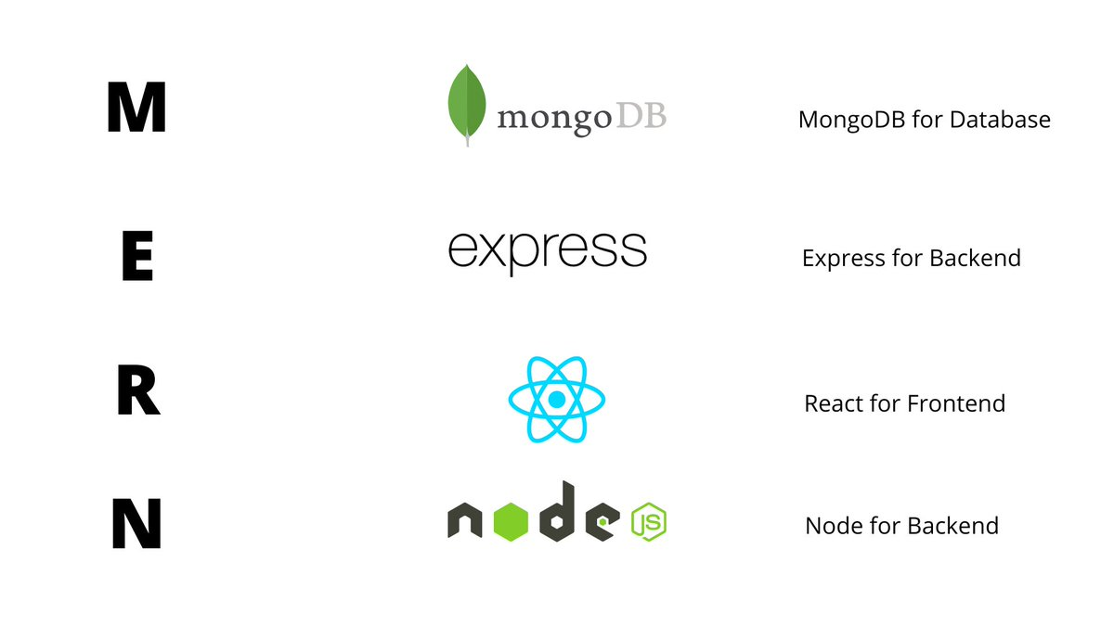
Software Requirements

Slide 6
Course Overview and Learning Objectives
Course Overview: Each course should include a detailed overview outlining the topics covered, learning objectives, and expected outcomes. This provides students with a clear understanding of what they will learn and achieve by the end of the course.
Learning Objectives: Break down the course content into specific learning objectives or milestones. This helps students track their progress and understand the purpose of each module or lesson within the course.

Slide 7
Content Management Module
Uploading and organizing course content (text, images, videos, documents).
Content version control and history tracking.
Content categorization and tagging for easy navigation.
Integration with external content repositories (e.g., Open Educational Resources).

Slide 8
Progress Tracking and Reporting Module:
Tracking of user progress within courses (completion status, grades, etc.).
Generation of progress reports for administrators, instructors, and students.
Analytics dashboard for monitoring course engagement, completion rates, etc.
Customizable reports for compliance and accreditation purposes.

Slide 9
MODULE OVERVIEW
The Course Management module focuses on the efficient organization, delivery, and support of courses within a Learning Management System (LMS).
Participants will learn the intricacies of designing course structures, providing comprehensive overviews, outlining future outcomes, and facilitating instructor-student interactions to enhance the learning experience across various domains.
Through practical demonstrations, case studies, and collaborative exercises, learners will gain the skills necessary to create engaging course content, foster active participation, and ensure learner success.

Slide 10
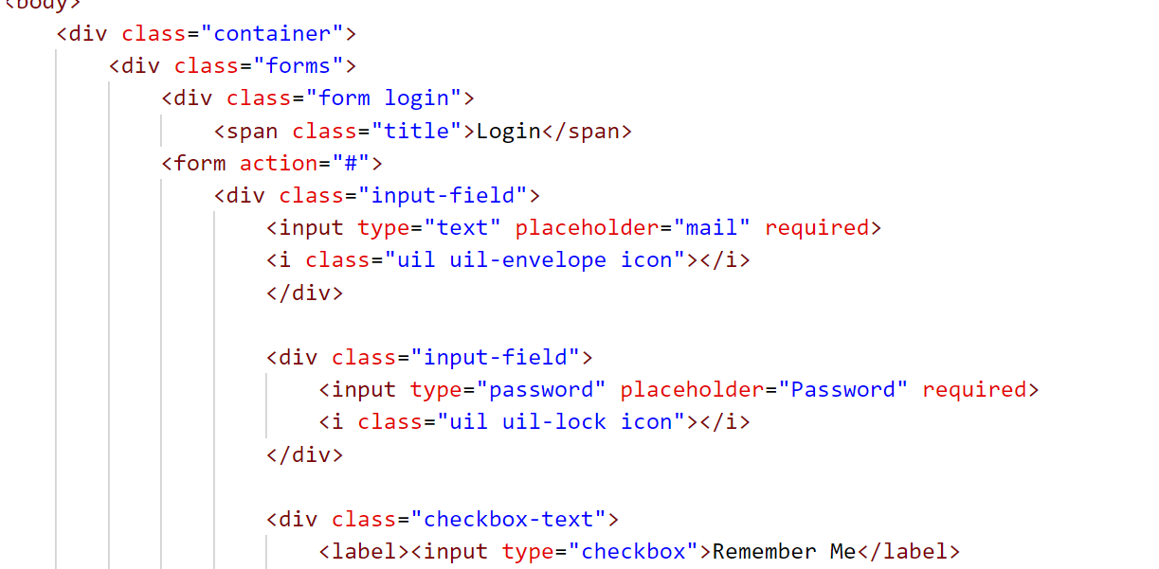
SAMPLE CODE

Slide 11
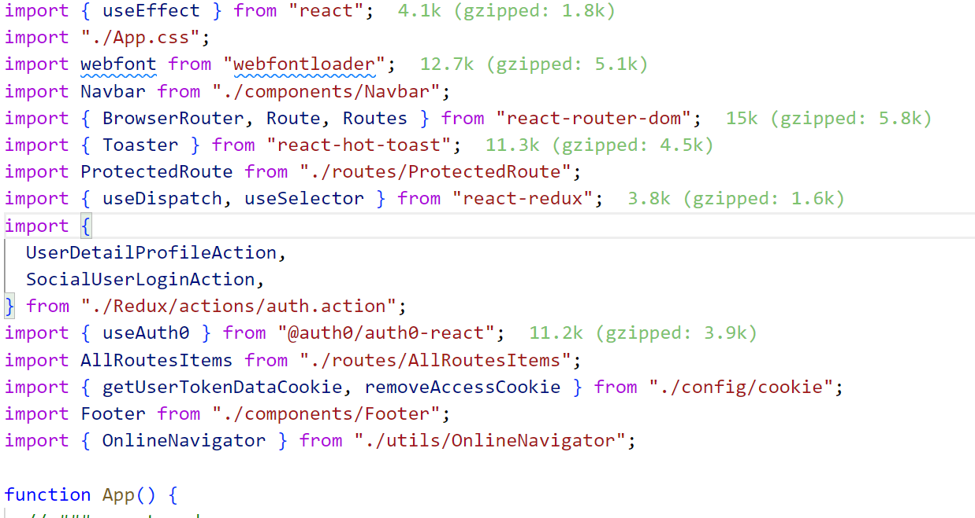
SAMPLE CODE

Slide 12
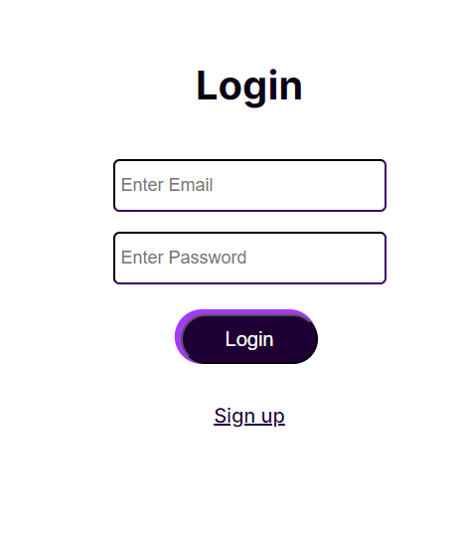
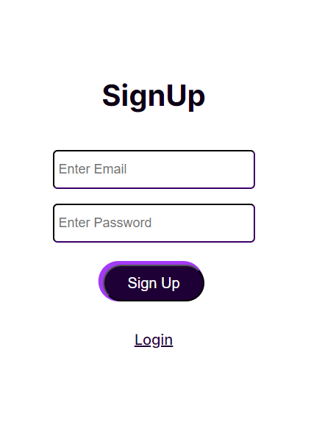
Sample Output

Slide 13

Sample output

Slide 14
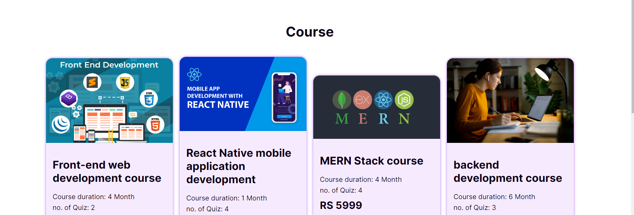
Sample Output

Slide 15
Future scope
Enhanced Personalization: Future LMS platforms will utilize advanced AI algorithms to deliver personalized learning experiences tailored to each student's preferences, abilities, and learning pace.
Blockchain Credentials: LMS will adopt blockchain technology to securely store and manage digital credentials, certifications, and academic records, providing a tamper-proof and universally recognized system for verifying achievements.

Slide 16
Conclusion
In conclusion, a robust Learning Management System (LMS) that enables students to readily clarify doubts and gain insights into project scopes fosters a dynamic learning environment.
By offering seamless avenues for interaction with instructors and peers, coupled with comprehensive project briefs and guidelines, students are empowered to navigate challenges with confidence and pursue their academic and professional aspirations effectively.
Such a system not only enhances student engagement and comprehension but also cultivates a culture of collaboration, critical thinking, and innovation essential for success in the digital age.

Slide 17


Thank
You

