Slide 1
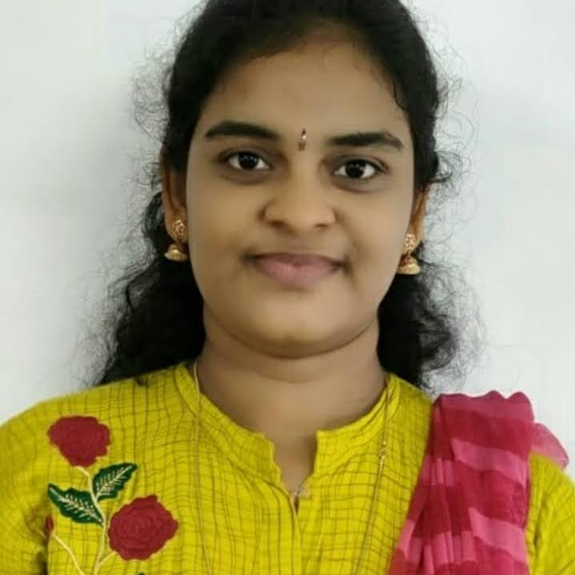



Rupasri Namburi
Analyst/Software Engineer
Bachelor of Technology
Information Technology : 2017 -2021
Skills
Java 8 /J2EE | Java Basics, OOPS, Generics, Collections, Arrays, Loops, Lambda Exp, Stream API Junit, Mockito, Servlets
Spring core | IOC & Dependency Injection, Autowire
Spring REST | REST controllers, Implementation of GET, POST, PUT & DELETE, Bean Validation & Exception Handling, Testing Services, Controller & Repository layer
Spring Data JPA | Implement DAO layer using spring Data repositories, Transaction Management
Spring Boot Microservices | Spring Boot Starters, annotations, Messaging Service, Sync/Async comms, Swagger API documents
Spring Cloud | Eureka, Netflix Ribbon, Feign Client, Netflix Hystrix, Netflix Zuul & Config Server
React | Components, Hooks, Event handling, Redux, Reducers, Testing using Jasmin & Karma
Database | MongoDB no Sql Basics My SQL RDS Basics
UI Tech | HTML 5& CSS 35,JavaScript, ES6 & TypeScript Reusable templates, Optimized UI Designed
Tools | Git, Postman, Maven, IDE
Devops | CI/ CD, Jenkins configuration, Build Pipelines, notifications, quality gate understanding
Add On Skills | Communication, Team management, peer learning
Hyderabad
RUPASRI.NAMBURI@capgemini.com
+91 7780289508
A4
Full Stack Developer
Hands on experience in creating microservices with Springboot, Spring Security, Spring Cloud API Gateway, Eureka server, load balancing.
Proficient in creating Single page Web Application in React with Authentication with route guards, Redux reactive forms, react routing, CSS.
Experience in working with swagger and in Unit testing using Junit, Mockito .
About:
Passionate Software Engineer eager to learn and implementing new technologies to improve my knowledge. I’m curious to work with a team and paly a role in improving and developing the project.
Deals and Coupons Finder Application
Completed end to end case study of Deals and Coupons Finder Application along with Swagger, responsive UI with CSS and React used for user interface.
Java Microservice Development knowledge using Spring Boot and spring cloud framework on an intermediate level.
Check out my work on GitHub & Video Profile

