Slide 1
Design patterns
- Shridhar Hegde
Contents in the presentation are referred from - http://www.baeldung.com/creational-design-patterns

Slide 2

What is Design Pattern ?
Design patterns are solutions to general problems that software developers face during software development
All these design patterns were obtained by trial and error by large number of developers over a long span of time.
These design patterns suggest the best practices to be followed by a software developer for extensive scalability and functionality.

Slide 3

Do you know him ?
You don’t ?
Unfortunately, even I don’t know !

Slide 4




These 4 scientist published a book in 1994 named:
Design Patterns – Elements of Object Oriented Software
Erich Gamma
Richard Helms
GOF
Gang
Of
Four
Ralph Johnson
John Vlissides

Slide 5
Classifications of Design Pattern
As per the design pattern reference book Design Patterns - Elements of Reusable Object-Oriented Software , there are 23 design patterns which can be classified in three categories
Creational Pattern
Structural Pattern
Behavioral Pattern
In this presentation, we will be discussing only about Creational Patterns.

Slide 6

Creational Patterns
Creational Design Patterns are concerned with the way in which objects are created.
They reduce complexities and instability by creating objects in a controlled manner.
Some of the important types of Creational Patterns are:
Singleton – Ensures that at most only one instance of an object exists throughout application
Factory Method – Creates objects of several related classes without specifying the exact object to be created
Abstract Factory – Creates families of related dependent objects
Builder – Constructs complex objects using step-by-step approach

Slide 7

Singleton Design Pattern
The Singleton Design Pattern aims to keep a check on initialization of objects of a particular class by ensuring that only one instance of the object exists throughout the code.
A Singleton class also provides one unique global access point to the object so that each subsequent call to the access point returns only that particular object.
Let us see an example of how the singleton design pattern is implemented in Java.

Slide 8

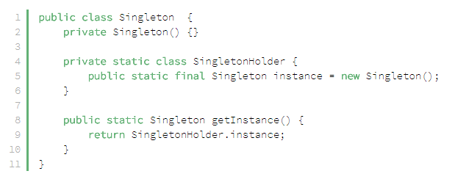
Singleton Design Pattern Contd..
Image showing the Java code to ensure Single Object for a method.

Slide 9

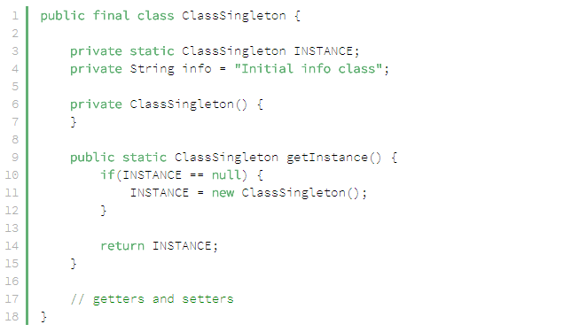
Singleton Design Pattern Contd..
This is the original DoF implementation which is more complex and causes problems while
Multi-threading.

Slide 10

Factory Method Design Pattern
According to GoF, this pattern “defines an interface for creating an object, but let subclasses decide which class to instantiate.
This pattern delegates the responsibility of initializing a class from the client to a particular factory class by creating a type of virtual constructor.
To achieve this, we rely on a factory which provides us with the objects, hiding the actual implementation details. The created objects are accessed using a common interface.

Slide 11


Factory Method Design Pattern Contd..
Let us create a Polygon Interface
Then, we are going to create a PolygonFactory class that uses the above interface to create object of the class that the user needs.

Slide 12
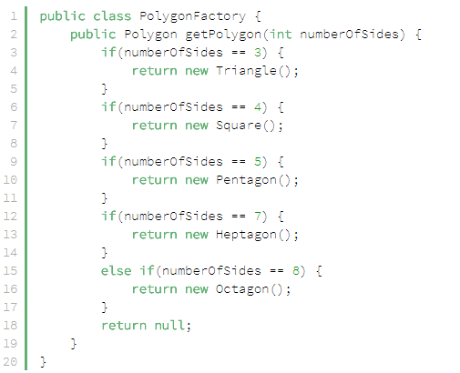

Factory Method Design Pattern Contd..
The above code depicts the PolygonFactory class deciding to return an object
that the user needs depending on the interface that was declared earlier.

Slide 13

Abstract Factory Method Design Pattern
In the previous section, we saw how the Factory Method design pattern could be used to create objects related to a single family.
By contrast, the Abstract Factory Design Pattern is used to create families of related or dependent objects. It’s also sometimes called a factory of factories.
The GoF definition states that an Abstract Factory “provides an interface for creating families of related or dependent objects without specifying their concrete classes”.

Slide 14
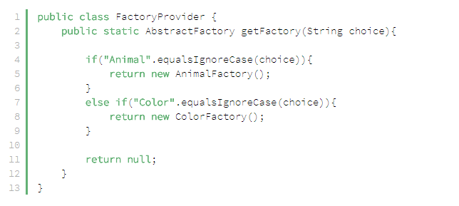

Abstract Factory Method Design Pattern Contd..
To deal with an example, here is a FactoryProvider which gives us either object of Animal or Color class depending on the user choice

Slide 15
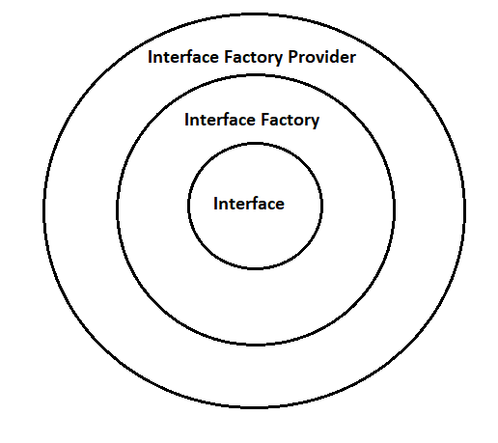

Abstract Factory Method Design Pattern Contd..

Slide 16

Builder Design Pattern
The Builder Design Pattern is another creational pattern designed to deal with the construction of comparatively complex objects.
When the complexity of creating object increases, the Builder pattern can separate out the instantiation process by using another object (a builder) to construct the object..
This builder can then be used to create many other similar representations
using a simple step-by-step approach.

Slide 17

Builder Design Pattern Contd..
The original Builder Design Pattern introduced by GoF focuses on abstraction and is very good when dealing with complex objects, however, the design is a little complicated.
Joshua Bloch, in his book Effective Java, introduced an improved version of the builder pattern which is very easy to understand and hence we will be using that version of Builder Design Pattern implementation.

Slide 18

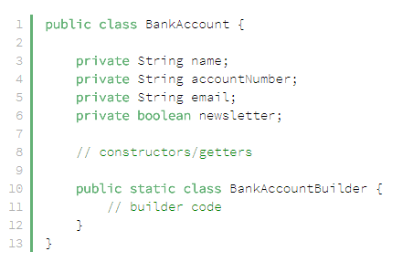
Builder Design Pattern Contd..
In the current implementation, we will discuss an object of BankAccount class can be created using a Builder Class.
The above code shows the class BankAccount having some private data fields and a static class
BankAccountBuiler that is embedded inside it for assisting in creating object.

Slide 19

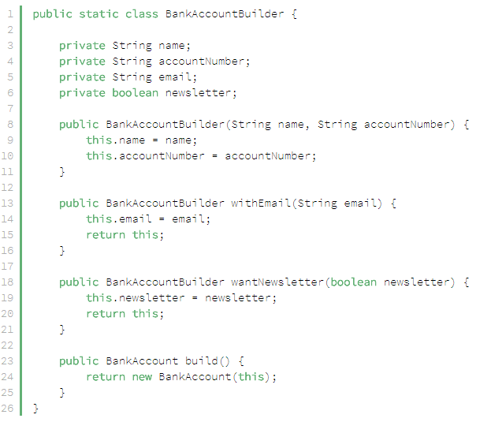
Builder Design Pattern Contd..
The above code shows how the BankAccountBuilder class is used to create objects.

Slide 20

Builder Design Pattern Contd..
In order to create object for the class BankAccount using the BankAccountBuilder class, the Java syntax to do so is:
BankAccount newAccount = new BankAccount
. BankAccountBuilder (“Shridhar”, “100269”)
. withEmail (“manushya.mruga@gmail.com”)
. wantNewsLetter (false)
. build( );

Slide 21


Summary
Design patterns are solutions to general problems that software developers face during software development.
These design patterns suggest the best practices to be followed by a software developer for extensive scalability and functionality.
Design Patterns can be mainly classified into 3 types as:
Creational Pattern
Structural Pattern
Behavioral Pattern

Slide 22

Summary Contd..
The 4 main types of Creation Design Patterns are:
Singleton – Ensures that at most only one instance of an object exists throughout application
Factory Method – Creates objects of several related classes without specifying the exact object to be created
Abstract Factory – Creates families of related dependent objects
Builder – Constructs complex objects using step-by-step approach

Slide 23


