Slide 1
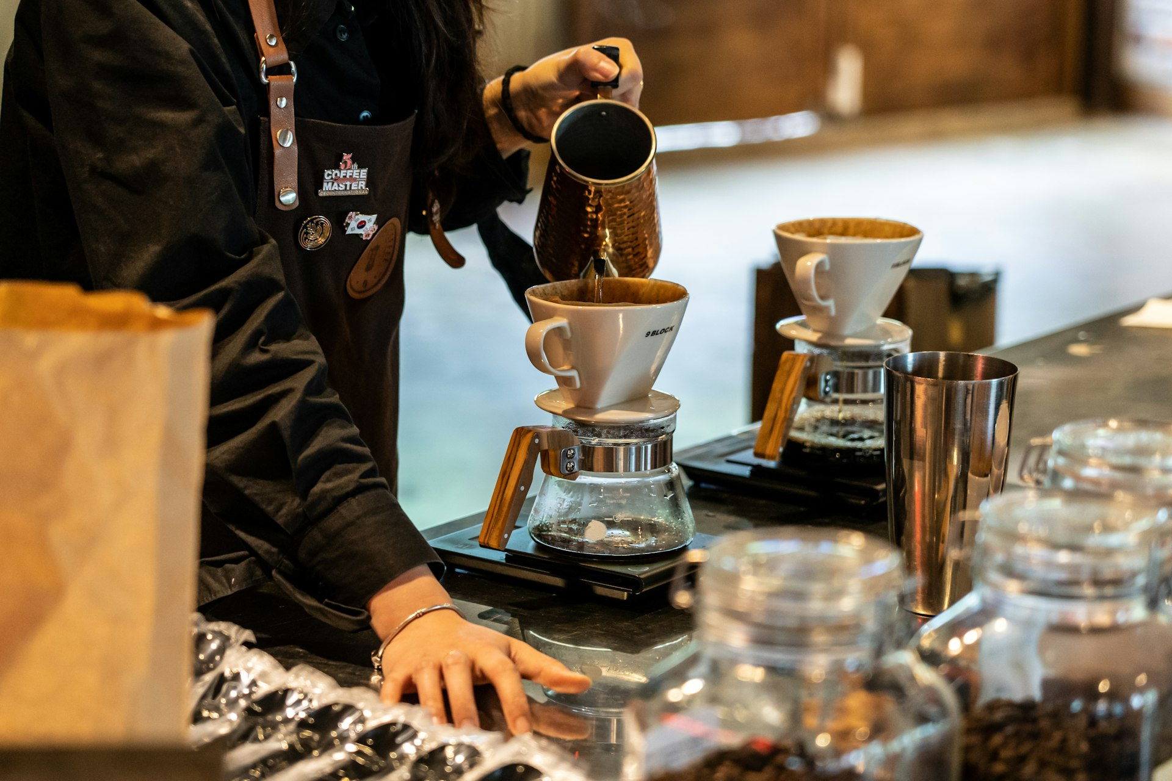


Aroma Coffee Roasters: Elevating Local Coffee Culture
Investment opportunity in a premium small-batch coffee roastery
Notes:
Welcome everyone. Today we are excited to share the growth story of Aroma Coffee Roasters and present a unique investment opportunity to expand our local footprint. As a dedicated small-batch roastery, we have built a loyal community around exceptional specialty coffee.

Slide 2
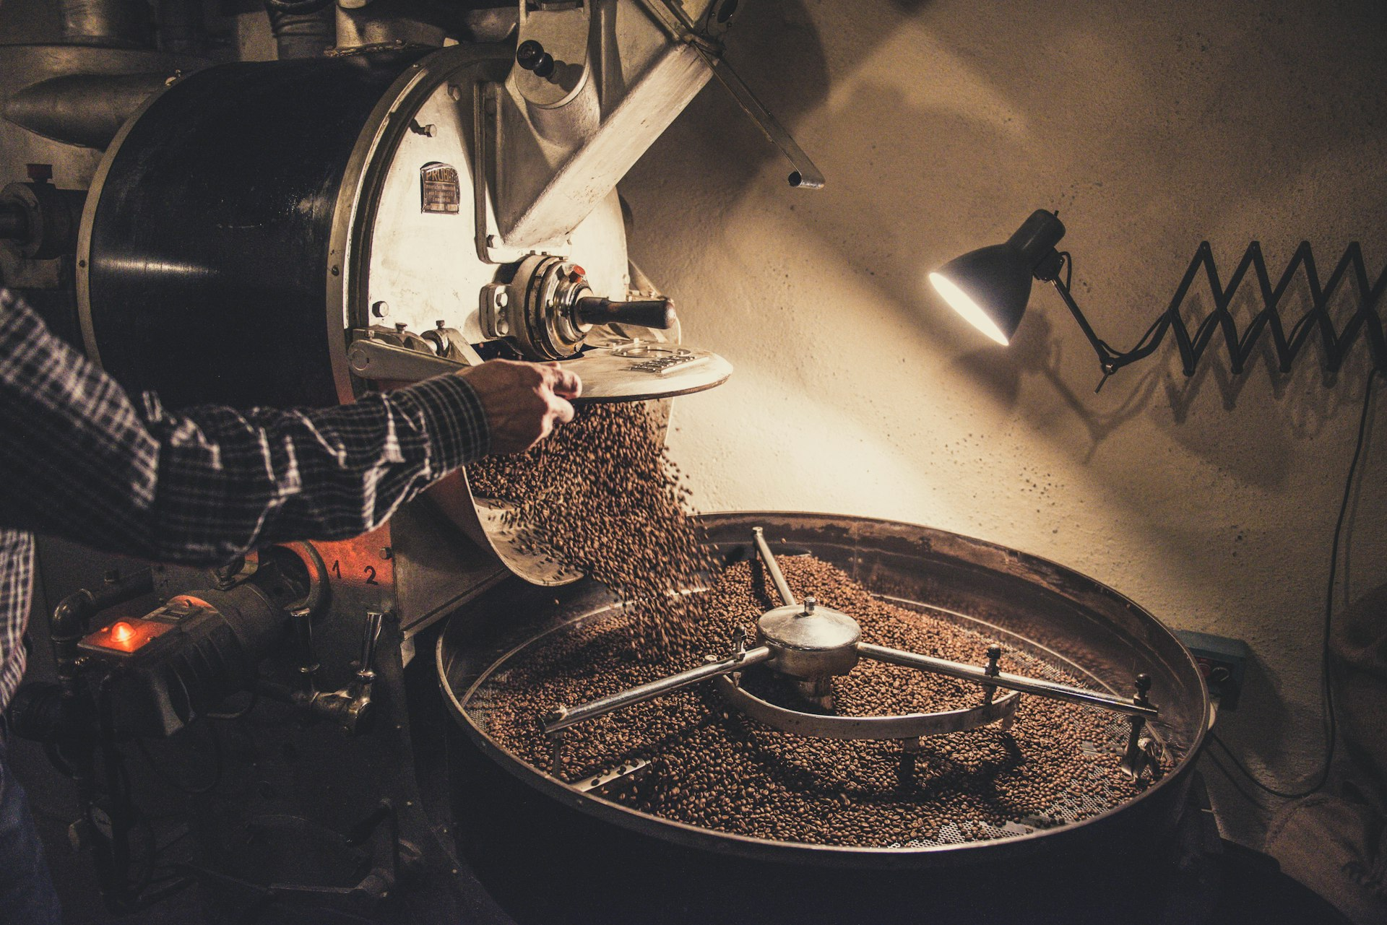
Our Business Model: Craft Roasting and 4 Retail Outlets
Small-batch coffee roasting focus ensures maximum quality and distinct flavor profiles
Currently operates 4 successful retail stores across the local region
Dual revenue streams from direct store sales and packaged bean retail
Notes:
Our business rests on a proven foundation. By controlling the roasting process in small batches, we maintain strict quality control while supplying our four existing retail stores. This craft approach creates high customer loyalty and strong store performance.

Slide 3
Growth Strategy: Expanding Store Footprint and Wholesale
Phase 1
Phase 2
Phase 3
Store Optimization
Retail Expansion
Wholesale Scaling
Optimize operations across existing 4 stores
Deepen local community engagement and loyalty
Identify high-footfall sites in adjacent neighborhoods
Open new retail store locations
Target local offices, restaurants, and grocers
Build recurring wholesale revenue channels
Notes:
Our growth plan is structured into three distinct phases. We will first maximize the potential of our existing four locations, then expand into strategic nearby retail markets, and finally scale our wholesale supply to local business partners.

Slide 4
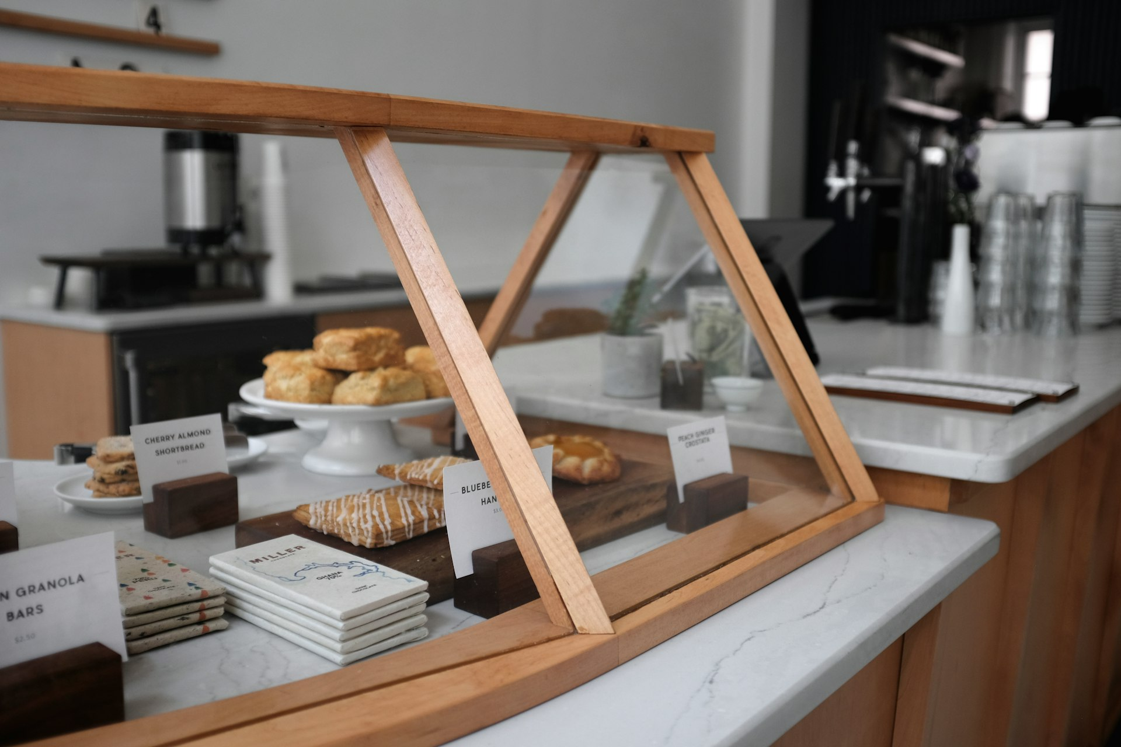
Financial Overview: Solid Foundation Across 4 Locations
Strong store-level profitability maintained across all 4 operating locations
High gross margins sustained through in-house craft roasting operations
Consistent customer retention supported by growing average transaction value
Notes:
Financially, our model has proven highly effective across our current footprint. Roasting our own beans grants us favorable unit economics and high gross margins across all four outlets, providing a resilient platform for scalable future growth.

Slide 5
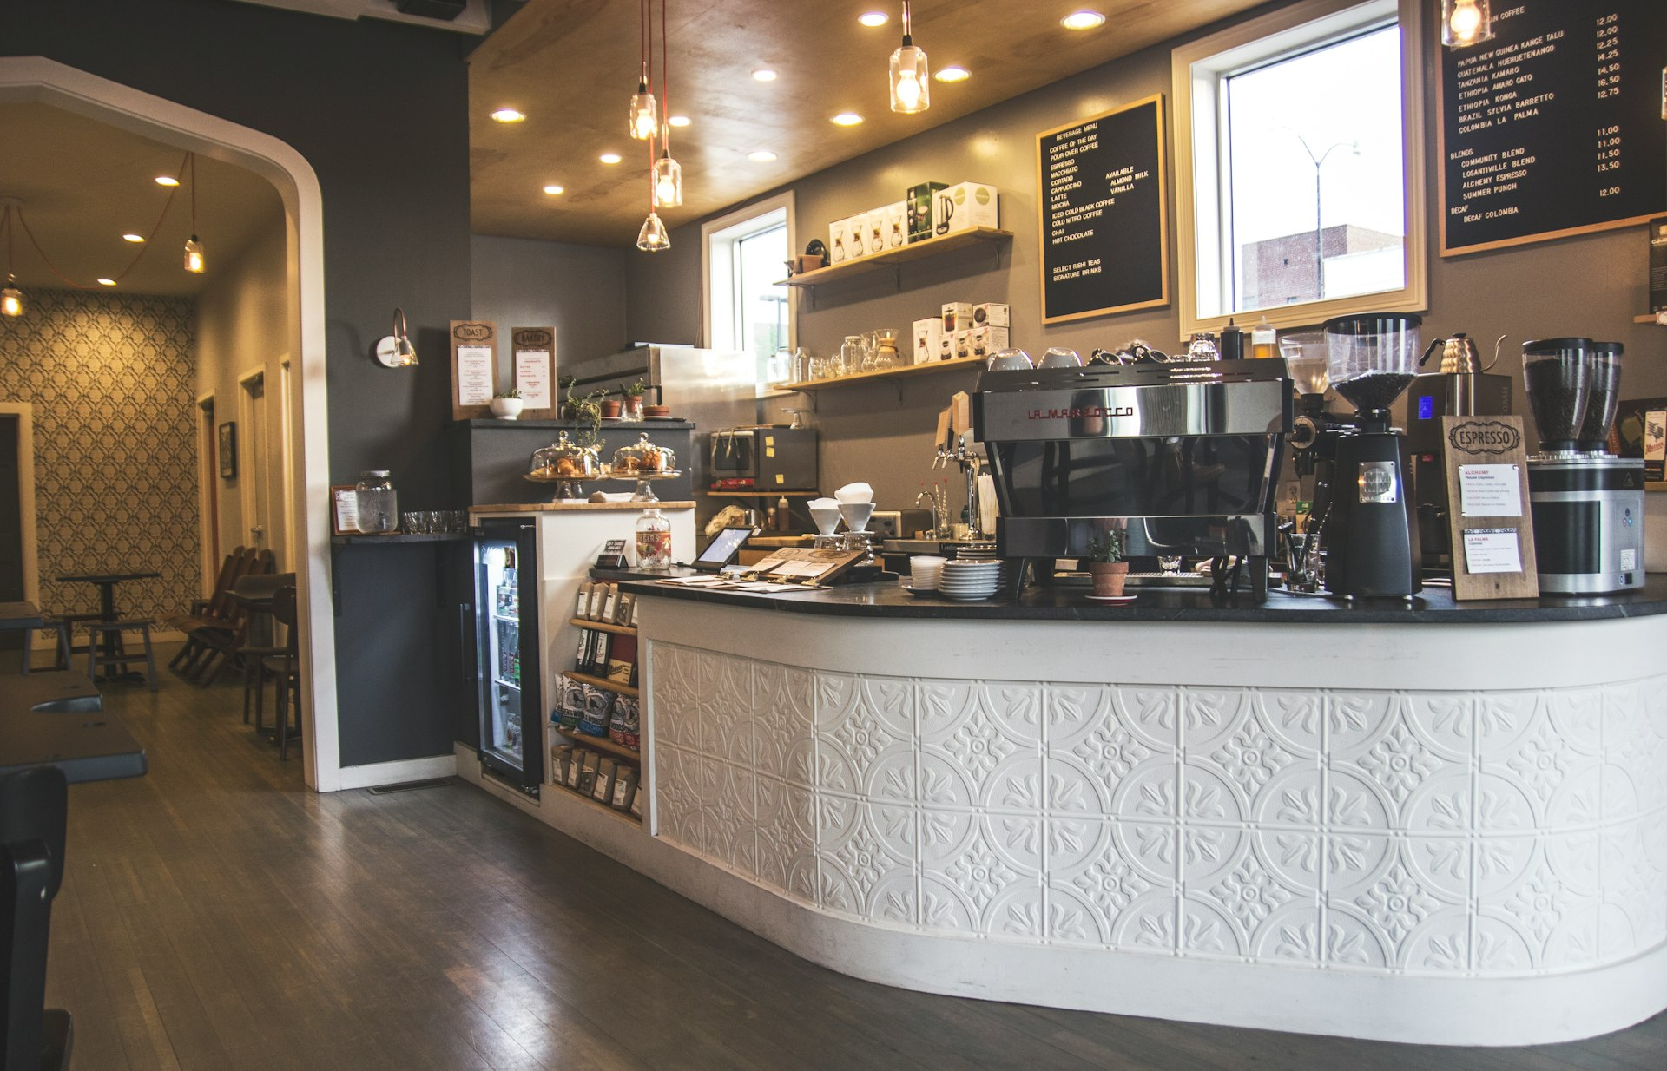
The Ask: Partnering with Local Investors for Next-Stage Growth
Join us in scaling Aroma Coffee Roasters from 4 thriving stores into the region's leading specialty coffee brand.
Notes:
We are seeking strategic local investor capital to fund our next batch of store openings and expand our small-batch roastery capacity. With four proven locations already operating successfully, your partnership will help us scale a beloved regional brand while sharing in our growth. Please reach out to our team today to review our detailed financial package and discuss equity partnership terms.

