Slide 1
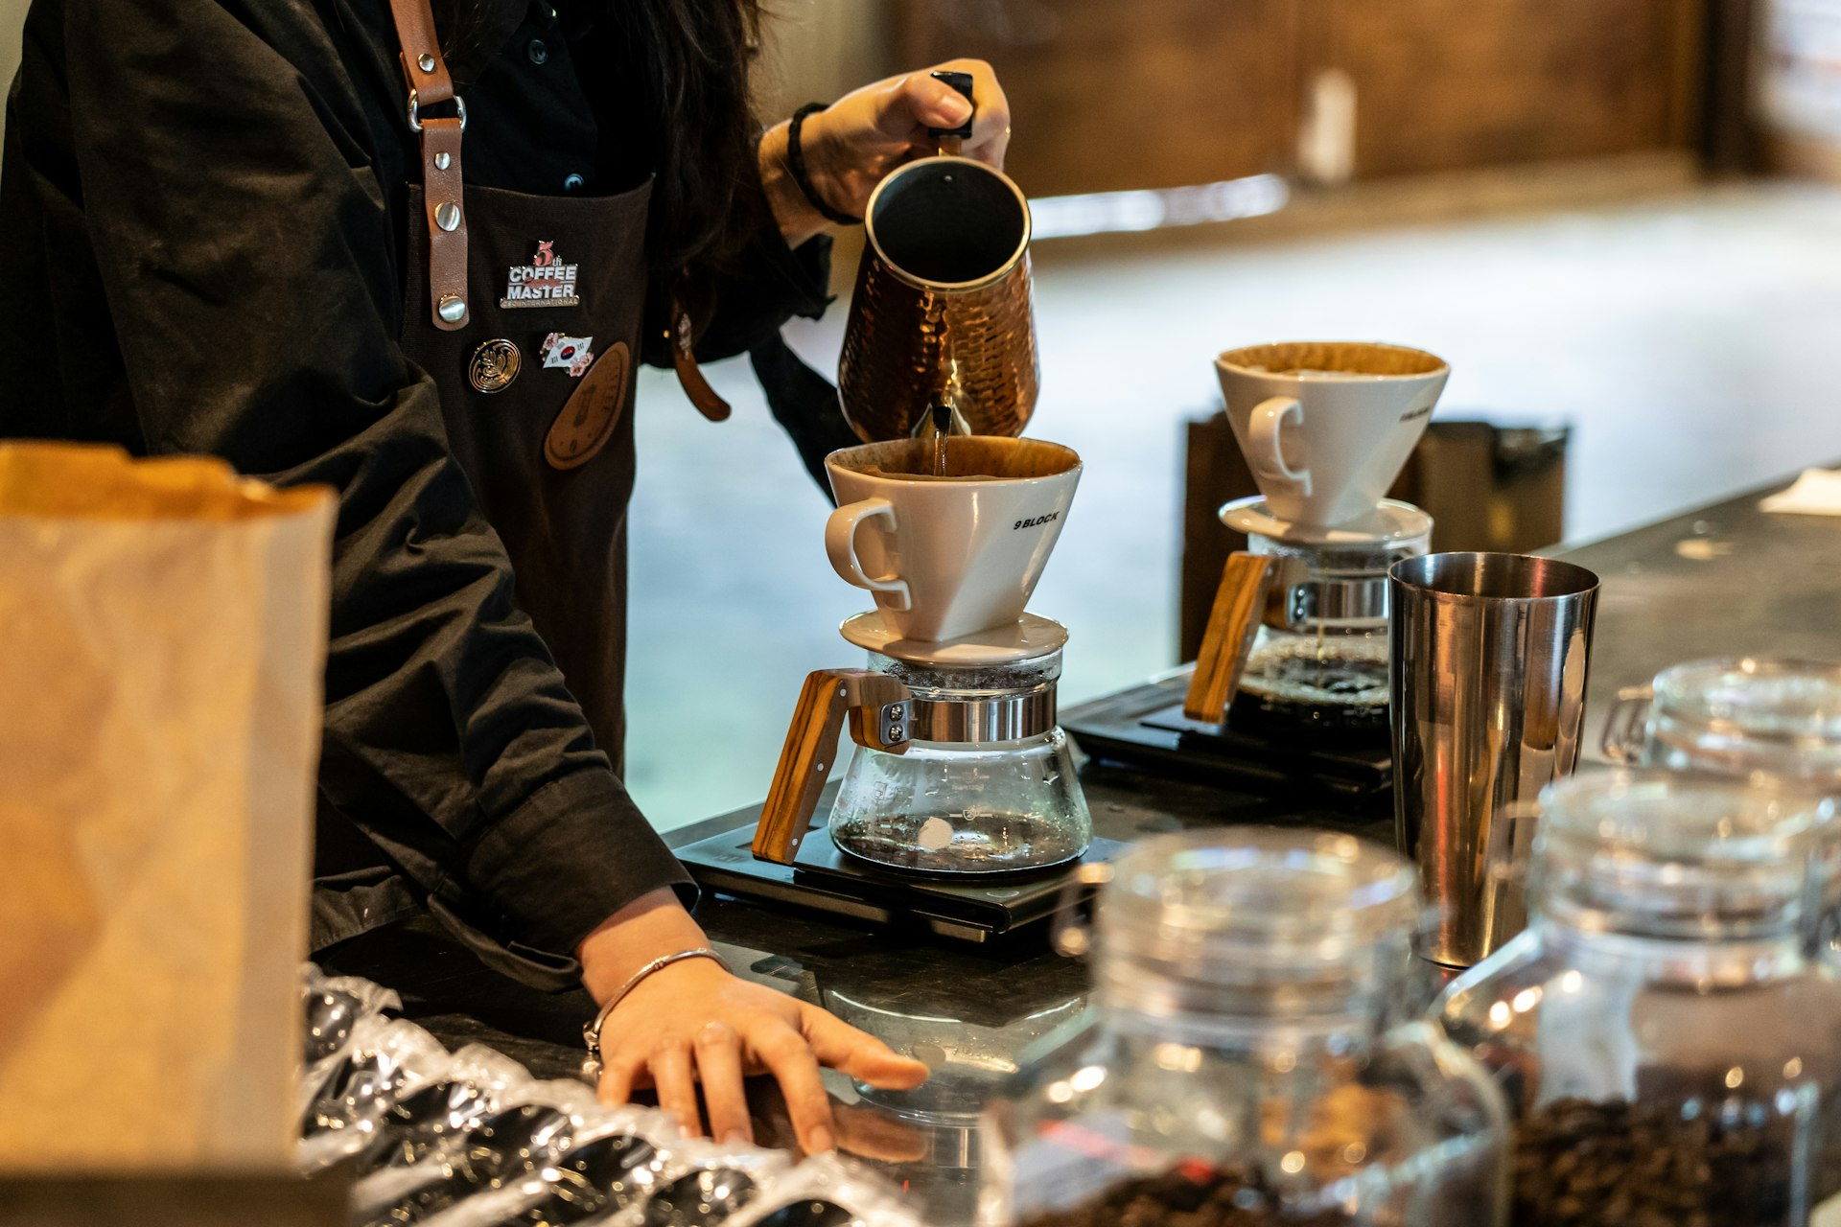


Aroma Coffee Roasters: Elevating Local Small-Batch Coffee
Investment opportunity in a growing specialty coffee brand with 4 established locations
Notes:
Welcome investors. Today we are excited to introduce Aroma Coffee Roasters, a specialty small-batch coffee roastery currently operating four successful stores in our community, and outline our next phase of growth.

Slide 2
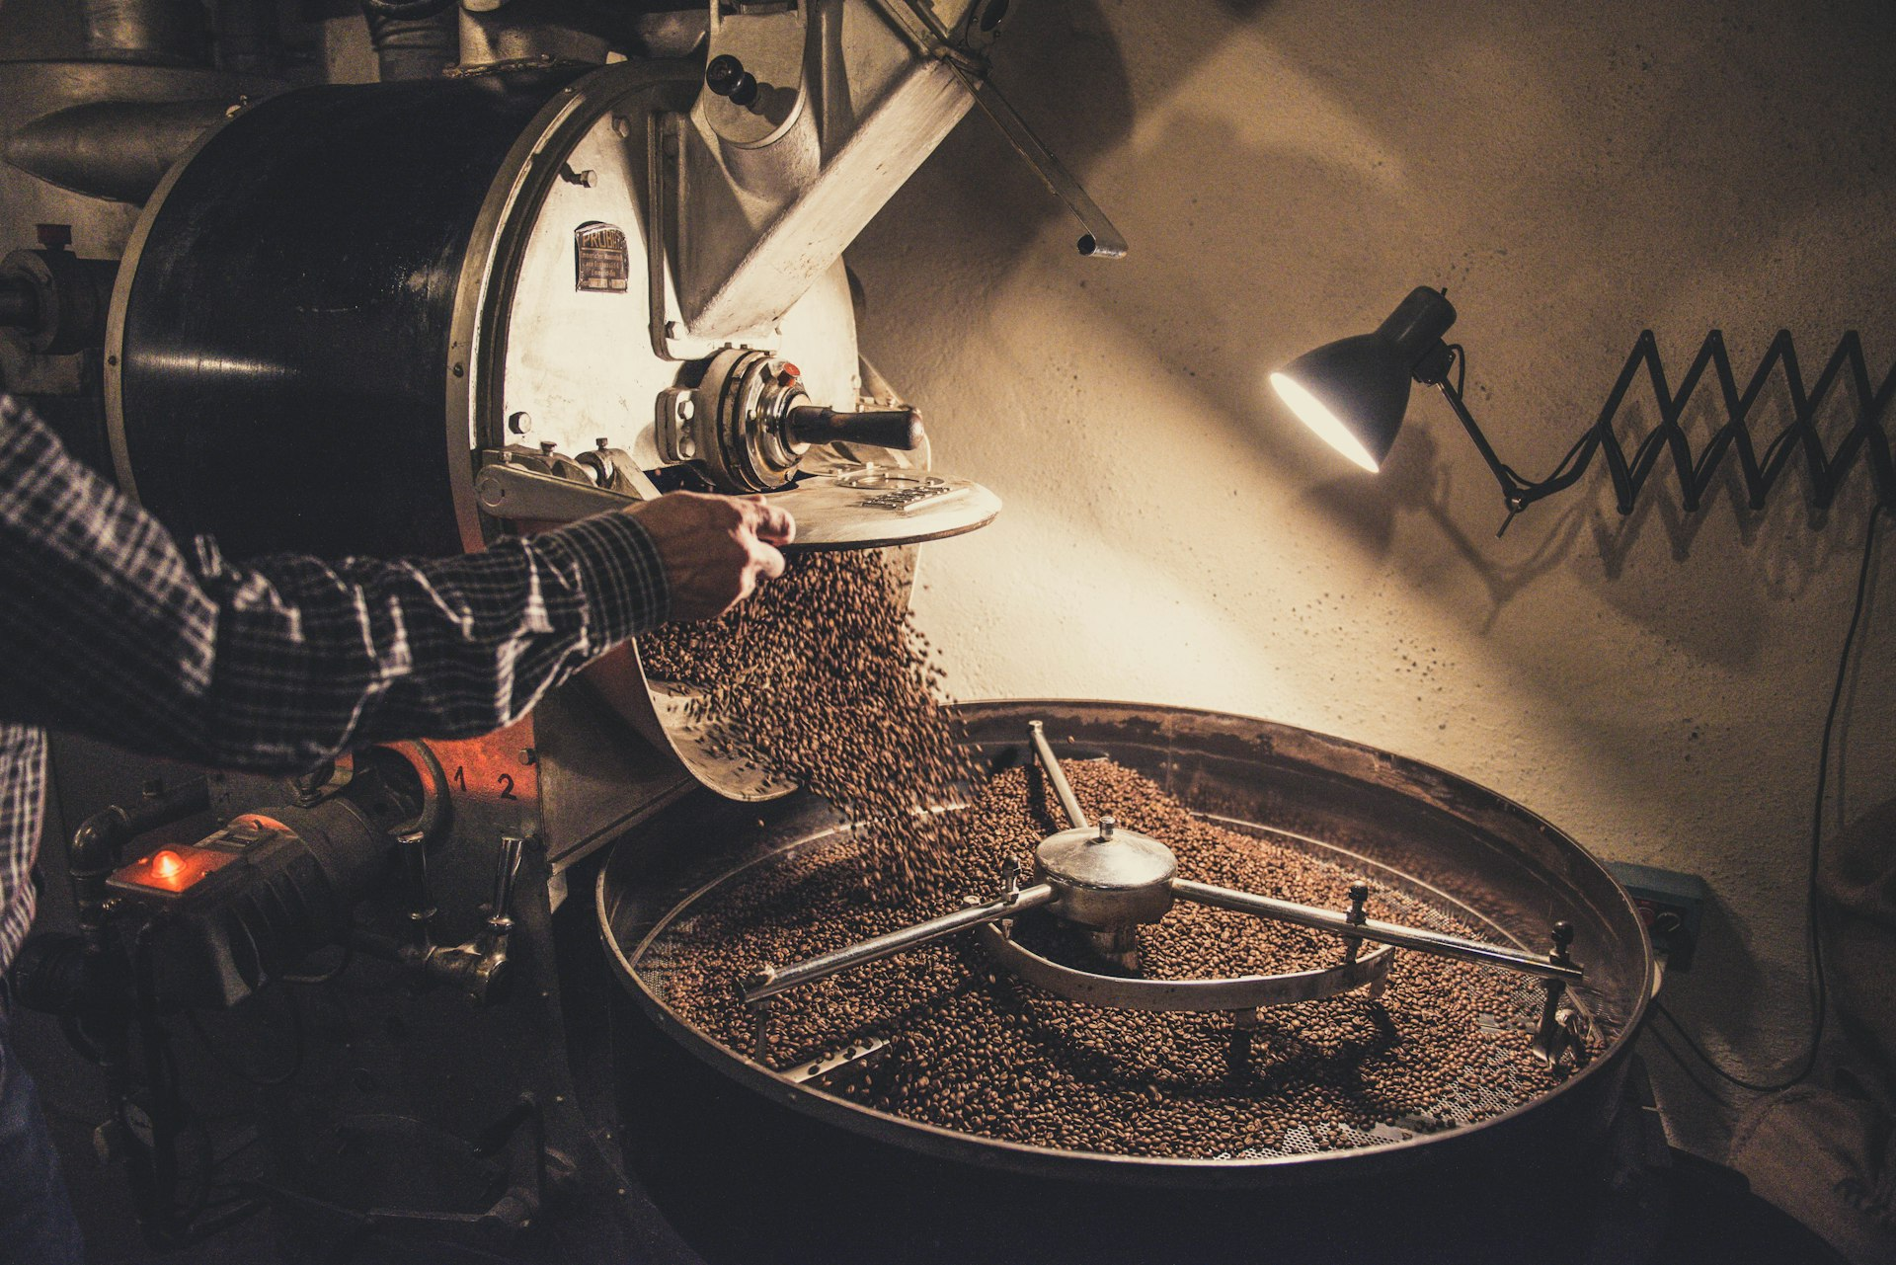
Our Proven Business Model & Operations
In-house small-batch roasting delivers artisanal quality while capturing higher profit margins.
Direct retail store sales across our 4 operating locations generate predictable daily cash flow.
Complementary wholesale bean distribution supplies local cafes and corporate offices.
Integrated operations maintain strict quality control from green bean sourcing to the final cup.
Notes:
Our business model relies on centralizing our small-batch roasting. By roasting in-house, we secure superior profit margins and serve both our four retail locations and a growing list of wholesale partners.

Slide 3
Current Market Presence & Community Footprint
01
Established footprint operating 4 strategically positioned stores across high-density local districts.
02
Strong brand equity built on dedicated craft coffee preparation and active community engagement.
03
Consistent customer foot traffic driven by recurring morning routines and strong brand loyalty.
04
Proven store-level economics that demonstrate demand for specialty small-batch roasting.
Notes:
We have successfully scaled to four thriving locations in high-traffic neighborhoods. Our community-first approach has earned us a highly loyal customer base that drives repeat daily foot traffic.

Slide 4
Phased Growth Strategy
Phase 1
Phase 2
Phase 3
Optimize & Scale Existing Operations
Expand Retail Footprint
Amplify Wholesale & Digital
Maximize roasting capacity at current facilities
Drive higher throughput across existing 4 stores
Target high-density neighborhood retail sites
Launch next wave of community-focused cafes
Expand regional wholesale cafe distribution
Scale direct-to-consumer online bean subscriptions
Notes:
Our expansion roadmap focuses on three clear phases: maximizing throughput across our four existing stores, opening new neighborhood retail footprint, and scaling our wholesale and digital subscription channels.

Slide 5
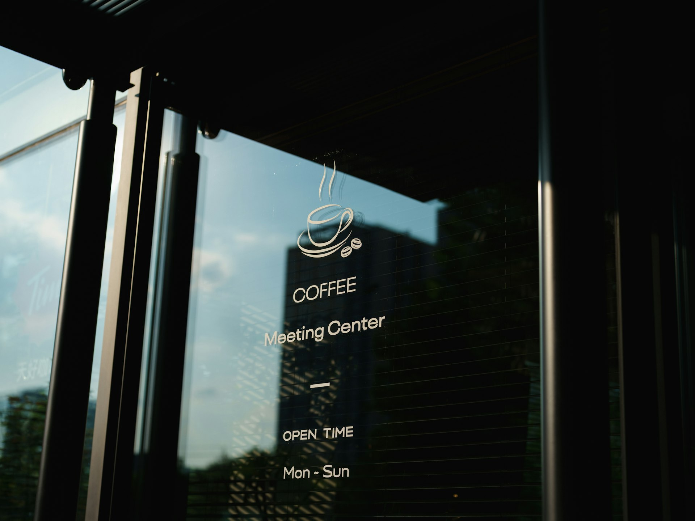
Partnering for Next-Stage Growth
Join us in scaling Aroma Coffee Roasters across the region
Notes:
We are seeking local investment capital to fund our next phase of growth. With four successful stores already operating, this is an opportunity to partner with an established craft brand as we expand our retail footprint and scale production. Thank you for your time, and we welcome your questions and investment inquiries.

