Slide 1
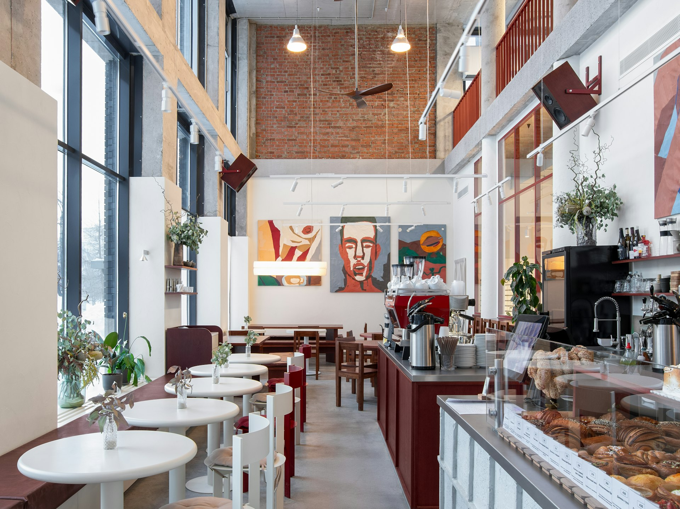


Aroma Coffee Roasters
Artisan Small-Batch Roasting with a Proven Retail Footprint
Notes:
Welcome investors. Today we are presenting Aroma Coffee Roasters, a dedicated small-batch coffee roaster that has successfully expanded to 4 operational stores. We are excited to share our journey and our vision for the next stage of growth.

Slide 2
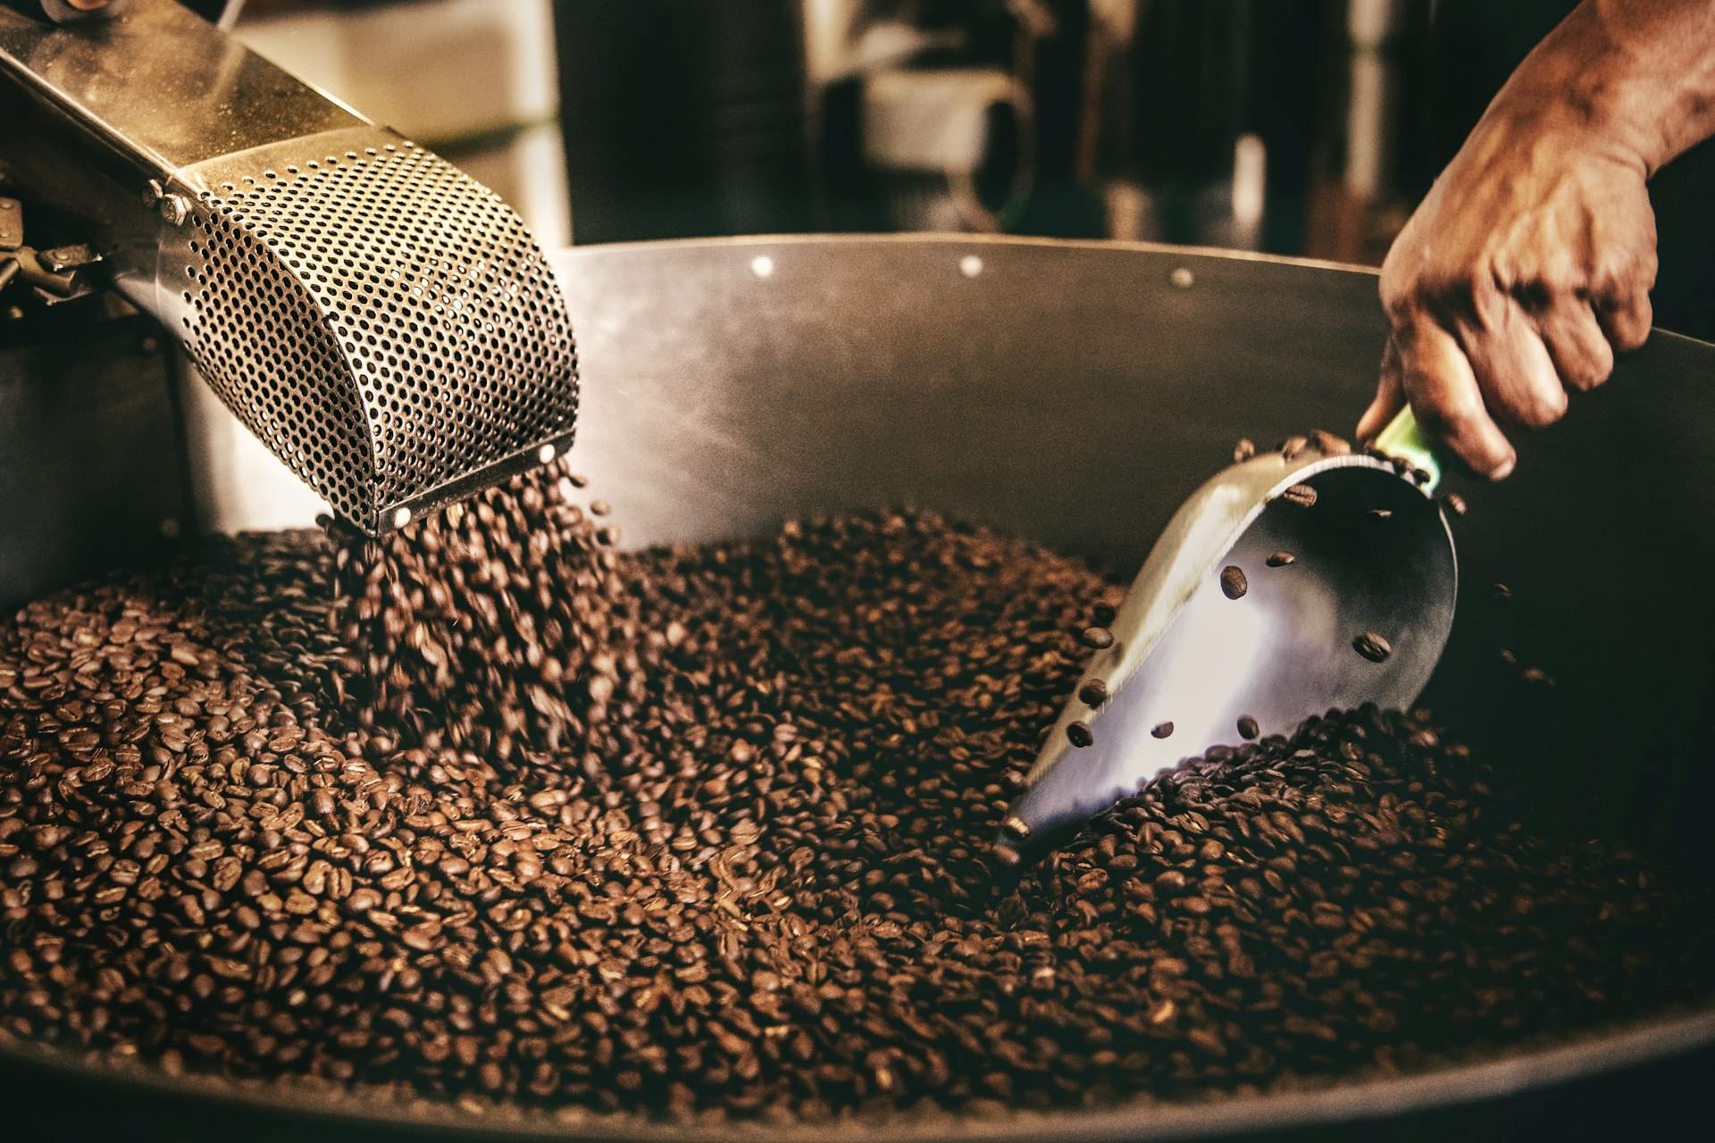
A Diversified Revenue Model Driven by In-House Roasting
Retail sales anchored by our 4 existing store locations
In-house small-batch roasting protecting product quality and gross margins
Direct-to-consumer packaged bean sales for home brewing
Wholesale supply partnerships with local cafes and business accounts
Notes:
Our business model relies on multiple revenue streams rather than just foot traffic. By controlling our own small-batch roasting, we capture higher margins across our 4 stores, direct bean sales, and wholesale client accounts.

Slide 3
Growth Strategy to Scale the Brand
Phase 1
Phase 2
Phase 3
Retail Footprint Expansion
Wholesale Operations Scale
Direct-to-Consumer Launch
Target high-footfall neighboring districts
Replicate proven small-batch store model
Build local brand recognition
Increase roasting facility capacity
Supply regional cafes and corporate offices
Maintain strict craft quality standards
Roll out specialty coffee subscription platform
Ship freshly roasted beans directly to homes
Drive recurring digital revenue streams
Notes:
Our expansion strategy builds systematically on our foundation of four operating stores. First, we will expand our physical retail footprint into adjacent high-density districts. Next, we will scale our small-batch roasting operations to supply commercial wholesale accounts while launching a direct-to-consumer home coffee subscription.

Slide 4
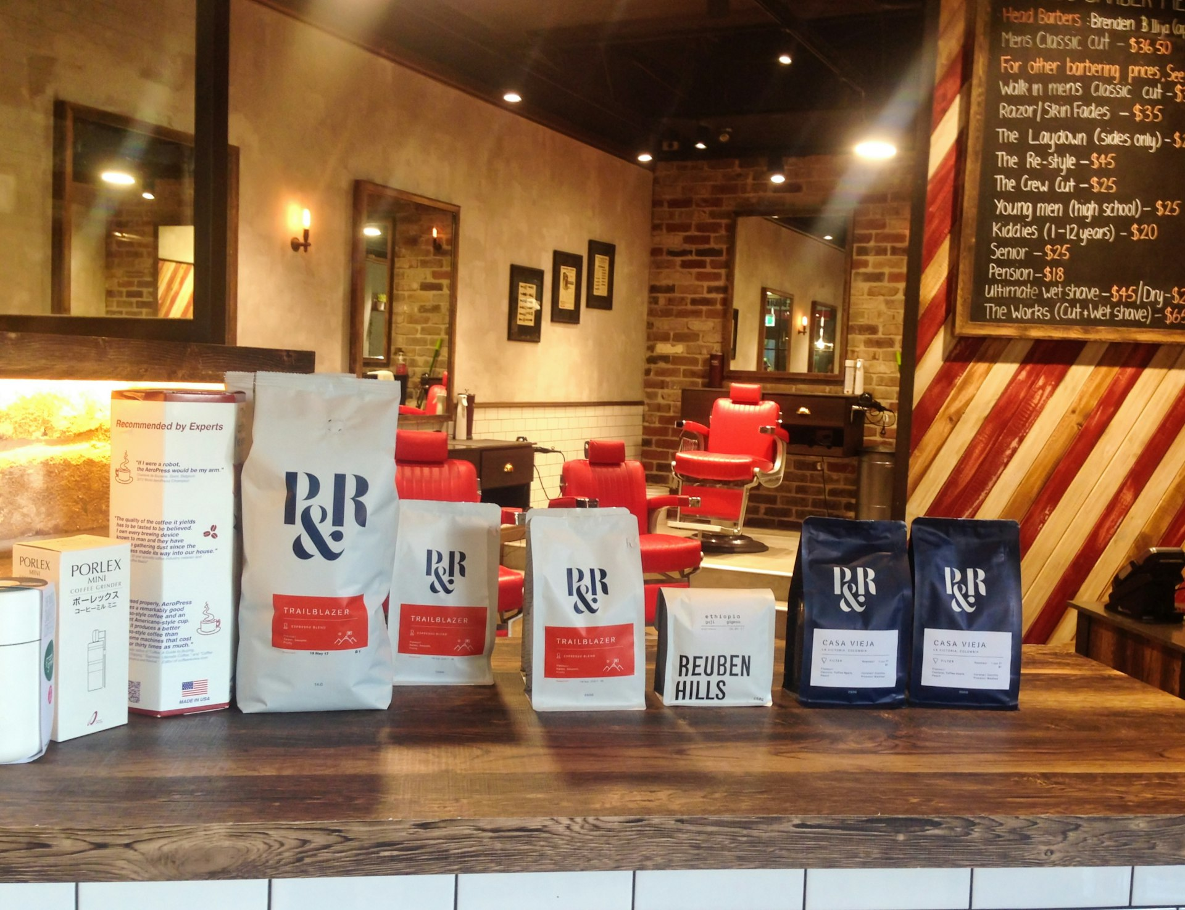
Investment Opportunity: Partnering for Expansion
Seeking local investor capital to accelerate retail and wholesale growth
Funds directed toward store buildouts and modern roasting equipment
Proven store model across 4 locations reduces execution risk
Clear path to business valuation growth and long-term returns
Notes:
We are offering local investors an opportunity to participate in our expansion. Capital will directly fund store buildouts and roasting equipment upgrades, backed by the operational success of our initial 4 stores.

Slide 5

Partner with Aroma Coffee Roasters
Join us in scaling our local specialty coffee brand. Contact invest@aromacoffeeroasters.com to request detailed financial disclosures and discuss next steps.
Notes:
Thank you for considering an investment in Aroma Coffee Roasters. With four successful store locations operating, we are ready to take our small-batch roastery model to the next level. Please reach out to our team at invest@aromacoffeeroasters.com to receive full financial documentation.

