Slide 1
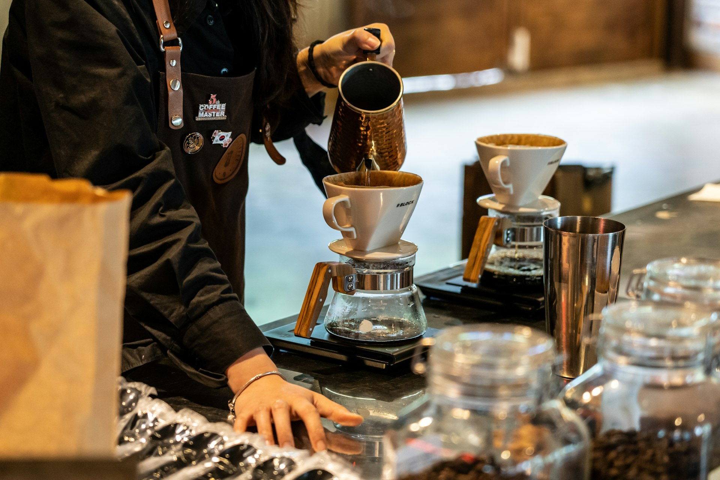


Aroma Coffee Roasters: Elevating Local Coffee
Seeking investment to expand our proven small-batch roastery and retail footprint
Notes:
Welcome investors. Today we are excited to introduce Aroma Coffee Roasters, a dedicated small-batch roastery bringing exceptional specialty coffee to our community. With four operational stores already thriving, we are positioned for our next stage of local growth.

Slide 2
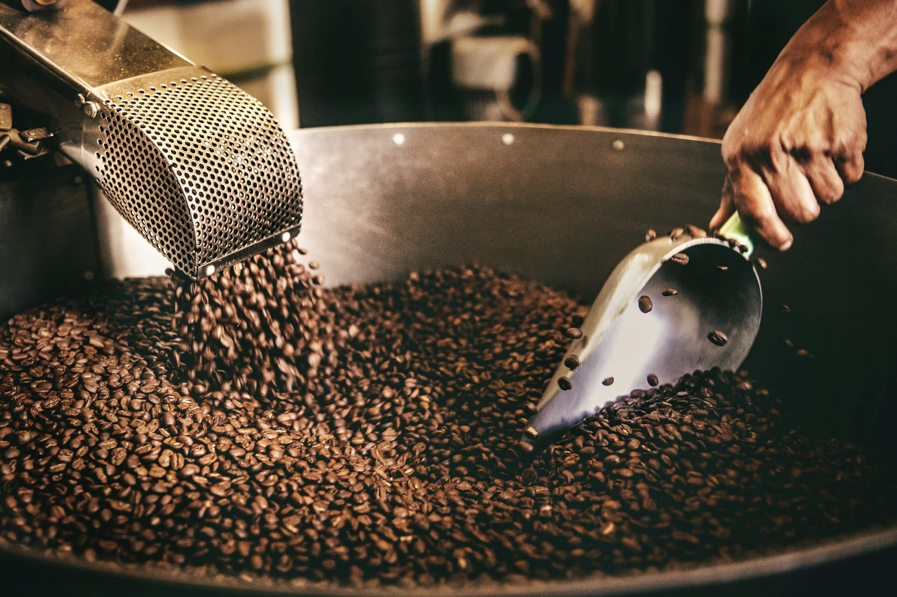
Proven Business Model & Local Operations
In-house small-batch roasting ensures premium product quality and strong margins
Centralized roasting creates operational synergies across all retail locations
Diversified revenue streams span retail beverages, packaged beans, and local wholesale
Notes:
Our model balances artisan quality with scalable efficiency. By controlling the roasting process in-house, we supply all four of our current stores while generating additional revenue through packaged bean sales and wholesale accounts.

Slide 3
Established Market Presence
Current Footprint
Operational Readiness
4 operational retail stores in high-demand neighborhoods
Established daily customer habits and loyal local following
Deep community connection built on specialty quality
Standardized store design and service workflows
Proven playbook ready for replication in new sites
Supply chain scaled to support rapid retail expansion
Notes:
We are not starting from scratch. We have successfully launched and operated four distinct locations, proving that our brand resonates locally and that our operating system is ready to replicate in adjacent markets.

Slide 4
Strategic Growth Potential
Phase 1
Phase 2
Phase 3
Operational Optimization
Retail Expansion
Brand & Wholesale Scaling
Maximize throughput across 4 existing stores
Refine central roasting production capacity
Secure prime high-footfall sites for new locations
Roll out proven store blueprint in target markets
Expand regional brand marketing initiatives
Grow strategic local wholesale partnerships
Notes:
Our expansion plan focuses on deliberate, high-return growth phases. We will first optimize existing capacity, then deploy capital directly into securing prime new sites and broadening our wholesale distribution.

Slide 5

Partner with Aroma Coffee Roasters
Seeking local investment partners to fund strategic store rollouts and expand roasting capacity.
Notes:
Thank you for considering an investment in Aroma Coffee Roasters. With four successful stores already operational, we are ready to scale our small-batch roasting business into its next chapter. We invite you to join us in bringing exceptional local coffee to even more communities.

