Slide 1
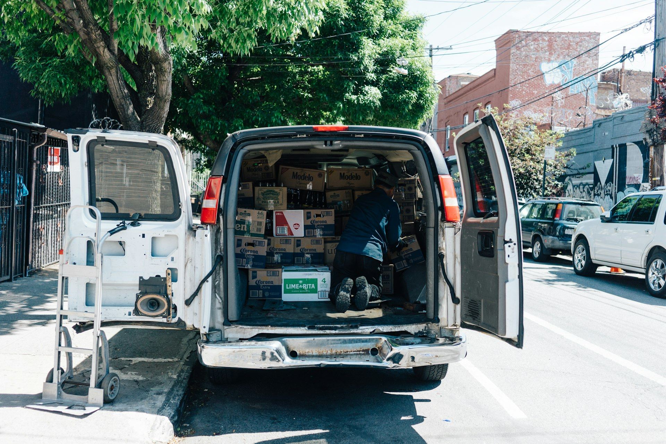


Northwind: logistics software that cuts delivery cost
Tailored route optimisation built for modern fleets of 5 to 200 vehicles
Notes:
Welcome everyone. Today we are sharing how Northwind helps modern delivery operations cut costs and increase reliability across every route.

Slide 2
Why Northwind offers superior delivery efficiency
Typical enterprise tools
Northwind delivery platform
Built primarily for massive enterprise fleets
Require months of complex onboarding
Use per-vehicle pricing that penalises growth
Tackles the 23% of delivery spend wasted on empty miles and failed first attempts
Designed specifically for fleets of 5 to 200 vehicles
Goes live in a single afternoon with simple flat pricing
Notes:
Traditional logistics tools often force smaller fleets through months of onboarding and expensive pricing models. Northwind delivers immediate relief from wasted delivery spend by getting fleets operational in an afternoon. This comparison illustrates how our solution provides robust routing capability without enterprise complexity.

Slide 3
A seamless process from order intake to final delivery
01
02
03
04
Import
Plan
Deliver
Notify
Upload the day's orders or sync your existing system
Routes are optimised for time, cost and capacity in under a minute
Drivers follow turn-by-turn routes directly in the mobile app
Customers get accurate live delivery windows and instant proof of delivery
Notes:
Our platform streamlines your daily logistics operations into four simple steps. We take your raw orders, build fully optimised routes in seconds, and keep both your drivers and end customers updated in real time.

Slide 4

Partner with Northwind
priya@northwind.example · northwind.example
Notes:
Northwind is already trusted by 84 paying fleets with a 98% retention rate because it works seamlessy with your existing vehicles and hardware. Reach out today to get started.

