Slide 1



Northwind: Logistics Software That Cuts Delivery Cost
Tailored route planning and fleet management for modern delivery operations
Notes:
Welcome everyone. Today we are introducing Northwind, our logistics software platform purpose-built to eliminate fleet waste and reduce delivery costs.

Slide 2

THE DELIVERY CHALLENGE FLEETS FACE
23%
of delivery spend is wasted on empty miles and failed first attempts
Small carriers plan routes by hand
Customers get vague delivery windows
No tool fits a fleet under 200 vehicles
Notes:
Small fleets face significant inefficiencies in daily delivery operations. Wasted spend stems from manual route planning and unreliable delivery windows. Existing enterprise tools fail to address the needs of fleets with under 200 vehicles.

Slide 3

Value Proposition: Automated, Reliable Routing
Automatic route planning generates optimised itineraries in under a minute
Live delivery windows give customers reliable arrival times they can trust
Seamless integration works directly with existing delivery vans and driver smartphones
Notes:
Our core value proposition centres on speed, reliability, and ease of adoption. By automating route planning in under a minute, we eliminate manual scheduling overhead. Drivers use the hardware they already own, while customers receive dependable live delivery updates.

Slide 4
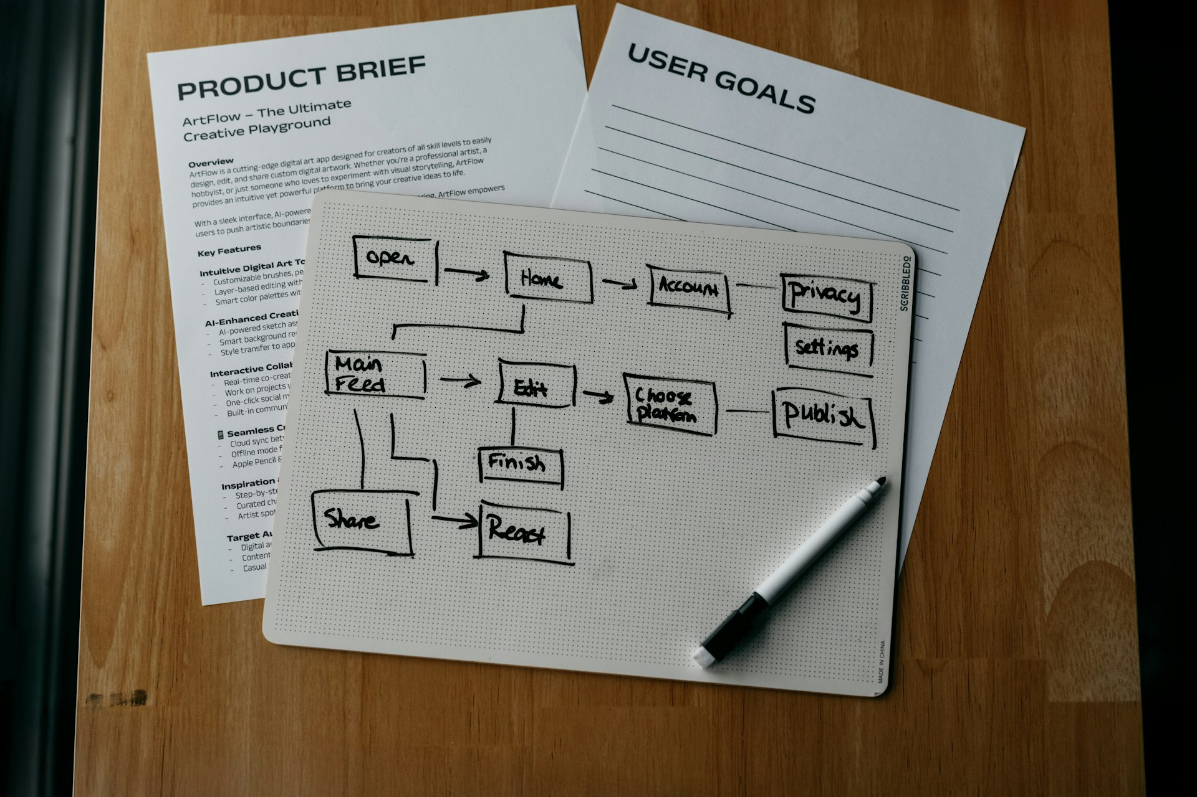
Streamlined Operational Workflow
Import orders, plan routes, deliver with live updates, and notify customers effortlessly
Notes:
Thank you for taking the time to review Northwind. Our straightforward process lets you import orders instantly, optimize routes for cost and capacity, support drivers in real time, and keep your end customers informed.

