Slide 1


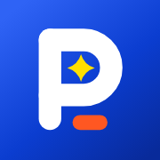
Journey: Logistics Software That Cuts Delivery Cost
Route planning and logistics software designed to reduce fleet operational costs
Notes:
Welcome. Journey provides modern route planning and logistics software designed specifically to cut delivery costs and solve complex operational fleet challenges.

Slide 2

Solving core delivery challenges with Journey
Eliminates wasted spend caused by empty miles and failed first attempts
Generates automatic route planning in under a minute
Provides live delivery windows that customers can trust
Built for fleets of 5 to 200, going live in an afternoon with simple flat pricing
Notes:
Journey targets the major pain points in last-mile logistics, where inefficient routing hurts profitability and customer satisfaction. Our software automates route planning rapidly and provides reliable live tracking. We specifically serve fleets from 5 to 200 vehicles with fast onboarding and clear pricing.

Slide 3
Demonstrating steady growth and strong client retention
84
$610K
17%
Paying fleets
Annual recurring revenue
Month-on-month growth
98%
Customer retention
Notes:
Our operational metrics show strong momentum across fleet adoption and revenue growth. We have expanded to 84 paying fleets while maintaining exceptional customer retention rates. This growth reflects the ongoing value Journey delivers to our fleet partners daily.

Slide 4
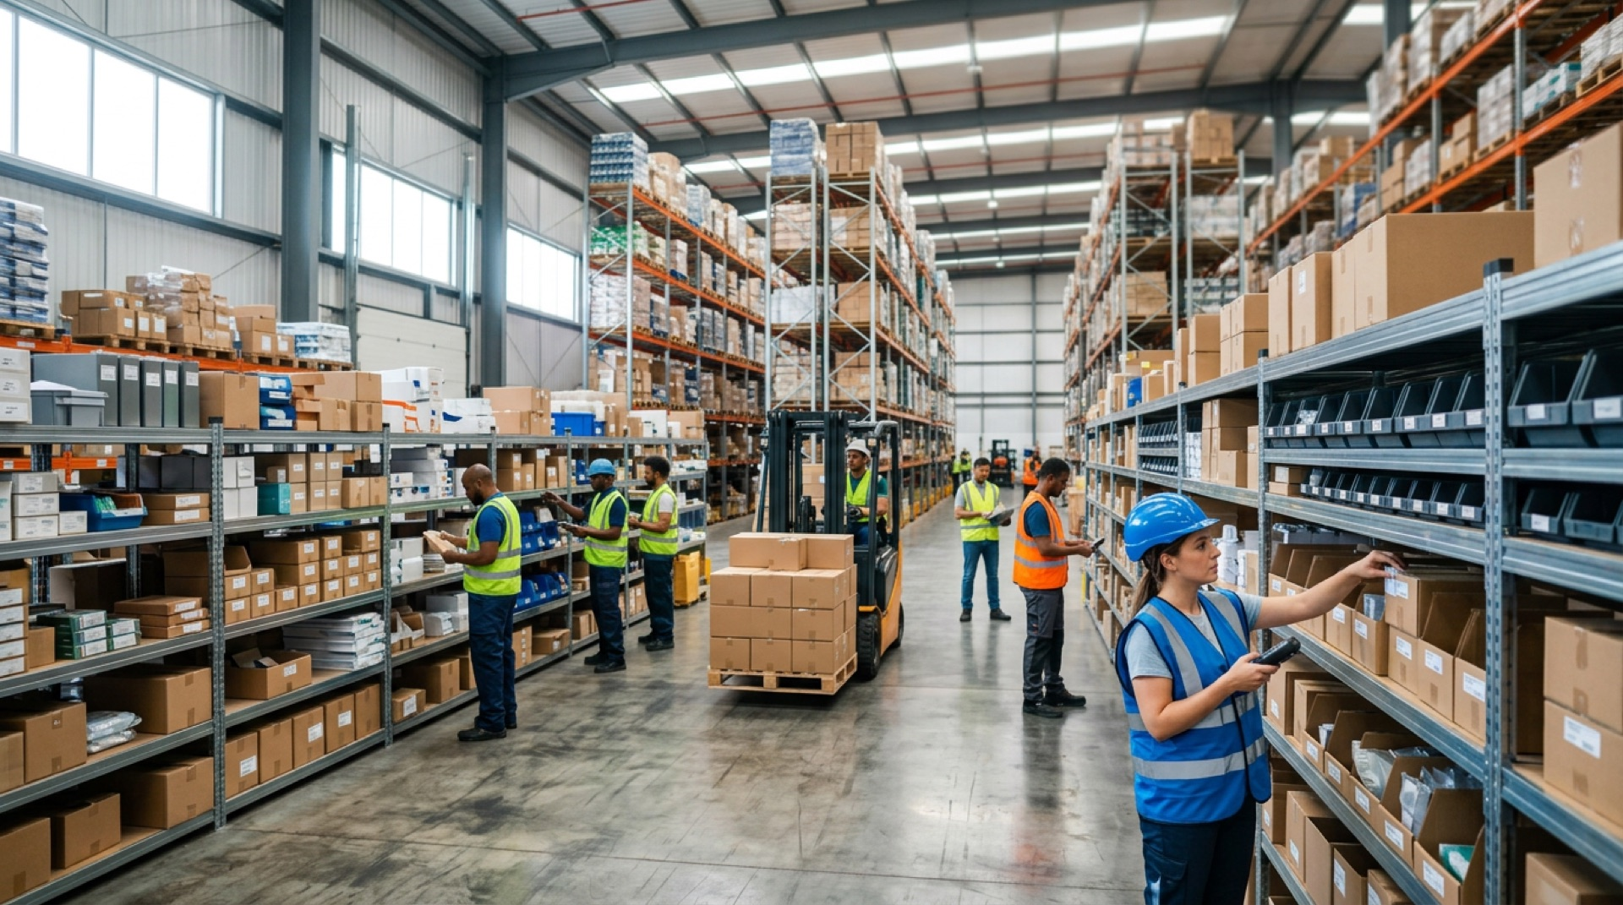
Get Started with Journey
Transform your fleet operations today · Contact: priya@northwind.example · northwind.example
Notes:
Thank you for your time. Connect with our team today to learn how Journey can optimize your delivery operations.

