Slide 1
Database Systems Project Hotel Booking System
Presented By,
Sai Kiran (700724533),
Prathyusha (700728370),
Rupendra Varma Mudunuri(700725327),
Lathasri Rayarapu

Slide 2
Contents
Introduction
Technology Stack Used
Data Model
Implementation
Output
Challenges faced

Slide 3
Introduction
Hotel Application using Reactjs, Nodejs and Mongodb. We will fetch all data from mongodb using a backend api. In this system we created a Admin panel, where admin can add or delete hotels, users and rooms based on the availability. And user can book his or her hotel. Once room is booked, it will be in unavailable state, for other user. In booking UI, we implemented Search using city, filter using dates. We implemented whole project using MERN Stack. And created Rest API, and provided security using JWT, and made api requests using custom hooks and react context api.

Slide 4
Technology Stack Used
Mongodb(Backend) — Document Database
Express js – Node.js web framework
React js – a client-side JavaScript library
Node js – the premier JavaScript web server

Slide 5
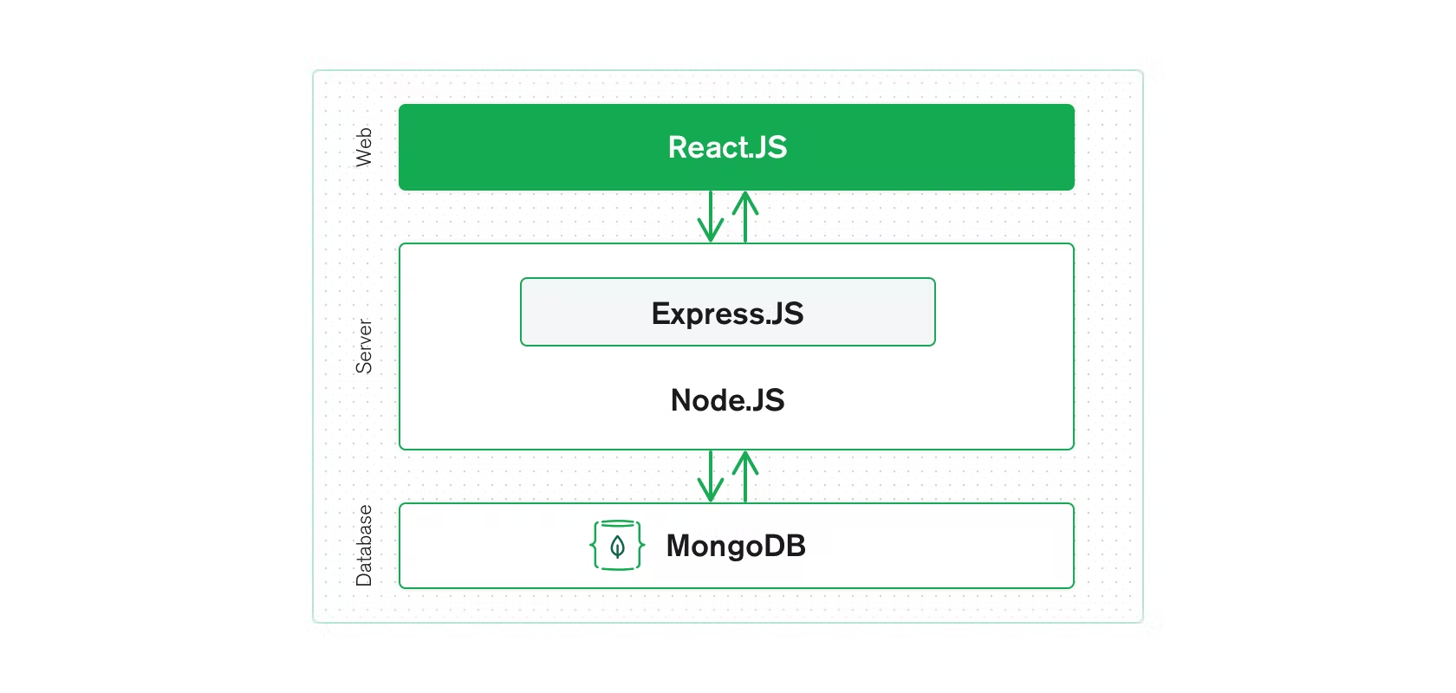
3 Tier Architecture

Slide 6
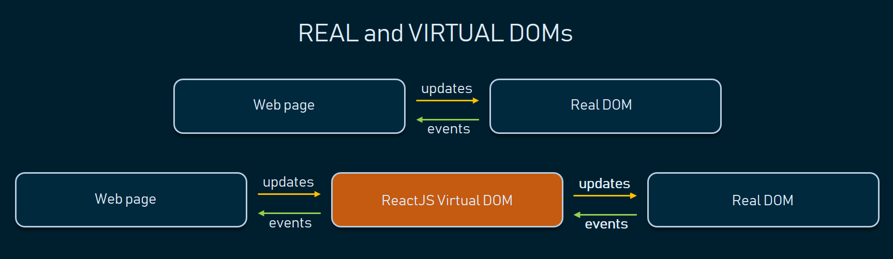
How does React work?
Instead of manipulating the browser’s DOM directly, React creates a Virtual DOM in memory, where it does all the necessary manipulating, before making the changes in the browser DOM.
React finds out what changes have been made and what need to be changes.

Slide 7
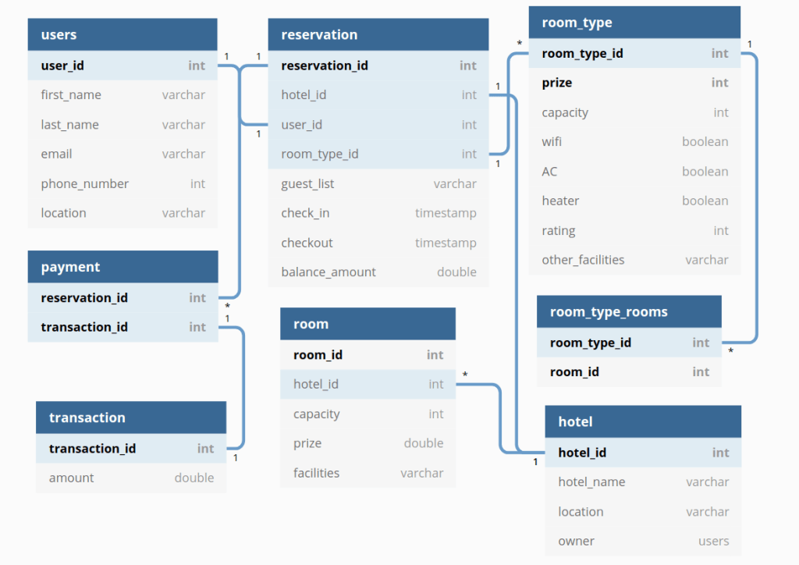
Data Model

Slide 8
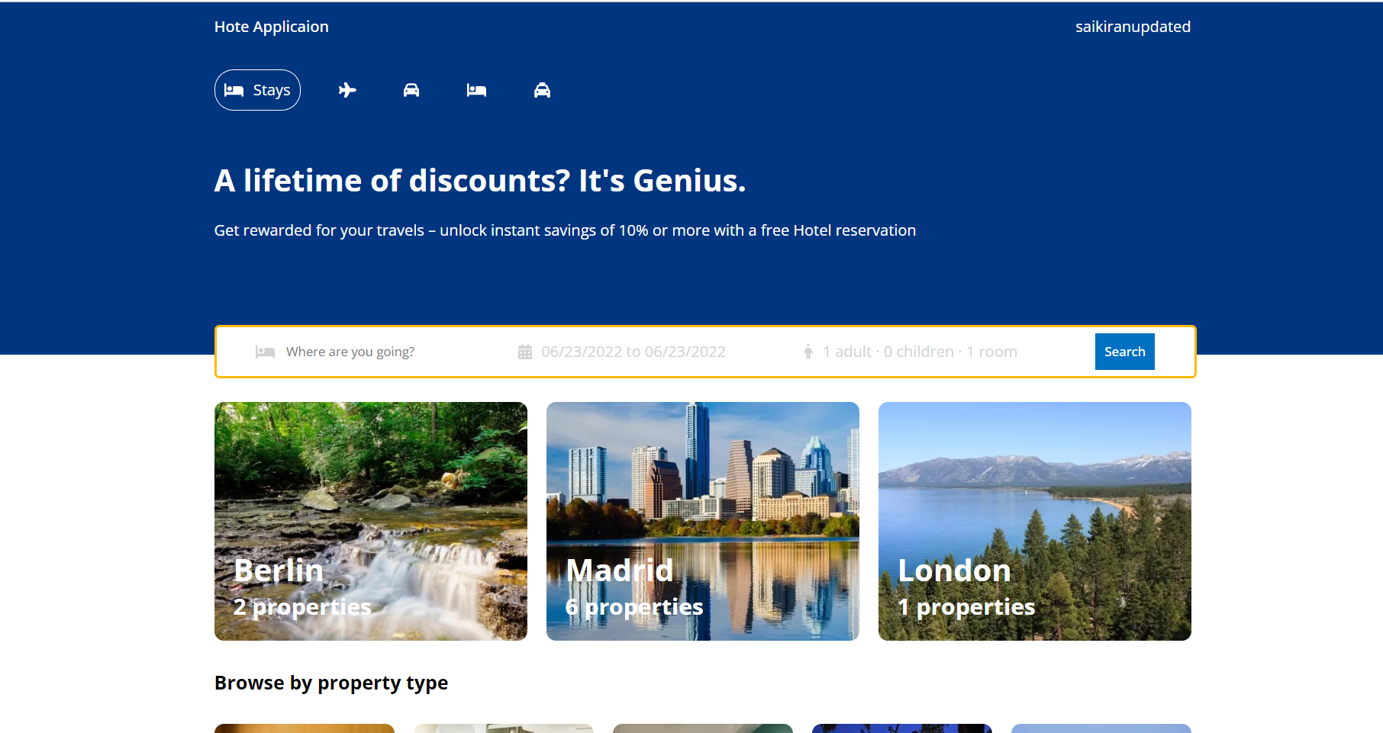
Outputs:

