Slide 1

Feature Extraction and Price
Prediction for Mobile Phones
Project By:
Rupesh Dewangan

Slide 2
Mobile Price Prediction Problem
Problem:
Predict mobile prices from features
Helps manufacturers and customers
Challenges:
High feature dimensionality
Missing and inconsistent data
Identify key price factors

Slide 3

Project Objective
Main Objective
Develop accurate mobile price prediction model
Specific Goals
Preprocess data effectively
Extract significant features
Evaluate multiple regression models

Slide 4






Methodology Overview
Data Exploration
Load data, visualize, check missing values
Preprocessing
Handle missing data, normalize, encode features
Feature Extraction
Correlation and feature importance analysis
Model Development
Train and evaluate regression models
Testing & Validation
Validate on unseen data
Conclusion
Analyze results and insights

Slide 5
Feature Extraction Process
Steps
Key Features
Correlation analysis
Processor brand
Feature importance from models
RAM
Remove redundant features
Storage
Camera quality
Battery capacity

Slide 6

Correlation Analysis
Objective
Visualization
Findings
Measure feature-price relationship strength
Heatmap of correlation coefficients
RAM and camera highly correlated
Hieght shows low or no correlation

Slide 7
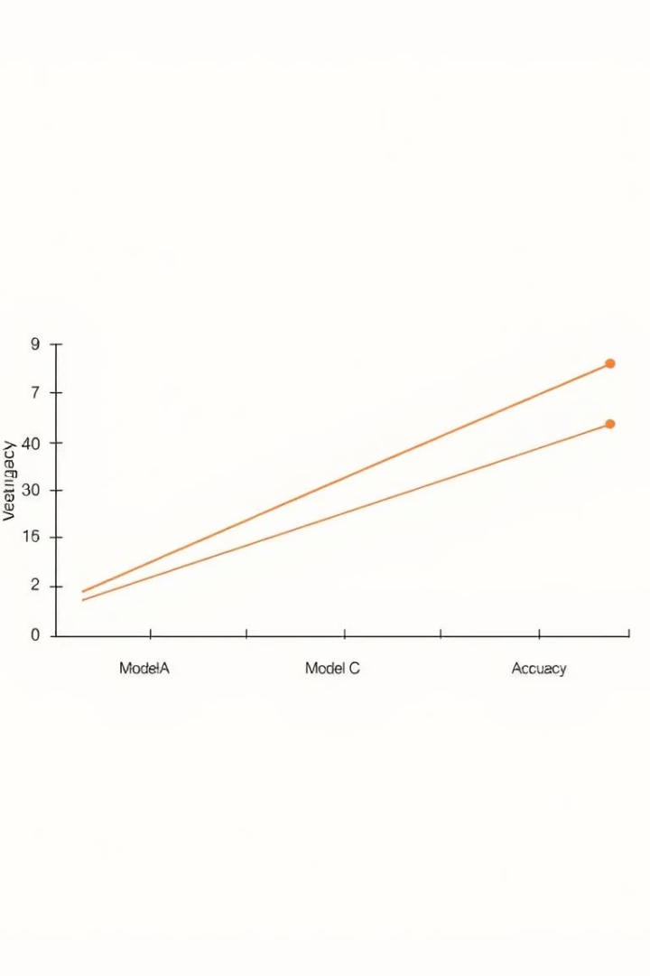
Model Evaluation
Models Trained
Metrics
Linear Regression
MAE
Random Forest Regressor
RMSE
Gradient Boosting Regressor
R-squared
Decision Tree Regressor
Best Model
Linear Regression: lowest RMSE, highest R-squared

Slide 8
Training and Testing
Training Set
Testing Set
Performance
80% data used for training
20% data used for validation
Testing accuracy matches training, no overfitting

Slide 9

Conclusion and Future Work
Summary
Future Work
Model developed successfully
Explore brand reputation
Optimize for real-time prediction
Random Forest most effective
Key features identified
Impact
Better pricing strategies
Informed customer decisions

Slide 10
Thank You

