Slide 1


GUI Calculator in Python with Tkinter
This presentation explores the development of a GUI calculator. It is built using Python and the Tkinter library. The calculator provides basic arithmetic functions.
by Rupesh Dewangan

Slide 2





Project Overview: Functionality and Features
The project aims to create a user-friendly calculator interface. It will support addition, subtraction, multiplication, and division. It also includes square and square root operations. A light theme will be used for visual clarity.
Addition
Subtraction
Multiplication
Division
Adds two numbers.
Subtracts two numbers.
Multiplies two numbers.
Divides two numbers.

Slide 3
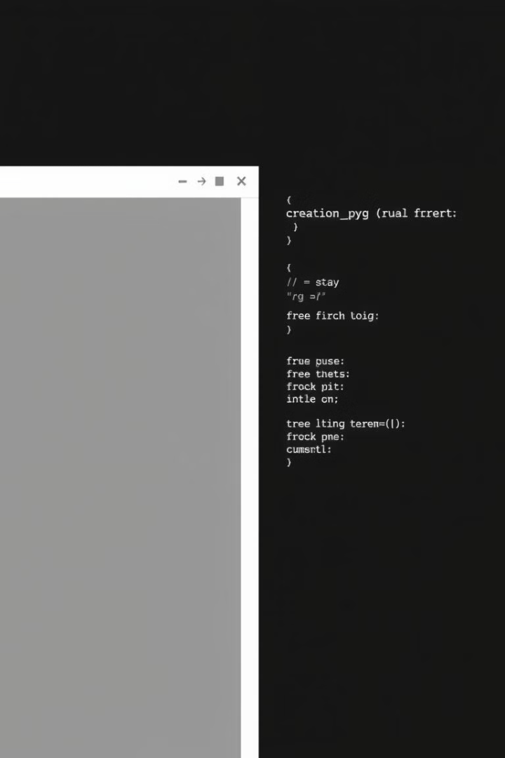
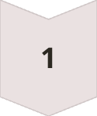
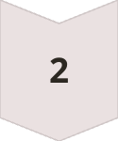
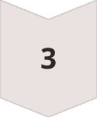
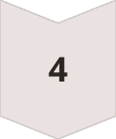
Tkinter Basics: Creating the GUI Window
Tkinter is Python's standard GUI library. We use it to create the main calculator window. Widgets like buttons and text fields are added. The geometry manager organizes the layout.
Import Tkinter
Import the library
Create Window
Initiate root window.
Add Widgets
Add Buttons and Text Fields.
Event Loop
Run the loop for event handling.

Slide 4
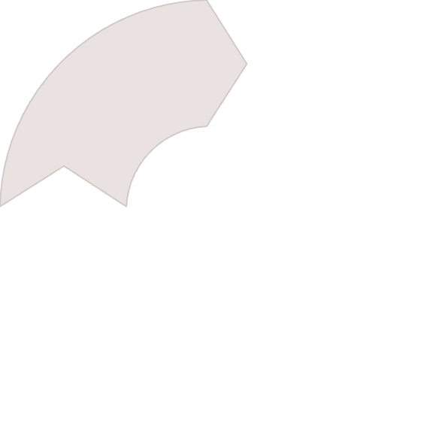
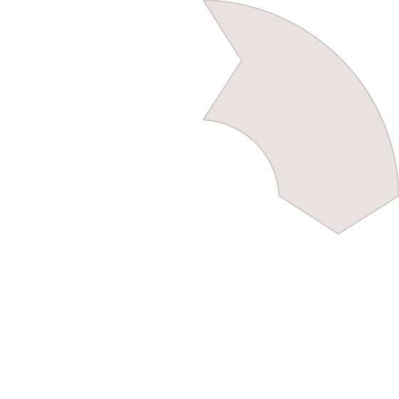
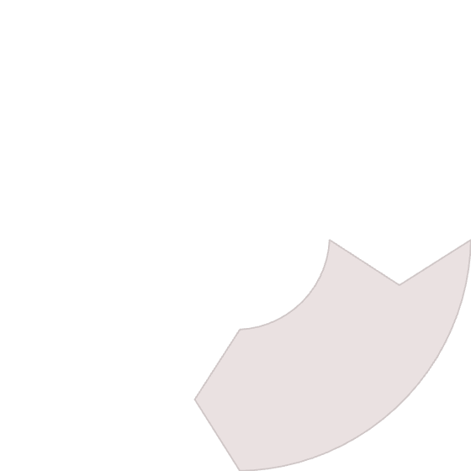

Adding Square and Square Root Functions
Additional functions are implemented for square and square root. These functions use the math module. Buttons for these functions are added to the layout. These functions also take input from the text field.
Import math module
1
Define sqrt function
2
4
Handle errors
3
Add sqrt Button

Slide 5
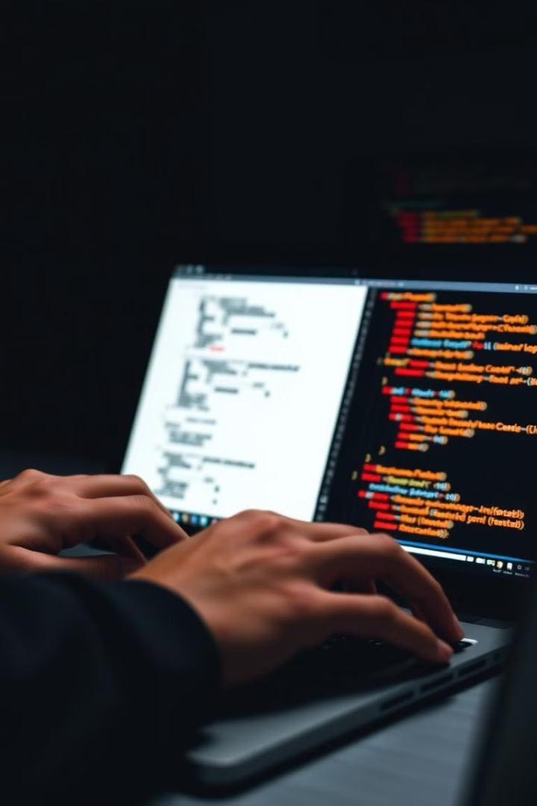
Conclusion: Demonstration and Future Enhancements
The presentation demonstrated a functional GUI calculator in Python. Future enhancements include advanced functions and memory storage. Optimization and error handling can be improved.
1
Demonstration
Calculator in action.
2
Enhancements
Improve functionality.
3
Optimization
Improve efficiency.

Slide 6
Thank You!

