Slide 1
Level -1 Submission Template
Hack-N-Stack: Code the Future
Java Full Stack with AI: Learning Hackathon 2026

Slide 2
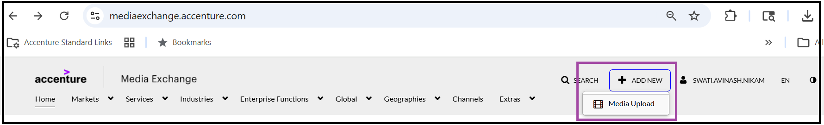
Instructions
Complete all slides of this PPT with requested data and upload it under:
Problem Statement -> Level 1- >Submission Tab -> Upload PPT tab in the Hackathon Site.
You can add additional slides to the presentation.
Existing slides should not be changed/modified.
Source code must not be more than 10 MB in size.
Refer to the Snipping Tool guide to record your video: SnippingToolGuide
Demo Video to be uploaded to media exchange site-Accenture - Media Exchange.
Access Media Exchange → Click Add New → Select Media Upload → Upload your demo video as shown below.

Slide 3
Team details
Team name: ThinkOut
Member details are on the next slide.

Slide 4
Team details
Provide team member name and details below.
Name | Email Id | Career Level | Role/Market
Shirish Mahajan | s.shirish.mahajan@accenture.com | <career level> | <role / market>
Durgadas Choudhari | s.durgadas.choudhari@accenture.com | <career level> | <role / market>
Rupesh Kumar | rupesh.v.kumar@accenture.com | <career level> | <role / market>
Saloni Sinha | saloni.c.sinha@accenture.com | <career level> | <role / market>

Slide 5
Technical Architecture details
Describe on the next slide the frameworks/libraries used across different application layers shown in the diagram.

Slide 6
Technical architecture details
Technical Architecture details
FRONT END - React 18 + TypeScript, Vite, React Router, Framer Motion (animations), custom design-system CSS. Talks to the API over REST/JSON with a JWT bearer token.
INTEGRATION LAYER - Spring Security + JWT (stateless, role-based), CORS, REST controllers, Bean Validation, centralized exception handling (@RestControllerAdvice). Apache POI for Excel import/export.
WEB LAYER - Spring Boot 3 (Java 17) MVC REST controllers exposing /api/* endpoints for auth, MCQs, reviews, admin question-bank, master data and bulk upload.
DAO / PERSISTENCE LAYER - Spring Data JPA / Hibernate repositories; service layer with an MCQ lifecycle state-machine enforcing all status transitions.
DATABASE - H2 in-memory by default (zero-setup demo, auto-seeded) with a PostgreSQL profile for production. Entities: User, UserSkill, TechStack, Topic, Mcq, ReviewAssignment.

Slide 7
Software Architecture details
Describe on the next slide using diagrams or at least 5-6 sentences the high-level architecture of your solution. E.g. UML diagrams, ER diagram, microservice oriented architecture diagram, design patterns used if any etc.

Slide 8
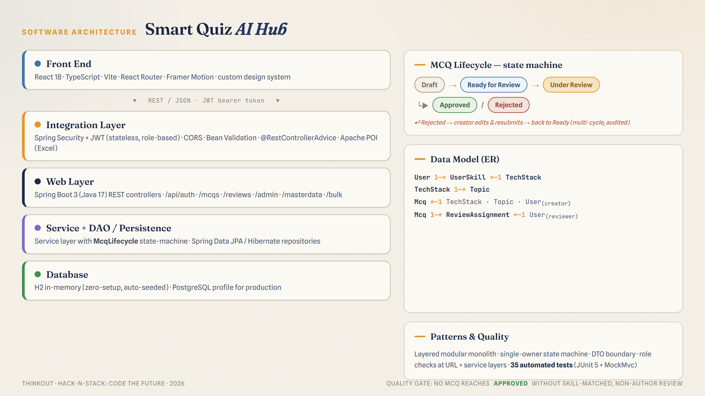
Software Architecture details
High-level architecture — a layered, modular monolith (Controller → Service → Repository) with a clear feature-based package layout.
Design pattern at the core: a State-Machine (McqLifecycle) is the single owner of all MCQ status transitions. No other class mutates status, so illegal transitions are impossible by construction.
Each MCQ moves through exactly one state: Draft → Ready for Review → Under Review → Approved / Rejected (with re-submission loops).
Other patterns: DTO mapping at the controller boundary; repository pattern via Spring Data JPA; role-based access enforced at both the URL layer (Spring Security) and the service layer (defense in depth).
Review history is modelled as separate ReviewAssignment rows, so multi-cycle reviews are fully auditable and prior reviewer feedback is preserved across resubmissions.
Quality: 35 automated tests (JUnit 5 + MockMvc) cover the lifecycle, services, controllers, auth and bulk import. Verified end-to-end against the running app.

Slide 9
Level -1 Solution Description
Describe here the solution details and how it solves the problem statement. Provide a brief on what makes your solution special or different from other solutions.

Slide 10
Level -1 Solution Description
Smart Quiz AI Hub centralizes MCQ creation, review and approval into one accountable pipeline — replacing the fragmented third-party tools the L&TT team relies on today.
SMEs author questions from an intuitive UI or by bulk-uploading an Excel template (Template_MCQs.xlsx) that is validated row-by-row and imported as drafts.
Every question carries a live status. SMEs track their work in 'My Questions'; rejected items show the reviewer's feedback inline and can be edited and resubmitted.
Admins manage the full question bank, edit any question (except another author's private draft), and assign reviewers. Reviewers see only what's assigned to them and must give a mandatory comment when rejecting.
What makes it different:
A real state-machine guarantees no question reaches 'Approved' without passing a skill-matched, NON-author review — a genuine quality gate, not just status labels.
Reviewer assignment is automatically restricted to SMEs whose skills match the question's technology stack, and excludes the creator to prevent self-review.
Full, auditable review history across multiple revision cycles; zero-setup demo (H2 + seeded data) with a production PostgreSQL profile; 35 automated tests.

Slide 11
Level -1 Solution Demo Video
Provide a video demo/walkthrough of the solution the solution showing the running application. Video must not be more than 5 mins.

Slide 12
Level-1 Solution Demo Video
Provide a video demo/walkthrough of the solution the solution showing the running application. Video must not be more than 5 mins. Video must be uploaded to media exchange. See instructions slide.

Slide 13
Workflow and Deployment instructions
Provide screenshots of the solution and deployment instructions/dummy data if any .

Slide 14
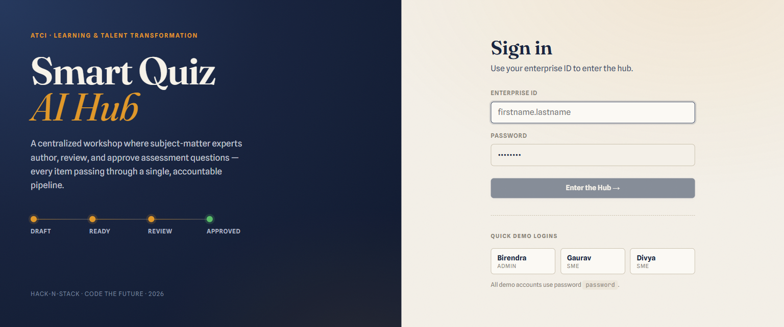
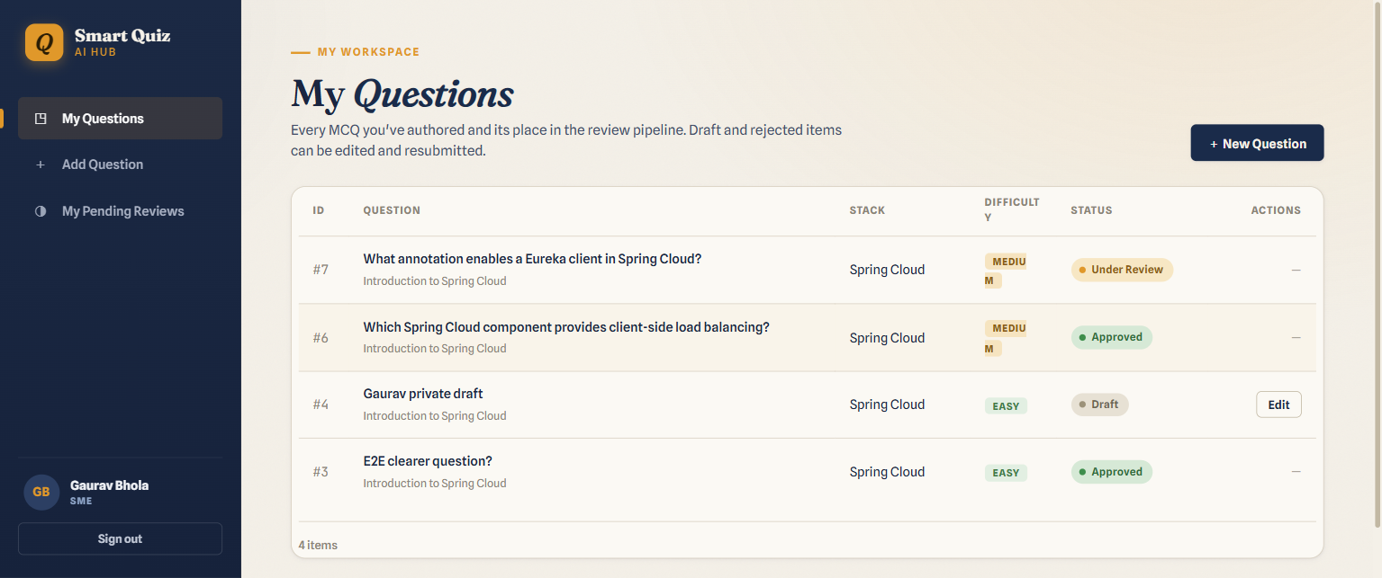
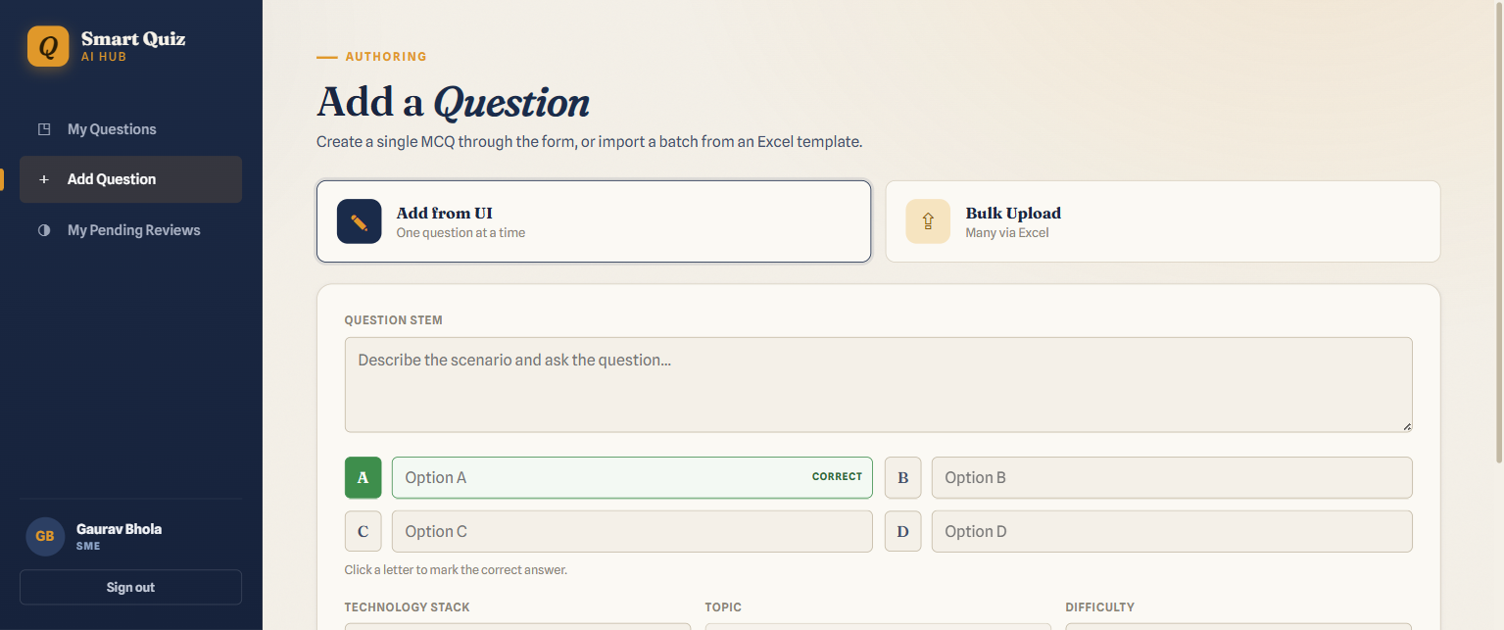
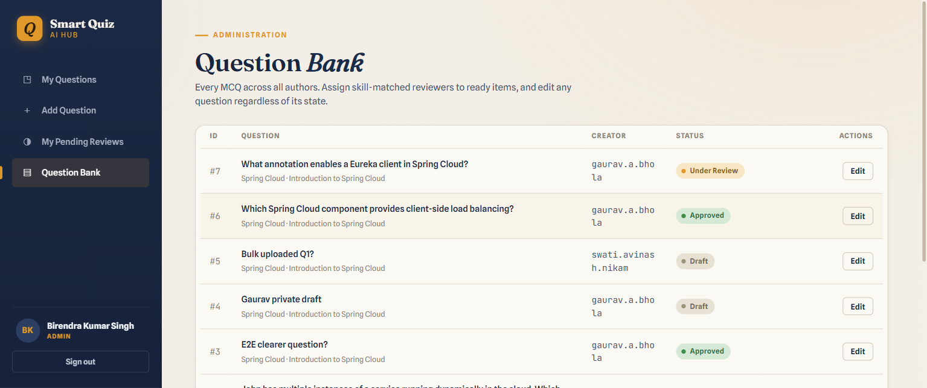
Workflow and Deployment instructions
Deployment / run instructions
1. Backend: cd backend && mvn spring-boot:run
→ http://localhost:8080 (H2 auto-seeded)
2. Frontend: cd frontend && npm install && npm run dev
→ http://localhost:5173 (proxies /api to :8080)
3. Sign in with a demo account (password = password):
birendra.kumar.singh = Admin; gaurav.a.bhola = SME
Optional: run on PostgreSQL with
mvn spring-boot:run -Dspring-boot.run.profiles=postgres
Workflow shown in screenshots →
Login · My Questions (with statuses & reviewer feedback) ·
Add Question · Admin Question Bank (assign reviewer).

Slide 15
Source Code
Upload the solution source code as a zip file to the Hackathon site.

Slide 16
Source Code
Upload the solution source code as a zip file to the Hackathon site. (Max 10 MB)
Upload the source code under the Problem Statement Level 1 -> Submission -> Upload Zip section.
For Java projects please delete everything under target folder before upload.
For React/Angular project please delete the node_modules folder before upload.

Slide 17
Additional Data
Tech stack: Java 17, Spring Boot 3.2, Spring Security + JWT, Spring Data JPA/Hibernate, Apache POI, H2 / PostgreSQL • React 18, TypeScript, Vite, Framer Motion.
Run locally — backend: 'cd backend && mvn spring-boot:run' (http://localhost:8080). Frontend: 'cd frontend && npm install && npm run dev' (http://localhost:5173).
Demo logins (password = 'password'): birendra.kumar.singh (ADMIN); gaurav.a.bhola, divya.madhanasekar, swati.avinash.nikam, indugu.hari.prasad (SME).
Seeded from the problem statement: 6 technology stacks, Spring Cloud topics, the SME-skill mapping, and the two sample MCQs — so the app is demoable the moment it starts.
Testing: 35 JUnit 5 / MockMvc tests (lifecycle, services, controllers, auth, bulk import), all green; verified end-to-end against the running application.
Packaging note: delete backend/target and frontend/node_modules before zipping (source stays well under the 10 MB limit).
AI roadmap (Phase 2): the architecture leaves a clean seam for Spring AI — question generation from a topic and duplicate/similarity detection at creation time.

Slide 18
THANK YOU

