Slide 1

Level 1 Hackathon Guide
Hack-N-Stack: Code the Future
Java Full Stack with AI: Learning Hackathon 2026

Slide 2
Legend - Abbreviations
SME: Subject Matter Expert, Expert, Trainer, Instructor
Learning Offerings: Trainings
Roles: SME, Admin
L&TT: Learning and Talent Transformation

Slide 3
Problem Statement
At ATCI, the Learning and Talent Transformation (L&TT) team is dedicated to continuously improving learning engagement initiatives for ATCI employees. A significant challenge identified is the absence of a centralized and customizable platform for administering practice quizzes.
Presently, subject matter experts (SMEs) must rely on external tools, which:
Restrict the ability to customize and manage content,
Lack seamless integration with internal processes.
This situation results in fragmented learning experiences and diminished transparency regarding participant performance.
Current Process:
SMEs utilize third-party platforms to develop and administer quizzes.
Participants access these quizzes through external links and tools.
There is limited control over data management, quiz customization, and reporting capabilities.
No unified leaderboard or session-based performance tracking is available.
The free versions of these tools offer limited features and analytics.

Slide 4
Problem Statement
For Level-1, the goal is to design and build a Smart Quiz AI Hub that simplifies the creation and management of a centralized quiz question repository.
SME Interface Requirements:
The solution should provide a dedicated SME Interface with the following capabilities:
MCQ Creation and Upload: SMEs should be able to create Multiple Choice Questions (MCQs) using an intuitive user interface or through bulk upload (e.g., spreadsheet-based upload).
Question Visibility and Status Tracking: SMEs should have access to view all MCQs created by them along with their current lifecycle status (Draft, Ready for Review, Under Review, Approved and Rejected).
MCQ Updates and Revisions: SMEs should be able to update and resubmit MCQs that have been reviewed and returned with comments from other reviewer SMEs.
Review and Approval: SMEs should be able to review assigned MCQs and approve or reject them, with mandatory comments for rejection.
Dedicated Admin Interface:
The solution should provide a dedicated Admin Interface with the following capabilities:
All SME functionalities should also be available to Admins.
As super‑users, Admins should be able to edit any MCQ in the question bank, regardless of its status or assigned SME.
Admins should be able to assign MCQs to SMEs for review.

Slide 5
Problem Statement
MCQ Lifecycle
MCQs will progress through a defined set of states from creation to finalization. At any given point in time, an MCQ will be in exactly one of the following states:
Draft - The MCQ has been created but is still a work in progress. In this state, it can ONLY be edited by the creator and is not yet ready for evaluation.
Ready for Review - The MCQ is complete and has been marked as ready to be evaluation by the creator. At this stage, the Admin can assign the MCQ to an SME for review.
Under Review - The MCQ is currently being evaluated by the assigned SME. Feedback comments may be provided, and updates may be required.
Approved - The MCQ has met all quality and correctness criteria and has been approved by the assigned SME.
Rejected - The MCQ does not meet the required standards and is rejected by the assigned SME. The creator will need to update the MCQ as per the received comments and resubmit it for review.
Note: MCQs may go through multiple review cycles before reaching the “Approved” state. As super-users, Admins can edit MCQs at any stage of the lifecycle(except for Draft state, where the MCQ is accessible only to the creator).

Slide 6
Technology Stack
The application should utilize the following technologies:
Backend:
Java (Preferred: Open JDK): JDK 8 and above.
Spring Framework: Any LTS Spring version and Spring modules can be used.
Database: Either SQL or NoSQL database can be used. Use PostgreSQL or MySQL for SQL databases, or MongoDB/Cassandra for NoSQL databases.
AI Integration: Use Spring AI for question generation and similarity detection.
Frontend:
ReactJS or AngularJS: These frameworks offer dynamic and responsive user interfaces, facilitating smooth interaction with the application.
[ Please refer to the Installation Guide available in the Reference Documents section of the Hackathon site ]
Note:
Participants can use any additional libraries/frameworks apart from the above to fulfil the requirements.
It is strongly recommended to use open-source, non-licensed software/frameworks for the Hackathon.

Slide 7
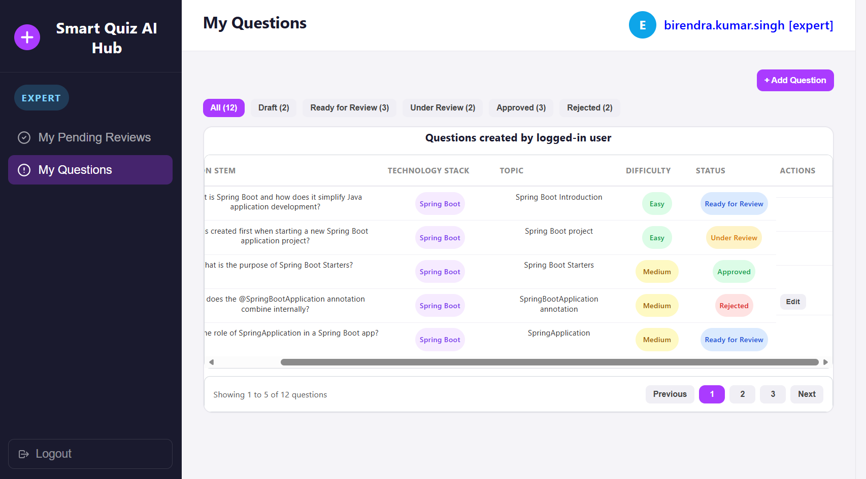
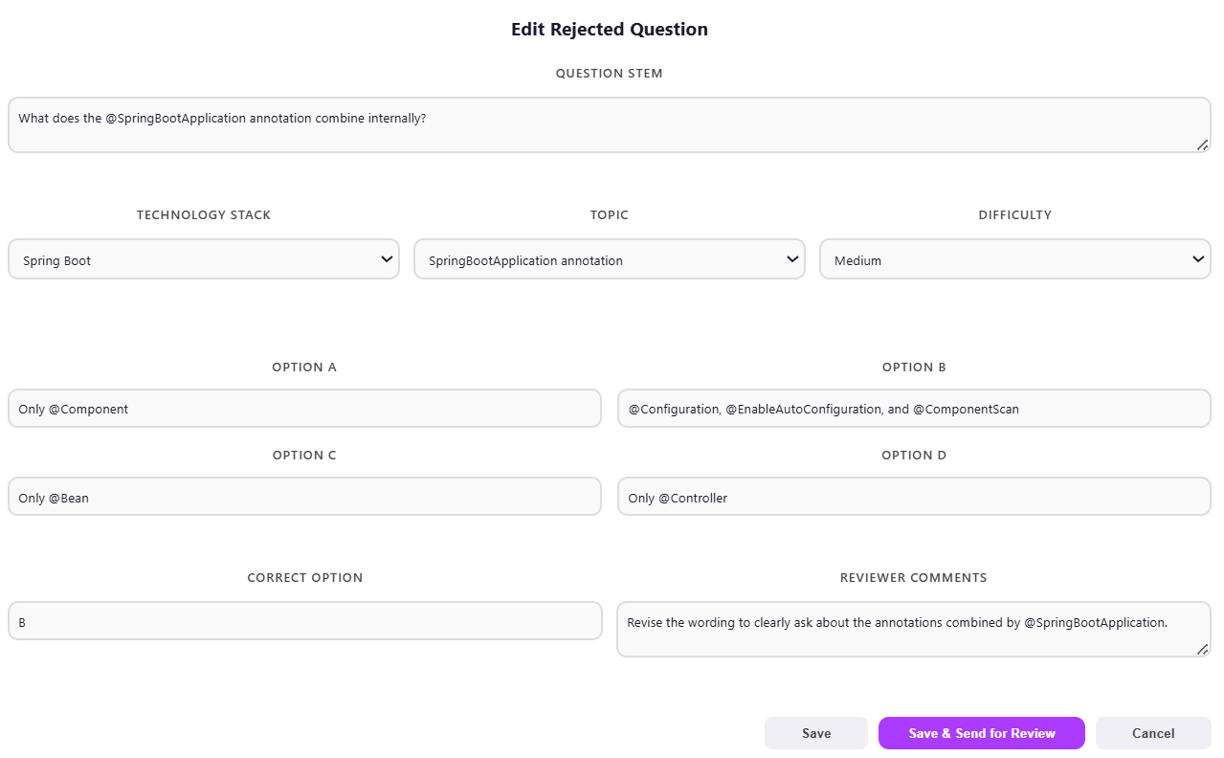
Role: SME Functionality: Update Question
Upon successful SME login, clicking the “My Questions” tab should display all quiz questions created by the SME, along with their statuses, in a paginated table on the main page. There should be an Edit button for each MCQ with a status of Draft or Rejected.
Clicking the “Edit” button should open a form showing question details such as: Question stem, Technology Stack, Topic, Difficulty, four options, the correct answer. If the question is in the “Rejected” state, then the reviewer comments must also be shown.
Clicking the Save button should simply update the MCQ in the database. It should not change the question status.
Clicking “Save & Send for Review” should save the question in the database with a “Ready for Review” status. This should make the MCQ available for the Admin to assign an SME for review.
Kindly note this page is for reference only and participants have the liberty to design it as per their ideas. Sample technology stack list is given in slide 5.

Slide 8
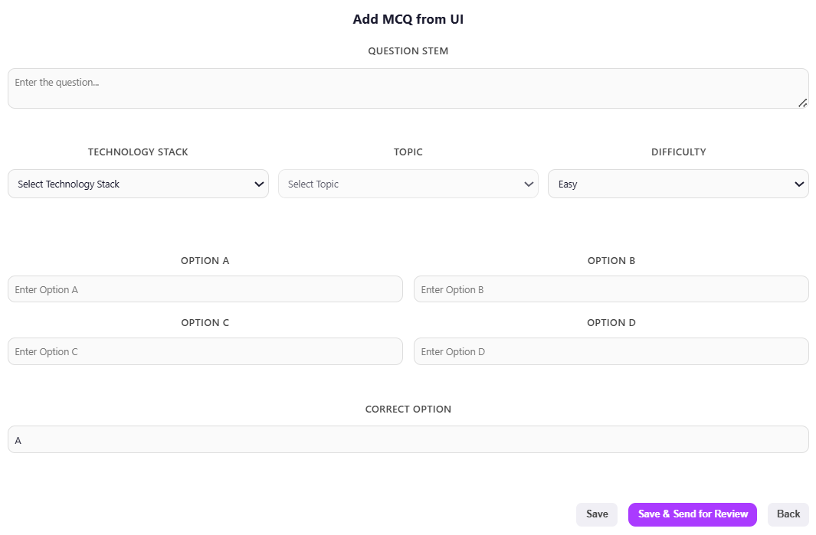
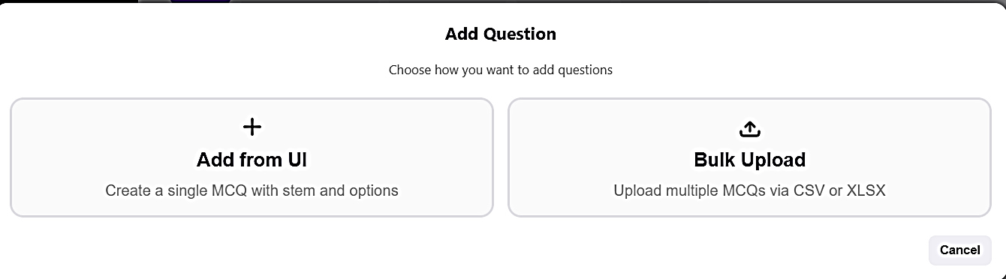
Role: SME Functionality: Add Single Question
Clicking Add from UI should open a form to enter question details including Question stem, Technology Stack, Topic, Difficulty, four options, and the correct answer.
On clicking the Add Question button, two options should appear for the SME: Add from UI and Bulk Upload, allowing SMEs to add a single question or upload MCQs in bulk.
Clicking the Save button should add the MCQ to the database. The question will be saved in the Draft state.
Clicking “Save & Send for Review” button should save the question in the “Ready for Review” state and make it available for the Admin to assign an SME for review.
Kindly note this page is for reference only and participants have the liberty to design it as per their ideas. Sample technology stack list is given in slide 5.

Slide 9
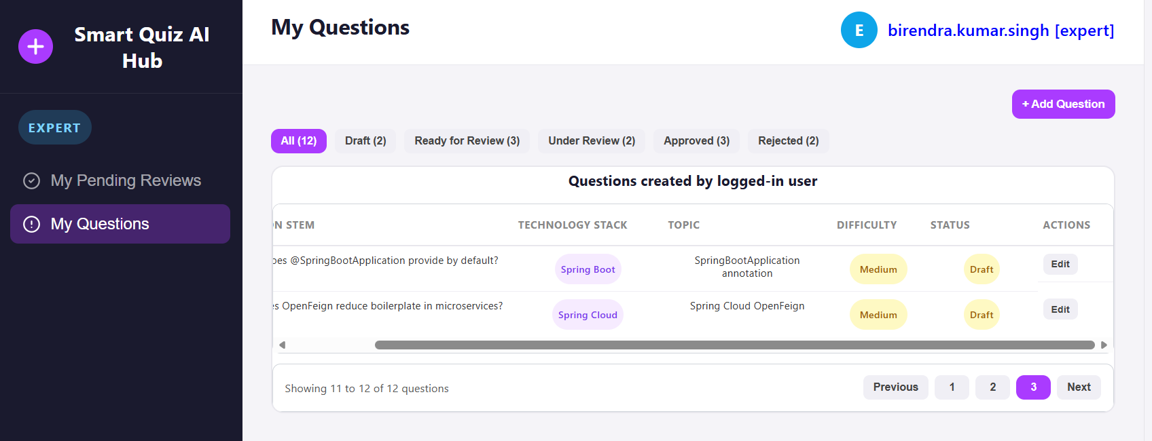
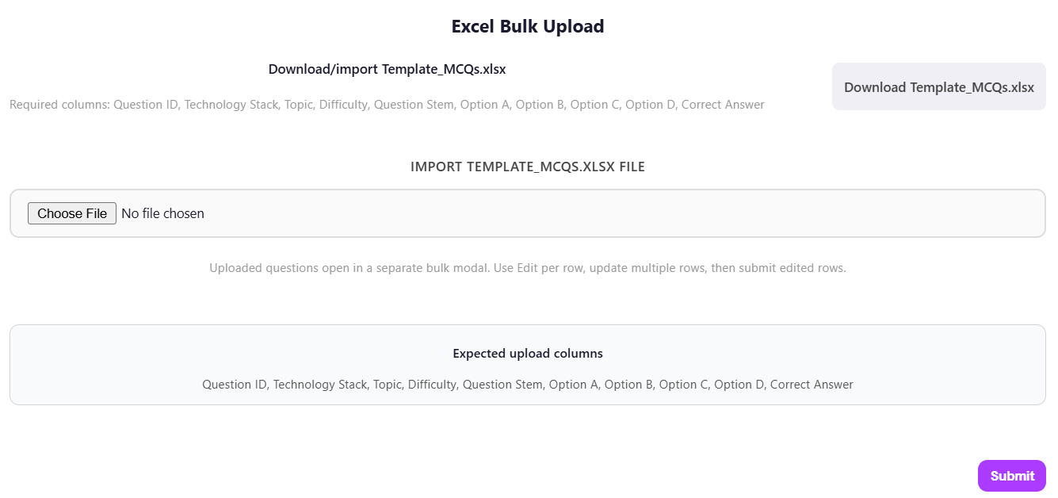
Role: SME Functionality: Upload Bulk Questions
Upon uploading the Template_MCQs.xlsx file populated with MCQs, the system should validate the required fields: technology stack, topic, difficulty level, question stem, four options, and the correct answer.
After successful validation, the imported MCQs should be available on the “My Questions” tab with the status set to Draft. The SME can edit the questions from there and send for review.
Clicking the Bulk Upload option should display a form as below:
Clicking the Download Template button should download the existing Template_MCQs.xlsx file.
Kindly note this page is for reference only and participants have the liberty to design it as per their ideas. Sample technology stack list is given in slide 5.

Slide 10
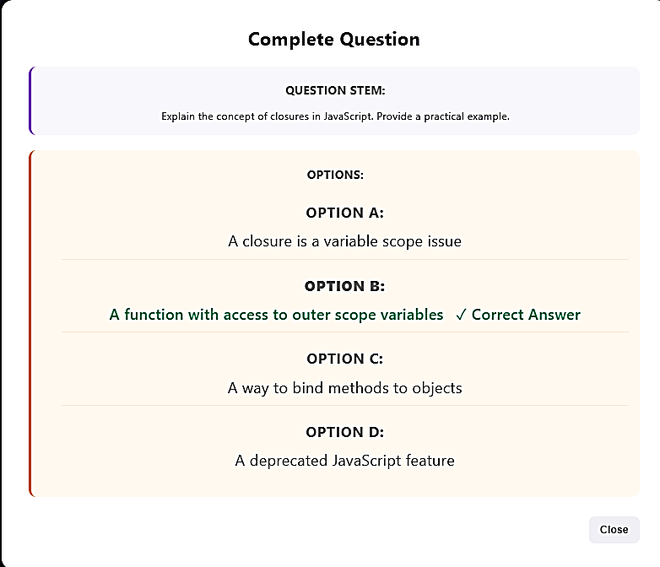
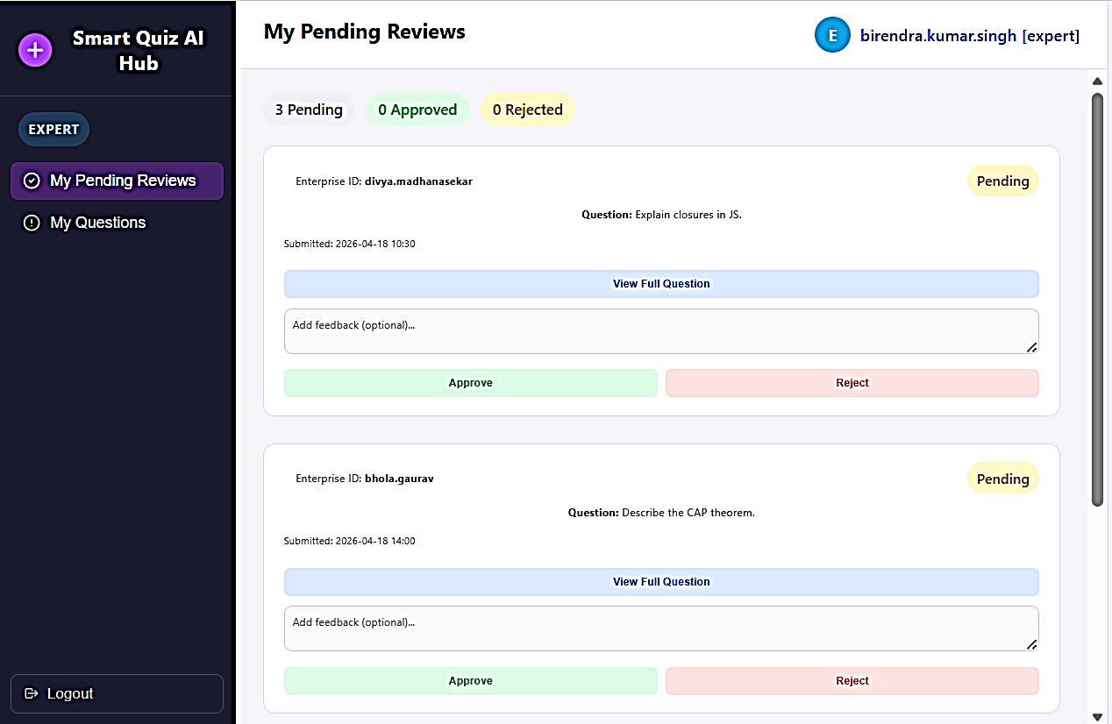
Role: SME Functionality: Review Questions
Clicking the “My Pending Review” tab should display only the MCQs that have been assigned to the SME by the Admin and have the status of “Under Review” in the database. These MCQs should be displayed with a “Pending” label in UI.
The SME can view the question by clicking the View Full Question button.
The reviewer SME should be able to provide feedback in the Feedback textbox on the main page and approve or reject the question.
Once the reviewer SME approves or rejects a question, the updated status (Approved or Rejected) should be reflected under the creator SME’s “My Questions” tab accordingly.
Kindly note this page is for reference only and participants have the liberty to design it as per their ideas. Sample technology stack list is given in slide 5.

Slide 11
Role: Admin Functionality: Update/ Add/ Upload/ Review Questions
Admins should follow the same procedure as SMEs when adding, updating or reviewing questions.
Therefore, the “My Questions” and “My Pending Reviews” interfaces will function identically to those used by SMEs.

Slide 12
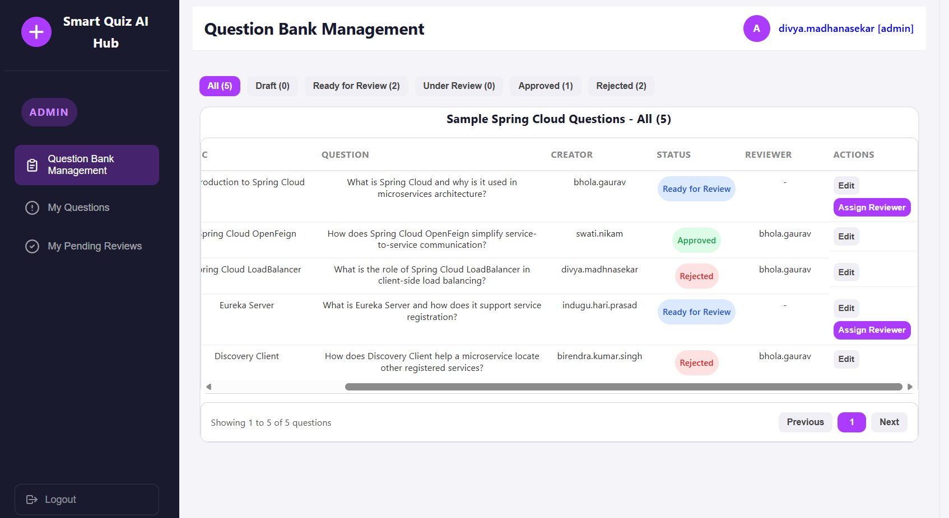
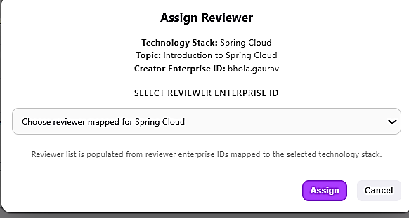
Role: Admin Functionality: Question Bank Management
After the Admin SME logs in and selects the “Question Bank Management” tab, all questions from the question bank should appear in a paginated tabular UI showing the creator's SME enterprise ID.
Under Actions column, the “Assign Reviewer” button should allow the Admin to assign an SME reviewer to questions marked as “Ready for Review”. Regardless of the MCQ’s status, the admin can always edit it by selecting the Edit button under Actions column.
Clicking the “Assign Reviewer” button in the Tabular UI should open a form where the Admin can select a reviewer SME from a dropdown list. This dialog box should include details such as the Question’s Technology Stack, Topic, and the enterprise ID of the Creator SME.
A list of all SMEs that match the MCQ’s technology stack should be available, excluding the creator SME to avoid self-review. The admin can also assign another admin as the reviewer.
Clicking the “Assign” button should assign the chosen SME as the reviewer and the MCQ status should change to “Under Review” in the database. This change should also be visible on the “Question Bank Management” screen.
Kindly note this page is for reference only and participants have the liberty to design it as per their ideas. Sample technology stack list is given in slide 5.

Slide 13
Assumptions
There are two user roles: SME and Admin, both of whom can log in and access the site.
A master list of technology stacks and topics is stored in the database and used to populate dropdown lists in the UI for both SMEs and Admins.
The database will contain a master list of SMEs tagged with their specific skills (technology stacks).
For bulk uploading MCQs through the application UI, refer to the attached Excel file: Template_MCQs.xlsx

Slide 14
Sample Quiz Question data
Question_id | Question_Stem | Option_A | Option_B | Option _C | Option_D | Correct_answer | Difficulty | Stack_id | Topic_id | E_id | status
1001 | Alex is building a microservices-based system using Spring Boot. He wants features like centralized configuration, service discovery, and client-side load balancing without building everything from scratch. Which is the primary purpose of Spring Cloud? | To replace Spring Boot completely | To provide tools for building distributed systems and microservices | To manage only database transactions | To handle only UI development | B | Medium | 1001 | 1001 | birendra.kumar.singh | Ready for review
1002 | John has multiple instances of a service running dynamically in the cloud. He wants each service to automatically register itself and discover others without hardcoding URLs. Which component is used for this purpose? | Spring MVC | Eureka Server | Hibernate | Apache Tomcat | B | Medium | 1001 | 1001 | birendra.kumar.singh | Approved

Slide 15
Master list of Technology Stack and Topics
Stack_id | Stack_name
1001 | Spring Cloud
1002 | Spring Boot
1003 | Spring Core
1004 | Spring MVC & REST
1005 | Spring ORM & Data JPA
1006 | Core Java
topic_id | Stack_id | Topic_name
1001 | 1001 | Introduction to Spring Cloud
1002 | 1001 | Service Discovery design pattern – Eureka Server & Discovery Client
1003 | 1001 | Eureka Heartbeats & Self Preservation
1004 | 1001 | Spring Cloud Loadbalancer
1005 | 1001 | Spring Cloud OpenFeign
1006 | 1001 | Resilience4J- Circuit Breaker
1007 | 1001 | Spring Boot Actuator

Slide 16
Master list of SME Technology Stack Mapping
enterprise_id | Stack_name
gaurav.a.bhola | Spring Cloud
birendra.kumar.singh | Spring Boot
gaurav.a.bhola | Spring Core
divya.madhanasekar | Spring MVC & REST
divya.madhanasekar | Spring Cloud
swati.avinash.nikam | Spring Boot
indugu.hari.prasad | Spring Cloud

Slide 17
THANK YOU !!!

