Slide 1
· ANALYTICS REPORT
IT Ticket Analysis
97,498 Tickets | 50 IT Agents | 2016 – 2020
Prepared by Rupesh Kumar

Slide 2
BUSINESS CONTEXT
Problem Statement
The Challenge
This Analysis Answers
Analyze IT support ticket data to evaluate agent performance, ticket resolution efficiency, and employee satisfaction. Identify performance gaps, operational bottlenecks, and high-impact improvement areas to support data-driven decisions around staffing, training, workload allocation, and service quality.
Between 2016 and 2020, the IT service desk fielded 97,498 support tickets from 2,000 employees, handled by a team of 50 agents. Ticket volume nearly tripled over that period, rising from roughly 13,000 tickets in 2016 to over 29,000 in 2020 — and the growth rate is still accelerating. Leadership currently lacks a consolidated, data-driven view of where ticket volume concentrates, how efficiently different issue types are resolved, how consistent service quality is across agents and employee segments, and whether current staffing and triage processes can keep pace with rising demand.
Where does ticket volume concentrate, and is it growing sustainably?
Which issue categories take longest to resolve, and why?
Are tickets being triaged and prioritized effectively at intake?
Is employee satisfaction improving, and where are the gaps?
What should management act on first for the biggest impact?
Business Value
A single, reliable view that turns raw ticket data into staffing, process, and training decisions.
02

Slide 3
FOUNDATION
Data Overview
97,498
50
2016–2020
4.55 days
4.10 / 5
Total Tickets
(Cleaned Data)
IT Agents
Date Range Covered
Avg. Resolution Time
Avg. Satisfaction Rate
Tickets
IT Agents
Cleaned Data
97,498 rows × 10 columns
50 rows × 6 columns
97,498 rows × 21 columns
Raw ticket-level export: Ticket ID, Date, Employee ID, Agent ID, Category, Issue Type, Severity, Priority, Resolution Time, Satisfaction Rate, Agent Name.
Agent reference table: Agent ID, Full Name, Email, Year/Month/Day of Birth, Email Domain, and current Age — joined into ticket data via Agent ID.
Analysis-ready dataset: standardizes labels (e.g. “Unclassified”, “Unassigned”) and adds derived fields — Year, Quarter, Month-Year, Day of Week, Age Band, and parsed Email fields.
How the datasets connect & data quality
Tickets and Cleaned Data share a 1:1 ticket record, joined to IT Agents through Agent ID to bring in agent age and identity. Cleaned Data is the standardized, analysis-ready version of Tickets: it corrects inconsistent labels found in the raw export (e.g. “0 - Unclasified” -> “0 - Unclassified”) and adds derived time and demographic fields — evidence of a deliberate data-preparation step prior to dashboarding.
03

Slide 4
DASHBOARD ANALYSIS · 1/9
Ticket Volume Trend by Month
KEY INSIGHTS
Volume is fairly stable year-round (7,242–8,495), but the second half of the year runs consistently higher — Aug, Sep, Oct and Dec all exceed 8,200 tickets, roughly 12–17% above the January low.
January is the clear trough (7,242), suggesting reduced activity right after year-end, while October is the single busiest month (8,495).
The 17% spread between the lowest and highest month is a moderate but real seasonal swing worth planning around rather than dismissing as noise.
APPROACH
Seasonality analysis of ticket counts aggregated by calendar month across all five years (2016–2020).
RECOMMENDATION
Shift a portion of agent capacity toward Aug–Oct and December to match the recurring seasonal peak, rather than staffing all months identically.
04

Slide 5
DASHBOARD ANALYSIS · 2/9
Ticket Category Distribution
KEY INSIGHTS
System issues are the single largest driver of ticket volume at 40% (39,002 tickets) — four times the share of Hardware (10%).
System and Login Access together account for 70% of all tickets, meaning the majority of the desk’s workload is concentrated in just two categories.
Hardware, while the smallest category by volume (10%), turns out to be the slowest to resolve — volume share alone understates its operational cost.
APPROACH
Composition analysis of ticket volume by request category.
RECOMMENDATION
Prioritize root-cause and self-service investment in System tickets first — at 40% of volume, even a modest reduction in recurrence has the largest fleet-wide impact.
05

Slide 6
DASHBOARD ANALYSIS · 3/9
Satisfaction Rate Trend + 2021–22 Projection
KEY INSIGHTS
Average satisfaction rose every single year from 2016 (3.98) to 2020 (4.16) — a sustained +4.5% improvement with no reversals.
Projected values for 2021–22 (4.21, 4.25) simply extend the observed trend line, implying satisfaction gains are structural, not a one-year blip.
A steady multi-year climb this consistent usually reflects compounding process or training improvements rather than a single change.
APPROACH
Time-series trend analysis with linear forward projection for 2021–22.
RECOMMENDATION
Identify and formally document what changed operationally each year (2016–2020) to keep replicating it — losing track of the driver risks flattening the projected 2021–22 gains.
06

Slide 7
DASHBOARD ANALYSIS · 4/9
Average Resolution Time by Category
KEY INSIGHTS
Hardware tickets take 7.63 days on average to resolve — nearly 25× longer than Login Access tickets (0.31 days), the widest gap on the dashboard.
System, the highest-volume category (40% of all tickets), is also the second-slowest to resolve (6.62 days) — a combination that drives a disproportionate share of total resolution effort.
Login Access resolves in under a day on average, confirming it behaves like a largely automatable, low-effort category (e.g. password/account resets).
APPROACH
Comparative benchmarking of average resolution time across request categories.
RECOMMENDATION
Target Hardware and System jointly: pre-stock common spare parts and build standardized System troubleshooting runbooks — these two categories offer the largest realistic cut to overall average resolution time.
07

Slide 8
DASHBOARD ANALYSIS · 5/9
Total Tickets by Severity Type
KEY INSIGHTS
90.9% of all tickets (88,656) are labeled “Normal” severity — Major and Urgent combined make up just 6.4%, meaning severity tagging currently offers little ability to differentiate urgency.
356 tickets (0.4%) are left “Unclassified,” a small but avoidable data-quality gap since severity should be assigned at intake.
With such heavy concentration in one bucket, genuinely urgent issues may not be visibly distinguished from routine ones in queue management.
APPROACH
Distribution analysis of ticket counts across severity classifications.
RECOMMENDATION
Review and tighten the severity-assignment criteria so “Normal” isn’t a default catch-all, and enforce a mandatory severity field at ticket creation to eliminate the Unclassified bucket entirely.
08

Slide 9
DASHBOARD ANALYSIS · 6/9
Total Ticket Volume by Priority
KEY INSIGHTS
36.5% of tickets (35,549) are High priority — the single largest priority bucket, meaning over a third of all volume is business-critical by the desk’s own tagging.
30.2% of tickets (29,410) sit in “Unassigned” priority — nearly one in three tickets bypasses prioritized routing altogether.
The remaining Low and Mid tiers are comparatively balanced (17% and 16%), so the real gap is the large Unassigned slice, not an imbalance among the assigned tiers.
APPROACH
Distribution of ticket volume by priority tier.
RECOMMENDATION
Make priority a mandatory field enforced at ticket intake (system rule or SLA policy) — closing the 30% Unassigned gap is the single fastest way to make routing and SLA reporting trustworthy.
09

Slide 10
DASHBOARD ANALYSIS · 7/9
Ticket Volume Trend by Year
KEY INSIGHTS
Ticket volume grew 123% over five years — from 13,051 in 2016 to 29,088 in 2020 — with no year-over-year decline.
Growth is accelerating, not leveling off: year-over-year increases were +14%, +27%, +13%, then +35% in the final year (2019 - 2020), the largest single jump in the series.
At the current trajectory, ticket demand is on track to keep outpacing prior-year levels, putting sustained pressure on a fixed 50-agent team.
APPROACH
Year-over-year growth-rate (trend) analysis of total ticket volume.
RECOMMENDATION
Build a capacity plan now — agent hiring, automation, or self-service deflection — sized to the accelerating +35% growth rate, not the 5-year average, to avoid falling behind demand.
10

Slide 11
DASHBOARD ANALYSIS · 8/9
Average Satisfaction Rate by Age Group
KEY INSIGHTS
Satisfaction doesn’t move linearly with agent age: the 54-58 age band scores highest (4.39), while the 34-38 band scores lowest (3.96) — a 0.43-point (11%) gap between them.
The most experienced agent band (54-58) outperforms every other group, suggesting tenure/experience correlates with better service outcomes.
The dip is isolated to the 34-38 band rather than a gradual decline, pointing to a specific, addressable segment rather than a broad age effect.
APPROACH
Segmentation analysis comparing average satisfaction across agent age bands.
RECOMMENDATION
Pair agents in the 34-38 band with senior mentors from the 54-58 band and review their ticket mix/coaching needs — closing this single segment’s gap lifts the desk-wide average.
11

Slide 12
DASHBOARD ANALYSIS · 9/9
Distribution of Tickets Based on Resolution Time
KEY INSIGHTS
Same-day turnaround dominates: 25,071 tickets (over 25% of overall volume) are resolved on Day 0, demonstrating fast initial response efficiency.
Secondary peak at Days 5–7: Resolution volume spikes again between Days 5 and 7 (23,173 tickets), reflecting standard weekly SLA limits and escalated cases.
APPROACH
Frequency distribution mapping of resolution turnaround times (in days) across total ticket volume to evaluate SLA adherence and identify cycle-time bottlenecks.
RECOMMENDATION
Streamline mid-tier workflows to compress the Day 5–7 resolution peak, and implement automated triggers for tickets approaching Day 10 to eliminate long-tail delays.
12

Slide 13
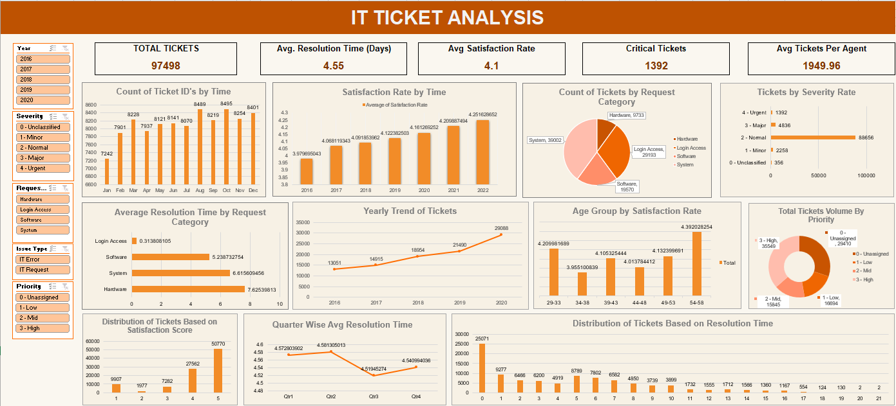
SYNTHESIS
Dashboard Overview & Key Findings
The Overall Story
Demand is outgrowing the current model: ticket volume more than doubled 2016–2020, with growth accelerating (+35% in the final year) against a flat 50-agent headcount.
Two categories — System and Login Access — drive 70% of workload, and System is simultaneously high-volume and slow to resolve, making it the top efficiency lever.
Almost 30% of tickets carry no priority and 91% share one severity tag, limiting the desk’s ability to route true urgency.
Despite rising volume, satisfaction has improved every year (3.98 → 4.16), showing service quality is not (yet) breaking down under load.
Service consistency varies by agent segment (age 34-38 lags at 3.96 vs. 4.39 for 54-58), pointing to a targeted coaching opportunity rather than a system-wide issue.
13

Slide 14
ACTION PLAN
Strategic Recommendations
1
Workload Optimization
5
Agent Performance
Observation: Ticket volume grew 123% (2016–2020) with the growth rate accelerating (+35% in the last year). Impact: Fixed 50-agent capacity will fall further behind demand, risking SLA breaches. Action: Build a capacity plan (hiring, automation, self-service) sized to the accelerating growth rate, not the historical average.
Observation: Satisfaction varies by agent age band: 34-38 lags at 3.96 vs. 4.39 for the 54-58 band. Impact: Uneven service quality across agent segments affects the overall employee experience. Action: Pair the 34-38 agent segment with senior mentors and review their ticket mix and coaching needs.
2
Operational Efficiency
6
Management Monitoring
Observation: System tickets are both the highest-volume category (40%) and the 2nd-slowest to resolve (6.62 days). Impact: This single category drives a disproportionate share of total resolution effort. Action: Prioritize root-cause reduction and self-service deflection specifically for System tickets.
Observation: Satisfaction has risen every year since 2016 (3.98 → 4.16), projected to reach ~4.25 by 2022. Impact: The gains are real but currently undocumented as to root cause. Action: Formally track and document the process changes behind each year’s gain to protect the projected trend.
3
SLA / Resolution Improvement
7
Process Improvement
Observation: Hardware tickets take 7.63 days to resolve on average — ~25× longer than Login Access (0.31 days). Impact: Hardware resolution time is the single largest drag on overall average turnaround. Action: Pre-stock common spare parts and set a dedicated Hardware SLA track distinct from software/access issues.
Observation: 356 tickets remain “Unclassified” in severity — a small but avoidable data-quality gap. Impact: Incomplete tagging slightly understates true Major/Urgent volume and weakens future reporting. Action: Add validation rules requiring severity classification before a ticket can be submitted.
4
Ticket Management
Prioritization
Observation: 30% of tickets have no priority assigned and 91% share a single “Normal” severity tag. Impact: True urgency is not distinguishable in the queue, risking delayed response to real emergencies. Action: Make priority and severity mandatory fields at intake, enforced by the ticketing system.
Items 1–3 offer the greatest business impact and should be sequenced first; items 4–7 sustain and protect those gains.
14

Slide 15
CONCLUSION
Data-Driven Decisions for a Growing Service Desk
What we found
Main challenge
Ticket demand has grown 123% since 2016 and is still accelerating, concentrated heavily in System and Login Access issues.
Triage gaps — 30% of tickets unassigned in priority, 91% sharing one severity tag — limit visibility into true urgency.
Biggest opportunity
Expected value
System and Hardware tickets combine high volume (or long resolution time) with the clearest levers for improvement.
Tighter triage, targeted process fixes, and proactive capacity planning can protect the satisfaction gains already achieved (3.98 → 4.16) as volume keeps rising.

Slide 16


