Slide 1







Emotion Recognition Using Multimodal Deep Learning
- GROUP 35
Rupesh - S20210010173
Varun - S20210010176

Slide 2





Introduction
Nowadays, many human machine interface (HMI) products are used by ordinary people and more HMI equipments will be needed in the future.
Emotional functionality in HMI products holds significant importance in everyday interactions
Many researches are going on emotion recognition and many researchers studied this from EEG

Slide 3


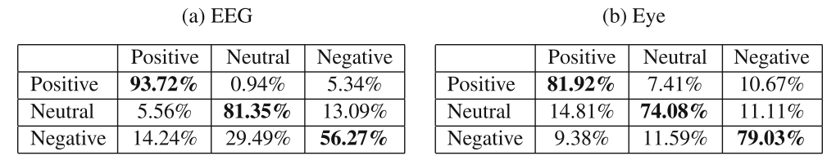


Idealogy of the Paper
These are the confusion matrices that are obtained when the emotion recognition is done using single modality data
The Aim of this paper is to build a Bimodal Deep Auto Encoder which extracts high level features from both datasets and uses those features for classification of different emotions

Slide 4

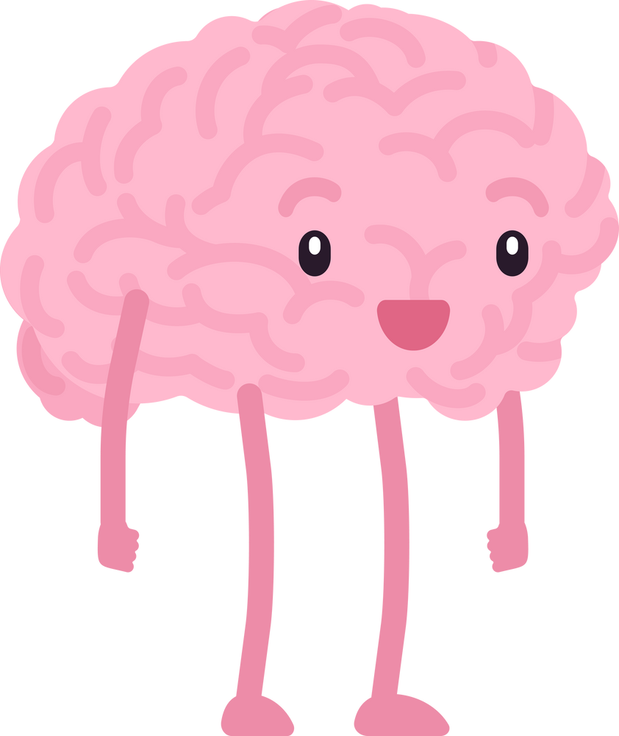


Dataset
The DEAP dataset contains 32 channel EEG signals and 8 peripheral physiological signals.
These signals are collected from 32 subjects when they were watching 40 one-minute long small clips
The subjects are asked to do self-assessment by assigning values from 1 to 9 to different status like valence, arousal, dominance, liking.
Among all of the data, 90 % samples were used as training data and the rest 10 % samples were used as test data

Slide 5
Contd....
Authors of this paper also worked with SEED dataset as well.
SEED dataset contains EEG signals and eye movement signals of three different emotions (positive, negative, and neutral)
These signals are collected from 15 subjects during watching emotional movie clips
There are 15 movie clips and each clip lasts about 4 min long

Slide 6
Model Construction
Here we use multimodal emotion recognition framework using deep learning
There are three steps involved in total
Step - I : The first step is to train the Bimodal Deep Auto Encoder(BDAE) network.
Step - II : The second step is Supervised training
Step - III : The Third step is testing.

Slide 7

Step -I
The BDAE training procedures, including encoding part and decoding part . This step is also called as Feature Selection
In encoding part, we first train two RBMs (Restricted Boltzmann Machine) for EEG features and eye movement features
After training these two RBMs, hidden layers are concatenated together.
In decoding part, we reconstruct the EEG and Eye features
When unfolding the stacked RBMs to reconstruct input features, we keep the weight matrices tied
Finally we use, back-propagation algorithm to fine-tune the weights and bias.

Slide 8
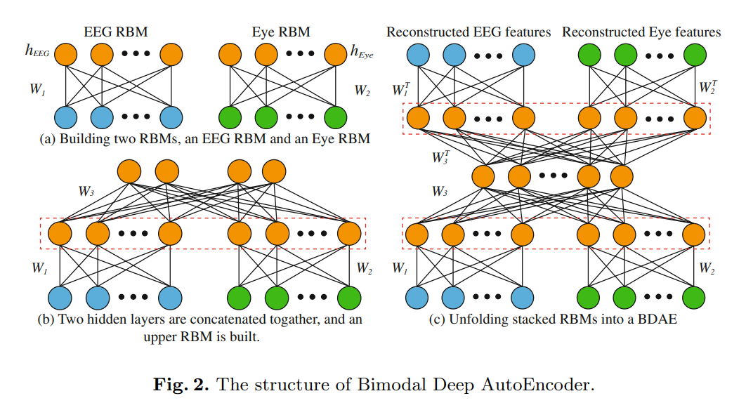
Contd.

Slide 9




Step -II
In the above step, BDAE network is used to generate high level features from low level features or original data
In this step, a SVM (Support Vector Machine) is trained with extracted high level features
Step -III
In the above step, the model is trained and ready for testing purposes
The trained model is tested on test dataset.

Slide 10
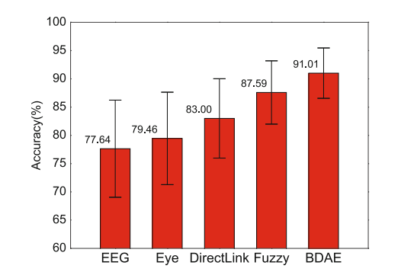
Results
When multimodal information is available, features of different modalities are linked directly and different emotions are recognized with the concatenated features by SVM
Here the first two bars denote single modality
The rest bars denote multimodal with different fusion strategies

Slide 11
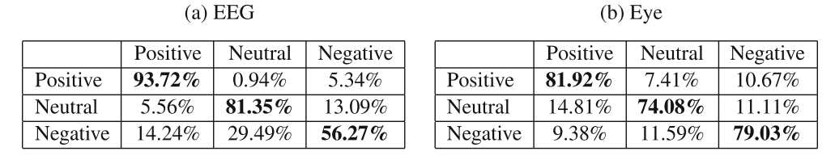
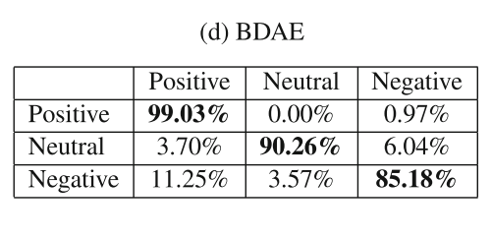
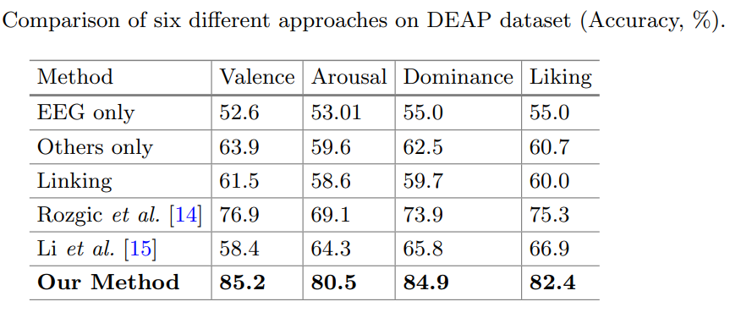
Contd.

Slide 12
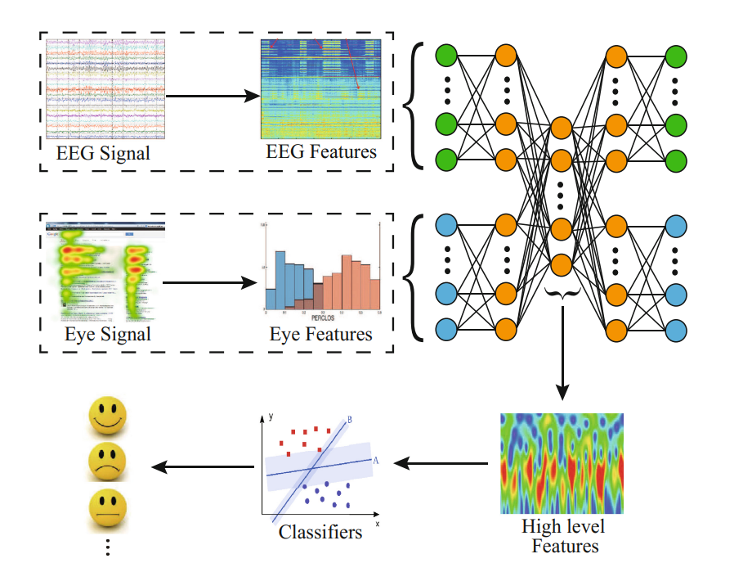
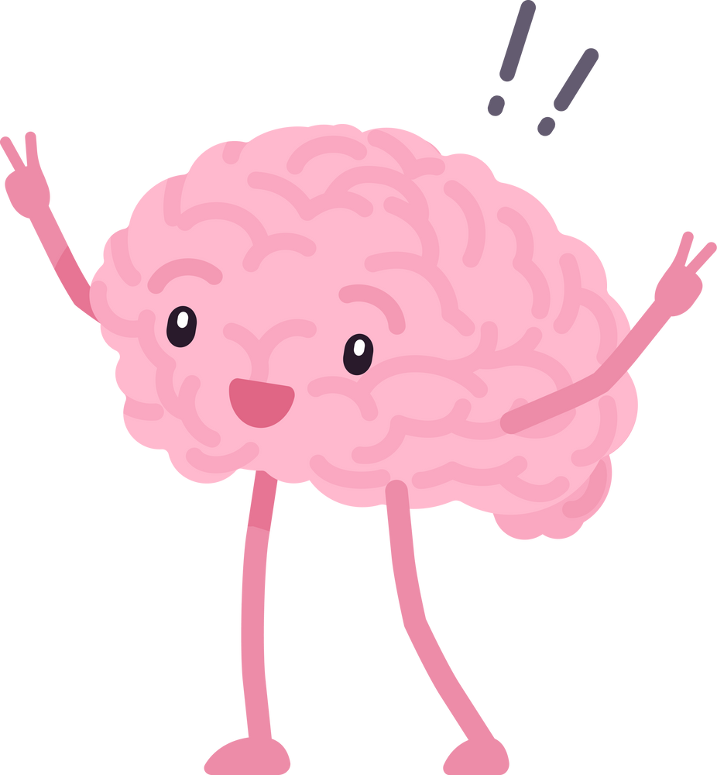
Overall Work Flow

Slide 13
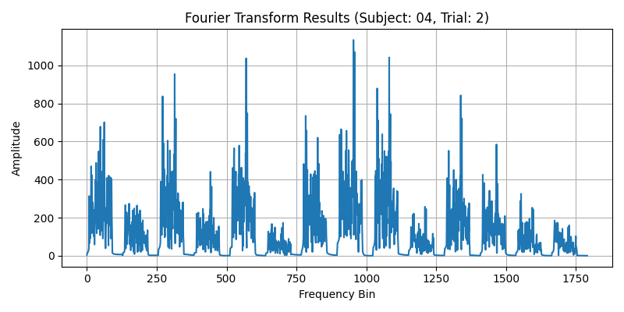

Data Pre-processing

Slide 14
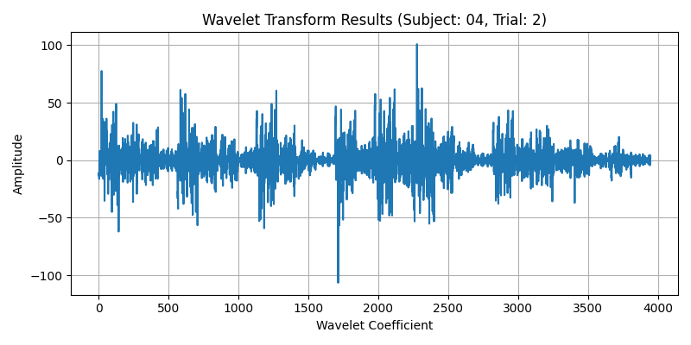

Contd.

Slide 15
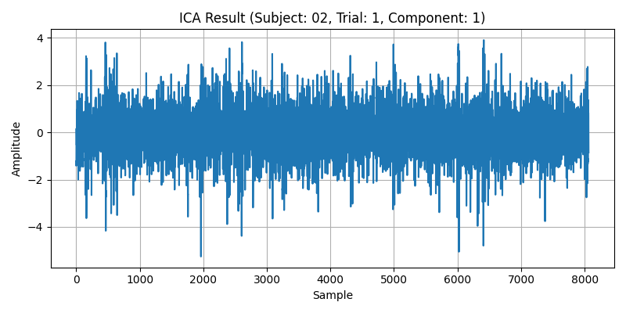
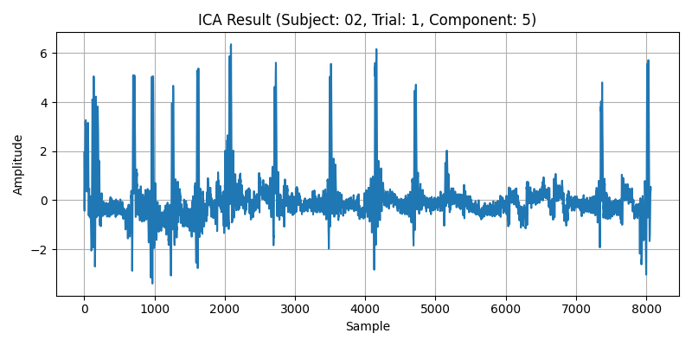
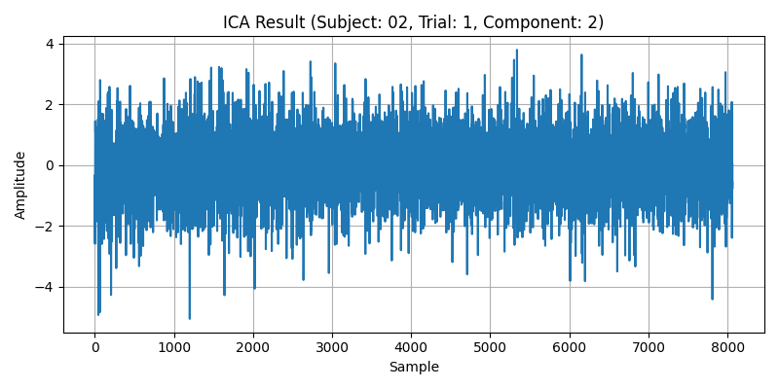
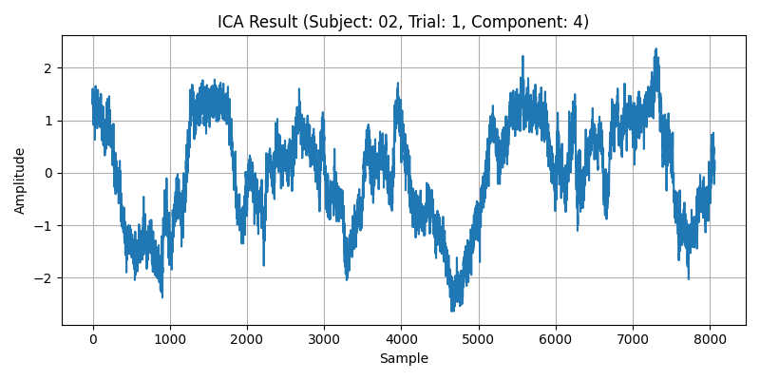
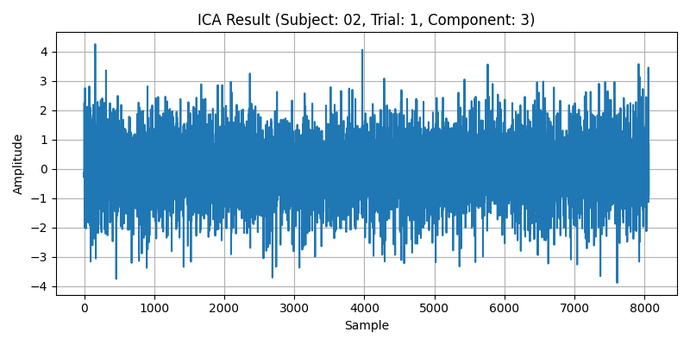

Contd.

Slide 16
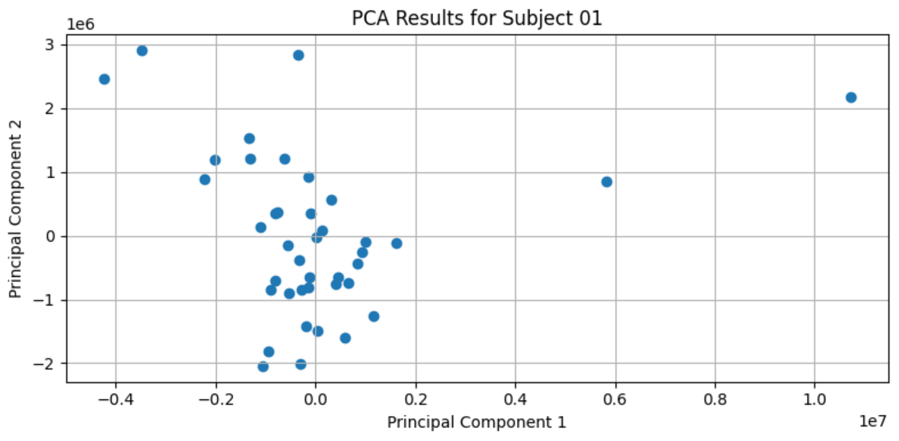

Contd.

Slide 17
Model Implementation
We have build a model by considering the DEAP dataset using the SVM classifier and Linear Regression
We extracted features from the signals, including variance, mobility, and complexity.
We normalized the extracted features using Min-Max scaling.
Later we trained the SVM classifier, using these extracted features
After we tested it on the test data using SVM classifier , which led to an test accuarcy of 53.90625
The results are true and already mention in results section of this presentation

Slide 18
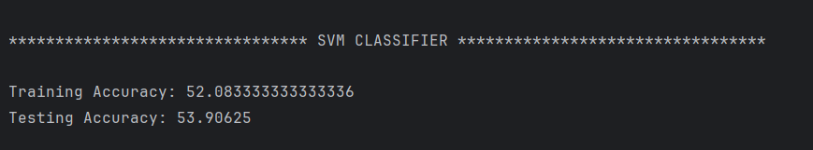
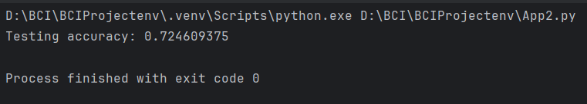
Contd.
SVM Classifier
Also, we used the test data to test using the linear regression, which led to an test accuarcy of 72.4609375
Linear Regression

Slide 19
Thank you!!!
- GROUP 35

