Slide 1

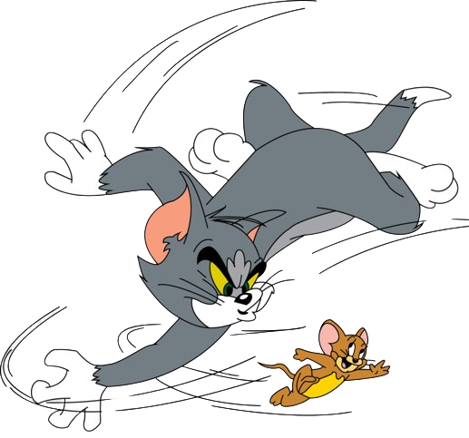


Multimedia Systems
S2024 Project
TOM AND JERRY
FREE FALL FRENZY
Rupesh chowdary (S20210010173)
Ramtej somisetty (S20210010211)

Slide 2
INTRODUCTION
Welcome to Tom and Jerry Free Fall Frenzy'!. In this game, Jerry falls from the sky, trying to avoid Tom while collecting cheese for extra lives. But watch out! Tom gets faster as jerry go down. Can you help Jerry escape? Let's dive into this exciting adventure filled with cheese, challenges, and endless excitement!

Slide 3
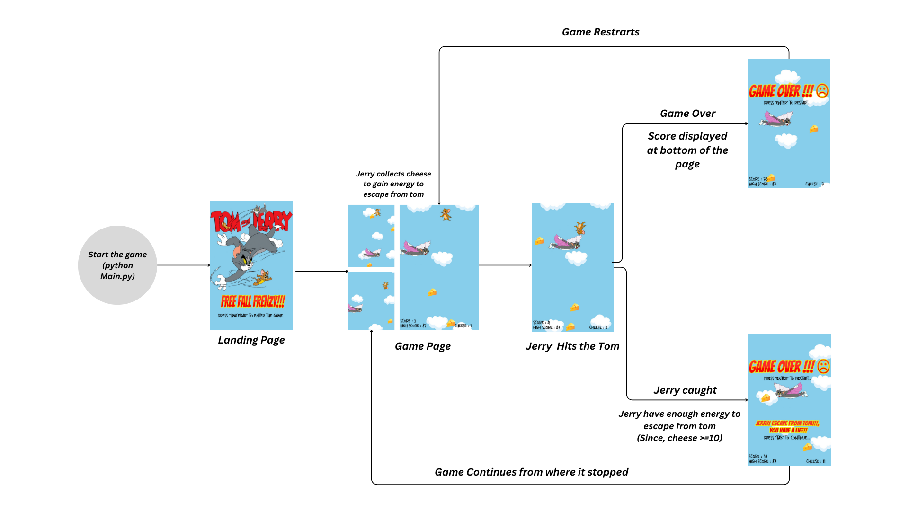
HOW TO PLAY?

Slide 4


Intialization
PACKAGES USED
Event Handlers
[pygame.init()]
[pygame.event.get()]
pygame Library
intialize all imported pygame modules
retrives a list of all the events that occured
Screen Setup
Sound
[pygame.display.set_mode()]
[pygame.mixer.sound()]
creates a window with specified width and height
Sound effects and music are loaded and played
Image Loading
Reactangle
Drawing
[pygame.image.load()]
[pygame.rec.Rect()]
image are scaled and tranformed as needed
[pygame.screen.blit()]
create Rectangle for
drawing shapes
drawing images into the screen at specified coordinates

Slide 5
PACKAGES USED
Random Number Generation
RandomChoice
[random.randint(a,b)]
[random.choice(seq)
It is used to generate a random integer btw a and b like generating random cloud types
choose a random element from a sequence (seq).
determining whether to generate one or two clouds .
Random Module
Randomized Enemy Movement
Randomized Cloud Placement
The speed of enemies is determined based score using current score//15
The placement of clouds and cheeses is random within certain constraints

Slide 6
CONTRIBUTIONS
RUPESH
RAMTEJ
Developed the logic of setting clouds and cheese positions
Developed the Landing page of
the game
Developed the logic of the both clouds and cheese moving up
Responsible for all the sound and
music effects
Developed the logic of movement of jerry to left and right of the game window
Developed the logic of jerry collecting cheese and bouncing on cloud
Developed the logic of jerry free falling
Developed the logic of tom catching the jerry
Developed the logic of tom moving
left and right
Developed the extra life logic for jerry
Developed all the event and exit handlers for the game
Developed the GAME OVER Page and included file handling to store highest score

Slide 7
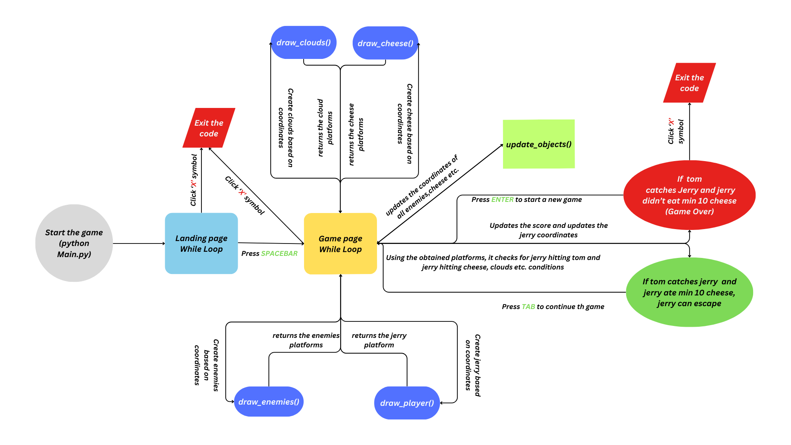
DETAILED WORK FLOW

Slide 8
CONCLUSION
In conclusion, we built a vertical scrolling platformer game where the player controls Jerry, collecting cheese while avoiding obstacles represented by Tom.
The game utilizes various features of Pygame such as image loading, collision detection, and event handling to create an interactive gaming experience
Players control Jerry's movement with the left and right arrow keys, aiming to collect cheese and avoid collisions with Tom.

Slide 9
FUTURE WORKS
Level Design
Multiplayer
Leader Boards
Create multiple levels with different layouts, obstacles, and challenges, gradually increasing in difficulty as the player progresses
Include a multiplayer mode where players can compete against each other or collaborate in completing objectives
Implement leaderboards to allow players to compare their scores with others and compete for high rankings

Slide 10
THANK YOU
Rupesh chowdary (S20210010173)
Ramtej (S20210010211)

