Slide 1
Pansharpening using PCA
607 Satellite Image processing
Team
M Rupesh Kumar Yadav 24m0319
Rajesh Gadhvi 24m0331
Jat Ajay Annaram 23m0326

Slide 2
Workflow Overview
1. Parse inputs.
2. Open and validate datasets.
3. Resample multispectral data to match panchromatic resolution.
4. Apply PCA pansharpening.
5. Save enhanced output.

Slide 3
PCA Pansharpening Algorithm
1. Perform PCA Algorithm.
1
2. Replace the first principal component with panchromatic intensity data.
2
3. Reconstruct multispectral data using modified PCA components.
3

Slide 4
Algorithm Flowchart
Start
Parse Inputs
Open and Validate Datasets
Resample Multispectral Data
Apply PCA
Replace the 1st PCA component with Panchromatic band
InversePCT
Save Output
End

Slide 5
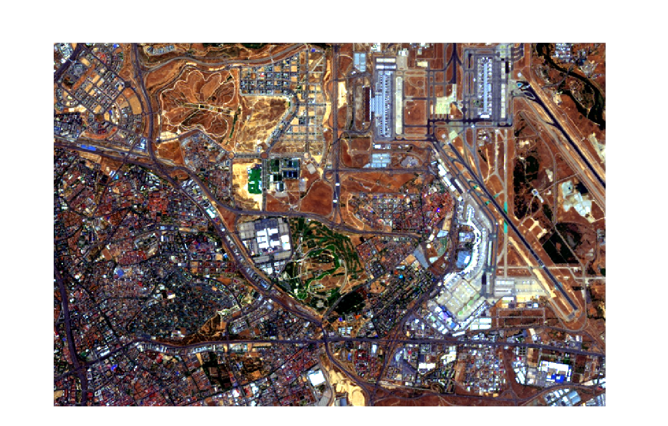
Landsat 8 Multispectral Pansharpened image using PCA
GEO: 40.472399°N/3.602001°W | MGRS: 30TVK4896980365

Slide 6

Landsat 8 Multispectral Image
GEO: 40.472593°N/3.602116°W | MGRS: 30TVK4895980387
Source: Google Earth Engine

Slide 7
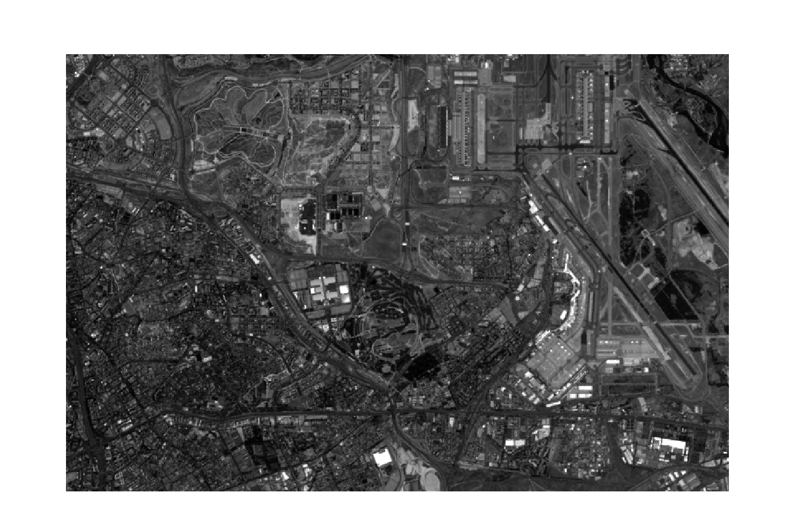
Landsat 8 Panchromatic Image
GEO: 40.472593°N/3.602116°W | MGRS: 30TVK4895980387
Source: Google Earth Engine

Slide 8
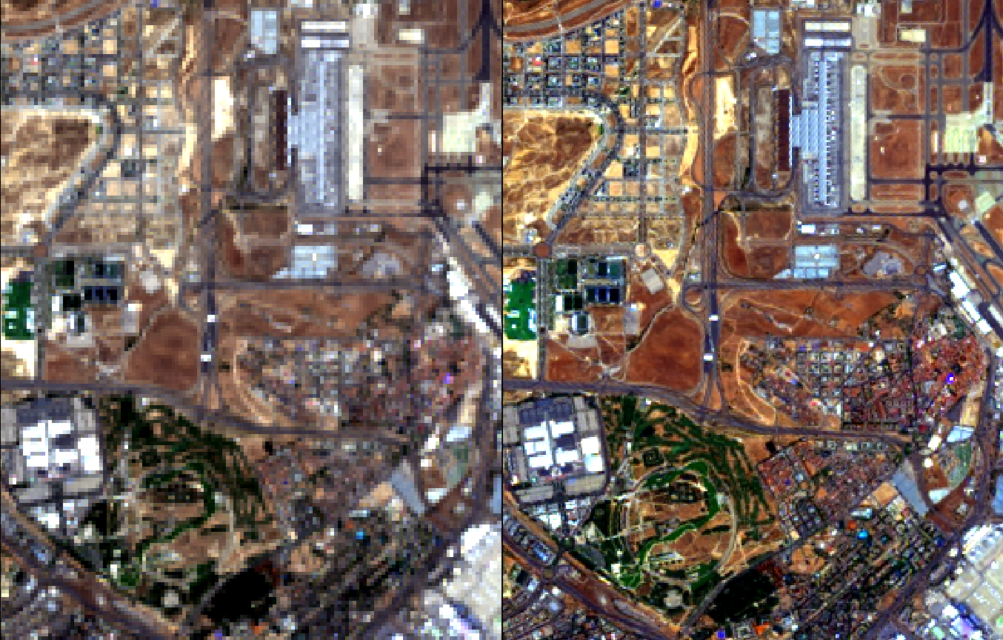
Enhancements in the Output image:
GEO: 40.477248°N/3.597487°W | MGRS: 30TVK4935580901

Slide 9
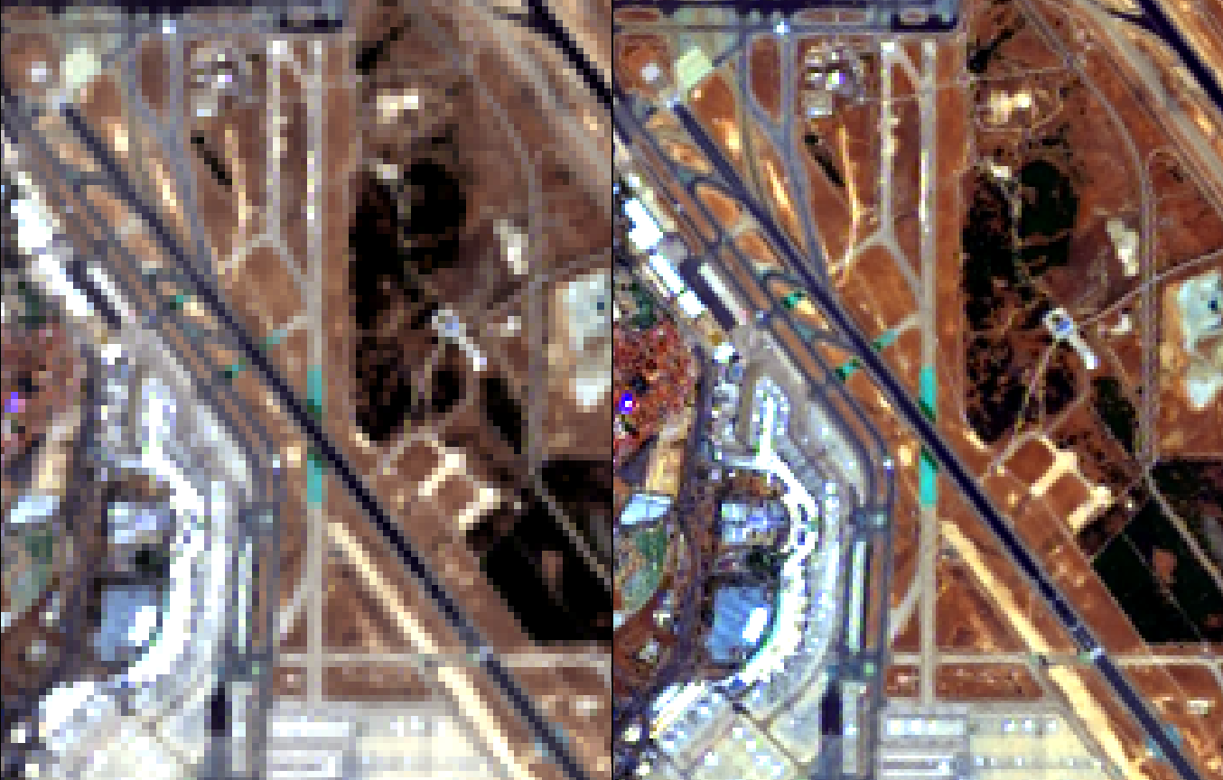
Enhancements in the Output image:
GEO: 40.473534°N/3.563197°W | MGRS: 30TVK5225980469

Slide 10
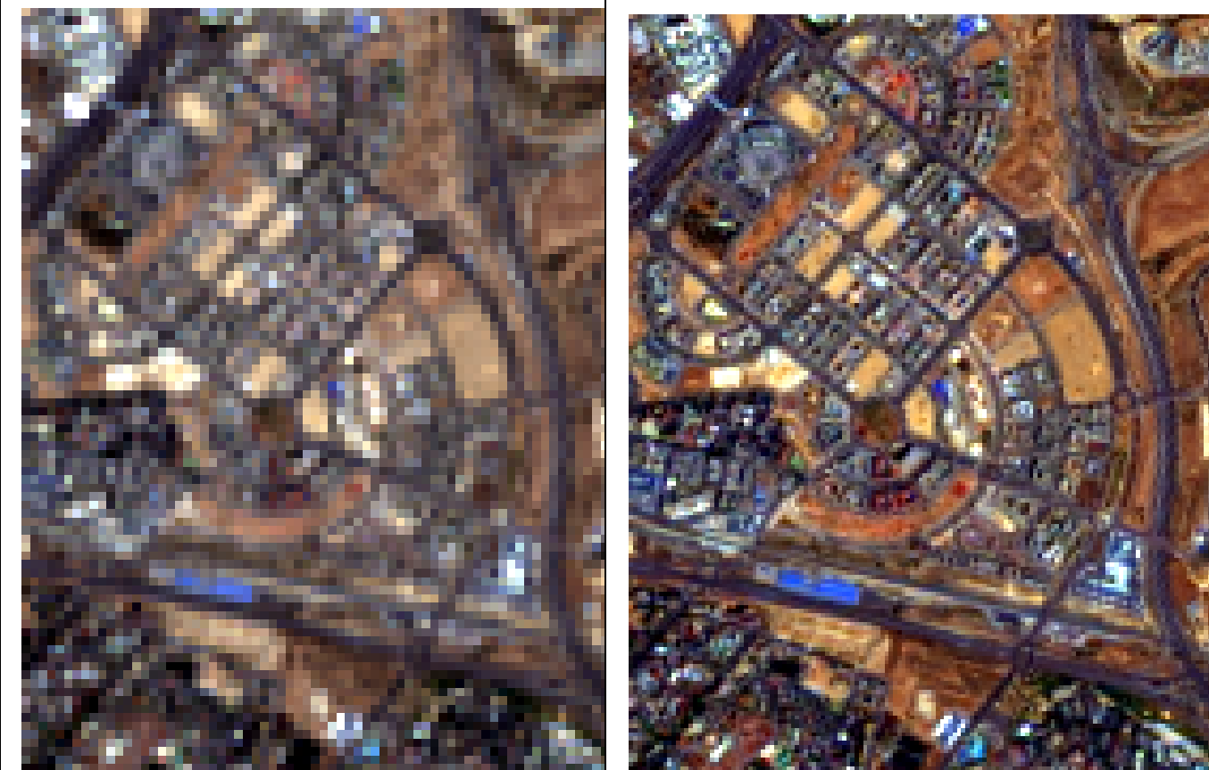
Enhancements in the Output image:
GEO: 40.489884°N/3.654942°W | MGRS: 30TVK4449682338

Slide 11
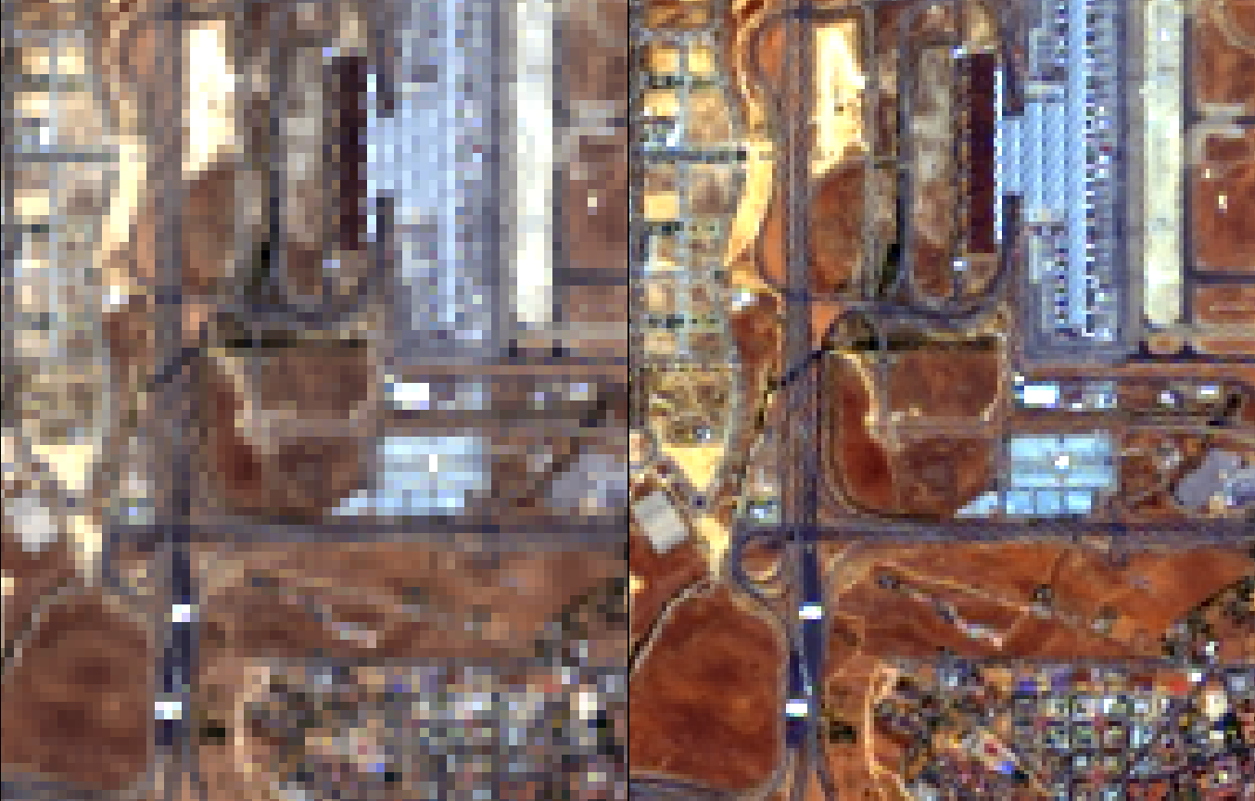
Enhancements in the Output image:
GEO: 40.483835°N/3.596127°W | MGRS: 30TVK4947681631

Slide 12
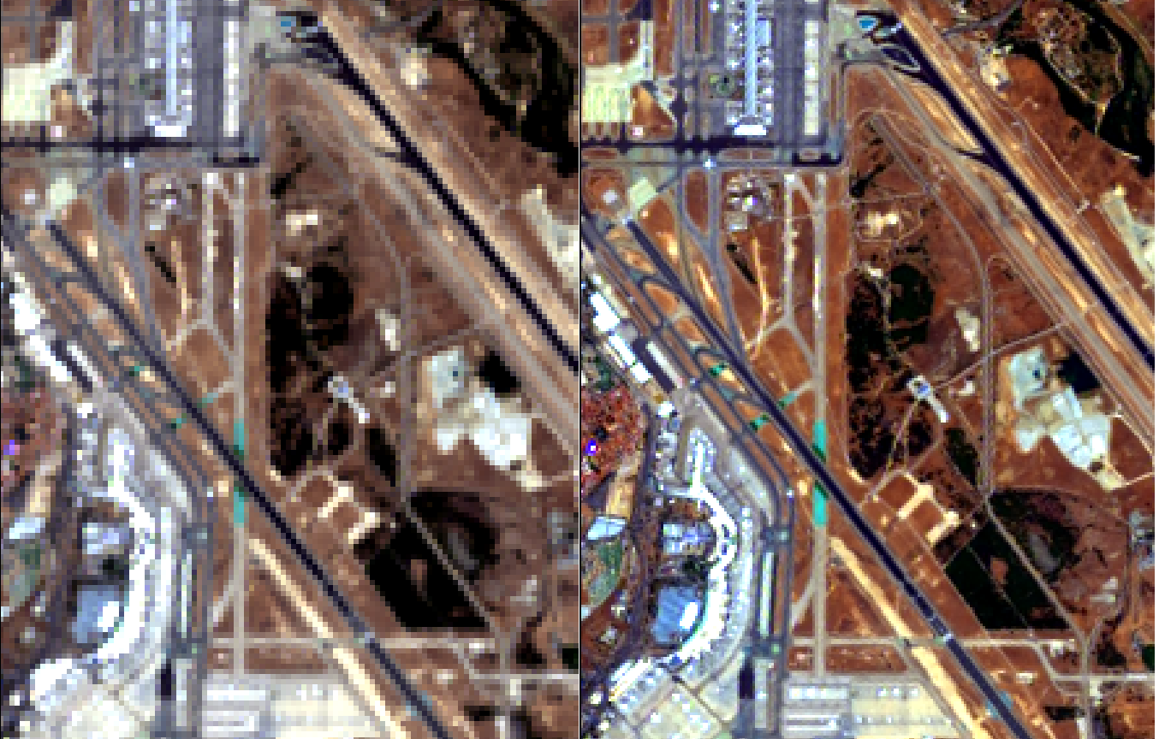
Enhancements in the Output image:
GEO: 40.477104°N/3.559330°W | MGRS: 30TVK5259080863

