Slide 2
Classes And Objects
Class →
Class is a blueprint / logical entity for an object.
Like real world entity has some properties and
behaviour which is represented by class variables and class methods in programming.
Syntax →
Class class_name:
#variables
#mehtods
This is the template of the class it dose’nt use any memory
We define only two things in class that is methods and variables.
Now to access the variables and the methods we need to take the help of objects without objects it is
not possible.
And we can’t start a class name with an underscore and a number.

Slide 3
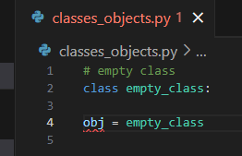
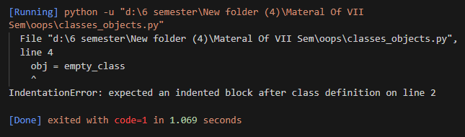
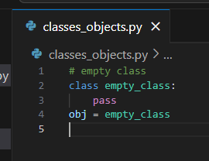
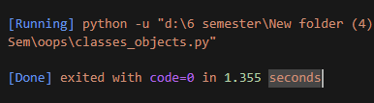
Object →
As we know class is a logical entity while an object is a real world entity or physical entity that actualy exists
that works on class data,
objects helps to access memory for class.
Note →
Each object has a distinct role or responsibility.(even if the objects are of same class).
Object creates space or memory according to class members.
Syntax to create object➔
Object_name = class_name()
Now below we have create an empty class but it gives indentation error as we have left the body of the class
Simply empty
But we use pass keyword to avoid the error as it means just pass, then we recive no error.

Slide 4
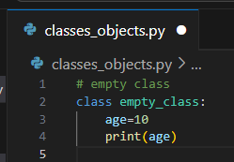
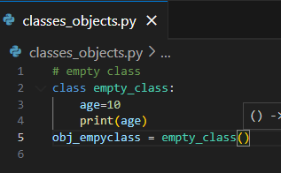
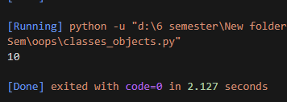
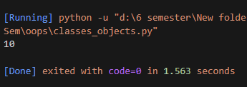
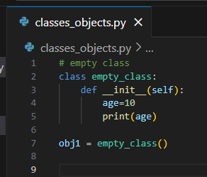
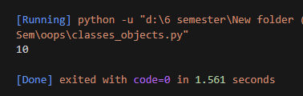
In the below code we have written some code and when we make an object then and without making the object in both the 10 is printed.
Then question comes in mind what is the use of that object ? It has it’s own advantages.
In python there is default constructor python creates on itself.
default constructor➔ def __init__(self):
This is the default constructor where self is the default reference parameter where it refers to the current object and it is used in every method of the class.
We will get the same output as without that constructor.

Slide 5
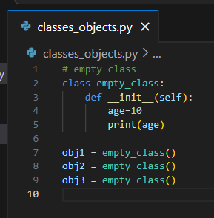
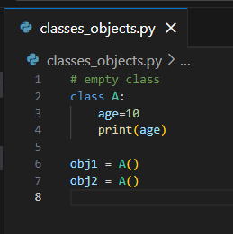
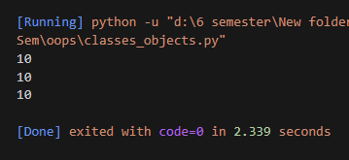
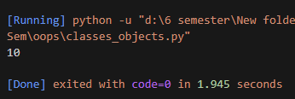
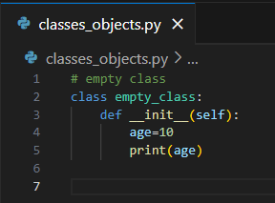

Then what is the use of creating the constructors.
Basically without the constructors we can access the variable one time even when after creating the multiple objects.
But in the case of constructor when we create multiple objects we are accessing that variable multiple time s.
Like below is the example.
Without Constructor With Constructor
When we not use in the case when we are using the constructor then in that case no output will be printed.

Slide 6
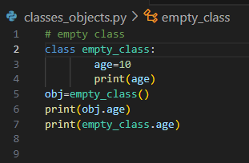
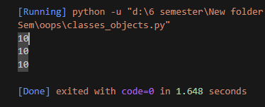
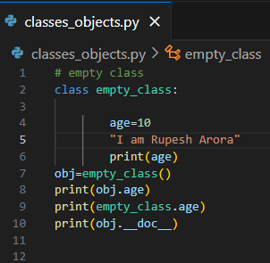
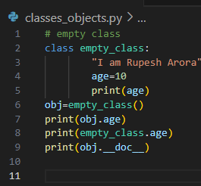
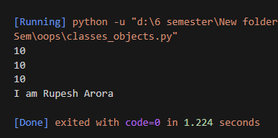
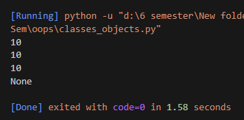
Self is used for referencing the current object an it is the default parameter.
There more number of methods to print the variables below in the code.(1.through name of the class,2.Through name of the object.)
Now we have the text or comment in the class and we have not assigned any variable to it so can we print it
too ? Then the question arises that if we have no variable assigned to it then how we will access string or
comment. It’s shown in the code below
But we need to keep in mind that it should present in the first line itself as if it is not present in first line then
it will not print that text or comment or string as compiler cant detect it, and it will show none.

Slide 7
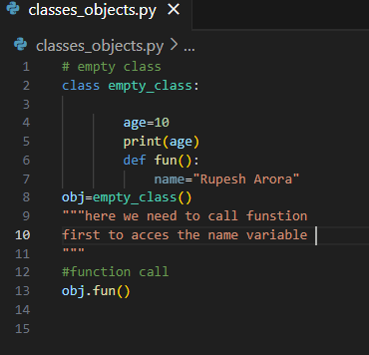
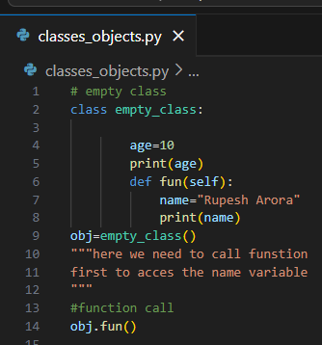
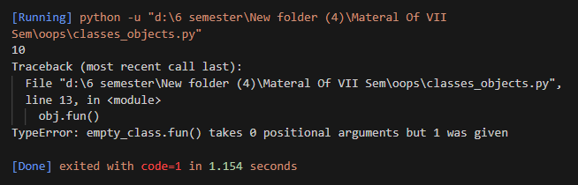
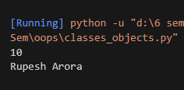
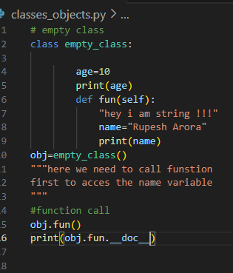
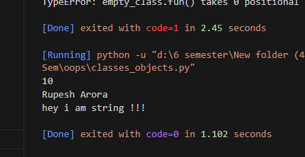
Now we will see how we acces the carriables of the function. In below code we have made a function fun.
Now this will give as error as we need to give one attribute to our function which is the default one that is self, after writing self we will not receve wnay error.
Now we will check how to access the string or comment which is assigned without any variable in a function. Same rule for here to that strin or text should be on the first line of the code. We need to use print(obj.fun.__doc__)

Slide 8
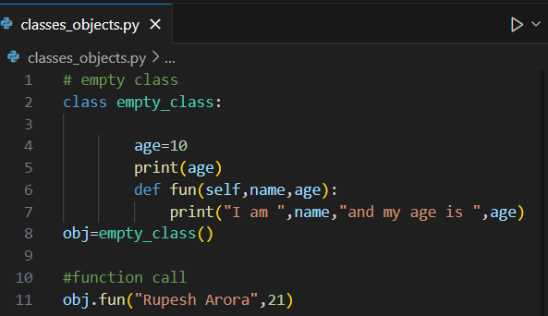
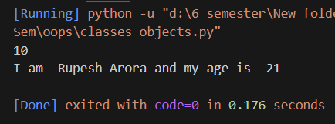
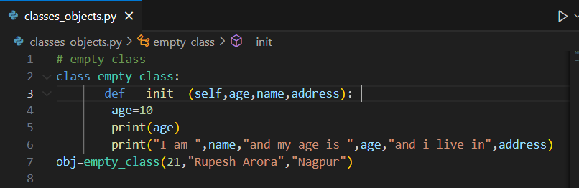
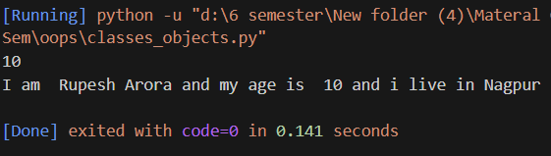
We can provide the value to the function also as shown below.
We can do the similar thing with the constructor also, we no need to call the constructor as it is default function which calls on itself.

Slide 9
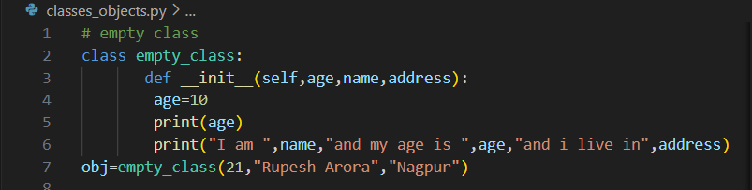
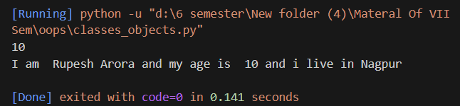
The size of the variable and the type of the value is decided at runtime.
We can call multiple object and pass different values in it .
Class is a logical entity so there is no storage that sotres the whole class and objects are the real entity theat store the data .

Slide 10
Constructor
Constructor is a special function which gets automatically called when object of that class is created.
The use / main purpose of the constructor is to create and initialize the object .
Syntax of the constructor →
It is always created for a class
def __init__(self):
#code
Self → reference argument → if we are creating any in the constructor we can assign it through using self we can initialize the variable or take the access of that variable we need to use self →self points to current object.
Without constructor we can’t initialize the constructor or create it.
Here obj = a()
Here in the above statement we have → a() → as the constructor where we have initialized obj as the object variable.

Slide 11
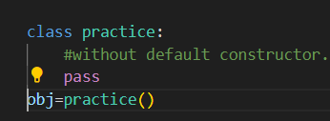
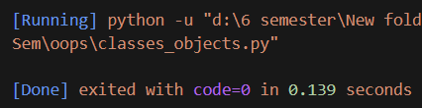
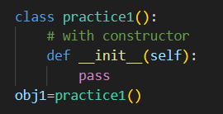
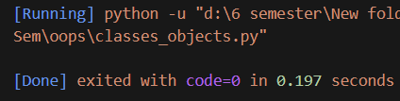

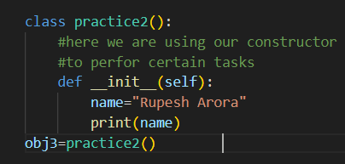
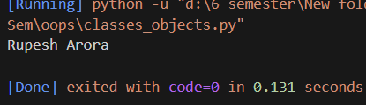
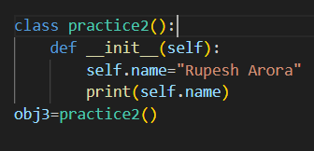
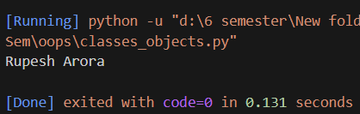
You can see below that with and without using the constructor the output is same. That is no output.
But then what is the use of defining the constructor on our own.By defining the constructor we can perform all our tasks.
As default constructor provides us this much things only you can see it below.
Now we are creating our own constructor to perform our tasks .
Now a question will arise in your mind that we use self to access the members ?
But here the name is the member of the constructor itself so there is no need to make use of self .And if use self in the same constructor there is no change in the output too. You can see it below.

Slide 12
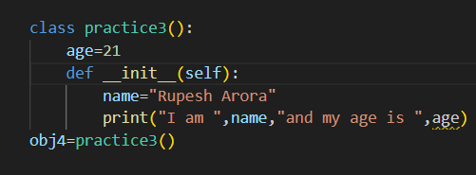
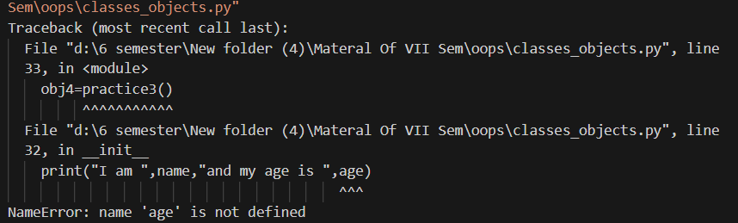
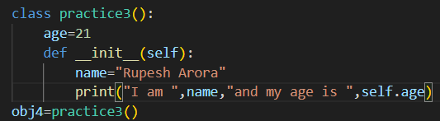
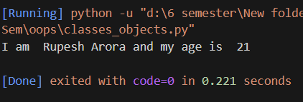
But if we initialize our variable outside the constructor but in the class then there we need to make the use of self as the vasiable is outside the constructor.
And when we make use of self for age it means for age point to the current object.
The main task of self is to just point the current object where as the age variable is also the part of the current object.
Now if we create two default constructors in one class then what happens? you can see it below

Slide 13
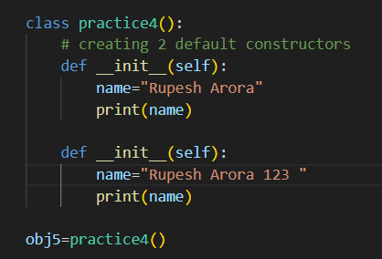
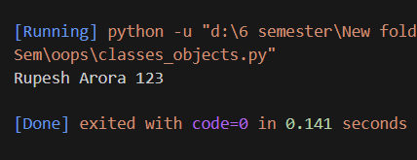
Here see below it will print the llast constructors output.
Requeirement of self is only for class members.
There are 2 types of constructors in python .
Default constructors
Parametrized constructor.

Slide 14
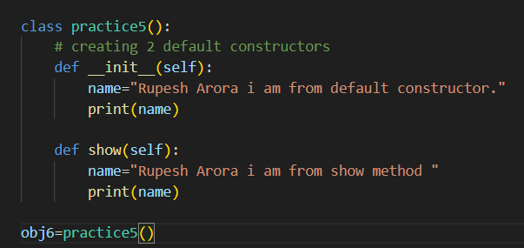
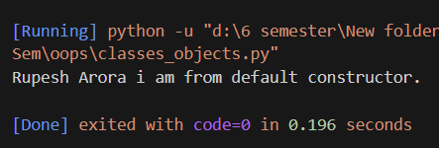
Default Constructors
Default constructors are empty constructors. Because it doesn’t have any parameters.
Note→ if we do not define any constructor, the compiler automatically calls the default constructor.
Syntax → class class_name :
def __init__(self):
#code
Self is not a parameter is a referencing argument and used for initializing and accessing the data members.
There is no need to call costructors as they are special type of functions .Where as in other methods we need to call them see the difference below .for calling show method we need to call it as it is not the default constructor.

Slide 15
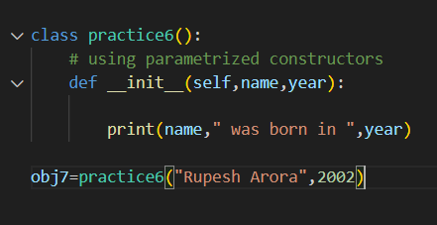

Parametrized Constructors
Parametrized cosntructors accept argument along with self, it is known as parametrize constructor.
And we can pass any number of parameters/arguments to it.
Syntax → class class_name:
def __init__(self,name):
#code

Slide 16

Access Modifiers
Access modifiers are used to select the limit of member accessibility.
They are used for making the variables secure.
And access modifiers tell about the access of the variable.

Slide 17

Public access modifiers are represented as → var →and they are the default access provided to each of the
variable in python.
Protected access modifires are those which are not accessable in the other classes where as we can access
these variables only in the same class and the inherited class and also outside of the class by using its object but
not in another class.
Private is the access modifier which is most secure and we can only use thse variables only in the same class, and
not anywhere else.
In above image the derived clsss means inherited class.
Same package means, package is the collection of cany different classes.
The other class means the any different class not in the same package.
Now you can see in the example below that how much access is provided to all the 3 access modifiers

Slide 18

Here we are receiving an error as the private access modifers can be accessed in only in the same class..
And we are trying to access it outside of the class.
But the public and the protected data members can be get accessed outside of the function also.
And the addition of 30 is also printing as we have call the function add in the class itself where all the access
modifiers are accessable.
Now we will see that we can check same for derived or inherited classes also.
You can see below the example.(example is in the next page).
There you can see that 10 and 20 got printed where as value of __c is no printed instead of it we received an
error, because __c is private data member. As public and protected access modifiers have the access to
inherited class.

Slide 19



Slide 20


In the below case you can see it is the case of classes present in the same module so only public and private access modifiers can get access in the classes in the same module.

Slide 21
Inheritance
When we define a class that inherits all the properties of other classes is called inheritance.
Syntax → class Father :
#code and properties
class Beta(Father):
#code and properties of own and also the properties of his father
You can see the example of inheritance in the below code.
In the below code hee we are watching that does on creating the object of the son
# we can access the properties that is function of the parent class

Slide 22




Now we will try the vice versa is possible or not can we access the properties or methods of son’s class on using
the fathers class.
We can see that in the above code father cant access the sons class properties it gives the error.

Slide 23
Types of Inheritance
Single/Simple Inheritance
Multiple Inheritance
Multilevel Inheritance
Hierarchal Inheritance
Hybrid Inheritance

Slide 24

Simple \ Single Inheritance
Simple inheritance is nothing but which contain only one parent class and only one child class.
Syntax → class parent:
#properties
class child(parent):
#here we can access parents as well as
childs properties i.e properties of it’s own.

Slide 25

Multilevel Inheritance
In this inheritance we have one parent class and multiple child classes.
Syntax → class Parent :
#properties of own
class Child1(Parent):
#properties of own + prop of Parent
class Child2(Child1):
#properties of own + prop of Parent +
prop of child1
It goes level by level that’s why called as multilevel inheritance.
In the below example you can see that in all the classes there
are methods and variables which got accessesd by simply creating
the class of last child .

Slide 26



Slide 27



Multiple Inheritance
In heritance contains more than one parents and only a single child. And this is called as the multiple inheritance.
Syntax → class parent1:
#prop of parent1
class parent2:
#prop of parent 2
class parent3:
#prop of parent3
class child(parent1,parent2,parent3):
#properties of own + prop of parent1,2,3
In the below code teamleaad can acces the properties of both the employees.

Slide 28

Herarchical Inheritance
Inheritance in which there are multiple child classes and single child class and all the child classes can acces the properties of the parent class is known as herarachial inheritance.
Syntax→ class parent:
#has own prop
class child(parent):
#has own as well as the parents prop
class child1(parent):
#has own as well as the parents prop
In Hierarchical inheritance, more than one sub-class inherits the property of a single base class.

Slide 29
Encapsulation
By default Python provides access to all the variables and methods globally. Means these methods and variables have an Public access.
So to make these variables and methods more secure the encapsulation help us to do that.
In encapsulation we can restrict the variables and methods accessing it globally.
By making it private or protected
Private variable have 2 underscores in start (like __B).
Here B will act as private variable.
And for protected only one underscore is used. (_A).
Here A is acting as protected variable.

Slide 30


Protected variable can access both functions and variables.
Private variable can only access functions.
Lets see the example below .
Here we can see that a variable is protected and b is private where in the above example Show method can access
Both the variable as they are in the same class so whenever that show method is called the result will be 30.
Outside the class we have made the object of class A and we know both private and protected variables can access
Objects and therefore when we call the show method using obj of that class we get the output as 30
But when we trey to call both the variables and print there values then at that time only _a variable got
Printed and the variable __b gave the error as it is private and cant be accessed outside the class.

Slide 31



Here we need to keep in focus that when variables are not initialized as private or protected then they acts as global variables
In python class is an example of encapsulation as the class is the combination of function/method and the variable where the variable should be private that is data member should be private

Slide 32
Abstraction
Abstraction is the process of hiding the implementation details from the user only the highlighted set of services provided to the user.
Example → we use mouse we know we can perform moving of arrow and clicks but the implementation part how it is happening don’t known to us.
Like we can make 2 files in python one having the code of addition and another file having the code of subtraction and there is a 3rd file which is shown to the user where we can use the functionality of add and sub but don’t; knoe what is happening behind it.

Slide 33
For achieving abstraction we can do it by 2 types →
Abstract class
Interface
Abstract Class is a class that contains one or more abstract method is called abstract class.
Note →
An object of an abstract class cannot be created.
Python provides abc module to work with abstraction
We use @abstractmethod decorater to define abstract method.
Syntax → from abc import ABC (abc is the module and the ABC is the super class that is in the abc
module, we are inheriting the class ABC and making a abstract
method in it).
class demo(ABC):
def fun(self):
#body
@abstractmethod
def fun2(self):
# abstract method has no body
And abstraction is used when the application is same and implementation is different.

Slide 35

Interface
Interface is nothing but abstract class which contains only abstract method but not any normal method.
Syntax → As here in the image there is

