Slide 1
APEX PROJECT
Developing a Sentiment Analysis Model To Classify Movie Theatres Reviews
Presented By:
Kamisetti Rupesh Durga Subrahmanyam
{BONAM VENKATA CHALAMAYYA ENGINEERING COLLEGE (ODALAREVU)}

Slide 2
OUTLINE
Problem Statement
Proposed Solution
System Development Approach
Algorithm & Deployment Result
Conclusion
Future Scope
References

Slide 3
PROBLEM STATEMENT
Statement : In the competitive restaurant industry, customer satisfaction is pivotal. Traditional feedback methods like surveys are cumbersome. Online platforms host vast, unstructured feedback.
Analyzing this data is crucial for understanding customer sentiment. Restaurants must streamline this process to enhance service quality.

Slide 4
PROPOSED SOLUTION
Automated collection from Yelp, TripAdvisor, Google Reviews, and social media using web scraping and APIs.
Data preprocessing: Clean, normalize, tokenize, remove stop words, and perform
stemming/lemmatization.
Implement machine learning (e.g., SVM, Neural Networks) for sentiment
classification (positive, negative, neutral).
Gain actionable insights: Analyze trends, extract keywords, and deploy on a scalable platform.
Visualize results with interactive dashboards (Tableau, Power BI) for enhanced
decision-making.Regular summary reports for management.

Slide 5
ALGORITHM & DEPLOYMENT
. Algorithm Selection:
BERT (Bidirectional Encoder Representations from Transformers): BERT is a cutting-edge deep learning model renowned for its contextual understanding of words in sentences through bidirectional processing.
Reason for Selection:
BERT offers superior performance in sentiment analysis by effectively capturing nuanced meanings and sentence structures in restaurant reviews.
Data Input:
Metadata: Includes review dates, user ratings, and restaurant-specific details, enhancing contextual analysis.

Slide 6
Dataset:
Utilizes a labeled dataset of restaurant reviews categorized into positive, negative, and neutral sentiments.
Preprocessing:
Tokenization: Breaks down text into individual tokens. Cleaning: Removes noise, stop words, and applies lemmatization.
Training Setup:
Fine-tunes the pre-trained BERT model on the labeled dataset, employing techniques like cross-validation for robust model evaluation.
Evaluation Metrics:
Assesses model performance using accuracy, precision, recall, and F1-score to ensure reliability Prediction Process:
Sentiment Classification:
Preprocess New Reviews: Cleans and tokenizes incoming text data.
Input Data: Feeds processed data into the fine-tuned BERT model.
Prediction: BERT model predicts sentiment for each review (positive, negative, neutral). 4. Aggregation: Aggregates sentiment scores for comprehensive insights.

Slide 7
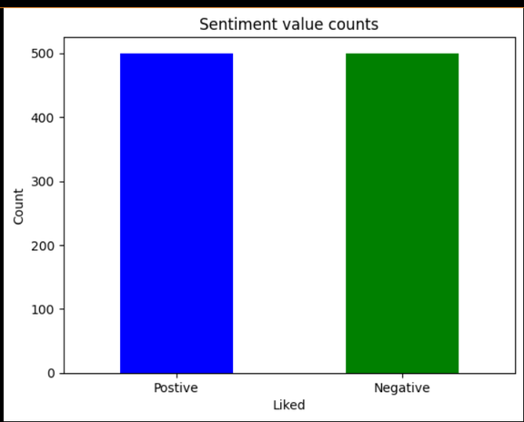
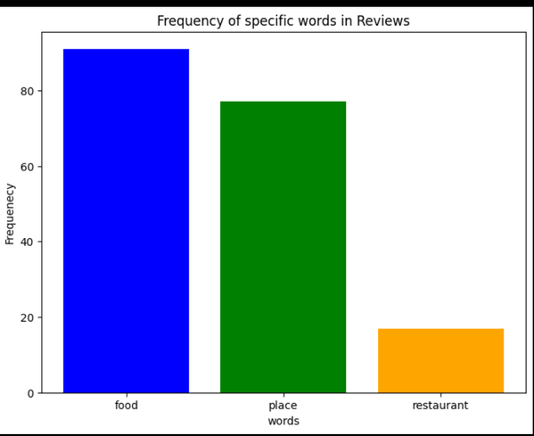
RESULT:
Frequency of specific Words:
A bar graph showing the frequency of words in reviews given by the customers in the restaurant.
Sentiment Distribution: bar graph showing the proportion of positive, negative, and neutral reviews.

Slide 8
FUTURE SCOPE
Expand the system to include voice sentiment analysis from customer service calls and integrate more data sources for comprehensive feedback analysis.
Improve sentiment analysis accuracy by employing advanced NLP techniques and larger datasets, while developing a mobile app for convenient access to insights by restaurant managers on the go.

Slide 9
REFERENCES
Relevant online articles and tutorials on sentiment analysis and NLP techniques.

Slide 10


