Slide 1

DSS IN FOOD PROCESSING INDUSTRY
Dilipkumar Prajapati - 112095
Rupesh Surve - 122274
Date of Presentation:11-11-2014
Under the guidance of: Ms. Bidisha Roy
Department of Computer Engineering,
St. Francis Institute of Technology

Slide 2

Content
Introduction
Problem definition & Proposed solution
Scope of project
Review of literature
System description
Hardware & software requirements
User Interface Design
Conclusions
Plan for next semester
Literature Cited
Acknowledgements

Slide 3
Introduction
DSS Manages inventory information in food warehouse.
This is the systematic and automatic ways provided for handling the inventory information in food warehouse.
The operation of food warehouse is driven by information captured directly using RFID.
The lead time for performing operation would be minimized.
With the help of this system food industry can utilize inventory information and manage the food handling process more effectively.

Slide 4
Problem definition & Proposed solution
It is well-known that contamination of food is one of the core problems in food handling.
Food which can easily deteriorate, is in great demand and relies on a quick response and on a fast supply chain.
There is no inventory information management system on the market that can extract information on a real time basis that checks the expiry status of goods stored in a warehouse.
There is no effective system that prevents food
contamination in a warehouse during assignment and
storage of foods.

Slide 5
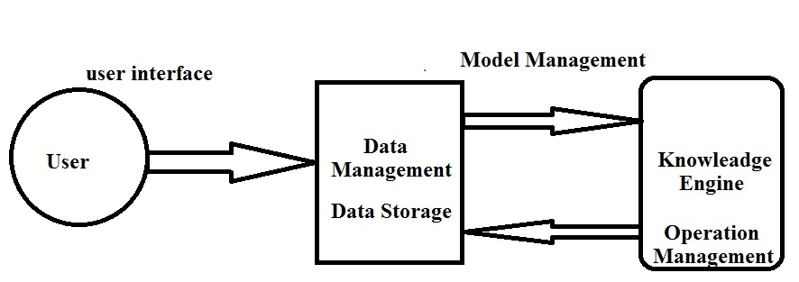
Scope of project
The System manages the storage environment of a food warehouse and enables management to arrange appropriate resources to be available for handling the warehouse operation.
The system integrates RFID technologies, and a rule-based engine.
The system architecture is composed of 3 tiers:
1. The Data Capturing.
2. Data Storage.
3. Operation Management.

Slide 6
Review of literature
Literature on Inventory Information in Food Industry is reviewed to demonstrate the importance of information In the Food Industry.
A. Inventory information in the Food Industry.
The inventory information is the records of the number of product
categories, sources ,expiry date ,location and status of goods etc.
This information acts as a foundation for the management to
undertake daily planning strategies.
B. Information Management System in Food Industry.
If there is a proper information utilization and management the positive effects of Implementing technology into food warehouse can be amplified.
with the help of information management technology , stock management has become easier.

Slide 7
Review of literature
C. Existing method for notification, and assignment of Facilities.
The existing notification of variance and the assignment of facilities mainly rely Manual inspection which involves human beings for variance checking.
It is rare that any real that any real -time mechanism is found in the food industry.
D. Radio Frequency Identification (RFID) and Rule-based Decision Support System
RFID is an auto-ID technology using radio waves for data Transmission.
RFID has been adopted in the food industry for improving the food traceability. It uses different sensors like temperature and humidity For monitoring of the surrounding environmental conditions.
A rule based engine is used because it is an effective method that provides recommendations to management for decision making Within a short time frame.

Slide 8
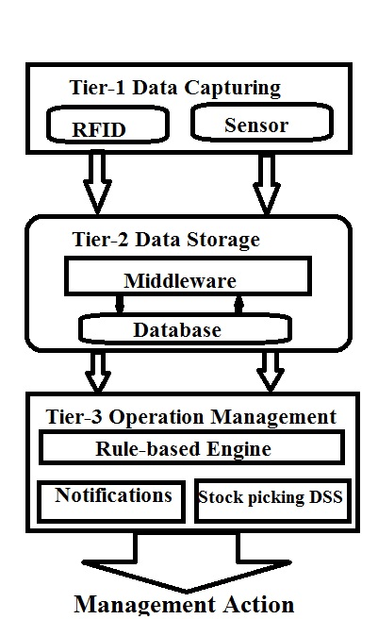
System description

Slide 9
System description
The Decision Support System (DSS) is one of the information system applications that can assist the decision making process of management and with the help of this information, warehouse managers can decide on different operational strategies.
The system was divided into three parts:
1) The Data Capturing:
- RFID Technologies are utilized in this system for capturing real time
Operational Data.
2) Data Storage:
- all Data collected by RFID are first decoded by middleware and
then Transferred to the database for storage and further processing.
3) Operation Management:
-control rule-base engine which is supported by Database.
-Notification Mechanism.

Slide 10
System description
The system will storing status and the quality report which includes: quantities, quality types, dates and Location etc.
The system will generate following types of Decisions:
It Determines the Quality of the product.
The Wastage quantities of foods in food warehouse.
It determines the new location with temperature.
It Display the available Food Stocks in the food Warehouse.
It Display the sales of product.
The following notification is display for the staff
Location of the degraded foods.
Available food Stocks in food warehouse.
Wastage of foods in food warehouse.

Slide 11
Implementation
K-means Algorithm:
Given k ,the k-means algorithm is implemented in 4 steps
Step 1. partition the object into k non-empty subsets
Step 2. compute the seed points as the centroids of the clusters
of the current partitions. The centroids is the center (mean point)
of the cluster.
Step 3. Assign each object to the current with the nearest seed point.
Step 4.Go back to step 2, stop when no more new Assignment.

Slide 12
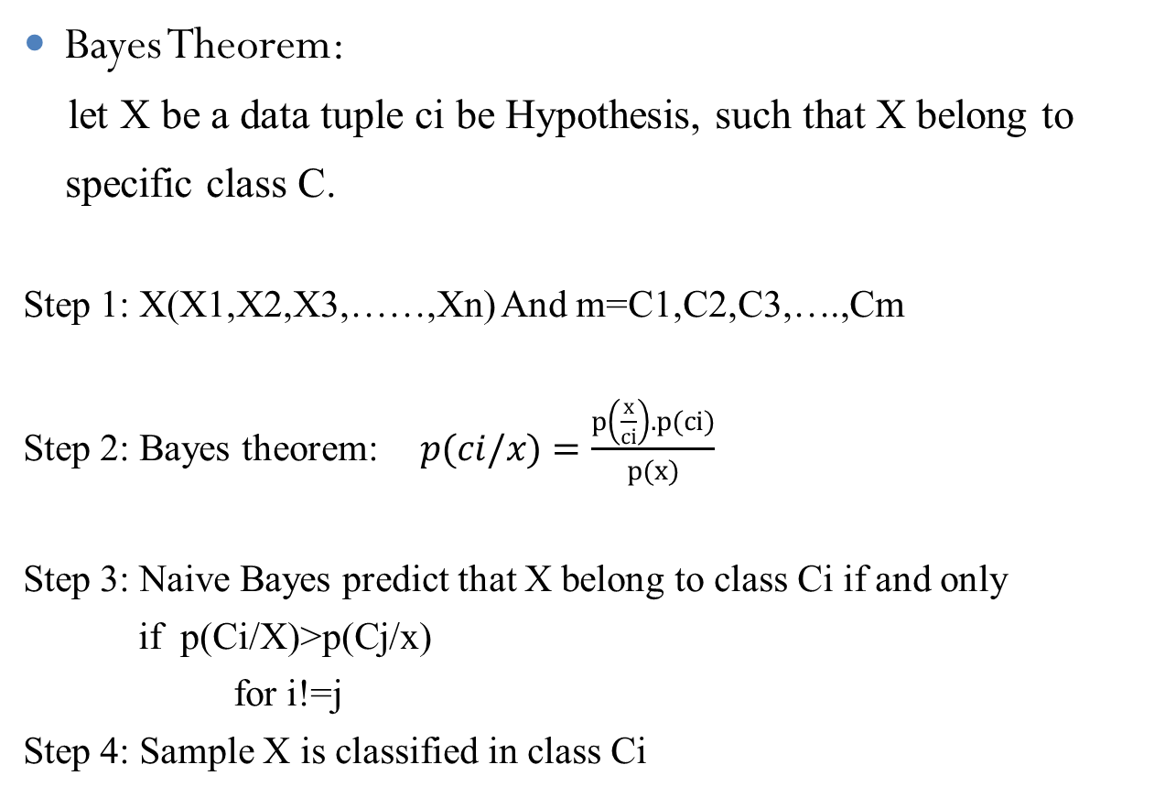
Implementation
Bayes Theorem:
let X be a data tuple ci be Hypothesis, such that X belong to
specific class C.
Step 1: X(X1,X2,X3,……,Xn) And m=C1,C2,C3,….,Cm
Step 2: Bayes theorem: $p(ci/x)=\frac{p\left(\frac{x}{ci}\right).p(ci)}{p(x)}$
Step 3: Naive Bayes predict that X belong to class Ci if and only
if p(Ci/X)>p(Cj/x)
for i!=j
Step 4: Sample X is classified in class Ci

Slide 13
Implementation
k-means clustering:
The clustering is utilized to segment food product
Firstly the food is clustered according to their Quality status
As the result the 3 clustered will detected.
Then each cluster is internally clustered according to three demographic
Variable Quantity ,prize , sales and location.
Bayes Theorem :
Bayesian classifier are able to predict class membership probabilities such as the probability that a given tuple belongs to a particular class.
This is applied on the sets of cluster to predict the Quality of the foods.
Based on the Prediction final decision will made.

Slide 14
Hardware & software requirements
Hardware Requirement
RFID(Radio Frequency Identification )
Sensors (Temperature & Humidity)
RFID Tag.
Intel Processors
RAM – 512 MB
Software Requirement
Windows operating system
Java programming.
Java Script.
Microsoft SQL Server 2005/2008

Slide 15
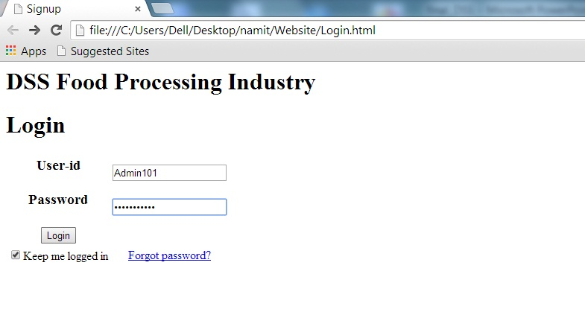
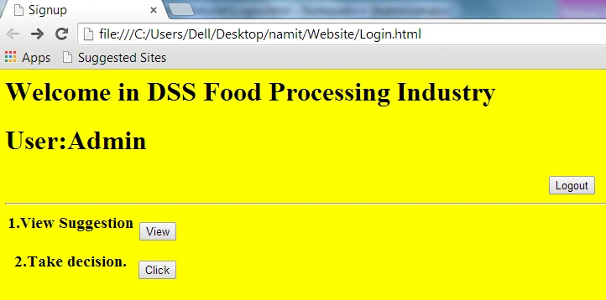
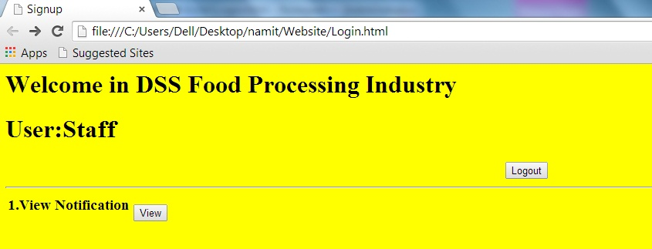
User Interface Design

Slide 16
Conclusions
This System is proposed to enhance the inventory information capturing and management in food warehouses.
The System uses RFID to gather real-time inventory information regarding the warehouse, and links this information to the decision making process of the manager. The process is supported by a rule-based engine.
the use of this inventory information management system, inventory information can be related to the warehouse operation, and the operation time needed is shortened.

Slide 17
Plan for next semester
The project development is based on the waterfall model
after the completion of design phase in this semester , the next step
is coding phase.
Firstly required database will Developed. After the database after the database is populated . coding for each module is will be done
Module to be developed are
1. Compute the probability value.
2. Display the notifications.
3. optimize the suggestions and plans.

Slide 18
Literature Cited
IEEE References
[1] An Integrative Food Handling System for Managing Inventory Information in Food Warehouses. S. I. Lao, K. L. Choy, Y. C. Tsim, S.K. Kwok, T.C. Poon Dept of Industrial and Systems Engineering, The Hong Kong Polytechnic University, Hong Kong
Book
[2] Data Mining and Warehousing by S. Prabhu Publisher : New Age International, 2007
Journal Paper
[3] Abad, E., Palacio F., Nuin , M., Zarate , G.A., Juarrros, A., Gomex, J.M.,
and Marco, S., "RFID smart tag for traceability and cold chain monitoring of foods : Demonstration in an international fresh logistic chain", Journal of Food Engineering, 93, pp. 394- 399, 2009.
[4] Achour, M., "A new method to assess the quality degradation of food products during storage", Journal of Food Engineering, 75, pp. 560- 564, 2006.

Slide 19
Acknowledgements
We would like to thank St. Francis Institute of Technology for providing us with excellent resource to carry out this Project and make it successful.
We would like to thank our Project guider Mrs. Bidisha Roy for their guidance and for sharing there valuable inputs with us.
We would like to thank our External guider Mrs. Varsha Nagpurkar for their guidance and support.
We would like to thank all the Documentation related support from our colleague and lab assistants for helping us as per our needs.
Finally, we extend our thanks and gratitude to our family and friends for providing us support needed to complete this project.

Slide 20
Questions??
Thank You!

