Slide 1

Project Presentation – DSS IN FOOD PROCESSING INDUSTRY
Dilipkumar Prajapati - 112095
Rupesh Surve - 122274
Date of Presentation:26-02-2015
Under the guidance of: Ms. Bidisha Roy
Department of Computer Engineering,
St. Francis Institute of Technology

Slide 2

Content
Introduction
Problem definition & Proposed solution
Scope of project
Review of literature
System description
Architecture or block diagram (broader topic/algorithm)
Explanation of individual blocks (if exists) or algorithm
Hardware & software requirements
User Interface Design (GUI snapshots)
Test cases
Results and Discussions
Conclusions
Future Scope
Literature Cited (book, web & paper References)
Publications by your group (if any)
Acknowledgements
Demo to be given

Slide 3
Introduction
DSS Manages inventory information in fruit warehouse.
This is the systematic and automatic ways provided for handling the inventory information in fruit warehouse.
The operation of fruit warehouse is driven by information Stored directly in Database.
The lead time for performing operation would be minimized.
With the help of this system fruit industry can utilize inventory information and manage the fruit handling process more effectively.
SFIT- CMPN department DSS in food processing Industry.

Slide 4
Problem definition & Proposed solution
It is well-known that contamination of food is one of the core problems in food handling.
Food which can easily deteriorate, is in great demand and relies on a quick response and on a fast supply chain.
There is no inventory information management system on the market that can extract information on a real time basis that checks the expiry status of goods stored in a warehouse.
There is no effective system that prevents food contamination in a warehouse during assignment and storage of foods.

Slide 5
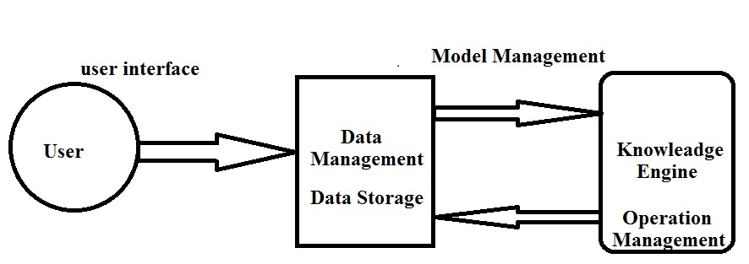
Scope of project
The System manages the storage environment of a fruit warehouse and enables management to arrange appropriate fruit which available in fruit warehouse.
The system integrate a rule-based engine.
The system architecture is composed of 3 tiers:
1. The Data Capturing.
2. Data Storage.
3. Operation Management.

Slide 6
Review of literature
Literature on Inventory Information in Fruit Industry is reviewed to demonstrate the importance of information In the Fruit Industry.
A. Inventory information in the Fruit Industry.
The inventory information is the records of the number of product
categories, sources ,expiry date ,location and status of goods etc.
This information acts as a foundation for the management to
undertake daily planning strategies.
B. Information Management System in Fruit Industry.
If there is a proper information utilization and management the positive effects of Implementing technology into fruit warehouse can be amplified.
with the help of information management technology , stock management has become easier.

Slide 7
Review of literature
C. Existing method for notification, and assignment of Facilities.
The existing notification of variance and the assignment of facilities mainly rely Manual inspection which involves human beings for variance checking.
It is rare that any real that any real -time mechanism is found in the food industry.
D. Rule-based Decision Support System
It uses different temperature For monitoring of the surrounding environmental conditions.
A rule based engine is used because it is an effective method that provides recommendations to management for decision making Within a short time frame.

Slide 8
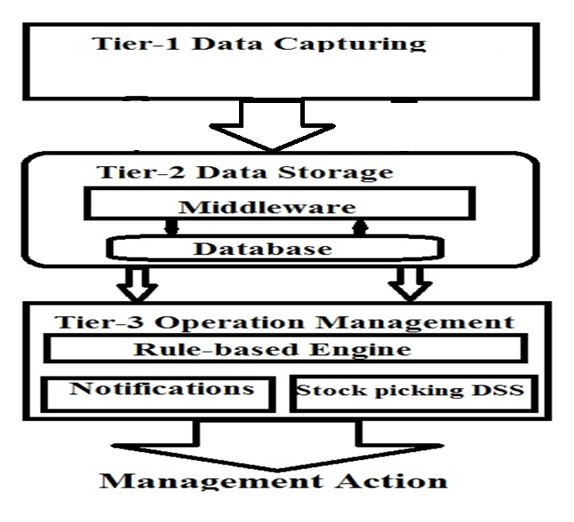
System description

Slide 9
System description
The Decision Support System (DSS) is one of the information system applications that can assist the decision making process of management and with the help of this information, warehouse managers can decide on different operational strategies.
The system was divided into three parts:
1) The Data Capturing:
- This system will capture all information about the fruits for capturing real time Data.
2) Data Storage:
- all Data collected are then Transferred to the database for storage and further processing.
3) Operation Management:
-control rule-base engine which is supported by Database.
-Notification Mechanism.

Slide 10
System description
The system will storing status and the quality report which includes: product-id, product-name, quantities, Dates and Location etc.
The system will generate following types of Decisions:
It Determines the Quality of the product.
It Determines the new location with temperature value.
It Display the available Fruits Stocks in the fruits Warehouse.
It Determine the Quantities of fruits should be purchased from Vendor.
It Display the total sales of product.
The following notification is display for the staff
Location of the available fruits.
Quantities of each fruits.
Available fruits Stocks in fruits warehouse.
Temperature of fruits in fruits warehouse.

Slide 11
Hardware & software requirements
Hardware Requirement
Intel Processors
RAM – 512 MB
Software Requirement
Windows operating system
Java-JDK 1.7.
Net-Beans IDE 7.4.
Oracle Server 10g.

Slide 12
User Interface Design

Slide 13
Test cases

Slide 14
Results and Discussions

Slide 15
Conclusions

Slide 16
Future Scope

Slide 17
Literature Cited

Slide 18
Publications (if any)

Slide 19
Acknowledgements

Slide 20
Questions??
Thank You!

