Slide 1
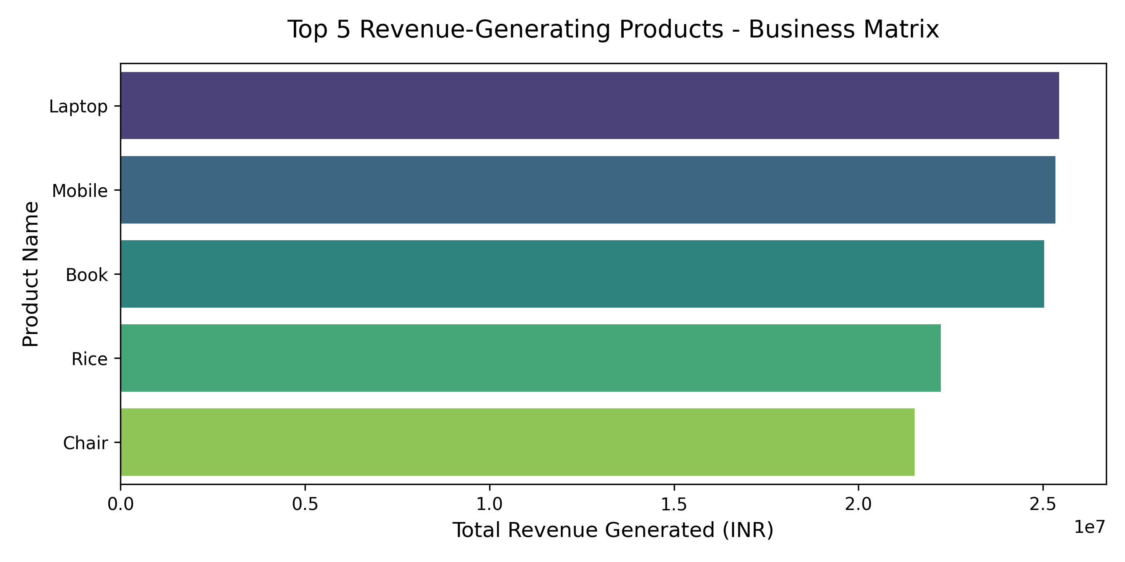
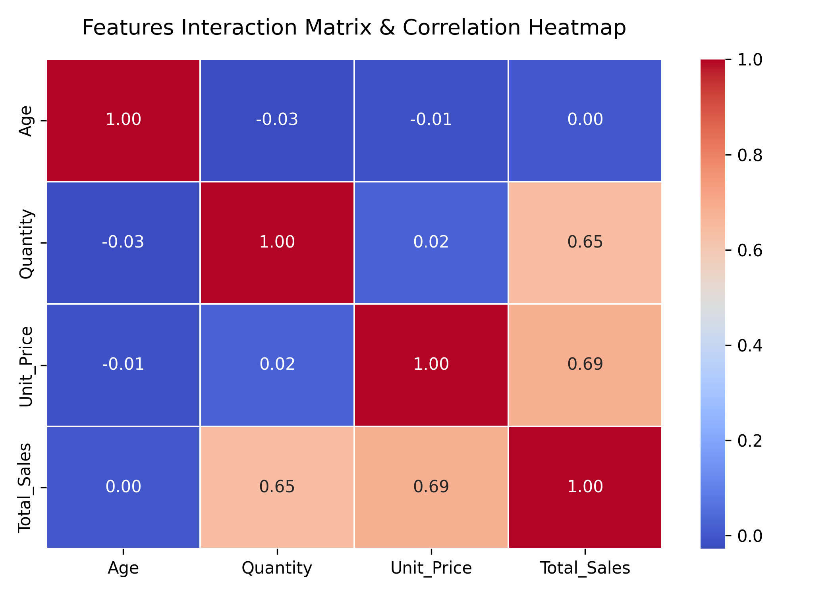
Executive Business Intelligence Dashboard - Task 2
Data Analyst Intern: Rupesh Kumar Yadav | Company: ApexPlanet
TOTAL SALES REVENUE
₹139.40 Million
TOTAL SYSTEM VOLUME
1,000 Orders
AVERAGE BASKET VALUE
₹139,399.44
💡 Strategic Enterprise Metrics Conclusion Summary:
• Core Revenue Drivers: Laptop (₹25.44M) and Mobile (₹25.33M) heavily out-scale alternative categories. • Data Pipeline Consistency: Features interaction displays uniform linear scaling matrices checking safely across unit price structures.

