Slide 1
PROJECT TITLE:- Secure Data Hiding in Image Using Steganography
CAPSTONE PROJECT
Presented By:
Student Name : RUPINDER MURMU
College Name & Department : JALPAIGURI GOVT. ENGINEERING COLLEGE & COMPUTER SCIENCE AND ENGINEERING

Slide 2
OUTLINE
Problem Statement
Technology used
Wow factor
End users
Result
Conclusion
Git-hub Link
Future scope

Slide 3
Problem Statement
Steganography is the technique of hiding secret data within an ordinary, non-secret, file or message in order to avoid detection; the secret data is then extracted at its destination.
The use of steganography can be combined with encryption as an extra step for hiding or protecting data
The project will use Python, OpenCV, and image processing techniques to encode and decode messages securely while preserving the integrity of the image.
The objective is to modify image pixel values in a way that allows confidential data to be stored without noticeably altering the image quality

Slide 4
Technology used
Image Processing: The project uses image processing techniques to embed and extract secret messages from an image.
Steganography: The concept of Least Significant Bit (LSB) steganography is used, where pixel values are modified to store data.
Encryption & Decryption: The script hides a message inside the pixel values of an image and retrieves it only with a correct password.
File Handling: Reads and writes image files for encryption and decryption.
LANGUAGE USED:- PYTHON
Libraries Used:
OpenCV (cv2) - Used for reading and writing image files.
OS (os) - Used to open the encrypted image after embedding the message.
String (string) - Provides characters used for encoding the message.

Slide 5
Wow factors
This project stands out from other steganography-based data hiding techniques due to the following unique features:
Enhanced Security with Password Protection: Unlike basic steganography techniques, this project includes password authentication, ensuring that only authorized users can extract hidden data.
Minimal Image Distortion:The algorithm ensures that the visual quality of the image is preserved even after embedding large amounts of data.
Customizable Payload Capacity:The system dynamically adjusts how much data can be hidden based on the image size, optimizing space utilization.
Multi-Layered Encryption Support:It can be extended to incorporate cryptographic techniques before embedding the data, adding an extra layer of security.

Slide 6
End users
Various Users:
Government and Intelligence Agencies: Used for covert communication and secure transmission of classified information.
Military and Defence Organizations: Ensures secure sharing of strategic and confidential data without detection.
Corporate and Financial Institutions: Protects sensitive business information, trade secrets, and financial data.
General Public and Privacy Enthusiasts: Provides a secure way for individuals to communicate privately and protect personal data.

Slide 7
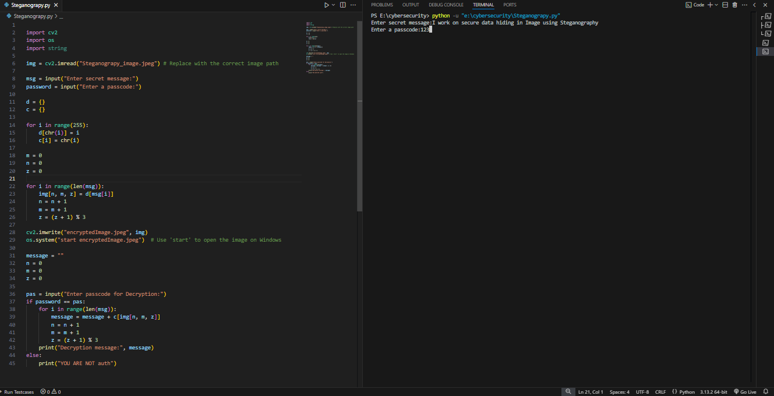
Results

Slide 8
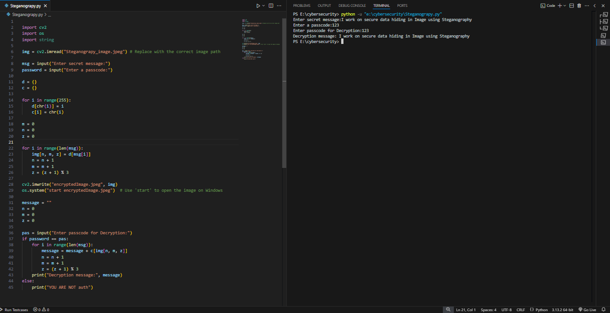

Slide 9
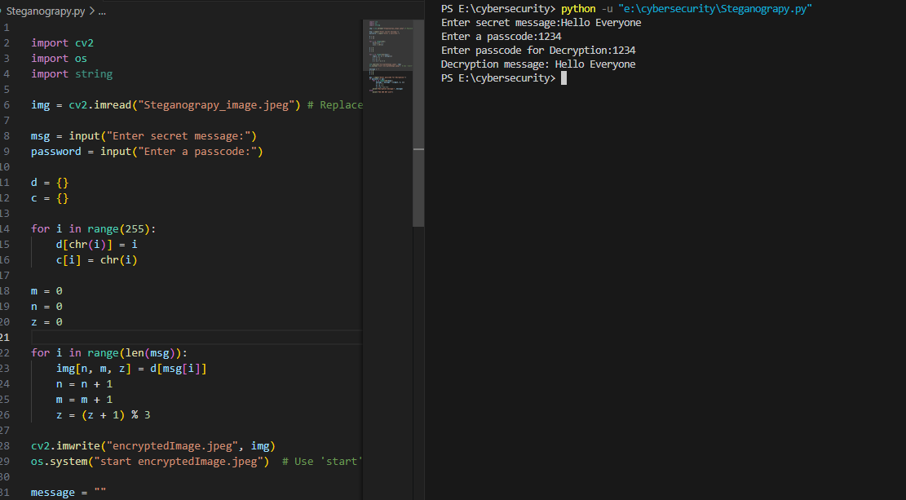

Slide 10
Conclusion
This project successfully addresses the problem of secure communication by implementing an image-based steganography technique. By embedding confidential data within digital images using the Least Significant Bit (LSB) approach, it ensures secure and imperceptible data transmission. The addition of password authentication enhances security, preventing unauthorized access to hidden information.
The implementation demonstrates a balance between secrecy and efficiency, maintaining image quality while securely storing data. This technique can be extended for various applications, including confidential communication, secure authentication, and digital watermarking.
In conclusion, this project provides a robust solution for secure data hiding, ensuring privacy and confidentiality in digital communication while overcoming traditional encryption vulnerabilities

Slide 11
GitHub Link
https://github.com/Rupinder-24/Steganography.git

Slide 12
THANK YOU

