Slide 1
CSE 5330
Course and Project Experience
Team 5
1. RAGHAVENDER CHOLLETI - 100202967
2. RUPINI NUTHAKKI - 1002036413
3. SRI PRANAVI DONAPATI - 1002028537
4. RISHI KATAKAM - 1002040302

Slide 2
Project
Title: SPORTS EVENT MANAGEMENT
Pitching the project:
The Entertainment industry is one such industry that provides pleasure and delight to its audience. The sports sector in specific has been of utmost significance for sports fanatics.
With the advancement in technology, it has become a mandate to link these to the entertainment industry.
It is important to do this in order to track expenditure, generate revenue and make necessary changes to attract people and to witness sport events.
The main objective is to maintain a Database System for College Park Centre to generate revenue but not to obtain profits and also manage the data of audience attending various kinds of sports events.

Slide 3
Project
How will this project be helpful if deployed in the real world?
1. To obtain useful insights about events, attendees and revenue.
2. To know which Sports Teams attract more people.
3. If deployed in real world, it would be useful for all event managers to organize their data and plan their event.
Overall we can say that if this project is deployed in real world then it will be helpful for the event organizers and colleges to know on what basis and how they can generate revenue and also they can know what sports are most likely to be watched by audience. From this they can improve their future events.

Slide 4
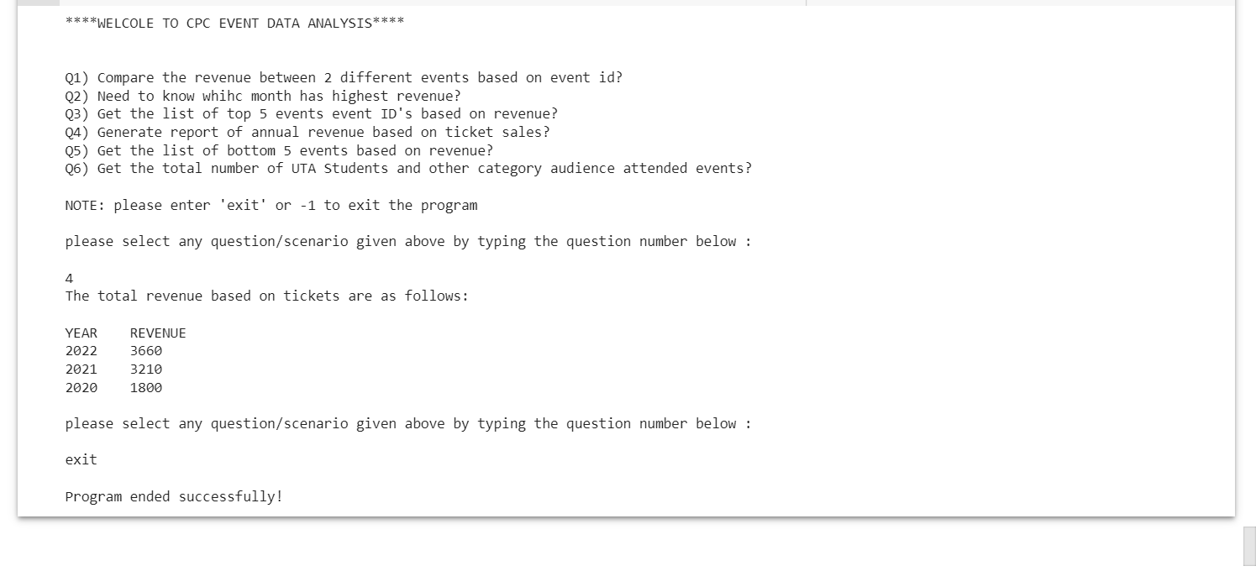
Project Overview
Give an overview of the front-end, if conceptualized
Use screenshots or embed video, if available
Using python to connect to the database. Then we will list all the business goals. Based on the user request we will type in the question and get the answer.( for example, which event has highest revenue, user types in the year and gets the revenue for the particular year).

Slide 5
Project Overview
Present the details of the tables created
#tables, #totalrows, #rows per table, …
List of tables created for this project:
Fall22_S004_5_person – 299 rows
Fall22_S004_5_person_phone – 396 rows
Fall22_S004_5_audience – 199 rows
Fall22_S004_5_parking_audience – 193 rows
Fall22_S004_5_employee – 100 rows
Fall22_S004_5_employee_supervisor – 100 rows
Fall22_S004_5_audience_tickets – 199 rows
Fall22_S004_5_stores – 100 rows
Fall22_S004_5_event – 100 rows
Fall22_S004_5_teams – 67 rows
Fall22_S004_5_event_stores – 500 rows
Fall22_S004_5_event_teams – 189 rows
Fall22_S004_5_audience_event – 200 rows
Fall22_S004_5_event_employee – 398 rows

Slide 6
Project Overview
Fall22_S004_5_person: Sample 3 rows
Fall22_S004_5_stores : Sample 3 rows
Fall22_S004_5_event_teams: Sample 3 rows
ID | NAME | EMAIL | GENDER | STREET | APT | ZIPCODE | DATE
672967 | Juliana, Valentine McCourt | juliana.mccourt@hotmail.com | FEMALE | Garfield Avenue | 2A | 10005 | 1/2/2020
419538 | Jeffrey, M. Chairnoff | jeffmchair@rocketmail.com | MALE | Ridge Street | 124 | 10001 | 1/5/2020
144538 | Richard, Pearlman | richard.peralman@gmail.com | MALE | Hill Street | 12S | 10002 | 1/9/2020
Store_ID | VendorName | StoreCategory | DateofPayment | Rent
1 | Subway | Temporary | 1/1/2018 | $30,000
2 | Starbucks | Temporary | 1/1/2018 | $30,000
3 | Dunkin' Donuts | Temporary | 1/1/2018 | $30,000
Event_ID | Teams
83792 | Austin Kangaroos Mens Basketball, Lubbock Christian Chaparrals Mens Basketball
93005 | Austin Spurs Mens Basketball, UT Arlington Mavericks Mens Basketball
97293 | Austin Spurs Womens Basketball, Lady Chaps Womens Basketball

Slide 7
Project Goal
Did you meet all your business goals? Discuss the need and result of your most interesting business goal
Yes, we met all our business goals.
The most interesting business goals are :
BG5: To create month/annual reports for all sport events so as to see revenue generated and improve in the areas needed.
Output:

Slide 8
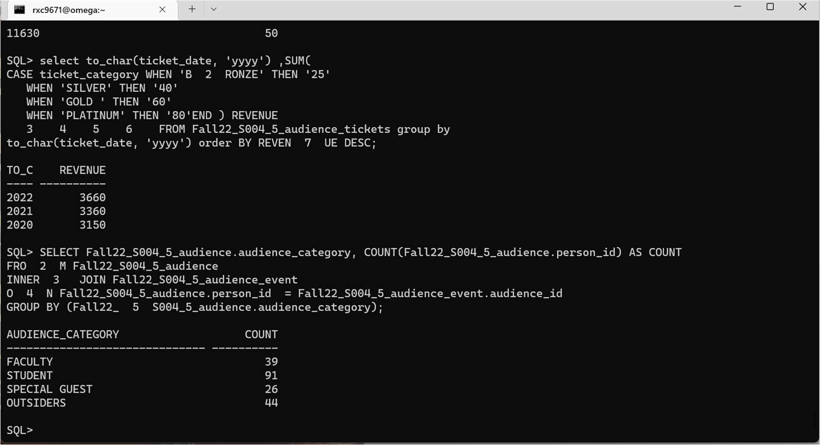
Project Goal
2. BG6: To compare whether UTA students or outsiders visit events more often by creating a “Student VS Outsider” report based on category.
Output:

Slide 9
Project Goal
3.BG7: Generate a yearly report of staff who worked more number of shifts in that tenure in order to decide rewards, hikes so as to display benevolence from management to the employees.
Output:

Slide 10
Project Goal
4. BG8: To generate a report for which Team is attracting more people. Eg: Dallas Cowboys Mens Volleyball etc.
Output:

Slide 11
Project Goal
5. BG9: Report generation for ticket categories, to see which category of tickets has the highest sales.
Output:

Slide 12
Project Takeaway
If done in a team, how did you manage the tasks and time?
We had done this project in a team and since this project is divided into phases, each phase has been thoroughly revised and done by all team members.
Like, in phase1 since it is the starting point and important , we sat for hours to discuss what our project goal is, the limitations and how it could be achieved. We did it by collecting ideas and brainstorming.
We created a plan by dividing the tasks as needed. We then worked on one task after another. In between we kept tracking our progress periodically to ensure that we were following the plan.
All throughout the project, we 4 have been communicating every single detail with each other. This helped us a lot.

Slide 13
Project Takeaway
Which phase(s) of the project was (were) difficult and why?
Phase 1. Because we had to think of what to develop from scratch. Generating business requirements, identifying participants, and having many limitations, this phase was the hardest. But this phase also laid a foundation to drive our project to success.
If you are asked to redo this project, what will you change in the approach you followed?
Approach: Instead of creating the dummy data in phase 4, we would do it at the start of our project along with phase 1. This would make it easier for us to draw EER, identify relations, schemas and proceed with other phases of the project.

Slide 14
Project Takeaway
Are you happy with what you have developed?
Yes, we are extremely happy and satisfied in the efforts that we have put for this project. This is something new for all 4 of us. It was challenging yet fun to learn and do something like this.
Do you think this will add strength to your resume?
Yes, it will add strength to our resume. Projects like these will add experience to most of the entry-level graduates out there. It would also help us showcase our leadership, collaboration, presentation, and public speaking skills.
What was your takeaway from the project that you think may help you in future?
Team management. This is a very important skill we learnt from this project. Dividing the work equally and ensuring every person gets their part done on time is something important and would be helpful in the corporate world as well

Slide 15
Overall Feedback
How can the project experience be improved?
For our team, the overall project experience was GREAT. Every project has certain limitations and here we personally felt it would be easier for us if we weren’t limited to the usage of just Oracle. Using MySQL would have been even more convenient for us.
How can the course experience be improved?
The entire course has been a rollercoaster ride. With assignments , projects, deadlines, the entire course was enjoyable, and we didn’t feel the need of anything to be improved.
How can the test experience be improved?
The overall test experience was good. Cumulative exams ensured previous topics were revised which is helped us keep in touch with the previously covered syllabus. We did not feel anything needed improvement.

Slide 16
General
Any general feedback or thought that you want to share?
All in all, the entire course was EXCELLENT. The course helped us gain theoretical knowledge and practical knowledge as well. Working on a real time database project would help us in our professional career as well. Apart form that, we learnt many useful life skills like time management and team management.
Also, the timely response to any doubts from the professor and the TA was very helpful and much appreciated.
THANKYOU

Slide 17
Discussion

