Slide 1


Slide 2
BUSINESS OBJECTIVE
To forecast the Carbon Dioxide emission levels for an industry so as the emission levels are within the standard limit, so that the organization can follow the government norms with respect to Carbon Dioxide emission levels.

Slide 3
PROJECT ARCHITECTURE/FLOW
Define Business Goal
Data Collection
Explore & visualize series
Partition series
Apply Forecasting methods
Implement Forecast/System
Pre-process data
Evaluate & compare Performance

Slide 4
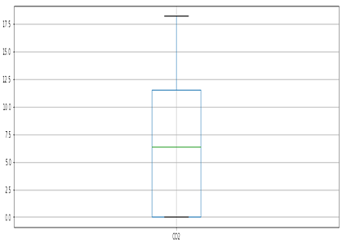
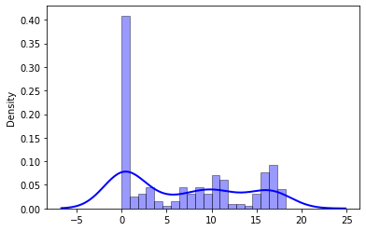
EXPLORATORY DATA ANALYSIS
Insights of the dataset:
215 rows & 2 columns
No Null values and duplicate values observed
No outliers detected
Data doesn’t look normal

Slide 5
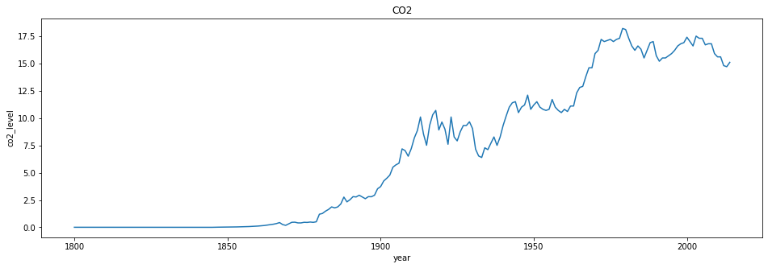
Time Plot

Slide 6
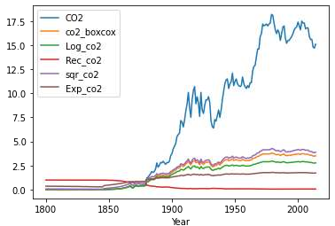
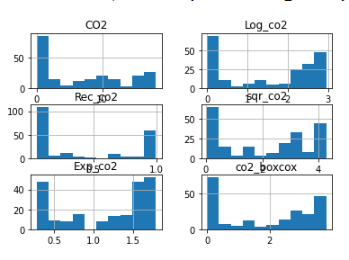
Transforming to Normal Distribution
Transforming techniques used:
logarithmic transformation
Reciprocal transformation
Square-root transformation
Exponential transformation
Box – cox transformation
Even after transformations data is
Not normal so we moved ahead
Without transformation

Slide 7
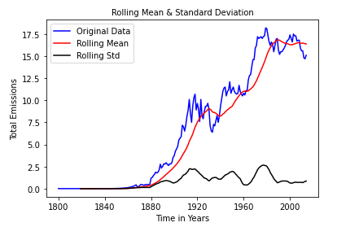
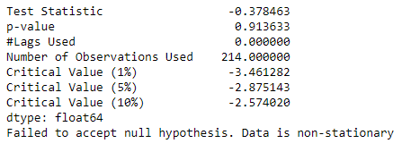
Stationarity Check
Test stationary using Augmented Dickey Fuller’s Test.
The emissions mean and the variation in standard deviation (black line) clearly vary with time. This shows that the series has a trend. So, it is not a stationary. Also, the Test Statistic is greater than the critical values with 90%, 95% and 99% confidence levels. Hence, no evidence to accept the null hypothesis. Therefore the series is non stationary.

Slide 8
Transforming the dataset to stationary
The most common techniques used to estimate or model trend and then remove it from the time series are:
Aggregation – taking average for a time period like monthly/weekly average
Smoothing – taking rolling averages
Polynomial Fitting – fit a regression model
We have used smoothing method here. Smoothing refers to taking rolling estimates, i.e. considering the past few instances.
Two ways of smoothing used here are: 1. Moving Average 2. Eliminating trend & seasonality
Eliminating trend & seasonality further contains two methods: Differencing & Decomposing.
We will use other smoothing techniques like Single Exponential smoothing, Double exponential smoothing using Holt-winter Function.
Lets see how different techniques gives required results:

Slide 9
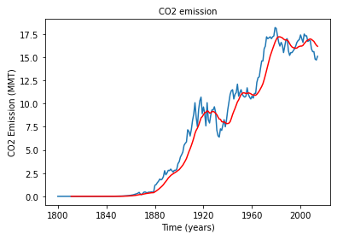
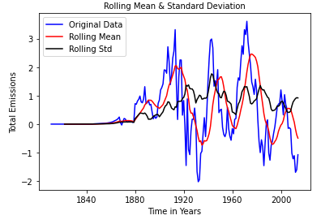
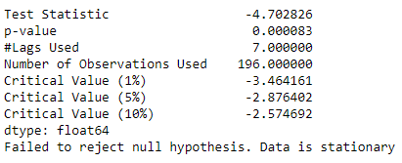
1. Moving Average
In this technique, we take average of ‘k’ consecutive values depending on the frequency of time series. Here, we will take the average over the past 12 year.
The rolling mean values appear to be highly varying. The Test Statistic is smaller than the 10% 5%, and 1% of critical values. So, we can say with 99% confidence level that the dataset is a stationary series.

Slide 10
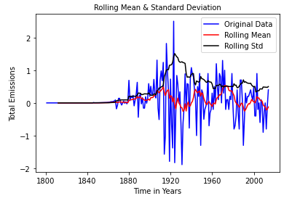
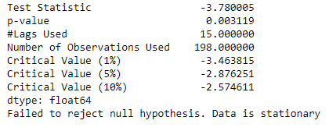
2. Eliminating Trend & seasonality : Differencing
Differencing : One of the most common methods of dealing with both trend and seasonality is differencing. In this technique, we take the difference of the observation at a particular instant with that at the previous instant. This mostly works well in improving stationarity.
First order difference:
The first difference improves the stationarity of the series. Let us use also the seasonal difference to remove the seasonality of the data and see how that impacts stationarity of the data.

Slide 11
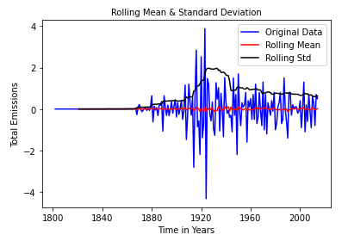
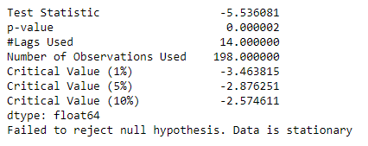
2. Seasonal first order difference:
Now, if we look the Test Statistic and the p-value, taking the seasonal first order difference has made our the time series dataset stationary. We are considering this seasonal first difference for further analysis because it looks more stationary

Slide 12
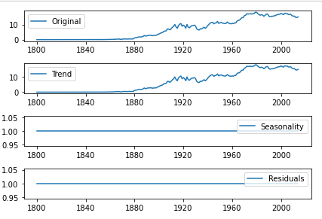
3. Eliminating Trend & seasonality : Decomposing
In this approach, both trend and seasonality are modeled separately and the remaining part of the series is returned.
Here we can see that the trend, seasonality are separated out from data and we can model the trend. Lets check stationarity of trend:

Slide 13
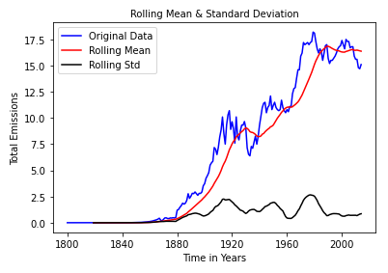
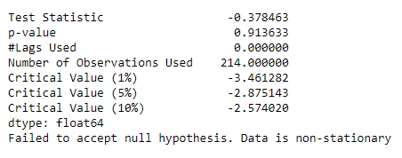
Data remains Non-stationary.

Slide 14
MODEL BUILDING

Slide 15
Model Building
Model building done both on Stationary and non-stationary data set
Models used:
ARIMA(Auto Regressive Integrated Moving Average)
AR(Auto Regressive)
MA(Moving Average)
Auto ARIMA
Simple Exponential smoothing
Double Exponential smoothing or Holt’s method
Triple Exponential smoothing or Holt’s –Winter method
Last Sample Technique Method (LSTM) using RNN

Slide 16
Model Building on Stationary data
Now building model on stationary after transforming the original data to stationary data.

Slide 17
Plot the ACF and PACF charts
Autocorrelation Function (ACF): It is a measure of the correlation between the time series with a lagged version of itself.
Partial Autocorrelation Function (PACF): This measures the correlation between the time series with a lagged version of itself but after eliminating the variations already explained by the intervening comparisons.
In the next step we will be determining the tuning parameters (p and q) of the model by looking at the autocorrelation and partial autocorrelation plots. The plot below provides a brief guide on how to read the autocorrelation and partial autocorrelation graphs in order to select the parameters.

Slide 18
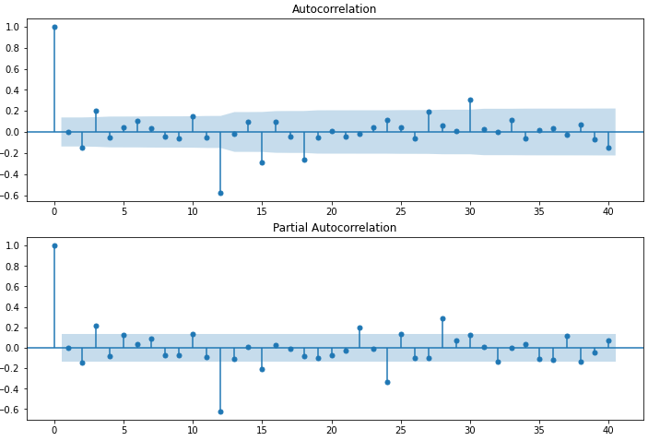
p – The lag value where the PACF chart crosses the upper confidence interval for the first time. If you notice closely, in this case p=2.
q – The lag value where the ACF chart crosses the upper confidence interval for the first time. If you notice closely, in this case q=2.

Slide 19
DATA PARTITIONING
Using Seasonal First Order Differencing data for building model for stationary data because it shows more stationarity.
Training Data = Fit the model only to training period
Validating Data = Assess the model performance on validation
Deploy model by training on whole dataset
No random partition That’s because the order sequence of the time series should be intact in order to use it for forecasting.

Slide 20
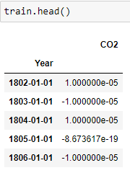
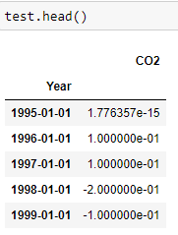

Slide 21
Hyper-parameter Tuning using Grid Search
Done Grid search for hyper-parameters to find out optimal order or (p, d ,q) for ARIMA model.
Best order found is (3,0,0) with least RMSE.

Slide 22
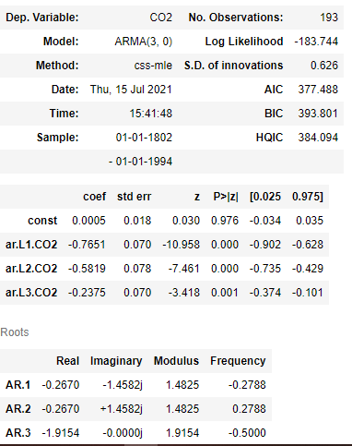
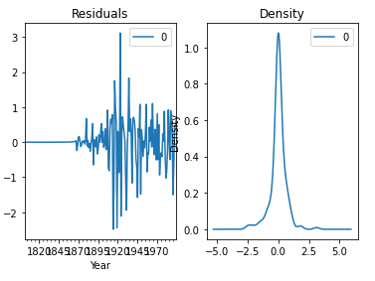
1. Model on Stationary Data
Auto Regressive Integrated Moving Average (ARIMA)

Slide 23
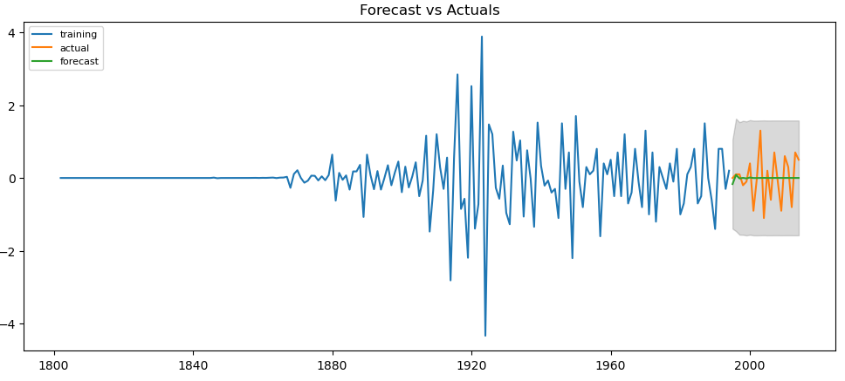


Slide 24
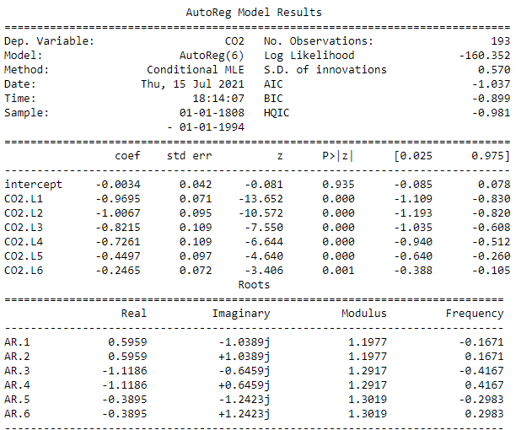
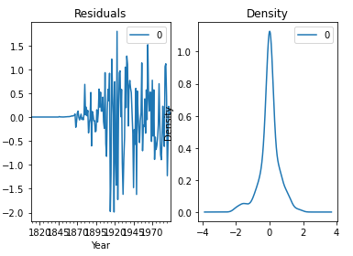
Auto Regressive (AR) model

Slide 25
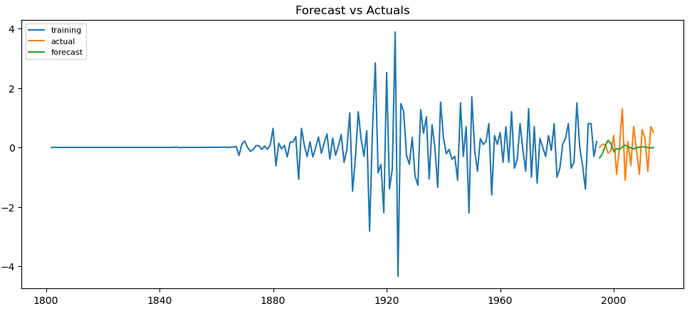
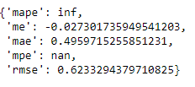

Slide 26
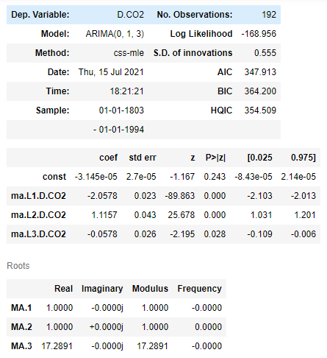
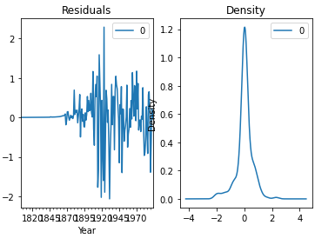
Moving Average (MA) Model

Slide 27
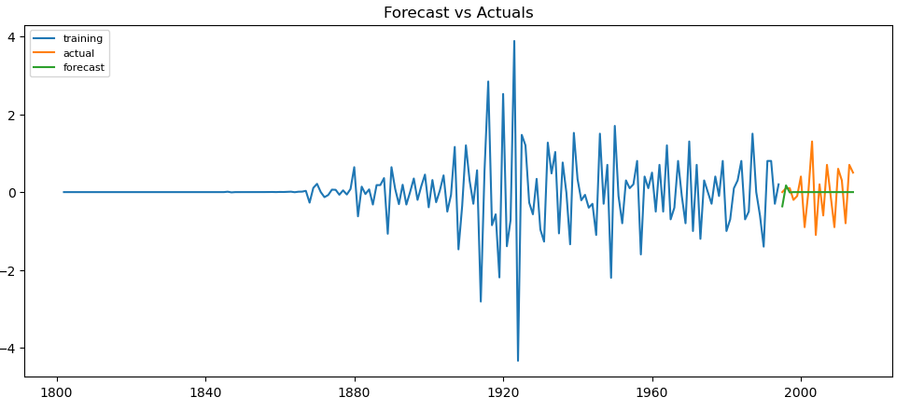
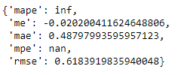

Slide 28
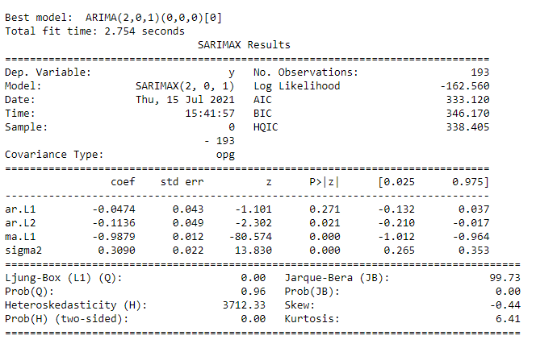
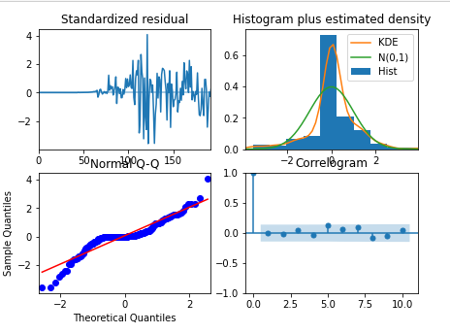
Auto ARIMA Model

Slide 29

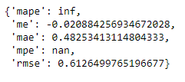

Slide 30
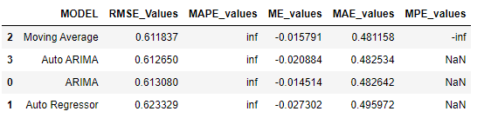
Comparing models build on stationary data
Moving average gave least RMSE but other forecasting accuracy like MAPE shows infinity and MPE says NaN.

Slide 31
Model Building on Non - Stationary data
Now building model on original data which is non – stationary.

Slide 32
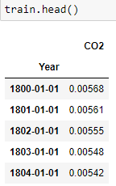
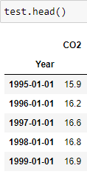
Data Partitioning

Slide 33
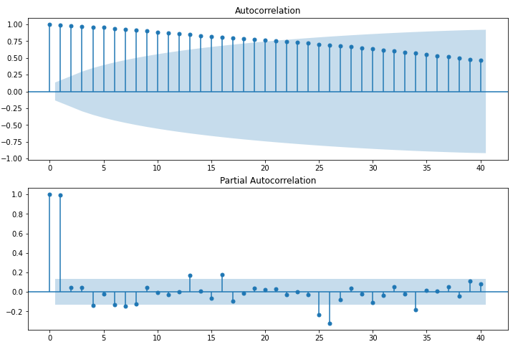
ACF & PACF Plots

Slide 34
Hyper-parameter Tuning using Grid Search
Done Grid search for hyper-parameters to find out optimal order or (p, d ,q) for ARIMA model.
Best order found is (3,1,4) with least RMSE.

Slide 35
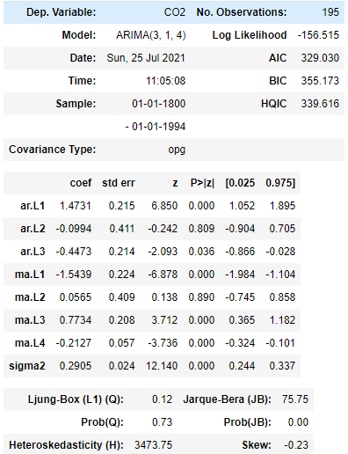
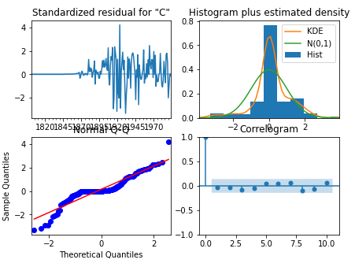
2. Models on Non-Stationary data
Auto Regressive Integrated Moving Average (ARIMA) model

Slide 36
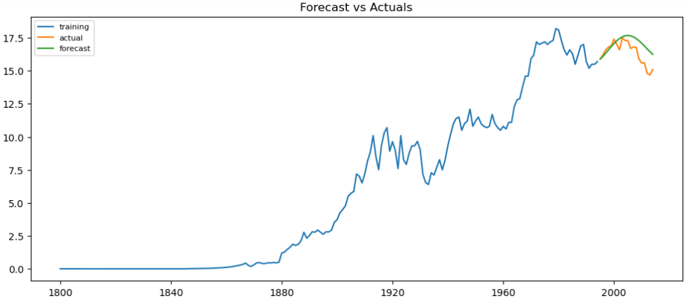
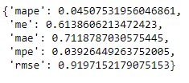

Slide 37
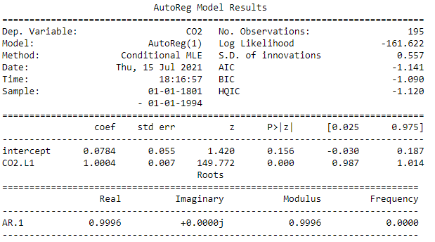
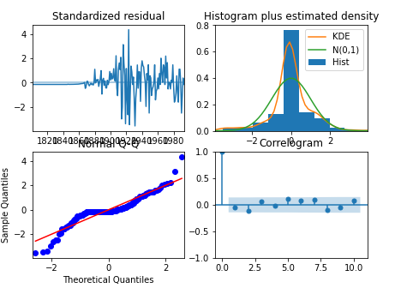
Auto Regressive (AR) Model

Slide 38
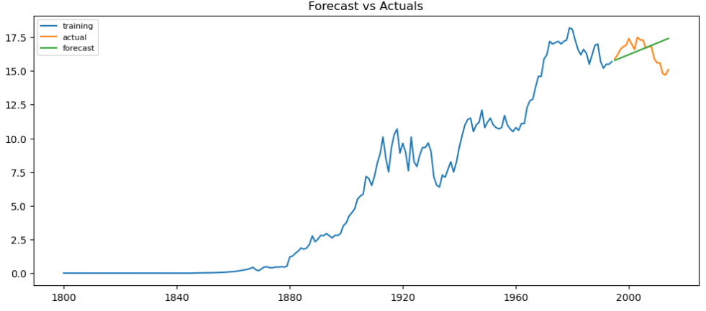
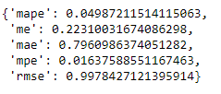

Slide 39
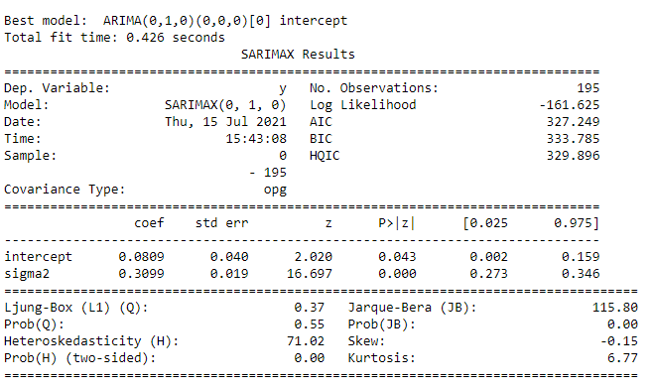
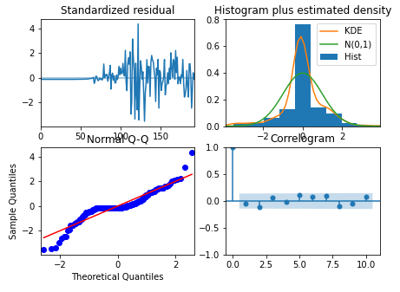
Auto ARIMA Model

Slide 40
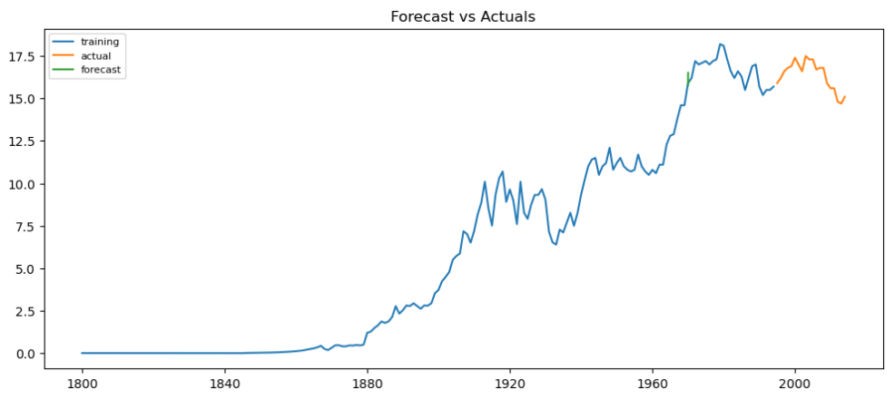

Slide 41
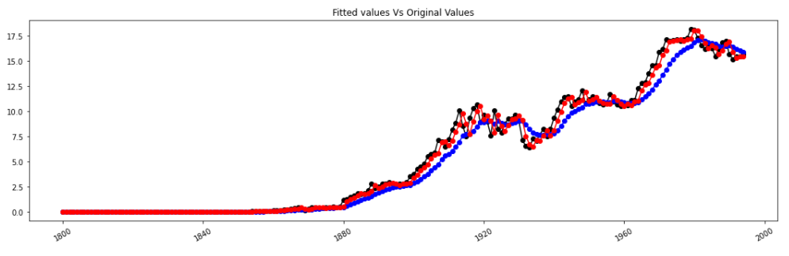

Simple Exponential Smoothing Model

Slide 42


Slide 43


Double Exponential Smoothing or Holt’s Method

Slide 44


Slide 45


Triple Exponential Smoothing or Holt’s – Winter Method
Seasonal = Additive and Trend = Additive

Slide 46


Seasonal = Multiplicative and Trend = Additive

Slide 47


Seasonal = Multiplicative and Trend = Multiplicative

Slide 48


Last Sample Technique Method – RNN

Slide 49



Slide 50


Slide 51

Comparing Model Performance

Slide 52
Final Model
The Final Model selected for the deployment is ARIMA(3,1,4) which will be trained on full original non-stationary dataset
Reasons to choose this model:
Least MAPE and MAE values
Forecasted values vs Actual values graphs capturing more information when compared to other models.
Now we will train this model using full original dataset and make forecast for future years.

Slide 53

Model training on full original dataset

Slide 54

It looks like this model captures a good amount of information and we can say that model is trained well.

Slide 55


Forecasting for next 5 years

Slide 56


Forecasting for next 10 years

Slide 57
Model Deployment

Slide 58

Deployed the final model using Streamlit
Steps to run python application:
Open Anaconda Prompt in the project directory
Then run command : “ streamlit run TS.py “
After opening of browser upload the dataset and choose number of years you want to forecast
Forecasted results and graph will be displayed

Slide 59


Slide 60
THANK YOU

