Slide 1

Vehicle Management System
Ruqayya Shah (Amity University, Noida)
09/01/2026

Slide 2
Project Overview
Objective:
The objective of this project is to design and develop a Vehicle Service Management System that digitalizes and automates the end-to-end operations of automobile service centers.
The system aims to provide a secure, scalable, and role-based full-stack web application using ASP.NET Core Web API and Angular, enabling efficient management of vehicle service requests, technician assignments, inventory, billing, and reporting.
This project focuses on implementing real-world service workflows, JWT-based authentication, clean architecture, and LINQ-driven data processing, while delivering an intuitive user interface and maintainable backend suitable for enterprise-level applications.
Technology Stack: .NET Core, Angular , SQL Server (localdb), Gmail SMTP
Duration: 10 days

Slide 3
Problem Statement
Automobile service centers handle a high volume of vehicle service requests every day, but many still rely on manual records or fragmented software systems. This results in poor visibility of service status, inefficient technician allocation, delayed service delivery, and difficulty in tracking vehicle history, parts usage, and billing information.
The lack of a centralized, role-based digital system makes it challenging for admins, service managers, technicians, and customers to coordinate effectively, leading to operational inefficiencies and reduced customer satisfaction.
Key Challenges
Manual or semi-automated tracking of service requests and vehicle history
Inefficient technician assignment and workload monitoring
Delays in service completion and billing
Limited reporting on performance, revenue, and service quality

Slide 4
Proposed Solution
• Centralized Web Platform for managing vehicle service operations with role-based access for Admin, ServiceManager, Technician, and Customer
• Customer Portal - Register vehicles, book service appointments, track service status, view bills, and make online payments
• Service Manager Dashboard - Assign technicians, manage service categories, generate bills with tax/discount, and view revenue analytics
• Technician Workstation - View assigned tasks, update completion status, and add parts used during service
• Parts Inventory Module - Track stock levels, low stock alerts, and part order management
• Automated Billing System - Auto-calculate service charges, parts cost, tax, and discounts with partial payment support
• Dual Notification System - Email + In-App notifications for status changes, assignments, and payment reminders
• Analytics & Reports - Real-time dashboards for monthly revenue, technician workload, and category-wise performance

Slide 5
Solution & Key Features
Role-Based Access Control
Separate interfaces for Admin, ServiceManager, Technician, and Customer
Secure access using JWT Authentication
Customer Features
Online service booking with vehicle registration
View service status and dashboard
Track bills, payments, and service history
Technician Features
View and complete assigned service tasks
Update task status and completion details
Add parts used during service
ServiceManager Features
Review and assign technicians to service requests
Generate bills with tax/discount calculations
Access reports dashboard and revenue summaries
Manage parts inventory and stock orders
Admin Features
Manage service categories and pricing rules
View and manage all users and pending approvals
Admin dashboard for system monitoring
Backend & Processing
RESTful APIs using ASP.NET Core Web API
Controllers for Auth, Services, Billing, Payments, Reports, and Admin
Business logic implemented using LINQ
Data & Security
Secure data storage using SQL Server
ORM handled via Entity Framework Core
API documentation with Swagger

Slide 6
Technology Stack
Backend
Frontend
ASP.NET Core 9 Web API, Entity Framework Core, Repository + Unit of Work Pattern, JWT Bearer Authentication, AutoMapper, LINQ Queries
Angular 17+, TypeScript, Reactive Forms, Angular Material, RxJS, HTTP Interceptors, Route Guards
Roles
Database
4 Roles with granular permissions: Admin (approvals), ServiceManager (operations/billing), Technician (tasks), Customer (bookings/payments)
SQL Server, EF Core , 15+ Entities, Migrations for schema versioning

Slide 7
Database Schema

Slide 8
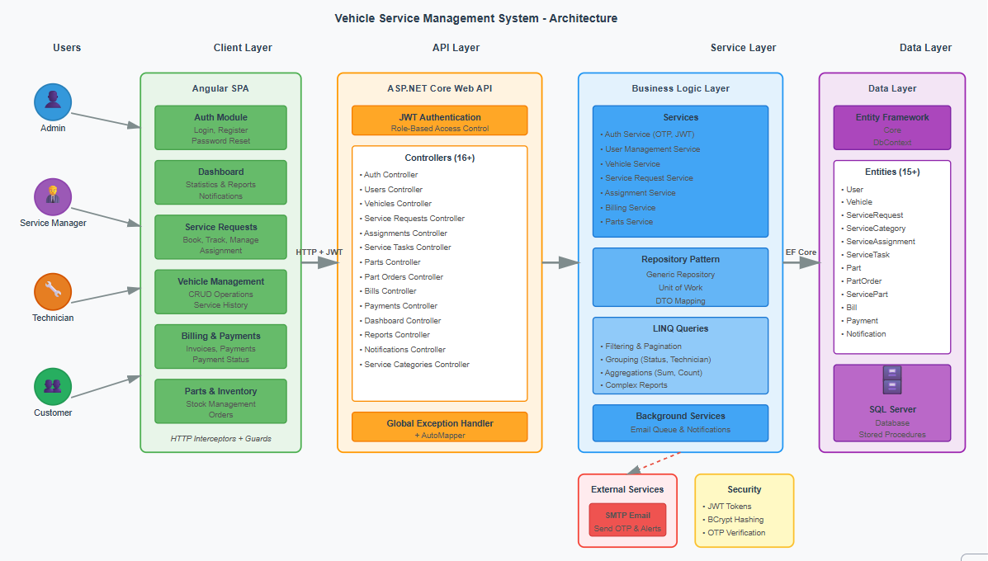
System Architecture
System Architecture Diagram

Slide 9
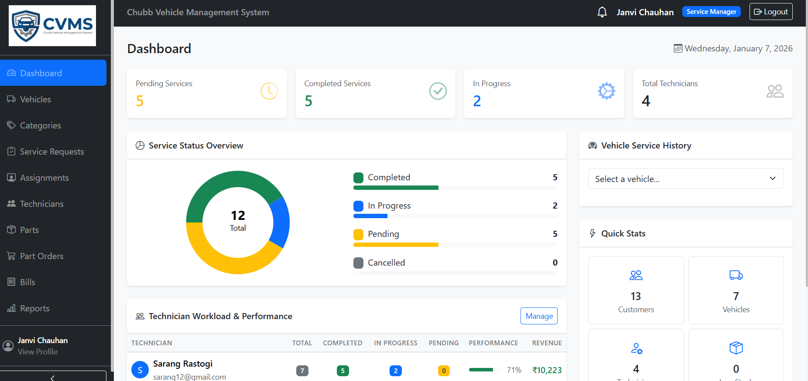
Dashboard Screen(Service Manager)
Provides a real-time overview of service operations including service status distribution, technician workload, vehicle history, and key performance metrics for effective decision-making.

Slide 10
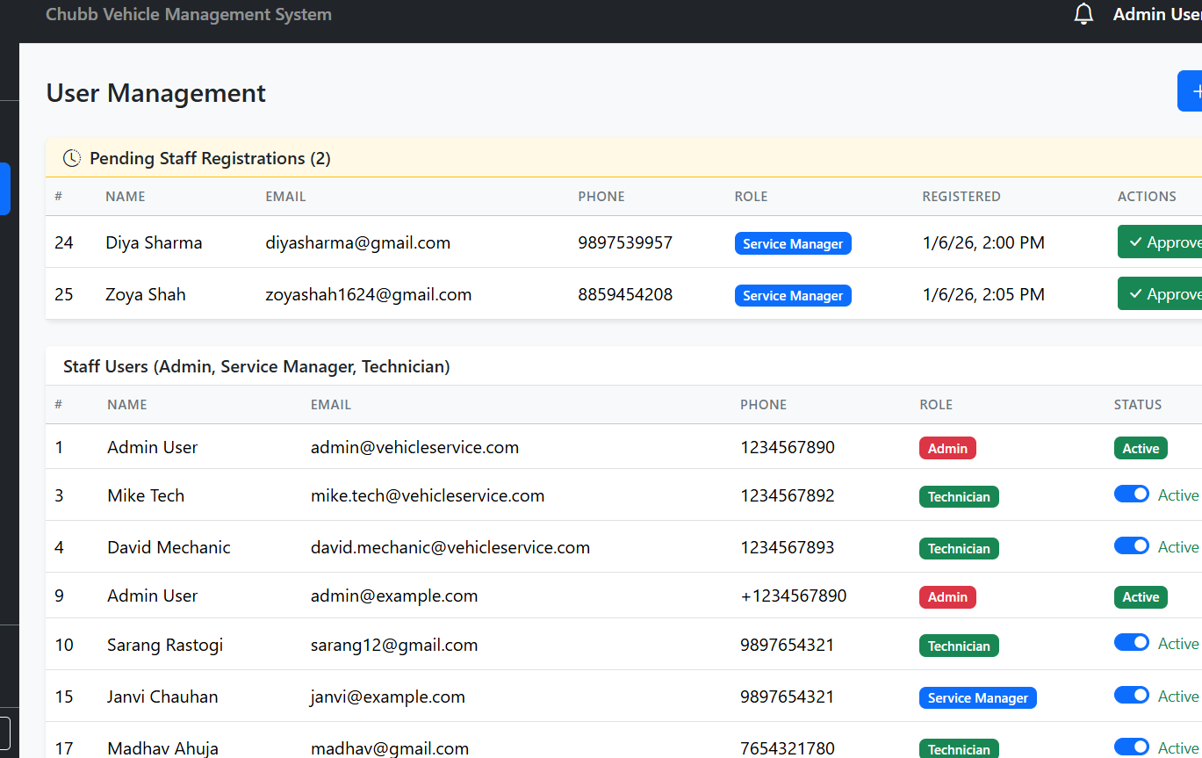
User Management Screen(Admin)
Enables admins to manage staff accounts with role-based access, approve or reject pending registrations, and monitor active status of Customers, Service Managers, and Technicians.

Slide 11
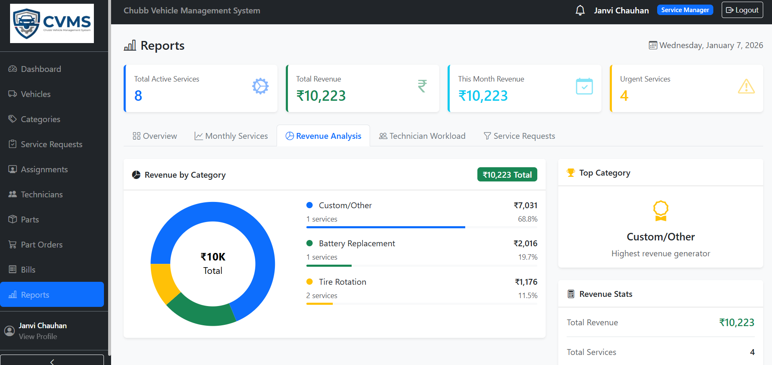
Reports & Analytics
Displays detailed service and revenue insights including total active services, total revenue, monthly revenue, and urgent service counts.

Slide 12
Results & Achievements
• Successfully developed a secure full-stack Vehicle Service Management System using ASP.NET Core and Angular
• Implemented JWT-based authentication and role-based authorization for Admin, ServiceManager, Technician, and Customer
• Automated the complete service lifecycle from booking to assignment, task completion, billing, and payment
• Enabled real-time service tracking, technician workload monitoring, and low stock alerts
• Achieved clean data handling using Entity Framework Core and LINQ queries (no raw SQL)
• Built interactive dashboards and reports for revenue analytics, technician performance, and service trends
• Ensured scalable, maintainable, and secure architecture following Repository Pattern and industry best practices

Slide 13
Live Demonstration
Live Demonstration
See the application in action
▶️

