Slide 1


EAST WEST INSTITUTE OF TECHNOLOGY
(Affiliated to Visvesvaraya Technological University Belgavi)
No.63,Anjananagara,Off Magadi Road,Near BEL Layout,Bangalore Karnataka 560091
DEPARTMENT OF ELECTRONICSAND COMMUNICATION ENGINEERING
MINI PROJECT WORK (BEC586)
PROJECT PHASE-1 REVIEW
on
“VOICE CONTROL HOME AUTOMATION WITH SMART DOOR LOCK ”
Presented by:
Rakshitha Jain S
Ruquiya Khanum
Sneha Chauhan
Varsha B Gotur
- (1EW22EC125)
- (1EW22EC130)
- (1EW22EC155)
- (1EW23EC172)
Under the Guidence of :
Mrs.Shilpa.V
Assistant Professor
Dept.ECE, EWIT

Slide 2
CONTENTS
ABSTRACT
INTRODUCTION
MOTIV A TION
PROBLEM STATEMENT
LITERATURE SURVEY
OBJECTIVES
DESIGN METHODOLOGY
BLOCK DIAGRAM
COMPONENTS REQUIRED
REFERENCES

Slide 3
ABSTRACT
IoT-enabled smart home automation system utilizing theESP32 microcontroller to enhance home management through real-time remote control. The proposed system integrates various sensors, including temperature, humidity, motion(PIR), light, and raindrop sensors, to automate tasks based on environmental conditions, thereby improving energy efficiency and convenience. Additionally, the system incorporates an RFID-based door locking mechanism for enhanced security and supports voice commands for hands-free operation catering to individuals with mobility limitations. A web interface allows users to monitor and control connected devices remotely via Wi-Fi, offering a seamless and user-friendly experience. Emphasis is placed on secure communication protocols to safeguard user data, while a modular architecture ensures scalability for future enhancements. This solution demonstrates the potential of IoT technologies to create energy-efficient, secure, and accessible smart home systems,addressing modern demands for sustainable living.
Key Words :Voice Control, Home Automation, Smart Door Lock, IOT, Wireless Control, Security System, Voice Recognition, Access Control, Smart Home, Microcontroller(ESP32).

Slide 4
INTRODUCTION
The rapid advancements in Internet of Things (IoT)technology have revolutionized various aspects of modern living, with smart home automation being one of the most prominent applications. Smart home systems provide home owners with the ability to remotely monitor and control household devices such as lighting, doors through smartphones, voice commands, or other connected devices. These systems enhance convenience, improve energy efficiency, and strengthen security, making them an integral part of sustainable and intelligent living solutions. This approach not only reduces manual effort but also enables energy optimization by ensuring appliances operate only when required. For instance, sensors can monitor temperature, humidity, or motion to adjust lighting, heating,or cooling systems automatically, leading to significant energy savings and improved environmental impact. Features like RFID-based access control, motion detection, and real-time notifications allow users to monitor their homes remotely and respond to potential threats effectively.

Slide 5
MOTIVATION
Time-Saving: The increasing demand for automated home systems motivates the need for a solution that reduces manual effort in controlling household devices.
Convenience: Voice-controlled and app-based smart automation offers a hands-free experience, catering to users who seek modern and convenient smart home solutions.
Security Enhancement: Growing concerns about home safety encourage the development of smart locking mechanisms using RFID technology to prevent unauthorized access.
Technological Advancement: The rapid evolution of IoT, wireless connectivity, and embedded systems provides an opportunity to design intelligent systems that improve everyday living.
Accessibility: Voice-operated systems provide greater accessibility for individuals with mobility challenges, helping them control home appliances independently.

Slide 6
PROBLEM STATEMENT
In modern households, the lack of an integrated, affordable, and intelligent automation system creates challenges in ensuring security, convenience, and energy efficiency. Traditional home appliances require manual operation, which can be difficult for elderly individuals or people with mobility limitations. Similarly, conventional door lock systems relying on physical keys pose risks such as loss, duplication, and unauthorized access. Existing automation solutions often lack real-time monitoring, environmental sensing, and seamless voice-based control. Therefore, there is a need for a smart home system that combines IoT technology, sensor based automation, secure RFID door access, and voice command functionality to provide users with a safe, accessible, and energy-efficient living environment. This project addresses these challenges by developing an ESP32-based home automation system capable of remote monitoring, intelligent control, and enhanced security.

Slide 7
LITERATURE SURVEY
Title of Paper | Author(s) | Year | Inference
Domicile - An IoT Based Smart Home Automation System | H. Patel, D. Gupta, & R. Singh | 2021 | It focuses on providing efficient remote monitoring and control of household appliances through wireless communication technologies.
Smart Home Automation System with Status Feedback Based on ESP32 and IoT | Jampana, J. G, Praneeth, A. J, Devi, J. H, & Rani, P | 2022 | The work utilizes the ESP32 microcontroller for its builtin Wi-Fi capabilities, enabling seamless communication between sensors, appliances, and a cloud-connected user interface.

Slide 8
Title of Paper | Author(s) | Year | Inference
Home Automation System Using ESP32 and Firebase | A. Koushal, R. Gupta, & F. Jan | 2023 | It focuses on cloud-based interaction, where Firebase acts as a centralized database for storing sensor data and synchronizing appliance states across multiple user devices.
Iot based smart home automation using esp32 | R Arunadevi, J Lurdhumary, R Ramya, M S Vinotheni, YuvikaShree S, Swathi D R, K Mariyamma | 2025 | It highlights the ESP32’s integrated Wi-Fi capabilities, low power consumption, and cost-effectiveness, making it an ideal platform for scalable IoT applications.

Slide 9
OBJECTIVES
Smart Home Automation: To automate the control of home appliances such as lights, fans, and doors using IoT-enabled ESP32 for seamless operation with minimal human intervention.
Voice-Controlled Operation: To integrate a voice recognition interface that enables users to control home devices hands-free, improving accessibility and ease of use.
Secure Access Control: To implement an RFID-based smart door locking system that allows only authorized users to enter, ensuring enhanced home security.
Environmental Monitoring: To use sensors such as DHT11, PIR, LDR, and raindrop modules for monitoring temperature, humidity, motion, and rain to automate actions and improve energy efficiency.
Remote Monitoring and Control: To develop a web-based dashboard that allows users to monitor and operate home devices remotely through Wi-Fi connectivity.

Slide 10
DESIGN METHODOLOGY
The hardware design consists of several essential modules. The ESP32 microcontroller is selected for its dual-core processing capability, integrated Wi-Fi and Bluetooth connectivity, and low power consumption making it ideal for IoT applications. The DHT11 sensor is incorporated to monitor temperature and humidity, allowing automated climate adjustments based on real-time data. Motion detection is handled by a PIR sensor, which activates lights or security alerts upon detecting movement. A photoresistor sensor enables ambient light-based automation, adjusting indoor lighting to optimize energy efficiency. A raindrop sensor is included to detect precipitation and trigger the automatic closing of windows or activating alerts for homeowners. For security and controlled access, an RFID module is implemented

Slide 11
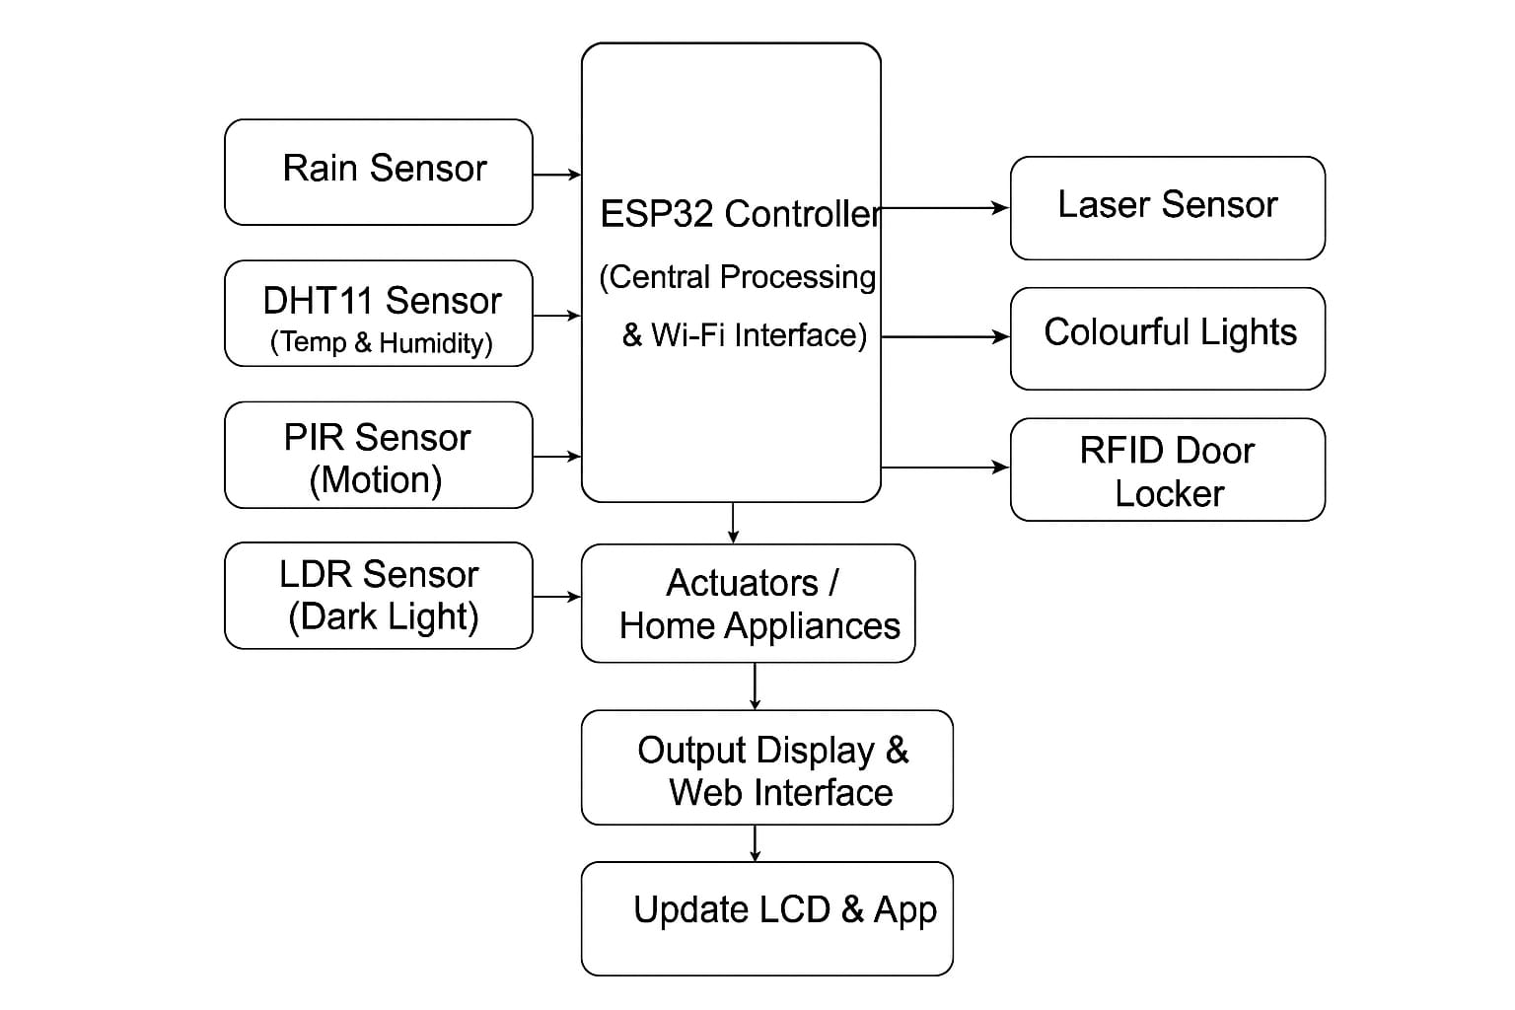
BLOCK DIAGRAM

Slide 12
Block diagram states that:
The block diagram illustrates a complete IoT-based smart home automation system centered around the ESP32 controller, which acts as the main processing unit and provides Wi-Fi connectivity for remote monitoring and control. Multiple sensors are interfaced with the ESP32 to gather real-time environmental, security, and lighting data. The rain sensor detects rainfall for automatic window or roof control, while the DHT11 sensor measures temperature and humidity to support climate-based automation. The PIR motion sensor identifies human movement to enable security alerts or automatic lighting, and the LDR sensor measures surrounding light intensity to turn lights ON or OFF automatically during dark conditions. After processing all sensor inputs, the ESP32 controls various output modules and home appliances through actuators. Additional smart modules, such as a laser sensor for intrusion detection, colourful decorative/ambient lights, and an RFID-based smart door locking system, enhance security and user convenience. The system continuously updates information on an LCD display and also sends data to a web or mobile app for remote monitoring. Users can view sensor readings, control appliances, and receive alerts through the online dashboard. Overall, this project demonstrates a fully automated IoT smart home system that integrates sensing, processing, actuation, and wireless communication to create a secure, energy-efficient, and intelligent home environment.

Slide 13
COMPONENTS REQUIRED
Hardware Components
Photoresistor Sensor
LCD Module
6 AA Battery Holder
Servo SG90 9G
RBG LED Strip
F-F 3P Dupont Wire
F-F 4P Dupont Wire
Wodden Board
Mirror Kit
Acrylic Board For Servo
ESP32 Controller Board
Blue LED Module
Raindrop Sensor
Voice Recognition Module
Laser Module
DHT11 Temperature & Humidity Sensor
PIR Motion Sensor
RFID Module+IC Keychain
Button Module

Slide 14
Software Components
Arduino IDE
ESP32 Board Libraries
HTML,CSS and Javascript
HTTP, I2C and UART Protocols
ESP32 Web Server
Speech -To- Text Library / Voice Processing Module
USB-To-UART Driver

Slide 15
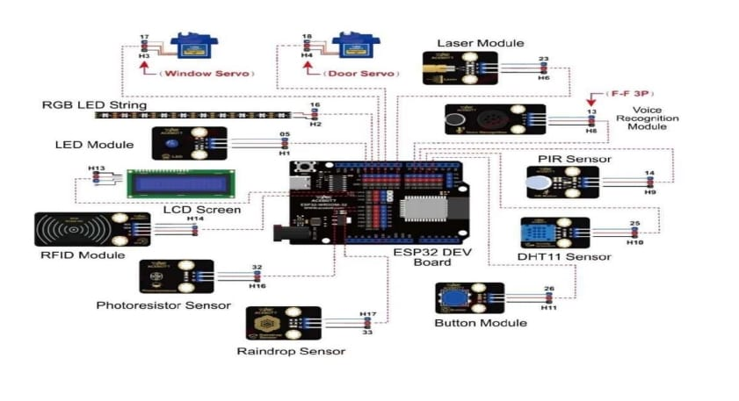
ESP32 Controller Board
As shown in the figure, the ESP32 MAX V1.0 is the main controller used in the smart home automation system. It has built-in Wi-Fi and Bluetooth, allowing remote control and voice operation. The board reads data from sensors like temperature, motion, light, and rain to automate different home functions. It also controls relays and the door lock system for switching appliances and securing the house.
The ESP32 supports RFID, LCD display, and voice modules to make the system safer and more user-friendly. It is programmed using the Arduino IDE and works as a small web server for real-time monitoring and device control.

Slide 16
RESULT
As shown in Figure, the proposed Voice-Controlled Home Automation System with Smart Door Lock was successfully designed, implemented, and tested using the ESP32 microcontroller. The system accurately performed real-time monitoring and automatic control of various home appliances and security components. The integration of temperature, humidity, motion, LDR, and raindrop sensors allowed the system to respond intelligently to environmental changes, enabling automatic lighting, window control, and security alerts. Voice commands were successfully recognized by the voice-processing module, enabling hands-free operation of lights, fans, and the smart door lock. This feature significantly improved user convenience, especially for elderly or physically challenged individuals.
Voice Control Home Automation With Smart Door Lock

Slide 17
References
[1] H. Patel, D. Gupta, and R. Singh, “Domicile - An IoT Based Smart Home Automation System,” in IEEE International Conference on Computational Intelligence and Networks (CINE), 2021.
[2] Jampana, J. G., Praneeth, A. J., Devi, J. H., & Rani, P- “Smart Home Automation System with Status Feedback Based on ESP32 and IoT”. Proceedings of the 7th International Conference on Innovations and Research in Technology and Engineering (ICIRTE),2022.
[3] A. Koushal, R. Gupta, and F. Jan, “Home Automation System Using ESP32 and Firebase,” in Proceedings of the IEEE International Conference on Smart Systems and IoT Innovations (ICSSI), 2023.
[4] R Arunadevi, J Lurdhumary, R Ramya, M S Vinotheni, YuvikaShree S, Swathi D R,K.Mariyamma- “Iot based smart home automation using esp32”2025 International Conference on computing and communication technologies (ICCCT),2025

Slide 18


