Slide 1
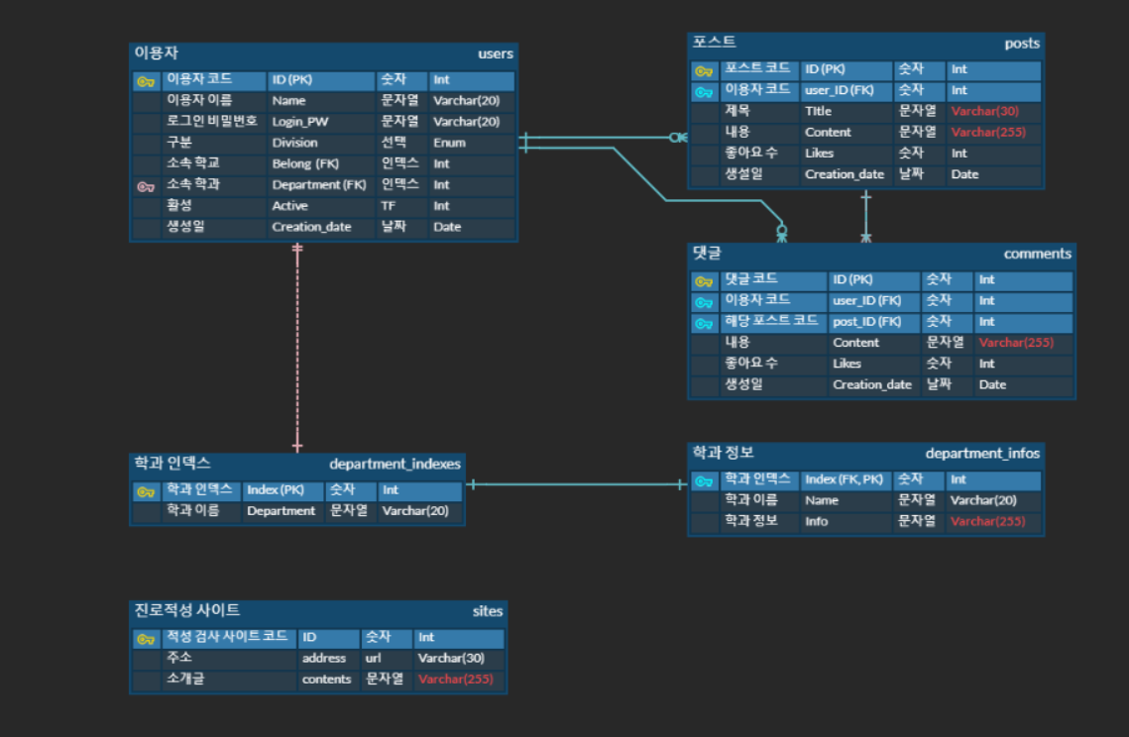
User
Posts
Departments
Career

