Slide 1
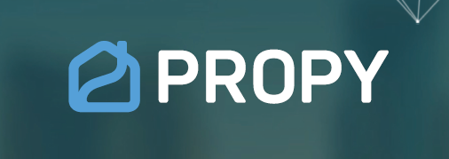
ISM 6930.370F22.94821 Block Chain Fundamentals
Ruslan Dubas
Propy: Real Estate platform that uses blcockchain-based title registry system
https://propy.com/browse/

Slide 2

Propy
Propy is a real estate transaction platform that empowers buyers, sellers, their agents, and escrow agents to close a traditional real estate deal entirely online
Platform provides access to the legal documents signifying ownership
The Promise: Reduced cost to the buyers and ability to buy a real estate property in a few minutes

Slide 3
Propy
Industry: Real Estate
Year Founded: 2016
Headquarters: Palo Alto, California
Geographical scope: Global (International Real Estate Transactions)
Vision: Removing barriers to real estate ownership, enabling self-driving real estate transactions with all of the logistics seamlessly executed on the back-end

Slide 4
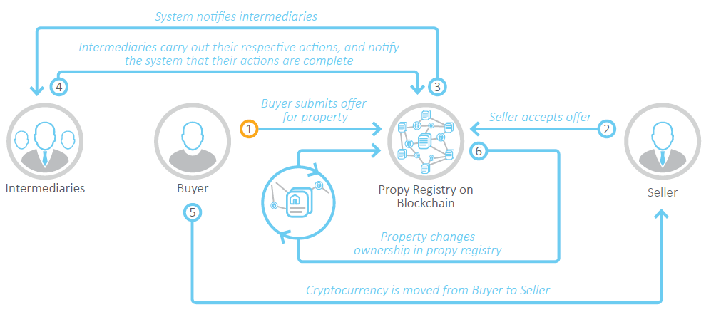
Workflow

Slide 5
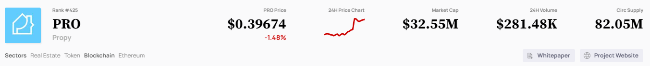
Type of chain and consensus
The purchase offer, payment, and deeds are uploaded to an immutable blockchain
Propy operates on the Ethereum platform and is built on the ERC721 (NFT standard for unique tokens on Ethereum) token standard, allowing it to integrate with users' wallets.
*https://cryptoslate.com/coins/propy/

Slide 6

Propy
The native token of the platform is PRO, an ERC20 token
Used for: creation of a new title or transferring an existing title
Propy use API to interact directly with the smart contracts

Slide 7
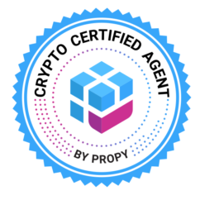
Propy: blockchain-based title registry system.
Governance: Terms of Use governing the creation and the listing of the NFT
Membership levels and pricing:
$19.99 Month/User & $497 Crypto Certified Agent Course
Type of members:
Agents
Solutions: List a Property, Offer and Closing Platform, Mint a Deed NFT
Buyers & sellers
Solutions: List a Property, Find Agent, Buy & Sell Property as NFT, Mint a Deed NFT

