Slide 1

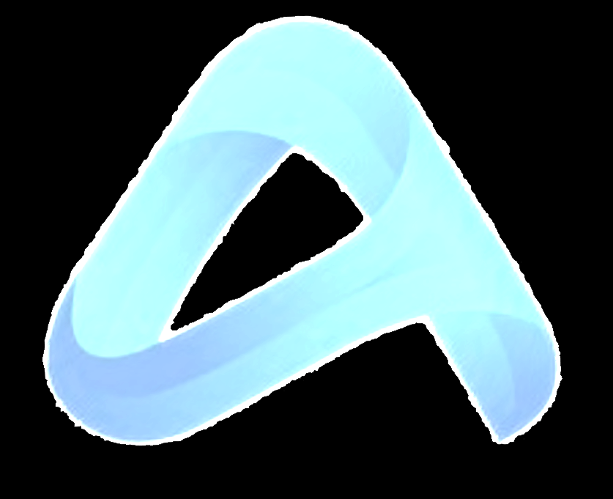


Performance Network
Install Campaigns
App Performance Campaigns
CPL (Form Targeted Campaign Setup)
Video & Display Performance
Publications (CPV – CPM)
Performance Network
Providing high performance by touching the target audience at the right time and with the right content
Reaching the relevant user by effective targeting
Opportunity to manage the budget correctly with correct positioning and detailed reporting

Slide 2

Performance Network
Install Campaigns
App Performance Campaigns
CPL (Form Targeted Campaign Setup)
Video & Display Performance
Publications (CPV – CPM)
Install Campaigns
We perform CPD and CPI campaigns by adhering to the growth strategies of your application.
Opportunity to work with more than 50 networks
broadcast either incentive or non-incentive
Guaranteed to rank high in your category
All tracking We have integration with tools .

Slide 3
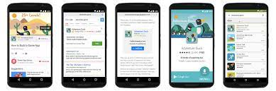
Performance Network
Install Campaigns
App Performance Campaigns
CPL (Form Targeted Campaign Setup)
Video & Display Performance
Publications (CPV – CPM)
App Performance Campaigns
CPS campaign management (pay per sale for e-commerce sites) & CPA (pay per action) in accordance with Marketing Strategies
Instant Performance optimization in line with brand targets and
Opportunity to gain new users with the opportunity to achieve maximum conversion with the right audience reach

Slide 4

Performance Network
Install Campaigns
App Performance Campaigns
CPL (Form Targeted Campaign Setup)
Video & Display Performance
Publications (CPV – CPM)
CPL (Form Targeted Campaign Setup)
The page where the brand collects forms is examined in detail.
A special conversion code is generated for each brand and campaign.
With all banner models, broadcasts are made on sites suitable for the brand.
Reconciliation is made over the leads falling on the brand website and CRM

Slide 5

Performance Network
Install Campaigns
App Performance Campaigns
CPL (Form Targeted Campaign Setup)
Video & Display Performance
Publications (CPV – CPM)
Video & Display Performance
Publications (CPV – CPM)
Right audience reach with targeting and wide network
High Viewability and Video completion Rate guarantee
Opportunity to take place in premium channels with price advantage
All tracking We have integration with tools .

