Slide 1

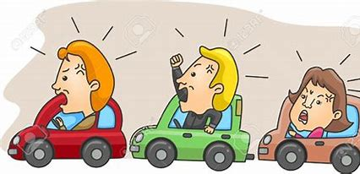
Major Project
Rush Hour
IMPROVED Traffic Control System (ITCS) to tackle heterogeneity of vehicles for green light timer computation using machine learning techniques
Team Members :
Deepak Sharma | 19103003
Rahul Jindal | 19103033
Mayank | 19103042
Raman Ailawadhi | 19103061
Mentor : Dr. Sudesh Rani

Slide 2
Literature Review
S. No. | Research Paper Title | Publication | Review
1 | Khushi, "Smart Control of Traffic Light System using Image Processing" | 2017 International Conference on Current Trends in Computer, Electrical, Electronics and Communication (CTCEEC), Mysore, 2017, pp. 99-103, doi: 10.1109/CTCEEC.2017.8454966 | Proposes an Arduino-UNO based system that processes the image in MATLAB, where the image is converted to a threshold image by removing saturation and hues, and traffic density is calculated. Depending on traffic count and traffic density, the Arduino sets the duration of green light for each lane.
2 | Renjith Soman "Traffic Light Control and Violation Detection Using Image Processing” | IOSR Journal of Engineering (IOSRJEN), vol. 08, no. 4, 2018, pp. 23-27 | Makes use of a support vector machine algorithm along with image processing techniques. Image processing is done using OpenCV and the images are converted to grayscale images before SVM is applied. This system detects traffic density and red light violations.

Slide 3
Literature Review
S. No. | Research Paper Title | Publication | Review
3 | A. A. Zaid, Y. Suhweil and M. A. Yaman, "Smart controlling for traffic light time" | 2017 IEEE Jordan Conference on Applied Electrical Engineering and Computing Technologies (AEECT), Aqaba, 2017, pp. 1-5, doi: 10.1109/AEECT.2017.8257768 | Proposes a smart traffic light system using ANN and fuzzy controller. This system makes use of images captured from cameras installed at traffic site. Segmentation is performed using sliding window technique to count the cars irrespective of size and ANN is run through the segmented image, the output of which is used in fuzzy controller to set timers for red and green light using crisp output. Results had an average error of 2% with execution time of 1.5 seconds.
4 | A. Vogel, I. Oremović, R. Šimić and E. Ivanjko, "Improving Traffic Light Control by Means of Fuzzy Logic," | 2018 International Symposium ELMAR, Zadar, 2018, pp. 51-56, doi: 10.23919/ELMAR.2018.8534692 | Proposes a fuzzy logic-controlled traffic light that can be adapt to the current traffic situations. Makes use of two fuzzy controllers with 3 inputs and one output for primary and secondary driveways. A simulation was done using VISSIM and MATLAB and for low traffic density, it improved traffic conditions.

Slide 4
Literature Review
S. No. | Research Paper Title | Publication | Review
5 | A. Kanungo, A. Sharma and C. Singla, "Smart traffic lights switching and traffic density calculation using video processing" | 2014 Recent Advances in Engineering and Computational Sciences (RAECS), Chandigarh, 2014, pp. 1-6, doi: 10.1109/RAECS.2014.6799542 | Makes use of live video footage, images in small frames are captured and the road with most traffic density is given green signal. MATLAB image processing tools along with C++ algorithms are used.

Slide 5



Previous Work Till Last Presentation
Simulation
Development Phase
Explored several simulation techniques and settled for PyGame.
Initiated by building backend in Node.js
Parallely, started working on the frontend too.
Idea Development
ML Model
Reached out to Chandigarh SMART CITY Project Officials
Discussed our idea and the problems they’re facing.
Code written to analyze frames from a video and counting the no. of vehicles and of its type.

Slide 6


Work Done After Last Presentation
ITCS Algorithm Development
Pygame Simulator Development
Analysis
Created an algorithm to dynamically manage green signal timer
Coded the algorithm
Built a simulator with Pygame library to visualize our dynamic traffic management on randomly generated data
Compared number of vehicles passed with our Dynamic Timer Algorithm vs Static Timer

Slide 7
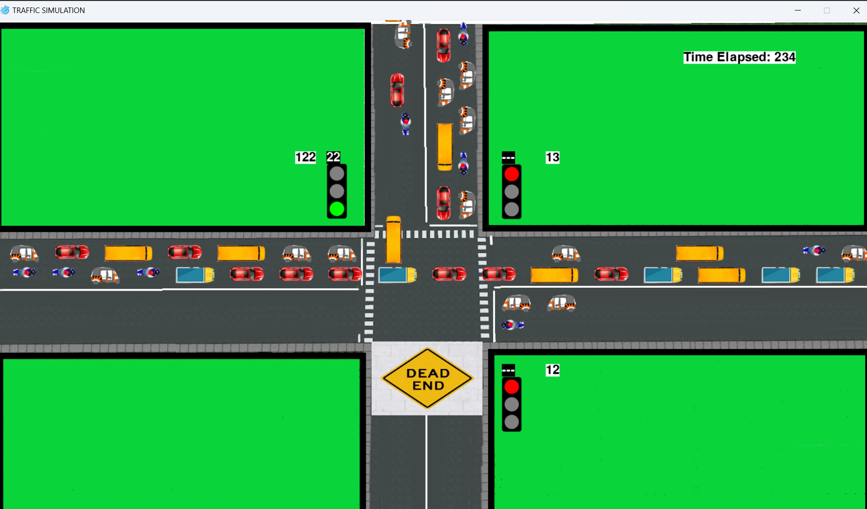
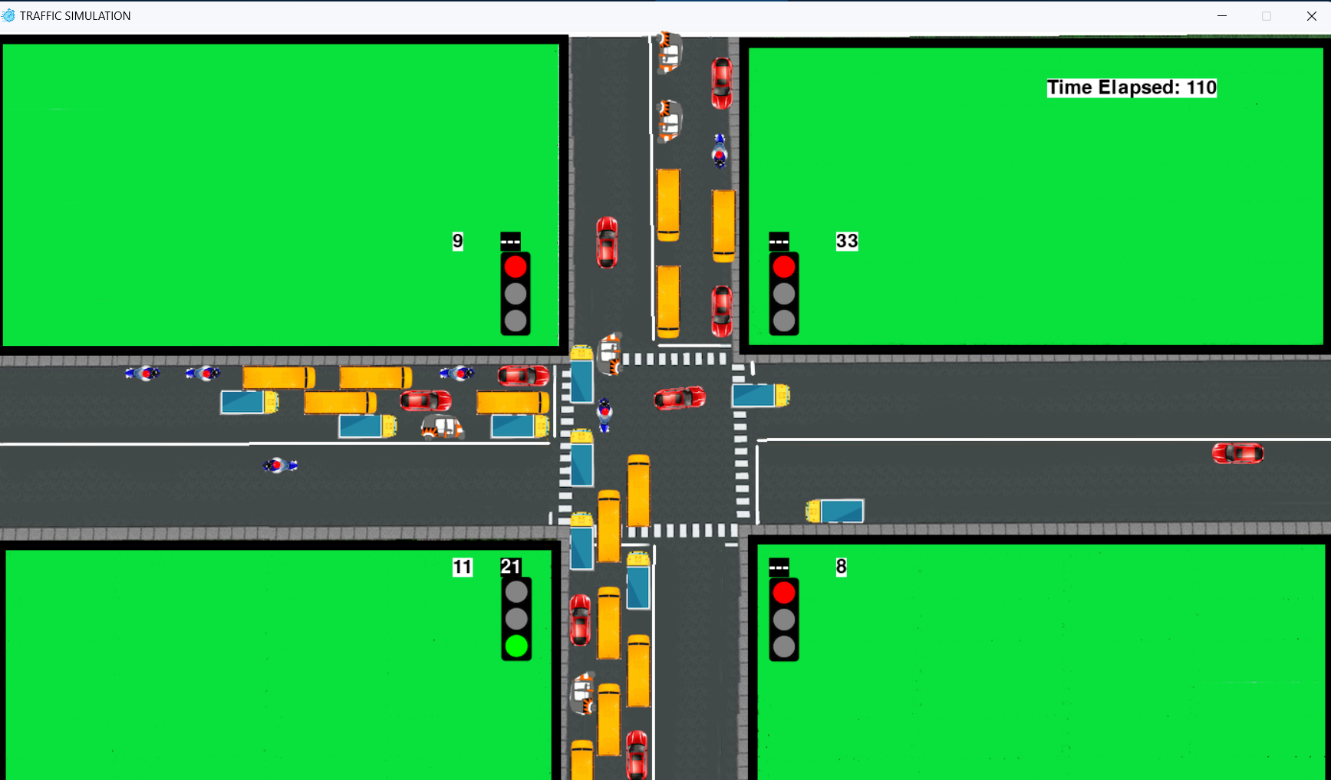
Results And Inferences
3 way
4 way
Pygame Simulator

Slide 8
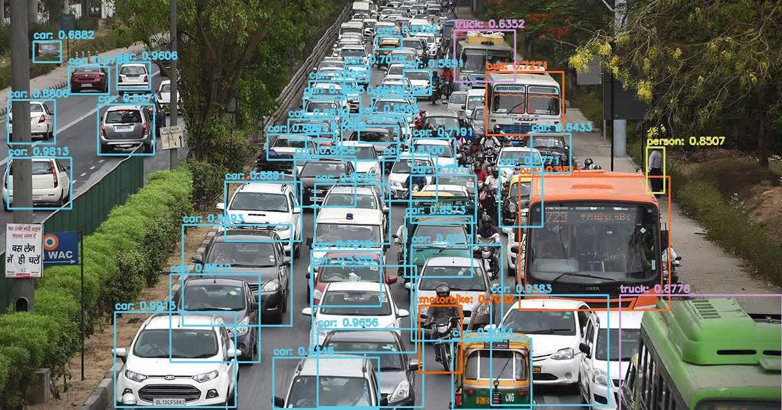
Results And Inferences
YOLO Model Output

Slide 9
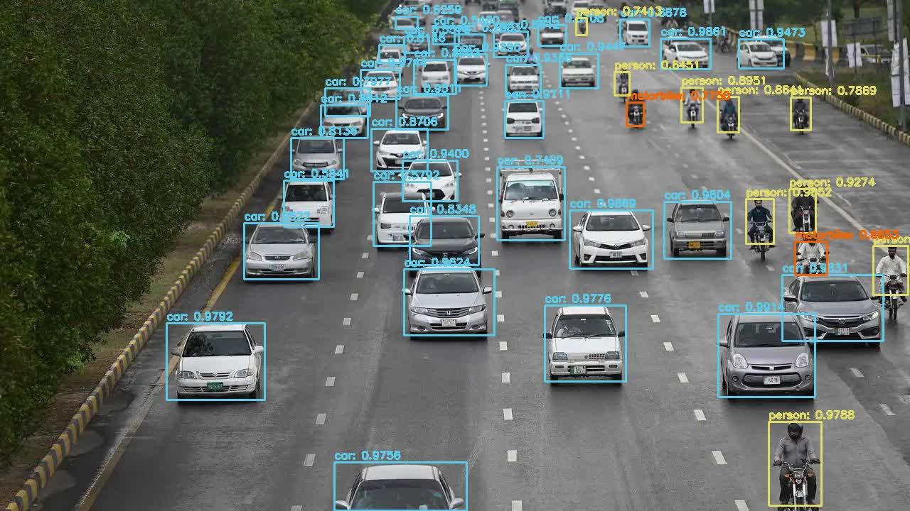
Results And Inferences
YOLO Model Output

Slide 10
Results And Inferences
P(i) indicates the traffic density, where the sum of all the P(i) is equal to one.
Lane(i) indicates the number of vehicles crossed from that lane.
Total(S) indicates the total number of vehicles crossed from all the lanes considering the static system.
Total(D) indicates the total number of vehicles crossed from all the lanes considering the dynamic system.
Improvement indicates the percentage improvement considering the dynamic system over the static system.
Data points indicate the number of the test case.

Slide 11
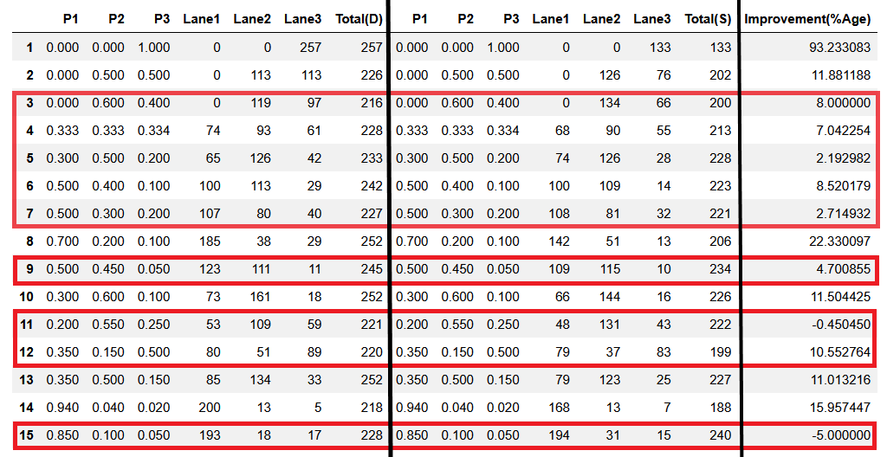
Results And Inferences
Dynamic System
Static System
3 - WAY SYSTEM
Notes:
Improvement = (No. of vehicles crossed in dynamic - no. of vehicles crossed in static) / no. of vehicles crossed in static [considering same simulation time]
Total(D) - tells the number of vehicles passed using Dynamic Timer
Total(S) - Tells the number of vehicles passed using Static Timer

Slide 12
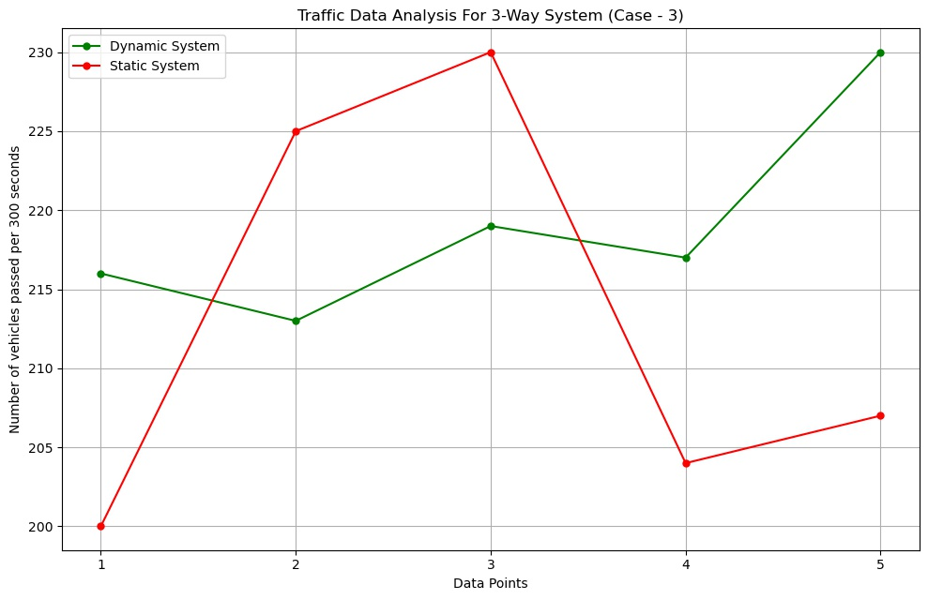
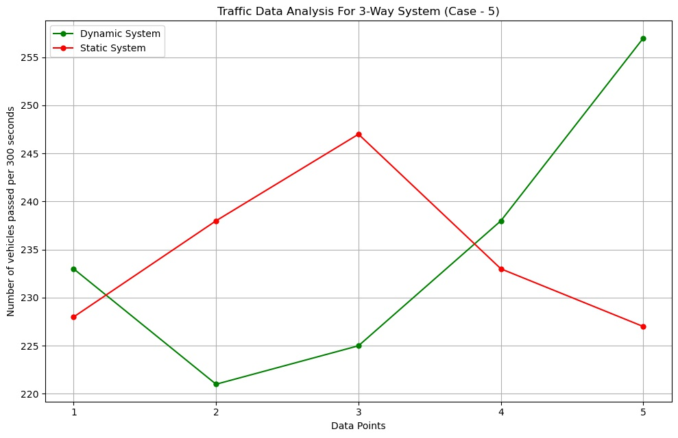
Results And Inferences
Notes:
The graph shown are the graphs for some of the cases considered separately for analysing purposes. Here the graphs are overlapping indicating that for 3 way system both dynamic and static performing almost the same with just a difference of about or less than 50 vehicles.

Slide 13
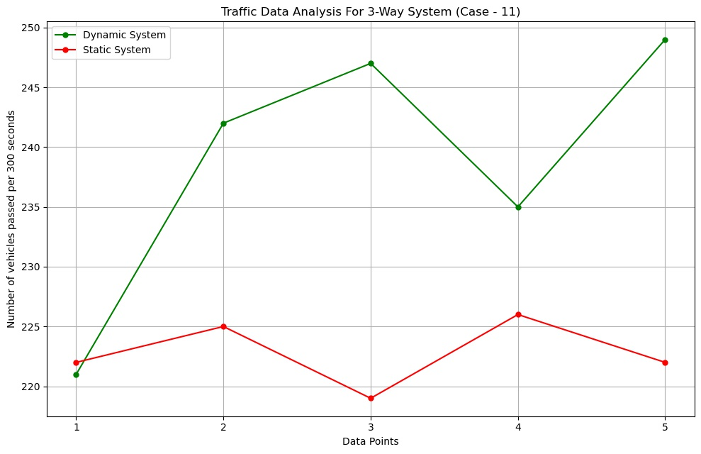
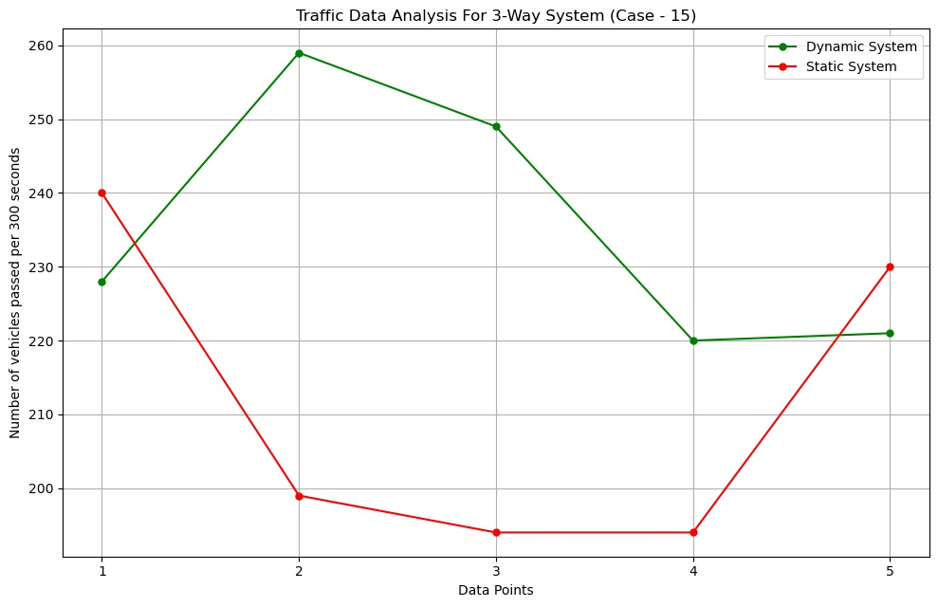
Results And Inferences
Notes:
Next graphs are also showing the same things

Slide 14
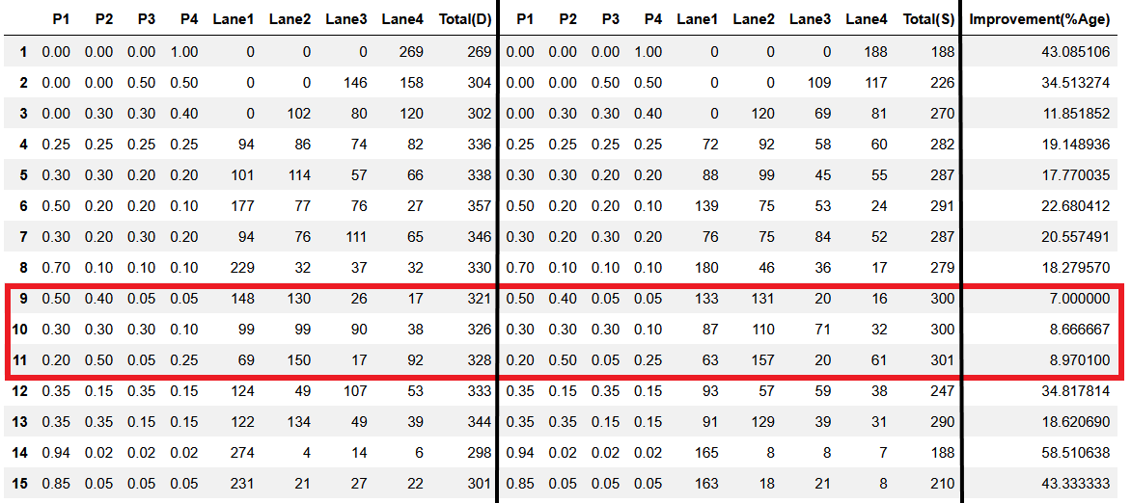
Results And Inferences
Dynamic System
Static System
4 - WAY SYSTEM

Slide 15
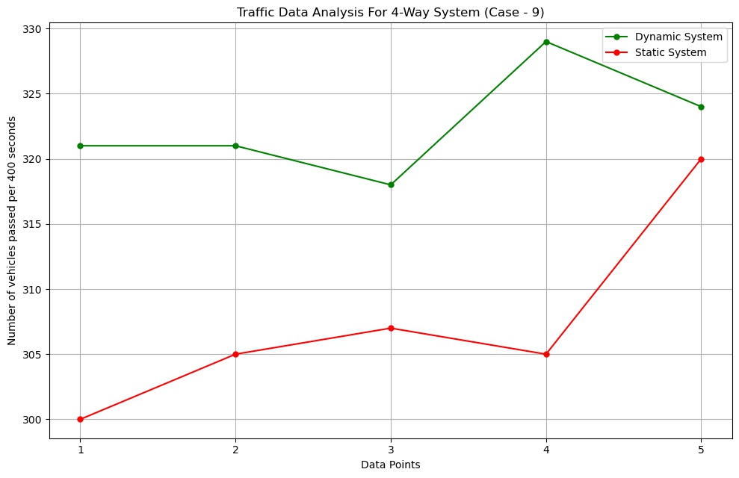
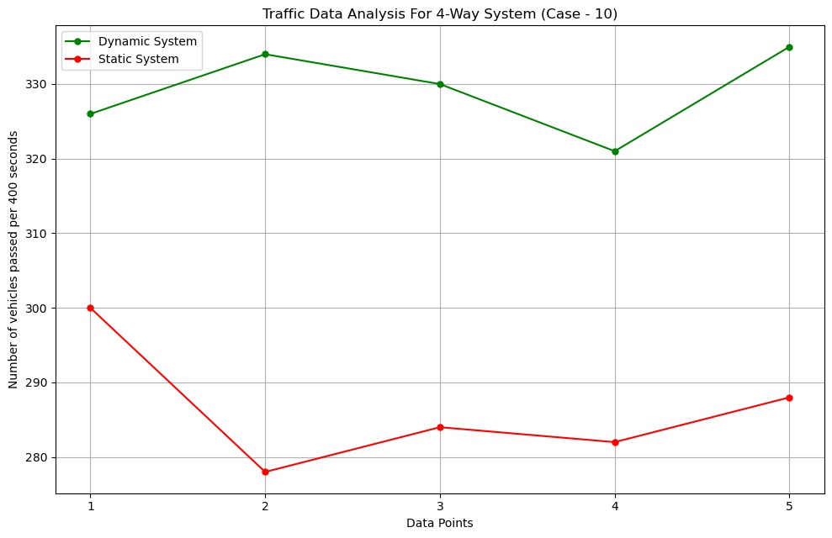
Results And Inferences
Notes:
Simulation time for 3-way - 300 sec
Simulation time for 4-way - 400 sec
X-axis - Data points - No of the test case
Y- axis - Number of vehicles passed in specified simulation time

Slide 16
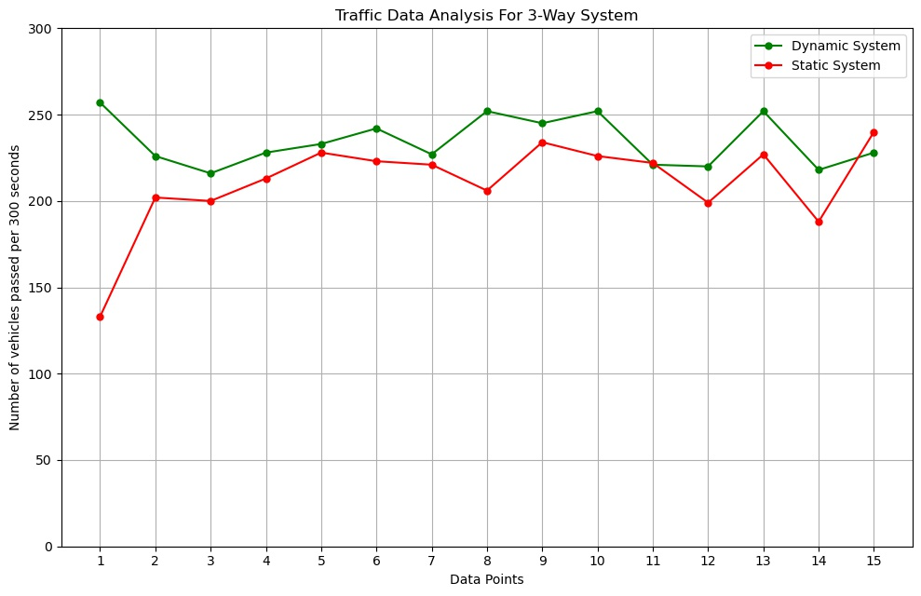
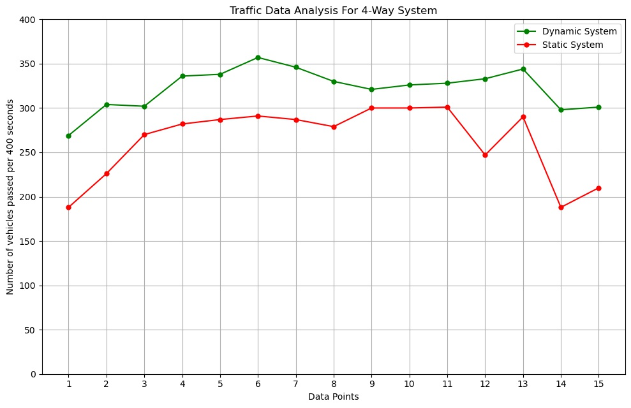
Results And Inferences
3 - Way System
4 - Way System
Notes:
Simulation time for 3-way - 300 sec
Simulation time for 4-way - 400 sec
X-axis - Data points - Number of vehicles distributed on the lanes
Y- axis - Number of vehicles passed in specified simulation time

Slide 17
Conclusion
The proposed system sets the green signal time adaptively according to the traffic density at the signal and ensures that the direction with more traffic is allotted a green signal for a longer duration of time as compared to the direction with lesser traffic which also took heterogeneity of vehicles into consideration. This will lower the unwanted delays and reduce congestion and waiting time, which in turn will reduce fuel consumption and pollution.
According to simulation results, the system shows about 24.52% improvement for 4 lane roads and 13.61% for 3 lane roads over the current system in terms of the number of vehicles crossing the intersection in a given time frame, which is a significant improvement. With further calibration using real life CCTV data for training the model, this system can be improved to perform even better.

Slide 18
Future Work
Hardware implementation using Raspberry Pi.
YOLO Model Improvement by adding more classifications like ambulances, fire brigades and police vehicles.
Control System that could work at night time.
Providing GREEN corridor to high priority vehicles.
Exploring other simulations like SUMO Simulations and Open Street Map.
User Interface Development (In progress).

Slide 19
References
[1] Khushi, "Smart Control of Traffic Light System using Image Processing," 2017 International Conference on Current Trends in Computer, Electrical, Electronics and Communication (CTCEEC), Mysore, 2017, pp. 99-103, doi: 10.1109/CTCEEC.2017.8454966.
[2] A. Vogel, I. Oremović, R. Šimić and E. Ivanjko, "Improving Traffic Light Control by Means of Fuzzy Logic," 2018 International Symposium ELMAR, Zadar, 2018, pp. 51-56, doi: 10.23919/ELMAR.2018.8534692.
[3] A. A. Zaid, Y. Suhweil and M. A. Yaman, "Smart controlling for traffic light time," 2017 IEEE Jordan Conference on Applied Electrical Engineering and Computing Technologies (AEECT), Aqaba, 2017, pp. 1-5, doi: 10.1109/AEECT.2017.8257768.
[4] Renjith Soman "Traffic Light Control and Violation Detection Using Image Processing”.” IOSR Journal of Engineering (IOSRJEN), vol. 08, no. 4, 2018, pp. 23-27.
[5] A. Kanungo, A. Sharma and C. Singla, "Smart traffic lights switching and traffic density calculation using video processing," 2014 Recent Advances in Engineering and Computational Sciences (RAECS), Chandigarh, 2014, pp. 1-6, doi: 10.1109/RAECS.2014.6799542.
[6] Siddharth Srivastava, Subhadeep Chakraborty, Raj Kamal, Rahil, Minocha, “Adaptive traffic light timer controller” , IIT KANPUR, NERD MAGAZINE.
[7] TomTom.com, 'Tom Tom World Traffic Index', 2019. [Online]. Available: https://www.tomtom.com/en_gb/traffic-index/ranking/
[8] Pygame Library, 2019. [Online]. Available: https://www.pygame.org/wiki/about
[9] Open Data Science, ‘Overview of the YOLO Object Detection Algorithm’, 2018. [Online]. Available: https://medium.com/@ODSC/ overview-of-the-yolo-object-detection-algorithm-7b52a745d3e0

Slide 20
Thank You!

