Slide 1
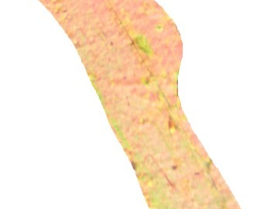
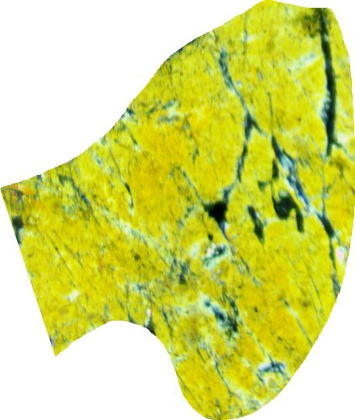
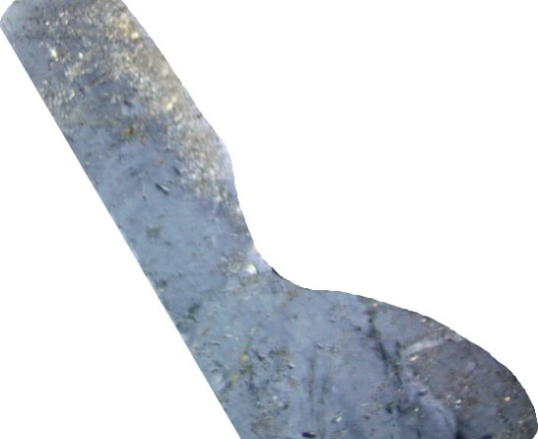
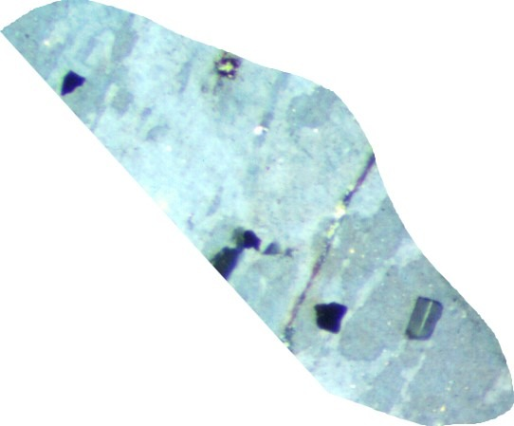
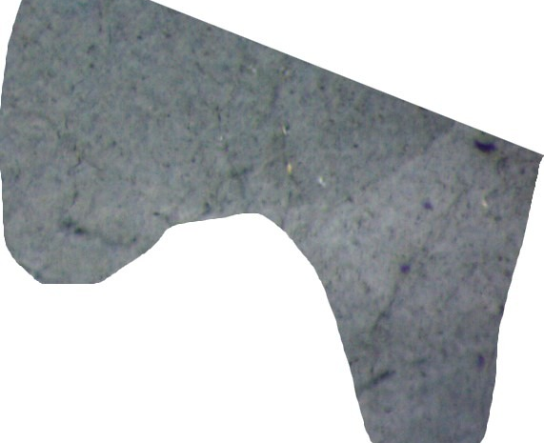
REPRODUCTION • CRITICAL EVALUATION
100% ACCURACY
— BUT ON WHAT?
Mineral photomicrograph classification
through the lens of dataset quality
Reproducing Amer et al. (2025), Scientific Data
Notes:
0:35. Introduce the reproduction of Amer et al. (2025). The research question evolved from reproducing Decision Tree and KNN into understanding what high classification accuracy means when observations are rotational views of a small number of acquisition groups. The central message is not that the dataset is worthless, but that image-level accuracy and novel-crystal accuracy are different quantities.

Slide 2
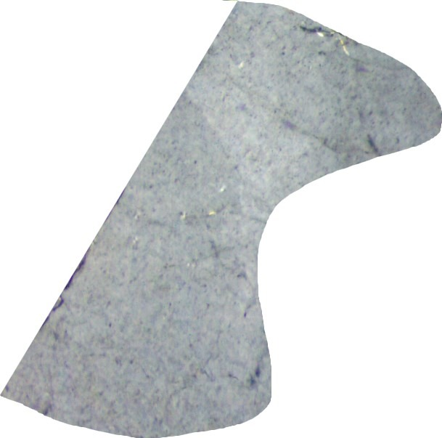
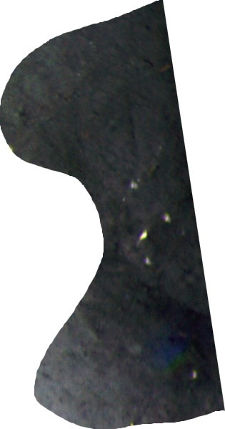
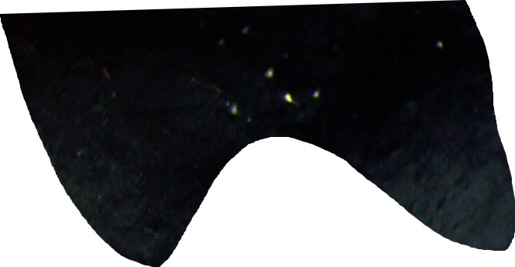
01 / ORIGINAL STUDY
Why mineral recognition is challenging
The same mineral can look very different when the microscope stage rotates.
ONE
MINERAL
many visual
appearances
0°
60°
150°
Illustrative quartz images from one named acquisition folder in the experimental archive.
Visuals: MUMDMC2025 experimental archive; acquisition geometry: Amer et al. (2025).
MUMDMC2025 / REPRODUCTION & CRITICAL EVALUATION
02 / 21
Notes:
0:45. Optical mineral classification is sensitive to extinction, birefringence, texture and angle. These three quartz photographs are from the experimental archive at different rotation angles and make the repeated-measurement nature intuitive. The next slide explains how the original paper formalized the rotation protocol.

Slide 3
01 / ORIGINAL STUDY
What the paper set out to deliver
Amer et al. (2025) propose a systematic photomicrographic mineral dataset and validate it with classical ML.
14,400
2,500
87.2%
images in the full collection
documented public XPL subset
reported KNN accuracy
72 rotations × 5 minerals × 2 modes × 20 crystals
500 photographs per mineral
on resized 150 × 150 images
Their premise: systematic acquisition + traceable metadata should support reliable mineral classification.
Source: Amer et al., “A Photomicrographic Dataset of Rocks for the Accurate Classification of Minerals,” Scientific Data (2025), Table 3.
MUMDMC2025 / REPRODUCTION & CRITICAL EVALUATION
03 / 21
Notes:
0:45. The paper is a data descriptor. The central advertised contributions are a high-resolution collection, systematic 360-degree rotation, filename traceability and baseline validation. The whole collection is described as 14,400 images, whereas the public XPL training subset is documented as 2,500 images. Reported resized KNN accuracy in Table 3 is 87.2%. The full collection should not be conflated with the public subset.

Slide 4
01 / ORIGINAL STUDY
How the data were produced
The original acquisition protocol samples rotations systematically, not independent specimens.
DECLARED FILENAME SCHEME
0° → 5° → 10° → … → 355°
F61-Quartz-CN-1-8-35deg
F61
Quartz
CN
72 frames / revolution
thin section
mineral
polarization
1
8
35°
crystal
frame
rotation
Source: Amer et al. (2025), dataset acquisition and filename convention, pp. 7–9.
MUMDMC2025 / REPRODUCTION & CRITICAL EVALUATION
04 / 21
Notes:
0:55. Authors describe 72 images per crystal, using 5-degree increments over one 360-degree rotation in PPL and XPL. Their filename format includes slide, mineral, polarization type, crystal number, image number and angle. This is important because if filenames uniquely identified a physical crystal, group-aware validation could be designed confidently. The files we accessed contain ambiguities.

Slide 5
02 / DATA AUDIT
The first reproducibility gap
The archive we could actually use did not match the 2,500-image subset described by the paper.
14,400
2,500
583
Full collection described
Public XPL subset described
Images in our working ZIP
Research paper · PPL + XPL
Metadata spreadsheets · 500/class
Five classes · 8 acquisition folders
Scope of our claim: a mismatch in the archive used for reproduction, not proof that every published file is unavailable.
Sources: Scientific Data (2025); accompanying five metadata spreadsheets (500 rows each); experimental ZIP count.
MUMDMC2025 / REPRODUCTION & CRITICAL EVALUATION
05 / 21
Notes:
1:00. The full paper describes 14,400 high-resolution images. Its curated public XPL subset is described as 2,500 balanced crops. The file set we could load contains 583 images and is unbalanced. The metadata tables are for 2,500 records, not the 583 image archive. We do not assert that the 2,500 files do not exist anywhere; we state exactly what was accessible and reproducible using our provided ZIP.

Slide 6
02 / DATA AUDIT
Eight acquisition groups, uncertain identities
The files form eight rotational folders. A folder may represent a crystal—but that is not independently verified.
IMAGE COUNTS BY MINERAL AND ACQUISITION GROUP
176
filenames repeated
across folders
Biotite
147
Hornblende
73
Plagioclase
146
Working hypothesis
Potassium feldspar
73
8 groups ≈ 8 individual crystals
Quartz
144
Group A
Group B
Visual inference, not validated metadata
Sources: experimental ZIP folder audit and accompanying 2,500-record metadata tables.
MUMDMC2025 / REPRODUCTION & CRITICAL EVALUATION
06 / 21
Notes:
1:05. There are 8 acquisition folders for five mineral classes: Biotite 2, Hornblende 1, Plagioclase 2, K-feldspar 1, Quartz 2. There are 583 images. Some full filenames repeat across folders even though the files differ visually; we found 176 distinct repeated names. Filenames in the article claim to encode crystal IDs, but this archive does not provide unambiguous physical identities. Preliminary visual inspection suggests one crystal per acquisition folder, but we explicitly label that a hypothesis, not a fact. Introduce the independence issue here without concluding leakage has been quantified.

Slide 7
03 / BASELINE
Reproducing the classification pipeline
We followed the article’s classical-ML logic on the subset available to us.
01
02
03
04
05
CROPPED IMAGE
→
STANDARDIZE
→
PIXEL FEATURES
→
SPLIT
→
CLASSIFY
Five mineral labels
224 × 224 / 150 × 150
Scale 0–1 · flatten RGB
80% train · 20% test
Decision Tree + KNN
Important implementation detail
The notebook’s “Original” branch standardizes variable crops to 224 × 224. It is not native microscope resolution.
Method: article, Table 3 and ML validation framework; implementation: final notebook, Experiment 1.
MUMDMC2025 / REPRODUCTION & CRITICAL EVALUATION
07 / 21
Notes:
1:00. Cropping isolates grains; resizing changes image dimensions. The article describes original crops versus 150×150 resized images. The notebook branch called Original cannot stack variable-sized crops, so it standardizes them internally to 224×224; this is NOT original full microscope resolution. Both pipelines normalize pixels, flatten them into feature vectors and use stratified 80/20 split at random seed 42. Baseline algorithms: default Gini Decision Tree and five-neighbor KNN with Euclidean distance.

Slide 8
03 / BASELINE
How do KNN and Decision Trees classify minerals?
Both receive the same pixel features, but learn and predict in different ways.
K-NEAREST NEIGHBORS
DECISION TREE
FIT
Store labeled training-image vectors.
FIT
Learn pixel thresholds that reduce Gini impurity.
PREDICT
Compare pixel distances and find the nearest examples.
PREDICT
Follow learned branches to a mineral-label leaf.
NEW IMAGE
k NEIGHBORS
CLASS VOTE
Pixel intensity ≤ threshold?
→
→
67,500 values
k = 5
Quartz
YES
NO
Example neighbors:
Another decision
Quartz
Q
Q
Q
B
P
→ Quartz
Simplified example — not a fitted tree.
KNN keeps training examples; Decision Tree keeps learned rules.
Conceptual diagrams. Methods: final notebook, Baseline Experiment 1.
MUMDMC2025 / REPRODUCTION & CRITICAL EVALUATION
08 / 21
Notes:
0:50. Explain that both baseline algorithms operate on the same normalized, flattened RGB pixel vectors; at 150 × 150 each image becomes 67,500 features. KNN is a lazy learner: fitting keeps the labeled training vectors. For a new photo, it computes distances to stored vectors, chooses five nearest images in the baseline, and assigns the most frequent mineral label. Decision Tree behaves differently: during training it learns feature thresholds that reduce Gini impurity; prediction follows those stored branches until a leaf class is reached. The pictured tree and vote are schematic illustrations, not actual model traces. Transition: now compare both classical models with the published paper.

Slide 9
03 / BASELINE
Published vs reproduced: all four metrics
150 × 150 test images · Decision Tree and KNN evaluated on different available datasets.
DECISION TREE
Paper
Our subset
K-NEAREST NEIGHBORS
Paper
Our subset
Accuracy
73.0%
Accuracy
87.2%
60.7%
75.2%
Precision
74.1%
Precision
85.1%
61.1%
76.5%
Recall
73.0%
Recall
87.2%
60.7%
75.2%
F1-score
74.7%
F1-score
87.2%
59.6%
74.5%
Paper: 2,500 documented images | Our evaluation: 583 available images (117 held out)
Paper: Amer et al. (2025), Table 3. Our metrics: saved notebook Experiment 1 (weighted averages).
MUMDMC2025 / REPRODUCTION & CRITICAL EVALUATION
09 / 21
Notes:
1:00. This is the fuller baseline comparison requested in the evaluation rubric. At 150 × 150 the article reports Decision Tree accuracy 73.0, precision 74.1, recall 73.0, F1 74.7 percent, versus our 60.7, 61.1, 60.7, 59.6. KNN in the paper is 87.2, 85.1, 87.2, 87.2, versus our 75.2, 76.5, 75.2, 74.5. All our reported precision/recall/F1 are weighted averages; the paper does not fully document averaging, so numerical comparison should not be regarded as exactly like-for-like. Different underlying image sets are the primary barrier to an exact replication.

Slide 10
04 / EXPERIMENTS
Cross-validation: results depend on the fold
Same model, different validation images · five stratified folds of the 466 training samples.
ACCURACY (%)
MACRO-F1 (%)
90
90
80
80
70
70
60
60
50
50
1
2
3
4
5
1
2
3
4
5
KNN 75.5 ± 6.7
DT 64.0 ± 3.5
KNN 75.5 ± 7.6
DT 62.3 ± 3.7
KNN
Decision Tree
Mean ± standard deviation in percentage points; 117-image holdout excluded from CV.
MUMDMC2025 / REPRODUCTION & CRITICAL EVALUATION
10 / 21
Notes:
1:10. A single train/test split gives only one estimate, and scores can change with data partition. Five-fold stratified cross-validation is applied only within the original 466-image training set, not the 117 holdout images. Accuracy varies for KNN 65.6–83.9% and Decision Tree 59.6–68.8%; average KNN 75.5±6.7 pp and DT 64.0±3.5 pp. The second chart shows Macro-F1 by fold; KNN 75.5±7.6 pp, DT 62.3±3.7 pp. CV does not address the same-folder problem because it is still image-level. Variation is not proof of leakage.

Slide 11
04 / EXPERIMENTS
One nearest neighbor changes the result
GridSearchCV selected hyperparameters using mean macro-F1 across five folds.
KNN: MEAN CV MACRO-F1 BY NUMBER OF NEIGHBORS
88.6%
k = 1
0.9
82.3%
0.8
75.5%
Best KNN setting
70.9%
67.6%
Decision Tree
0.7
Best depth: 10
0.6
k=1
k=3
k=5
k=7
k=9
No holdout gain for DT
Search: KNN k={1,3,5,7,9}; DT max_depth={5,10,15,None}. Selection metric: mean macro-F1.
MUMDMC2025 / REPRODUCTION & CRITICAL EVALUATION
11 / 21
Notes:
1:00. Why macro-F1? Five classes are imbalanced: 73–147 images each. Hyperparameters are selected only using five-fold CV within training. KNN k=1 gives mean CV macro-F1 0.886, versus 0.755 for k=5. Values for k=3,7,9 are 0.823, 0.709, 0.676. Decision Tree max_depth=10,15,None tie at rounded mean macro-F1 0.623; 5 is lower at 0.578. Selection of k=1 raises a new question: do close views of the same acquisition group make single-neighbor matching unusually easy?

Slide 12
04 / EXPERIMENTS
The tuned model gains 12 percentage points
On the same 117-image holdout, k=1 outperformed the baseline k=5.
KNN TEST ACCURACY
k = 5
75.2%
k = 1
87.2%
+12.0 PERCENTAGE POINTS
Caution: the same holdout was evaluated repeatedly; this is an observed split-specific improvement.
Final evaluation on 117 images; tuned test macro-F1 for KNN = 0.870.
MUMDMC2025 / REPRODUCTION & CRITICAL EVALUATION
12 / 21
Notes:
0:50. After CV selects k=1, train on all 466 training images and evaluate the already used 117-image test split. Test accuracy increases from 75.2 to 87.2%, 15 errors remaining. Decision Tree stays 60.7%. Because the test set had been examined in baseline and later analyses, this should not be marketed as an untouched independent test after model exploration. This result sets up error analysis and nearest-neighbor provenance.

Slide 13
04 / EXPERIMENTS
Where do the models make mistakes?
Confusion matrices show that Potassium feldspar is especially challenging.
KNN · 102 / 117 CORRECT
DECISION TREE · 71 / 117 CORRECT
Bio
27
0
2
0
0
Bio
24
0
1
0
4
Horn
0
15
0
0
0
Horn
4
10
1
0
0
Plag
2
0
24
1
2
Plag
6
0
18
2
3
K-Fsp
0
0
0
10
5
K-Fsp
0
0
5
3
7
Quartz
0
1
2
0
26
Quartz
3
0
8
2
16
Bio
Horn
Plag
K-Fsp
Quartz
Bio
Horn
Plag
K-Fsp
Quartz
KNN: 5 of 15 Potassium-feldspar photos were misclassified as Quartz.
Rows = true labels; columns = predictions. Notebook, Experiment 4; tuned 150×150 models.
MUMDMC2025 / REPRODUCTION & CRITICAL EVALUATION
13 / 21
Notes:
1:00. Read confusion matrices row by row: each row is the true class and each column is the predicted class. The diagonal is correct. KNN gets 102/117 correct; DT 71/117. KNN correctly identifies all 15 Hornblende tests, but only 10/15 Potassium Feldspar; the remaining five are predicted as Quartz. The images and class count show the type of errors rather than just average accuracy.

Slide 14
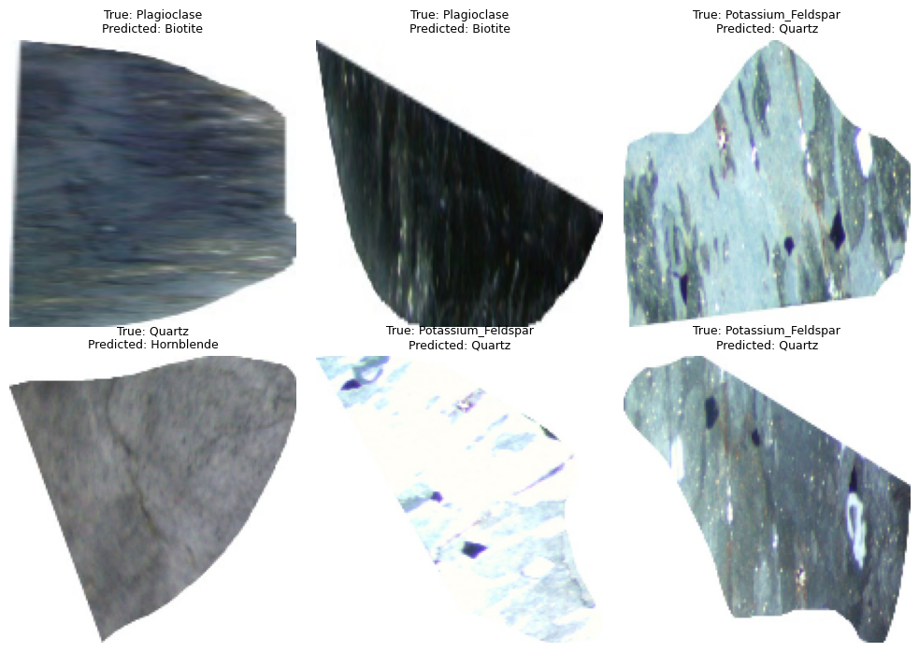
04 / EXPERIMENTS
The errors are visible in real images
Six examples of test images classified incorrectly by tuned KNN.
What we can say
• Several K-feldspar images were predicted as Quartz.
• Appearance changes across rotation angles.
• Six examples cannot prove which visual cues caused each error.
Source: saved Colab outputs, Experiment 4; examples are actual test images, not stock photography.
MUMDMC2025 / REPRODUCTION & CRITICAL EVALUATION
14 / 21
Notes:
0:45. These are six actual errors from the tuned KNN, not new or independently selected test data. Labels above each picture give ground truth and prediction. Several K-feldspar samples are mistaken for Quartz; the matrix revealed five such errors. The photos are illustrative; do not claim to know the decisive learned feature just from their appearance.

Slide 15
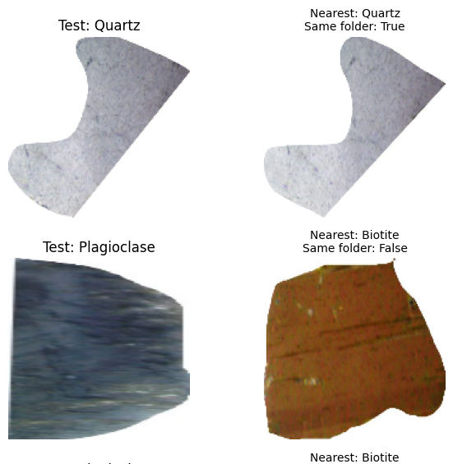
04 / EXPERIMENTS
What does k = 1 really match?
Nearest-neighbor provenance links high accuracy to shared acquisition folders.
NEAREST NEIGHBOR FROM THE SAME FOLDER
101 / 117
101 / 101 correct
when the nearest neighbor shares the folder
Only 1 / 16 correct otherwise
A same-folder match guarantees the right label here because each folder contains just one mineral class.
Experiment 4, Euclidean nearest neighbors on 150×150 flattened RGB.
MUMDMC2025 / REPRODUCTION & CRITICAL EVALUATION
15 / 21
Notes:
1:05. We traced the closest training image for each test sample using tuned k=1 KNN. For 101/117 test samples, the nearest training image comes from the same acquisition folder. As each folder contains just one mineral class, those 101 are necessarily correctly classified. For 16 neighbors from other folders, only one is correct. Therefore 101/101 is an expected consequence of folder identity and k=1, not an independent validation of performance. If a folder is a single physical crystal, these predictions often match other angles of a crystal already encountered during training. The physical identification remains a hypothesis.

Slide 16
05 / CNN EXTENSION
A stronger model — but the same evaluation unit
We tested ImageNet-pretrained EfficientNet-B0 and ConvNeXt-Tiny using transfer learning.
CNN DATA SPLIT
TWO-STAGE TRANSFER LEARNING
396
70
117
1
2
train
validation
test
Freeze backbone
→
Fine-tune
Train a 5-class head
Last backbone stage
Same 117 test images as classical ML
ImageNet pretrained · input 224×224 · augmentation on train only
Experiment 5 in final Colab notebook: EfficientNet-B0, ConvNeXt-Tiny, validation-based checkpoint selection.
MUMDMC2025 / REPRODUCTION & CRITICAL EVALUATION
16 / 21
Notes:
0:55. CNNs are pretrained on ImageNet; this is transfer learning, not training from scratch. Split derived from same original 466/117: 396 training and 70 validation images carved out of the training pool, 117 test. Stage 1 trains a new five-class classifier while freezing the backbone; Stage 2 fine-tunes the last block and classifier. Augmentations are only on training, and checkpoint selection uses validation. The separation is image-level, not acquisition-group-level. Input is 224×224.

Slide 17
05 / CNN EXTENSION
CNNs improve every reported test metric
Results for the 117-image holdout · Precision, Recall, F1 are weighted averages.
MODEL & TRAINING STAGE
ACCURACY
PRECISION
RECALL
F1 (W)
MACRO-F1
EfficientNet-B0
Head only
96.6%
97.0%
96.6%
96.6%
96.6%
EfficientNet-B0
Fine-tuned
99.1%
99.2%
99.1%
99.1%
99.3%
ConvNeXt-Tiny
Head only
100.0%
100.0%
100.0%
100.0%
100.0%
ConvNeXt-Tiny
Fine-tuned
100.0%
100.0%
100.0%
100.0%
100.0%
ConvNeXt-Tiny was perfect on this test set even with a frozen pretrained backbone.
Important: 100% on images from known folders ≠ verified 100% on independent crystals.
Source: final notebook, Experiment 5; 396 train / 70 val / 117 test; transfer learning from ImageNet.
MUMDMC2025 / REPRODUCTION & CRITICAL EVALUATION
17 / 21
Notes:
1:00. The full five-metric comparison avoids over-reliance on accuracy. EfficientNet head-only gets test accuracy 96.6, weighted precision 97.0, weighted recall 96.6, weighted F1 96.6, macro-F1 96.6 percent. Fine-tuning improves to 99.1,99.2,99.1,99.1,99.3. ConvNeXt Tiny is 100% across all metrics in both head-only and fine-tuned stages. These are saved final notebook values, and the 117-image test is not independent of acquisition folders in training. It does not establish superior generalization to new crystals.

Slide 18
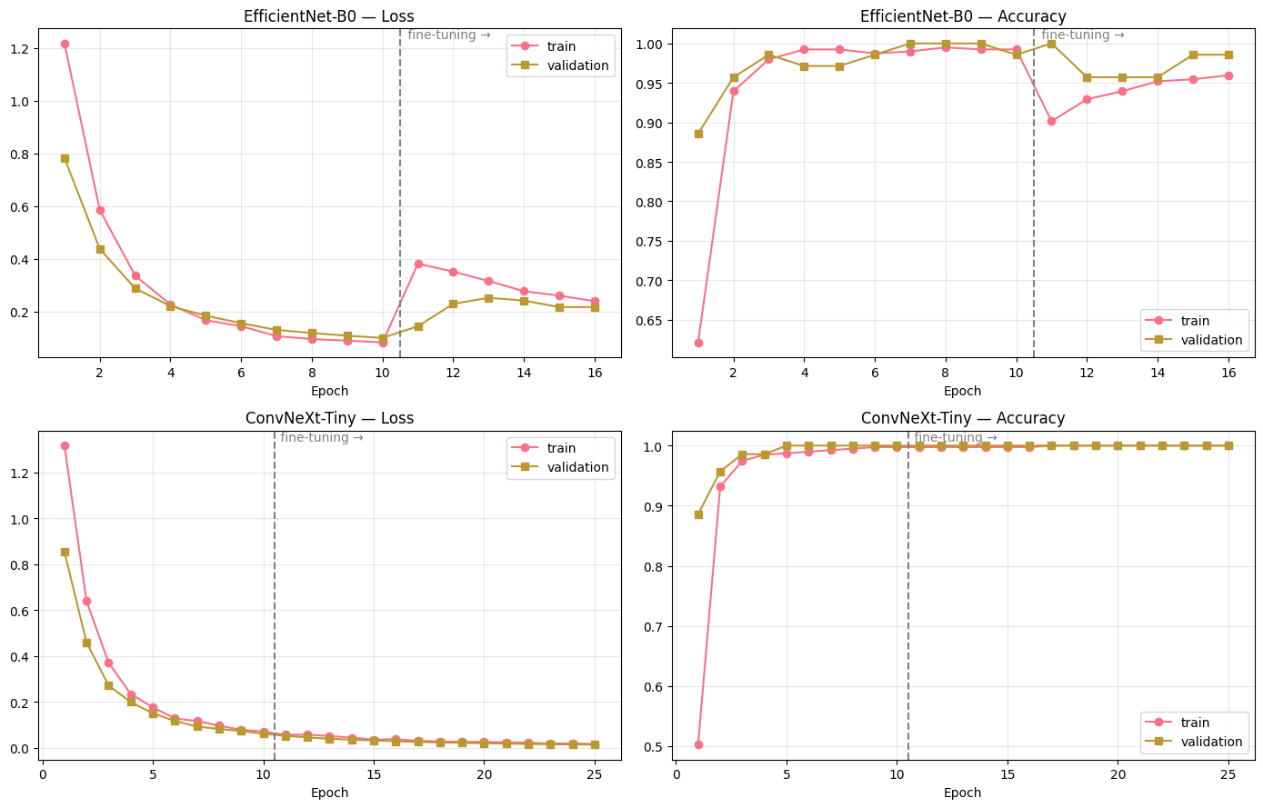
05 / CNN EXTENSION
Learning curves: rapid convergence on this split
Train and validation traces illustrate why high accuracy alone is insufficient evidence.
WHAT THE CURVES SHOW
EfficientNet-B0
Validation accuracy reaches 100%, but fluctuates after fine-tuning.
ConvNeXt-Tiny
Validation accuracy remains at 100% over many epochs.
Original plots from Experiment 5, training/validation learning curves; dotted line marks fine-tuning.
MUMDMC2025 / REPRODUCTION & CRITICAL EVALUATION
18 / 21
Notes:
0:45. The plots are the actual training traces from the final notebook. EfficientNet and ConvNeXt converge rapidly with pretrained ImageNet representations. ConvNeXt validation accuracy reaches 100 percent by epoch 5 of head-only training and remains there, while loss continues to decline. The stage boundary is shown with a vertical dashed line. EfficientNet validation accuracy fluctuates after fine-tuning, even when its test accuracy rises. The graphs show fitting and checkpoint selection on a related-image validation set—not validated generalization to independent crystals.

Slide 19
06 / SCIENTIFIC INTERPRETATION
The unit of splitting is the real issue
The test set contains unseen photographs—not necessarily unseen crystals.
ILLUSTRATIVE IMAGE-LEVEL SPLIT OF ONE ACQUISITION FOLDER
8 / 8 groups
ANGLE
ANGLE
ANGLE
ANGLE
ANGLE
ANGLE
appear in both train
and test
0°
5°
10°
15°
20°
25°
TRAIN
TRAIN
TEST
TRAIN
TRAIN
TEST
117 / 117
test images belong to groups
already seen during training
Same folder / potentially same physical crystal
Group overlap: final notebook Dataset Audit (117/117). Physical crystal identity remains unconfirmed.
MUMDMC2025 / REPRODUCTION & CRITICAL EVALUATION
19 / 21
Notes:
1:10. The key issue is the unit of splitting. All eight acquisition folders are represented in both training and test (8/8 groups). Every one of the 117 test photographs belongs to a folder already represented in training (117/117 images); these counts describe group overlap, not model accuracy. Different rotation angles from the same folder can enter both sets. If each folder represents a distinct physical crystal, as preliminarily hypothesized but not verified, this is group-level leakage relative to testing on unseen crystals. We cannot quantify the inflation of model accuracy without a group-disjoint evaluation. The published metadata does not reliably identify physical crystals in this 583-image archive.

Slide 20
06 / REPRODUCIBILITY
Can someone else repeat the experiment?
We document what can be rerun—and what the available data do not allow us to verify.
REPRODUCIBLE EXECUTION
INCLUDED WITH THE PROJECT
01
Google Colab
Notebook
Five fully documented experiments
Install, download the archive, run cells top-to-bottom
02
Fixed methodology
README
Execution steps and data limitations
Seed 42 · 80/20 holdout · stratified 5-fold CV
Recorded outputs
Requirements
Pinned package versions and environment notes
03
Metrics, plots, confusion matrices and model files
Limits: Colab-focused paths, external pretrained weights, and no verified crystal-disjoint test set.
Files: final Colab notebook, README.md, requirements.txt; data loaded from the public experimental ZIP.
MUMDMC2025 / REPRODUCTION & CRITICAL EVALUATION
20 / 21
Notes:
0:45. We have a runnable notebook designed for Google Colab. The README explains dependencies, GPU setup, exact source archive and order of execution. A requirements file captures dependencies, and the notebook prints key library versions. All classical splits use seed 42; model parameters, CV procedures and experiment outputs are recorded. CNN uses pretrained weights downloaded from PyTorch and may not reproduce bit-for-bit across hardware versions. Local execution may require Colab path changes. Scientific reproduction is limited by ambiguous group IDs and the 583-file subset versus 2,500 documented images. This satisfies transparency without pretending that the code is universally platform-independent.

Slide 21
CONCLUSION
A benchmark is only as strong
as its test-set independence.
01
02
03
Reproduced
Extended
Identified
DT and KNN on available data
CV, tuning, error analysis, CNN
Data–metadata mismatch and group overlap
100% accuracy on 117 related images ≠ proven accuracy on unseen crystals.
Amer et al. (2025) · Scientific Data · DOI: 10.1038/s41597-025-05879-9
Notes:
0:45. Summarize the contributions: methodological reproduction of the paper’s pixel-based Decision Tree and KNN approach; controlled CV and hyperparameter tuning; detailed errors and nearest-neighbor examination; two pretrained CNNs; and a careful dataset audit. The most important claim is that image-level held-out photographs are not a substitute for verified new-crystal validation. We do not discard the dataset or dismiss the models. A future benchmark requires full documented data, unique physical specimen IDs and group-disjoint evaluation. Thank the audience and invite questions.

