Slide 1
RTE Presentation
Parameter Tying by Quantization applied to Logistic Regression (Prof Vibhav Gogate , UTD and Prof Piyush Rai (IIT Kanpur)
Hacking/ML Tasks (Prof Manindra Agarwal and NY Office IIT Kanpur)
Rushab Munot
3rd Year Undergraduate, Dept. of CSE, IIT Kanpur

Slide 2
On Parameter Tying by Quantization
A major problem in machine learning is the problem of over-fitting
The paper ‘On Parameter Tying by quantization’ (Gogate, Ruozzi, Chou, Sarkhel from UTD, 2016) discusses one such way in which the parameters are bound by certain equality constraints
The method generally applies where there are a large number of features compared to the number of examples

Slide 3
On Parameter Tying by Quantization: Background
The basic task of parameter learning is to minimize the cross-validation error
But as the learning is done only over the training set, the problem of over-fitting arises
To reduce over-fitting certain constraints are put on the learning algorithm, which are generally supervised
In this method, however the constraints imposed are unsupervised
The constraints are decided on the basis of the learned weights

Slide 4
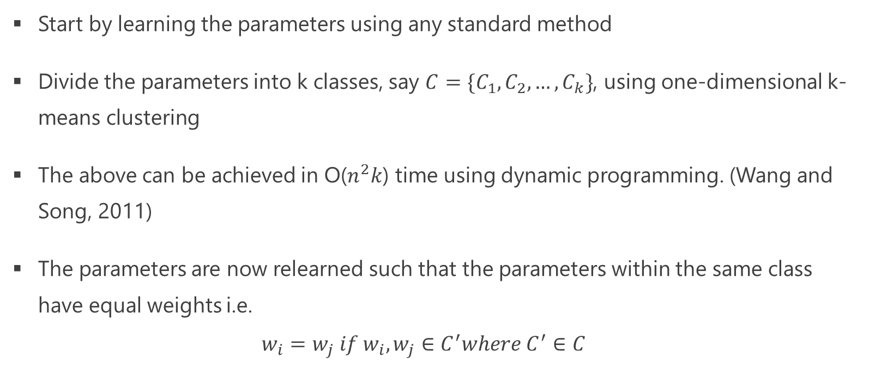
On Parameter Tying by Quantization: The Model
Start by learning the parameters using any standard method
Divide the parameters into k classes, say ${C=\{C}_{1},C_{2}, …, C_{k}\}$, using one-dimensional k-means clustering
The above can be achieved in O($n^{2}k$) time using dynamic programming. (Wang and Song, 2011)
The parameters are now relearned such that the parameters within the same class have equal weights i.e. $w_{i}=w_{j} if w_{i},w_{j}∈C^{′}where C^{′}∈C$

Slide 5
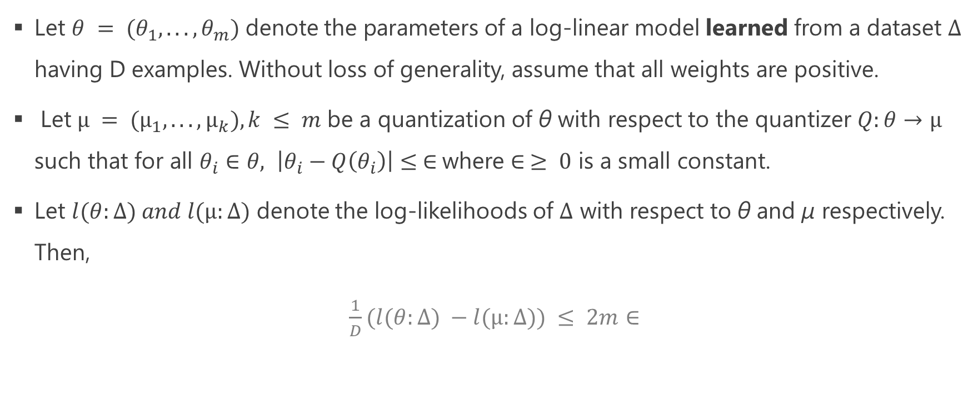
On Parameter Tying by Quantization: Error Bounds
Let $θ = (θ_{1}, . . . , θ_{m})$ denote the parameters of a log-linear model learned from a dataset $Δ$ having D examples. Without loss of generality, assume that all weights are positive.
Let$µ = (µ_{1}, . . . , µ_{k}), k ≤ m$ be a quantization of θ with respect to the quantizer $Q:θ→µ$ such that for all $θ_{i}∈θ, \left|θ_{i}−Q\left(θ_{i}\right)\right|≤ ∈$where $∈ ≥ 0$ is a small constant.
Let $l(θ:∆) and l(µ:∆)$ denote the log-likelihoods of $∆$ with respect to θ and µ respectively. Then,
$\frac{1}{D}(l(θ:∆) −l(µ:∆)) ≤ 2m∈$

Slide 6
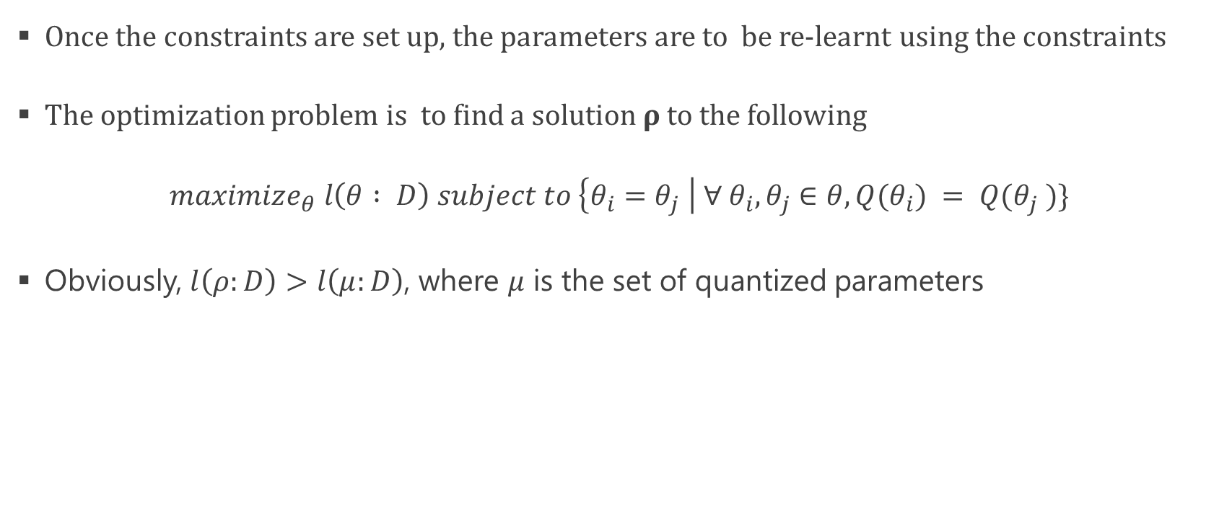
On Parameter Tying by Quantization: Re-Learning
Once the constraints are set up, the parameters are to be re-learnt using the constraints
The optimization problem is to find a solution $ρ$ to the following $maximize_{θ} l\left(θ : D\right) subject to \left\{θ_{i}=θ_{j} \right| {∀ θ}_{i}, θ_{j}∈θ, Q(θ_{i}) = Q(θ_{j} )\}$
Obviously, $l\left(ρ:D\right)>l\left(μ:D\right)$, where $μ$ is the set of quantized parameters

Slide 7
When applied to Logistic Regression: Experiments and Results
The algorithm was tested on three datasets – email classification, iris dataset and digit recognition
For training, optimizations were done using the L-BFGS algorithm
Results were compared with Gaussian Naïve Bayes and Logistic Regression with L2 regularization.

Slide 8
When applied to Logistic Regression: Experiments and Results
Email Classification :
Pre processing: Bag of words model, with variable vocabulary size, a separate feature for number of numbers, stop-words removed/not removed, etc
Maximum accuracy obtained was 98.326% (vocabulary size=2000, separate feature for number of numbers, and stop-words removed, number of iterations=4)
For the same dataset the accuracy with L2 regularization was 94.979% and with Naïve Bayes was 92.050%

Slide 9
When applied to Logistic Regression: Experiments and Results
Iris Dataset:
Even though there are only 4 features in the Iris Dataset, the results obtained were better than L2 regularization with the accuracy being about 3% higher for k=2 and 2.5% higher for k=3.
Semeion Digit Recognition Database:
The model fails miserably for digit recognition with the maximum accuracy of about 83% compared to L2 regularization accuracy of about 89%.

Slide 10
Hacking/ ML Tasks: Introduction
This involved two tasks
Debugging of an existing code to automate of Phabricator Daemons when the docker image is run
To develop a code for feature selection (e.g names, skills, etc) from profiles (html files)

Slide 11
Hacking/ ML Tasks: Automation of phabricator daemons
This involved working on docker, phabricator and a little bit on kubernetes
The task was to automate phabricator daemons while keeping phabricator and mysql properly connected
It was a totally new platform to work on

Slide 12
Hacking/ ML Tasks: Feature Selection from html files
For this task the challenge was that the document vectors of all the documents were similar as were the word vectors for related words i.e. the word vectors for ‘amit’, ‘ajay’, ‘rakesh’, etc or ‘flipkart’, ‘amazon’, ‘ebay’, etc were quite similar.
To extract these features, skip gram with negative sampling was used
The word vectors were then multiplied by their term frequencies in a particular document to create a dissimilarity between related words

Slide 13
Acknowledgements
I would like to thank Prof Manindra Agarwal and Sajay Khosla sir for giving me this opportunity to present myself, Mrs Nazia, our project manager
I would like to thank my mentor Prof Vibhav Gogate, University of Texas at Dallas, and my IITK mentor Dr Piyush Rai and also Dr Purshottam Kar
I would like to thank my parents and family to support me throughout this project
Further I would like to thank Adarsh Jagannatha, Saksham Sharma, Vikraman, Aadil Hayat for mentoring the hacking/ ML tasks
I would also like to thank Abhinav Agrawal for being such a wonderful team mate and also Amur Ghos and Labhansh Agarwal
Finally special thanks to all my friends who have supported me throughout this

Slide 14
References
On Parameter Tying by Quantization – Gogate, Ruozzi, Chou, Sarkhel, 2016
Dynamic Programming Approach to one dimensional k-means clustering- Wang and Song, 2011
Feature selectionL1 vs. L2 regularization, and rotational invariance- Andrew Ng, 2004
Distributed Representations of Words and Phrases and their Compositionality – Mikolov et al.
Distributed Representations of Sentences and Documents- Mikolov, Quoc Le
Language/Platform: python, docker, kubernetes, phabricator
Packages used/tried: Theano, , gensim , scikit-learn, scipy, numpy, etc.

Slide 15
Thank You

