Slide 1
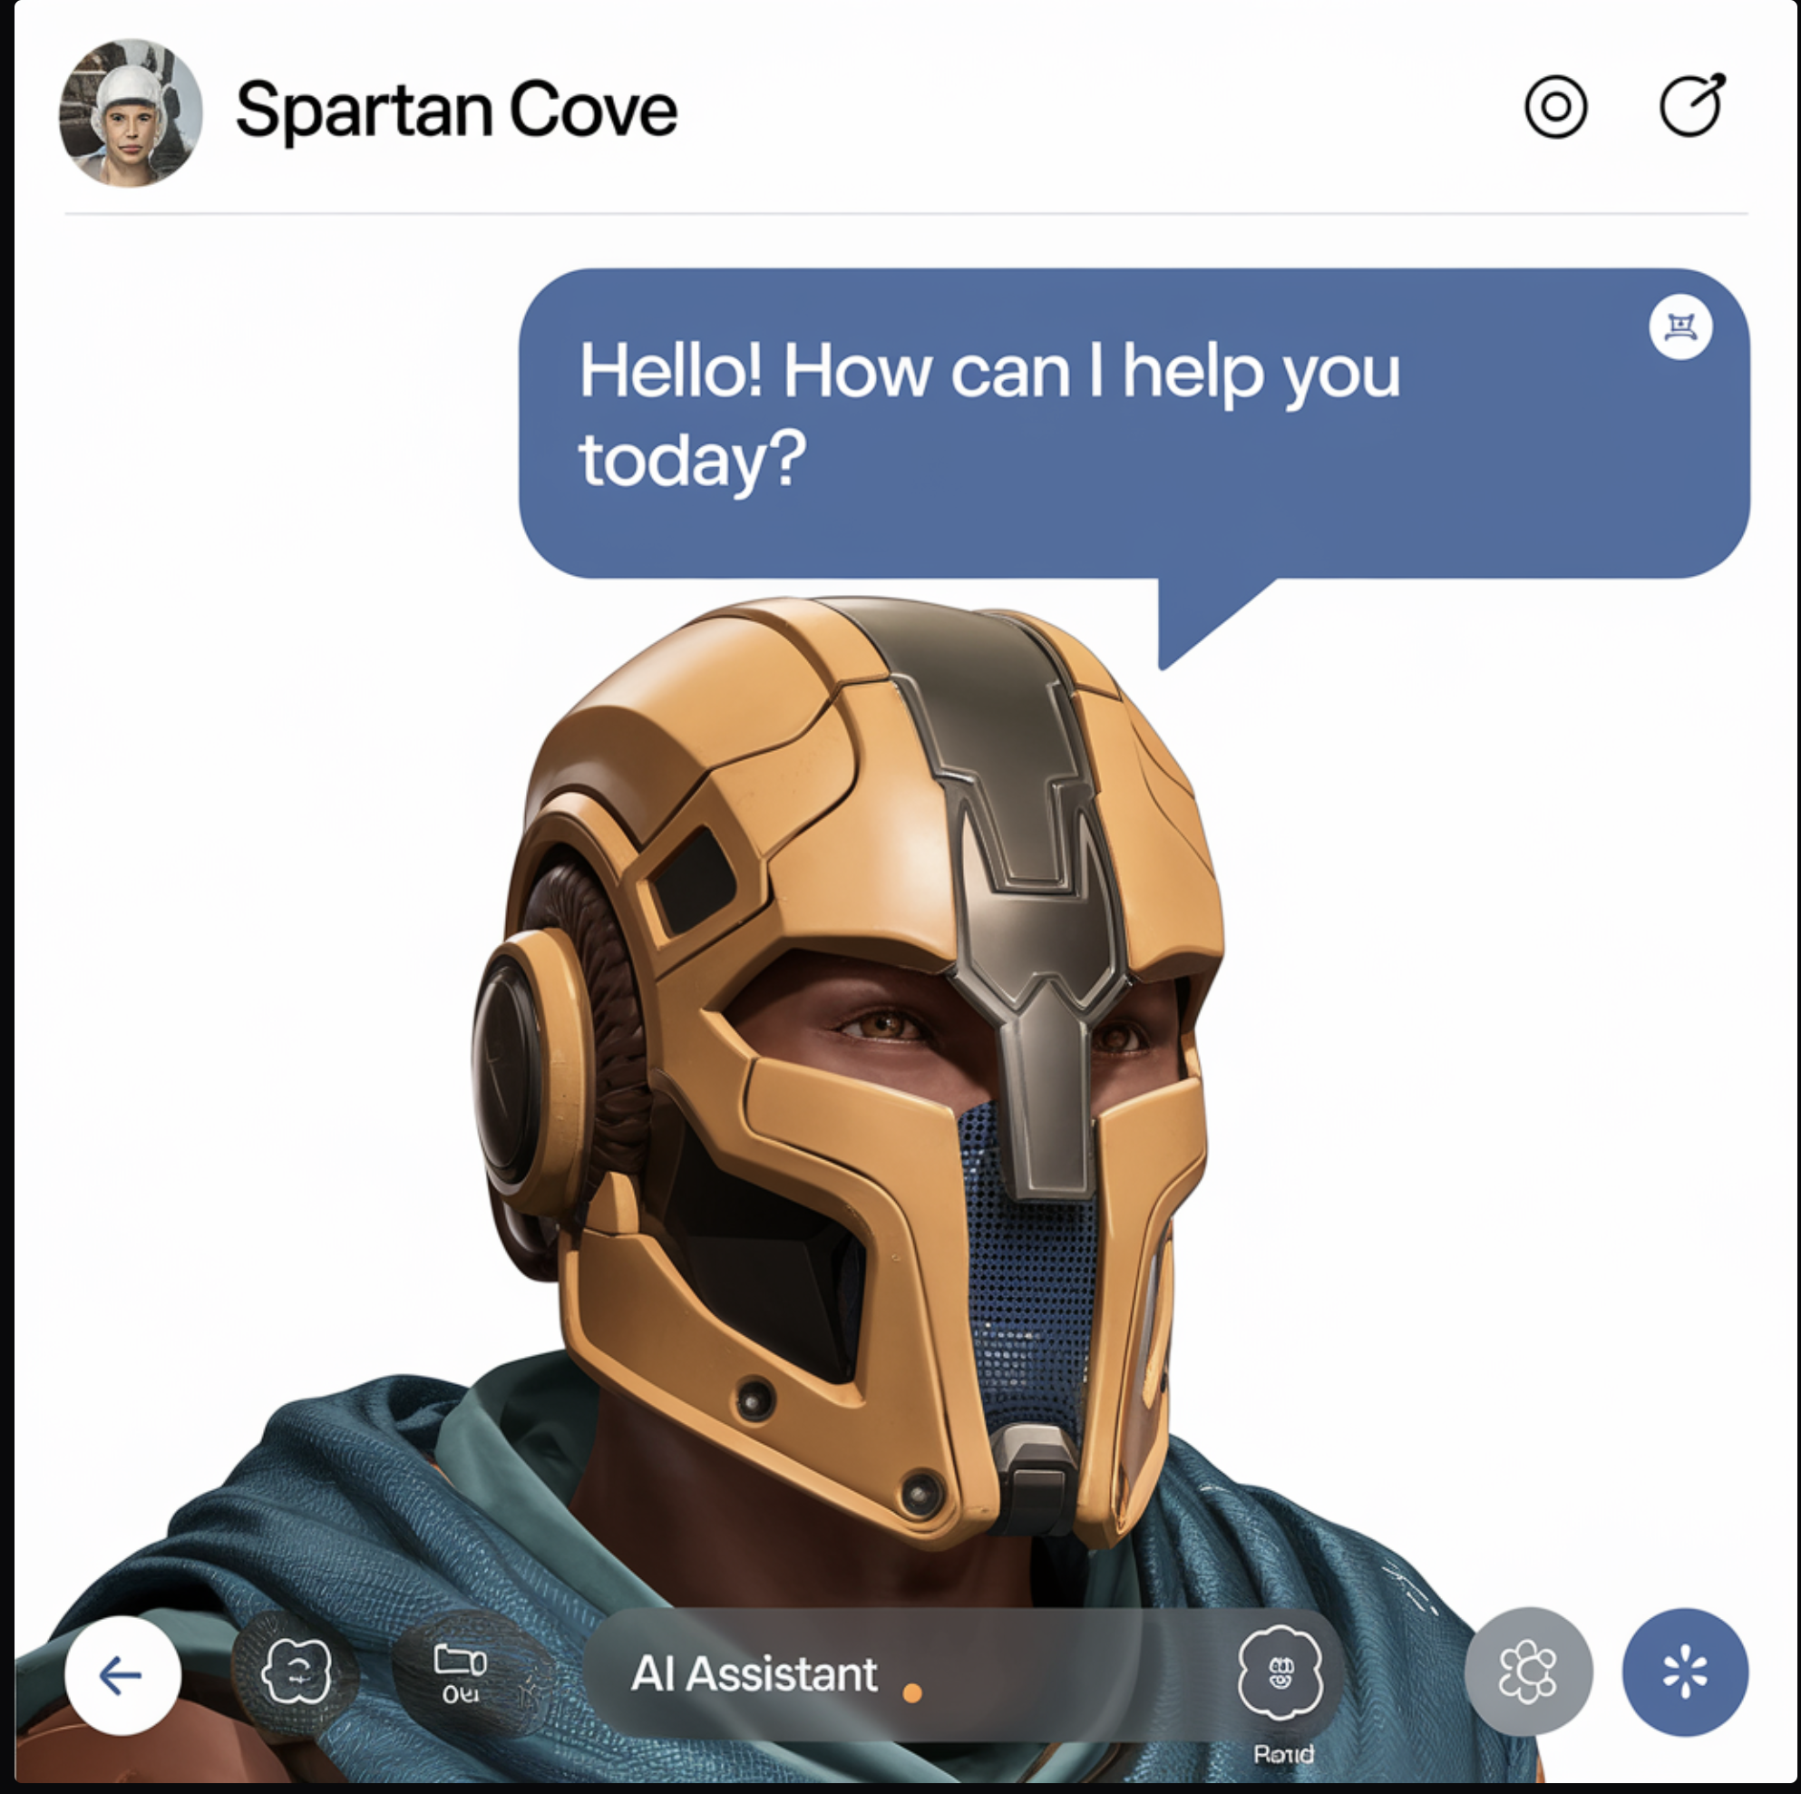
SpartanCove
SJSU’s own Chat application with AI assistant

Slide 2
Contributors
Aditya Rajpurohit
Rishi Patel
Rushabh Runwal
Yashishvin Pothuri

Slide 3
Problem Statement
San Jose State University students and faculty often face challenges in accessing real-time, relevant information about university services, schedules, events, and academic resources.
Traditional methods, such as searching through university websites or contacting departments via email, can be time-consuming and inefficient.
Additionally, students and faculty need a more streamlined communication platform tailored specifically to their academic community, allowing for faster collaboration and support.

Slide 4
Solution
We have developed a dedicated chat application exclusively for SJSU students and faculty, designed to enhance communication and access to information.
This platform not only allows seamless messaging between users within the university’s ecosystem but also features an AI-powered assistant that delivers real-time, accurate information on university-related topics such as class schedules, campus events, faculty contacts, and more.
By integrating Google SSO for secure login, end-to-end encrypted messaging, and AI capabilities, our application fosters an efficient and collaborative environment for all users.

Slide 5
Features
A chat application where user can perform following actions
1. Chat with an AI assistant to retrieve San Jose state university specific information
2. User Registration and Authentication using Google SSO
3. Create and Join Chat Rooms in real-time
4. Chat with WebSocket Integration
5. User Profiles with Avatars
6. Search for Users and Chat Rooms
7. Mobile Responsive Design

Slide 6
Real-Time Communication System
Socket.io integration enables instant message delivery and group chat functionality
Live message status updates and typing indicators enhance user experience
Bidirectional communication channels maintain persistent connections
Real-time user presence tracking keeps chat participants informed

Slide 7
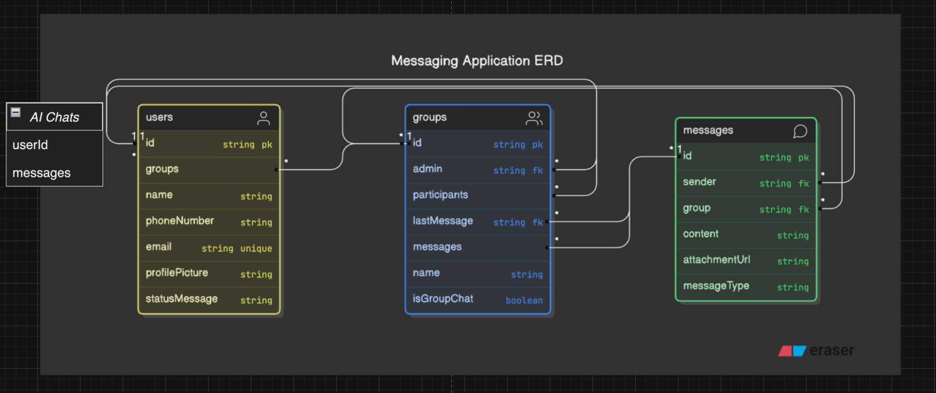
Database Schema

Slide 8
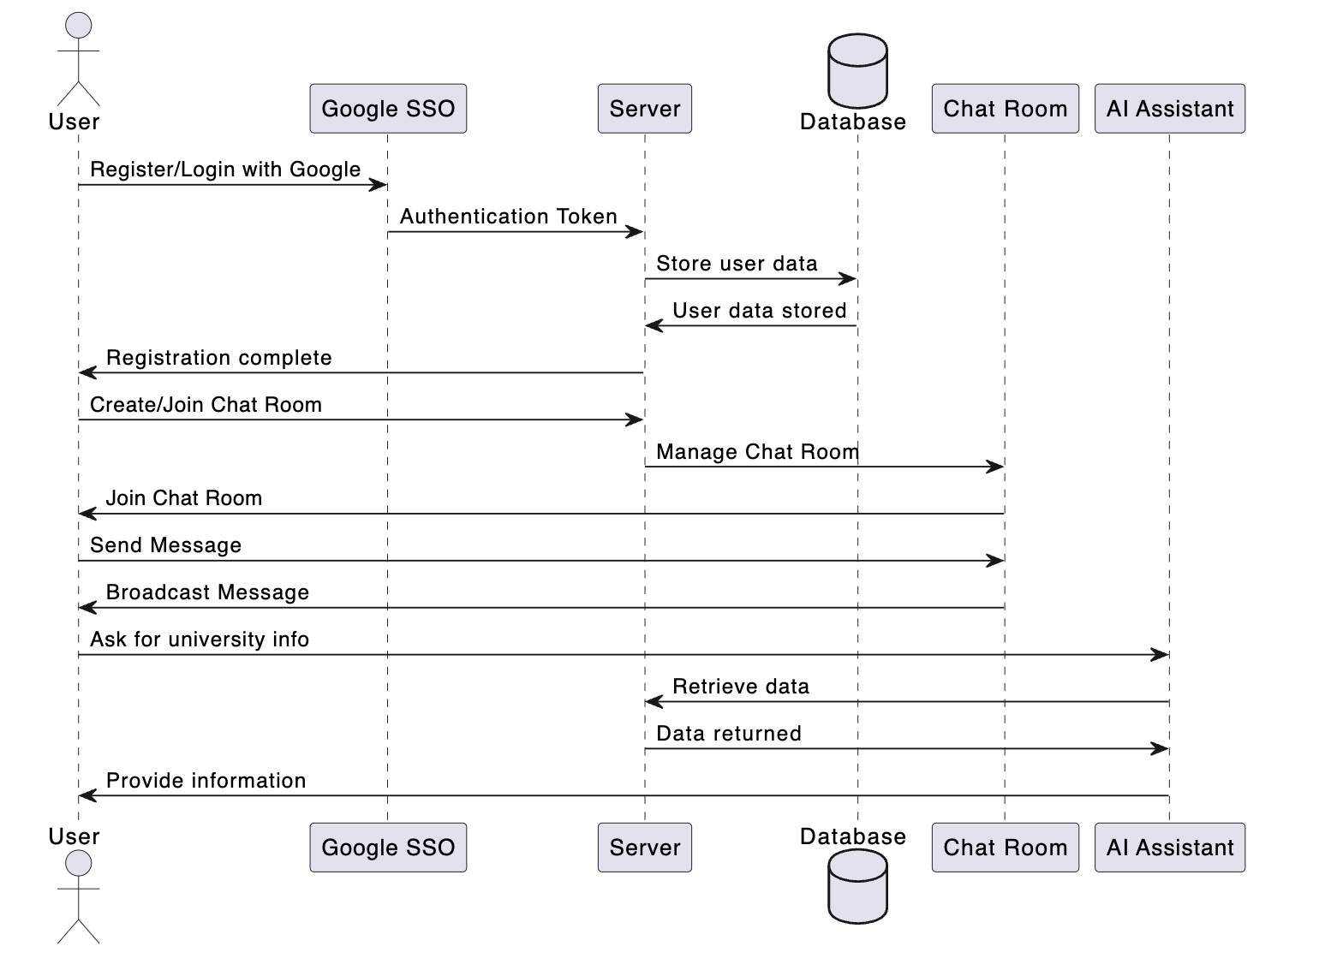
Use Case Diagram

Slide 9
TECH STACK
Full-Stack MERN Architecture
MongoDB handles flexible data storage with optimized schemas for users, groups, and messages
Express.js powers the robust backend API with organized controllers for group and message handling
React.js delivers a responsive frontend with real-time updates
Node.js enables efficient server-side operations with asynchronous processing
We are Using xAI’s Grok 2 from getting real time AI response

Slide 10
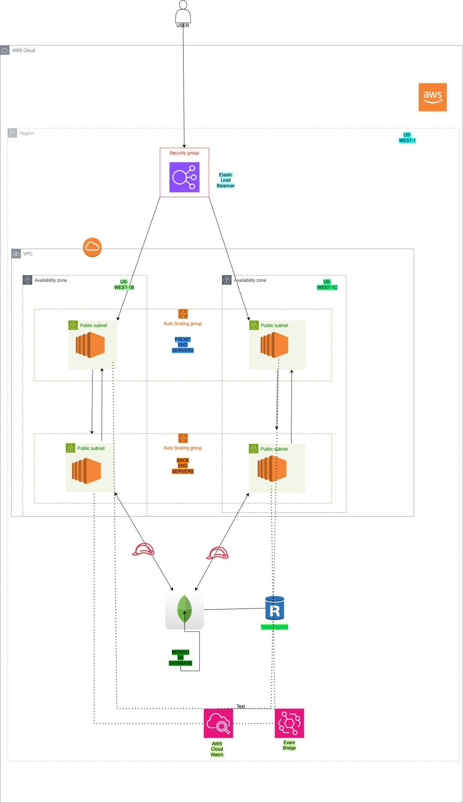
ARCHITECTURE
Infrastructure as Code with Terraform for Multi-AZ deployment
Elastic Load Balancer for High Availability
Auto Scaling Groups for Resilience and Scalability
Monitoring and Event Management through Cloud Watch and Event Bridge

Slide 11
Scalable and Secure Infrastructure Design
Highly Available and secure Infrastructure was achieved by using Terraform to provision AWS resources
Configuring Auto Scaling Groups across Multiple Availability Zones
Security Groups for Controlled Network Access and VPC Configurations for network segementation

Slide 12
Challenges Faced
Integration with AI to get real time info:
we tried multiple AI model but very few could actually give real time updated information. We tried applied few shot inference on chatgpt model but Grok performed overall better than other models
Data Privacy and Security:
We were facing challenges on filter user with just SJSU email id, later it was fixed with just a simple check on email string
Real-time Communication:
Developing a reliable real-time communication system required careful consideration of scalability and performance issues, particularly under high loads.

Slide 13
Future Work
Enhanced AI Capabilities:
Implement more advanced AI features such as personalized learning paths, predictive analytics for student performance, and integration with additional university services.
Mobile Application Development:
Develop a native mobile application to provide a more seamless user experience on smartphones and tablets.
Integrating Google Podcast AI on a huddle ( voice room ):
User can join to get a university specific radio which gives latest updates, news and interesting events from around

Slide 14
Conclusion
Summary of Achievements:
The project successfully developed a secure, real-time chat application tailored to the SJSU community, featuring role-based access control and AI-powered responses.
Impact on SJSU Community:
This application addresses inefficiencies in academic communication tools, enhancing information accessibility and collaboration within the university.
3. Path Forward:
With the proposed future work, the application has the potential to become an indispensable tool for SJSU students and faculty, continuously evolving to meet their needs.

