Slide 1

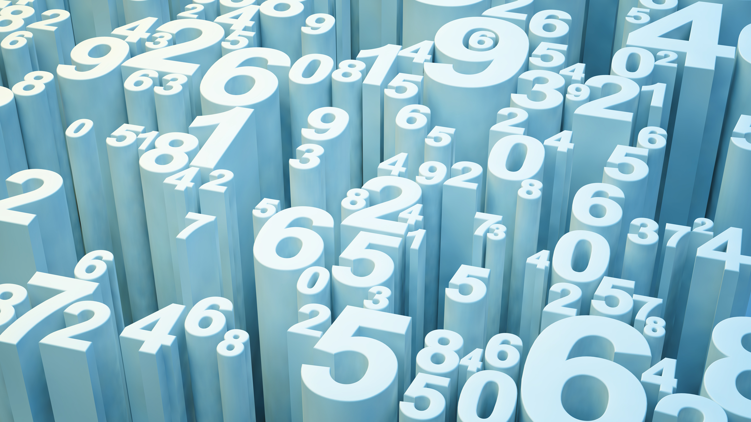
Vehicle Insurance
By: Rushabh Shah
Under Guidance of : Prof. Murat Guner

Slide 2
Introduction
A health insurance company is looking to make its way into the market providing vehicle insurance. The goal of this project is to compare various classification algorithms to find the one which is more accurate and appropriate for this dataset. Deciding a model to predict whether the policyholders (customers) from past year will also be interested in Vehicle Insurance provided by the company.
Data Source: https://www.kaggle.com/anmolkumar/health-insurance-cross-sell-prediction

Slide 3
Motivation
This dataset is from Kaggle hackathon. The challenge here is to evaluate different classification models in order to predict the most appropriate class. This will give me an opportunity to explore different algorithms and see the results. This dataset has a class imbalance problem that encouraged me to address this problem.

Slide 4
Goal
To suggest the best classification algorithm for predicting the response of customers of an insurance company to a vehicle insurance market
Classification Models
The models used in this project are:
1) Gaussian Naïve Bayes
2)Kth nearest neighbor
3)Random Forest classifier
4)Logistic model
Results
The best performance amongst these was by balanced Random Forest classifier.

Slide 5
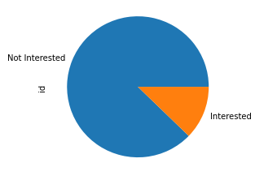
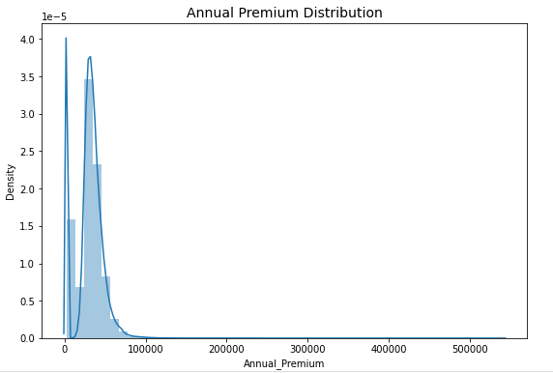
Exploratory Data Analysis
Responses
Annual Premium Distribution

Slide 6
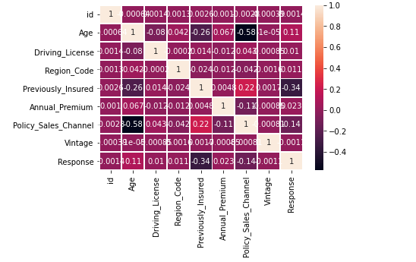
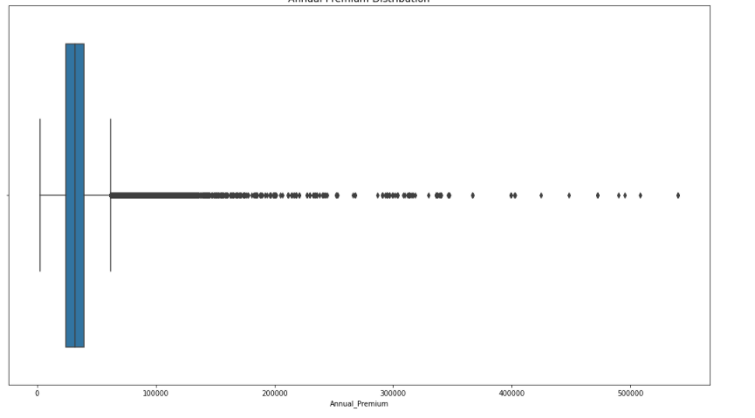
Exploratory Data Analysis
Correlation
Outliers in Annual premium

Slide 7
Class Imbalance
We have seen that in the train data set there is a class imbalance. The number of responses of ‘Yes’ are very less in comparison to ‘No’.
This will improve the model’s accuracy as they will identify one class appropriately, but the other class will not be predicted as it has less samples.
Thus accuracy will not be the metric to select the best classification algorithm as both positive and negative classes are important, we will use the confusion matrix and its results to determine the better classification algorithm.
The method we have used in the problem to handle class imbalance is upscaling.

Slide 8
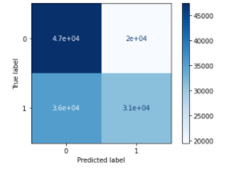
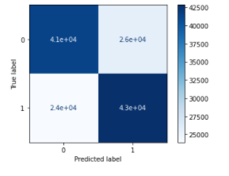
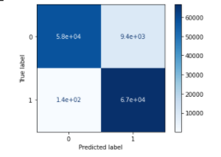
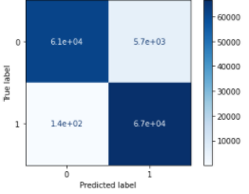
Comparing the confusion matrix of the balanced class.
This is the confusion matrix of the balanced Logistic method. We can see that the number of misclassified samples are more.
This is the confusion matrix of GaussianNB. We can see that the number of misclassified are less than logistic with better accuracy.
This the confusion matrix of Kth nearest neighbor. It has the same no. of misclassified samples as GaussianNB
This is the confusion matrix of Random Forest Classifier. It has least number of misclassified samples and has the best accuracy.

Slide 9
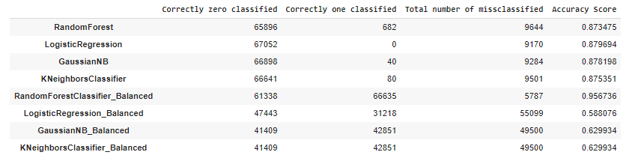
Comparing the Results of the confusion matrix and accuracy score
We can see that the Random Forest Classifier which has been balanced has the least values misclassified and best accuracy score.

Slide 10
Conclusion
Data analysis is important aspect as it gives more insight about data.
Accuracy is not the correct metric to assess this problem.
Class imbalance must be addressed first.
The balanced model that performed well was Random Forest classifier.

Slide 11
Any Questions?

