Slide 1
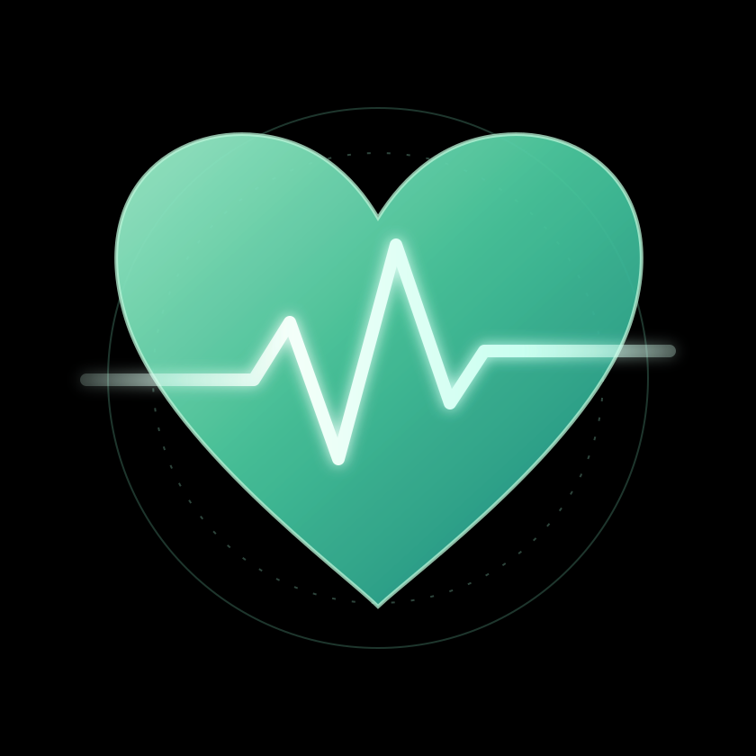
StrokeTwin
See the signals. Understand the story.
A clinician-facing digital-twin workflow that brings a virtual patient's health history, simulated wearable trends and a public ECG sample into one review screen.
Synthetic EHR
Simulated wearables
Public ECG
Demo data only. Not a medical tool.
Notes:
StrokeTwin is a research prototype: one screen where a clinician sees a virtual patient's history, wearable trend and an ECG sample, with every limit stated.

Slide 2



Heart signals live in silos
Health history
Wearable trends
ECG snapshots
Diagnoses and risk factors sit in the EHR.
Steps, sleep, heart rate and HRV drift day by day.
Short rhythm recordings are read one at a time.
A trend only means something next to the patient's history. StrokeTwin is a prototype that puts all three on one review screen, with each stream's limits stated.
Notes:
The problem: the context a clinician needs is scattered. The prototype demonstrates how a combined workflow could look.

Slide 3
StrokeTwin in one view
INPUTS
PROCESSING
CLINICIAN WORKSPACE
EHR profile
Wearable watch
Rule: 2 or more trend thresholds crossed, plus a profile risk factor
Patient overview
Synthea synthetic patient
Review queue
Wearable trend charts
ECG replay and result
Score factors and history
Mark reviewed
Wearable stream
7 days, simulated
ECG sample
ECG classifier
4 rhythm classes
Public PhysioNet recording
Kept honest: the watch never uses the ECG, and the ECG sample is not that patient's own recording.
Notes:
Three inputs, two separate engines, one workspace. A separate WHO South Asia chart lookup gives a 10-year combined CVD estimate on the profile page; it is not stroke-only.

Slide 4
Wearable watch: spot the shift
The rule
First 3 days vs latest 3 days
Resting HR
up 10%+
HRV
down 20%+
Sleep
down 15%+
Steps
down 25%+
Watch triggers when 2+ thresholds are crossed and the profile has 1+ risk factor
Noise-free view of the scripted scenario in the demo data
Notes:
In the example all four thresholds are crossed: steps down 36%, sleep down 24%, resting HR up 16%, HRV down 30%. Thresholds are illustrative demo values, not medical cutoffs.

Slide 5
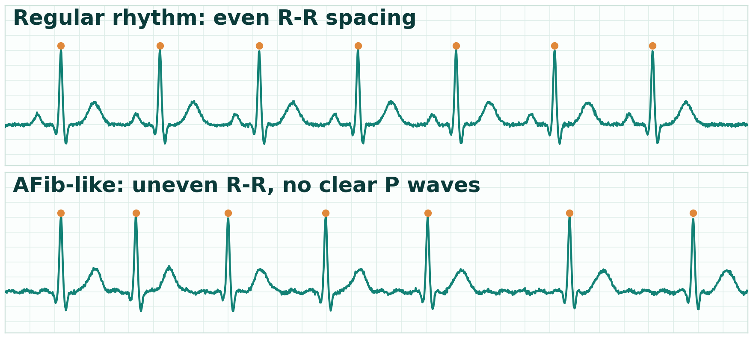
ECG model that can say “unsure”
What the model returns
Normal rhythm
Shown as no AFib pattern
AFib pattern
Shown as AFib pattern
Other rhythm
Shown as inconclusive
Noisy recording
Shown as inconclusive
Illustrative synthetic waveforms, not patient data
73.6%
0.62
74.1%
Below 50% confidence is also inconclusive. Unclear samples are never reported as “no AFib”.
four-class accuracy
macro F1
AFib sensitivity
PhysioNet 2017 public recordings, random holdout. Dataset-only, not clinical performance.
Notes:
XGBoost on NeuroKit2 heart-rate-variability features. No patient identifiers exist in the public files, so no patient-level split or external validation is possible yet.

Slide 6
From watch to clinician review
How a review flows
REVIEW SUGGESTED | SCRIPTED DEMO WATCH
Patient #123
Watch rule triggers on wearable data
1
68 years, female, synthetic profile
Steps
6,000 to 3,840
-36%
Suggestion saved with the changes that caused it
2
Sleep
7.0 h to 5.3 h
-24%
Resting HR
70 to 81 bpm
+16%
Clinician opens the profile and reviews it
3
HRV
50 to 35 ms
-30%
Context used: age 65+, hypertension in profile
Marks it reviewed, with a timestamp
4
Open profile →
Mark reviewed
Simplified illustration of a review queue card
In-app only: no push or emergency alerts. A workflow demo, not a medical alert.
Notes:
The queue stores a snapshot of the crossed changes and profile context, so the explanation stays visible even if later readings change. Open suggestions are one per patient. No push or emergency notifications are sent.

Slide 7




How it is built
Data in
Processing
Storage
Clinician app
Synthea EHR
PhysioNet ECG
Simulated wearables
HRV features
XGBoost model
Watch rule
PostgreSQL
SQLAlchemy
Docker Compose
FastAPI + Jinja
Review queue
Model details
Runs on a laptop: five scripts rebuild the whole demo from raw data.
Notes:
Pipeline order: load_synthea, generate_wearable_stream, extract_ecg_features, train_afib_classifier, fuse_patients. Then uvicorn serves the dashboard.

Slide 8


Honest scope, clear next step
What it is
What it is not
A transparent rule-based demo watch
A clinician review workflow concept
An ECG model with an “unsure” state
Not a diagnosis or stroke prediction
Not validated on real patients
ECGs are randomly assigned, not the patient's own
Next research step
Paired longitudinal data (EHR, wearables, outcomes), then patient-level evaluation and external validation.
Notes:
Close on honesty: this is a transparent demonstration, and the path to a real forecast requires paired longitudinal data and external validation.

