Slide 1
Air Quality Detector
BY
BONY CARVALHO
ROYAL DIAS
RUSHABH PIPADA
SHASHANK SHIVDAS

Slide 2

Past 150 years, pollution activities have pumped enough carbon dioxide into the atmosphere to raise its levels higher than they have been for hundreds of thousands of years
Air quality within our homes can be up to eight times worse than outdoors(Coloring Indoor)
Different kinds of pollution—some visible, some invisible
Needs to detect and monitor the presence of air pollution

Slide 3

Particle pollution - dust, dirt, soot, or smoke, particles which cannot be seen but only be detected under electron microscope.
Impact
  Health
  Visibility
  Environment
  Aesthetic damage

Slide 4
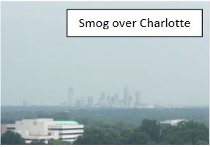
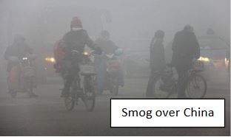
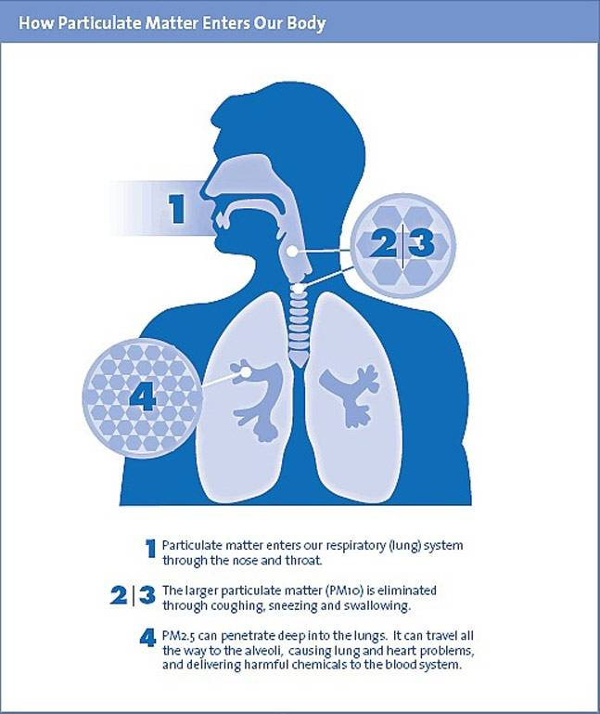
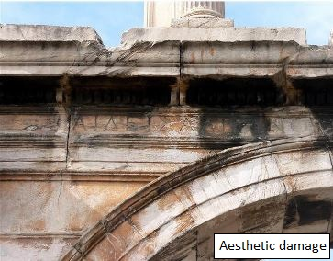
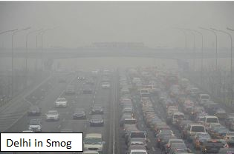

Slide 5

Gadget: Air quality detector
  Detects particles present in air
  Displays how much polluted the air is

Slide 6

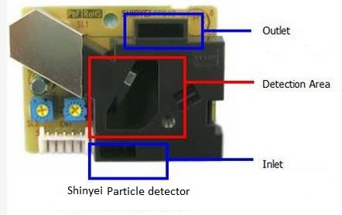
Arduino Uno
Breadboard
LED’s
Shinyei particle sensor
Wires ,Resistors and Battery

Slide 7

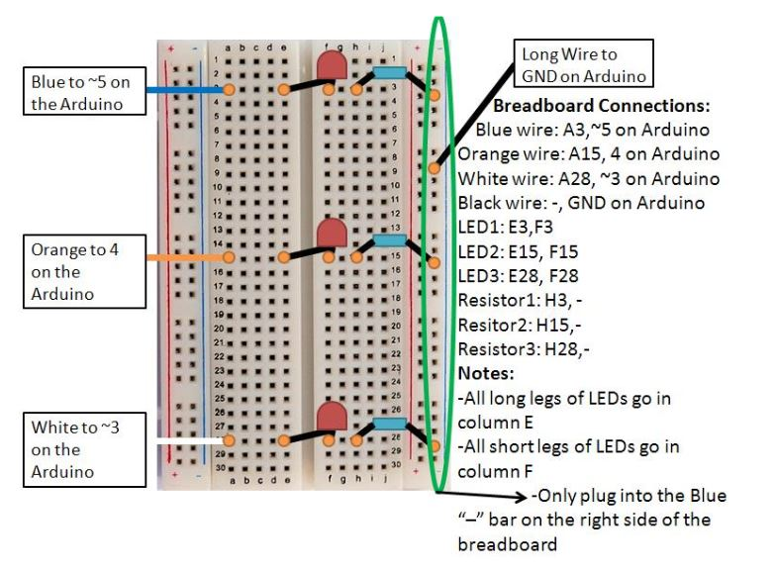

Slide 8

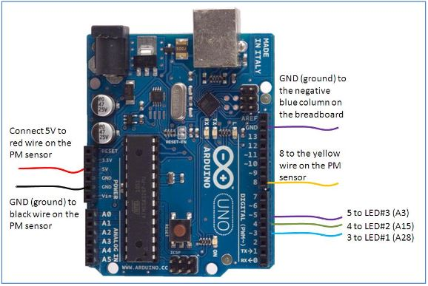

Slide 9
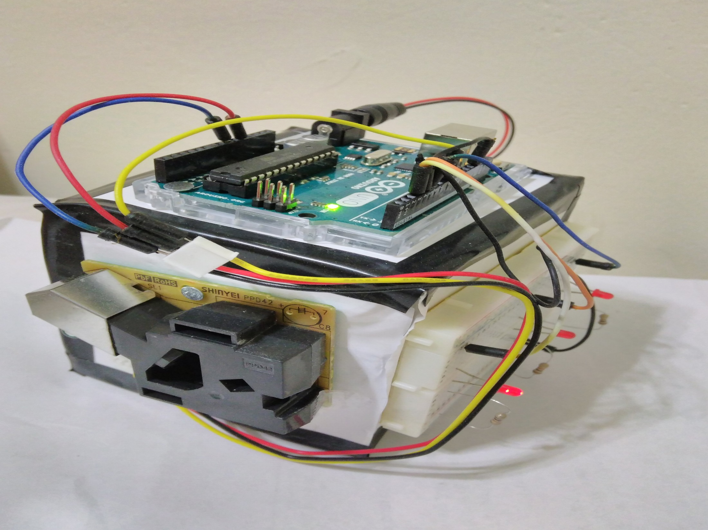

Slide 10

Classrooms with blackboards
Traffic Signals
Sports Stadium
Industrial Area/ Factory
Kitchen

Slide 11

Help in detecting and managing the Environmental pollution
Used for both indoor and outdoor environments
Suitable Air Quality for Infants or the Elders
Shape our daily Activities and Routines
Detect any slight changes to our environment

Slide 12


Slide 13

https://create.arduino.cc/projecthub/OpenSensorsIO/how-to-measure-air-quality-on-opensensors-34c488
https://blog.adafruit.com/2015/05/26/make-an-air-pollution-detector-with-arduino/
https://www3.epa.gov/airnow

Slide 14


