Slide 1
Fintech Hiring trends in the largest banks in the US

Slide 2
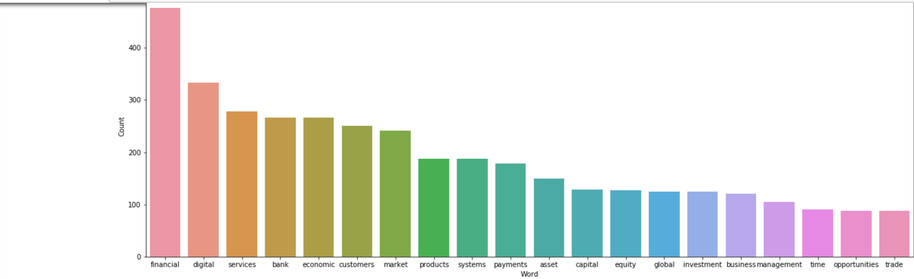
Analysing the Hiring Trends Fintech in largest banks in the US

Slide 3
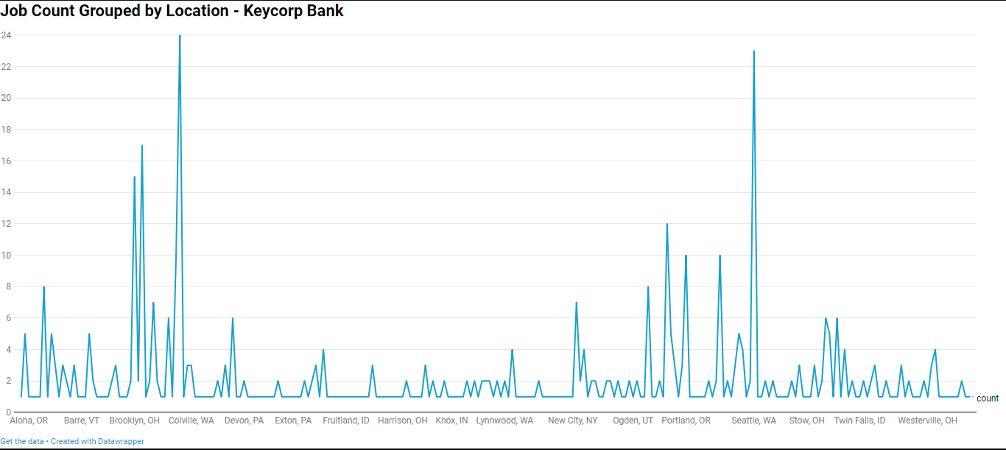

Slide 4
